Slide 1

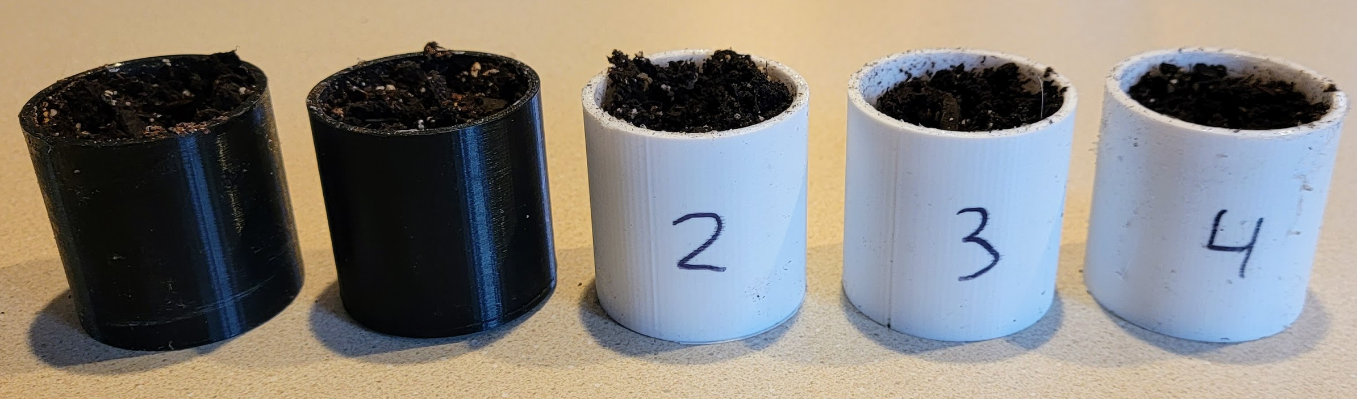
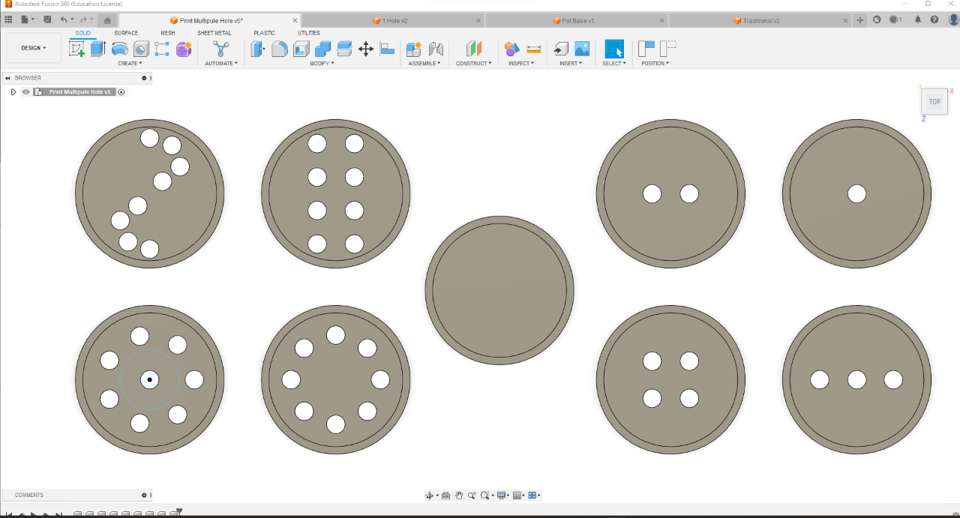
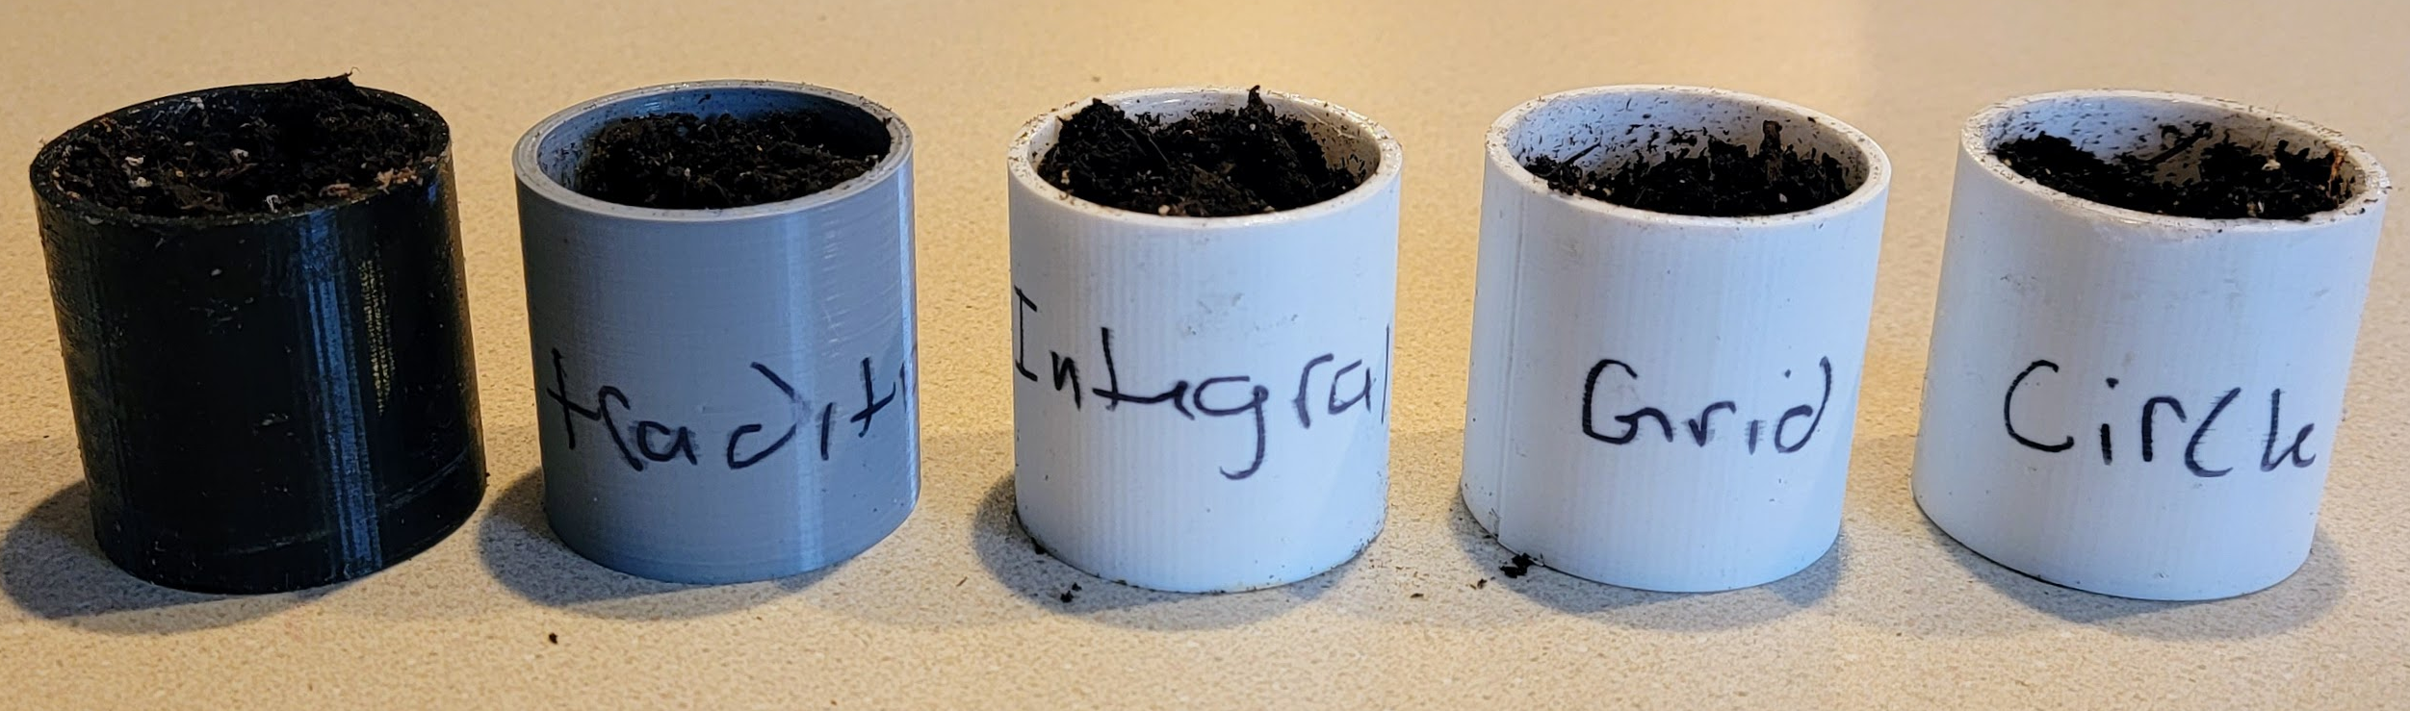
Plant Drainage Analysis
Catherine Bodenrader & Josephine Crotty, Innovation Scholars, University of New Hampshire
background
methods
Resolved issues
Many commercial plant pots are sold with either no drainage hole or insufficient drainage holes.
Plants are healthiest when their environment mimics the natural environment they belong in, including moisture retention, type of soil, and the amount of sunlight received.
Insufficient drainage leads to a host of health issues in plants, including root rot, fungus, gnats, harmful bacteria, and a lack of oxygen in the soil.
The purpose of this experiment was to determine how the configuration of drainage holes and the number of drainage holes in a pot affects moisture retention in soil.
Pots were designed using Fusion360 and printed using a PRUSA 3D printer and PLA filament.
Each pot was filled with 27 g of Miracle-Grow Soil and watered with 30 mL of tap water on Day 1 of observation.
Moisture level for each pot was measured on a scale of 1-10 at 8 p.m. each day over the course of five days, which was then put into the corresponding table in Excel for further comparison and analysis.
Issues with Slicing Files:
When attempting to print multiple pots at once, the file sliced incorrectly leading to the pots being filled oddly. This also caused the pots to lift part way through printing, preventing them from being completed.
This was resolved by decreasing the number of pots printing at once and adjusting the infill of the pots.
PRUSA Bed Thermistor Broke:
While fixing the slicing issue, it was also noted that the thermistor (temperature regulation) on the PRUSA broke, causing the printer to stop printing.
This issue was resolved through multiple troubleshooting methods being applied to fix the thermistor by experts until the PRUSA printed normally.
Results
(a) Figure 1: Difference in Moisture Level based on Number of Drainage Holes
(b) Figure 2: Difference in Moisture Level based on Configuration of Drainage Holes
conclusions
Conclusions cannot be drawn from the data collected due to the lack of trials completed within the time frame available to the researchers. However, the data collected suggests support for both hypotheses. Both the number of holes and the configuration of holes affect the level of moisture retained in plant pots.
The research compiled here has applications at both the consumer and producer levels. With the tentative conclusions made, consumers can make more informed purchases and producers could provide more options that are tailored to a wider variety of plants.
Hypotheses
Hypothesis 1: Number of Drainage Holes affect Moisture Retention in Soil
Hypothesis 2: Configuration of Drainage Holes affect Moisture Retention in Soil

