Slide 1


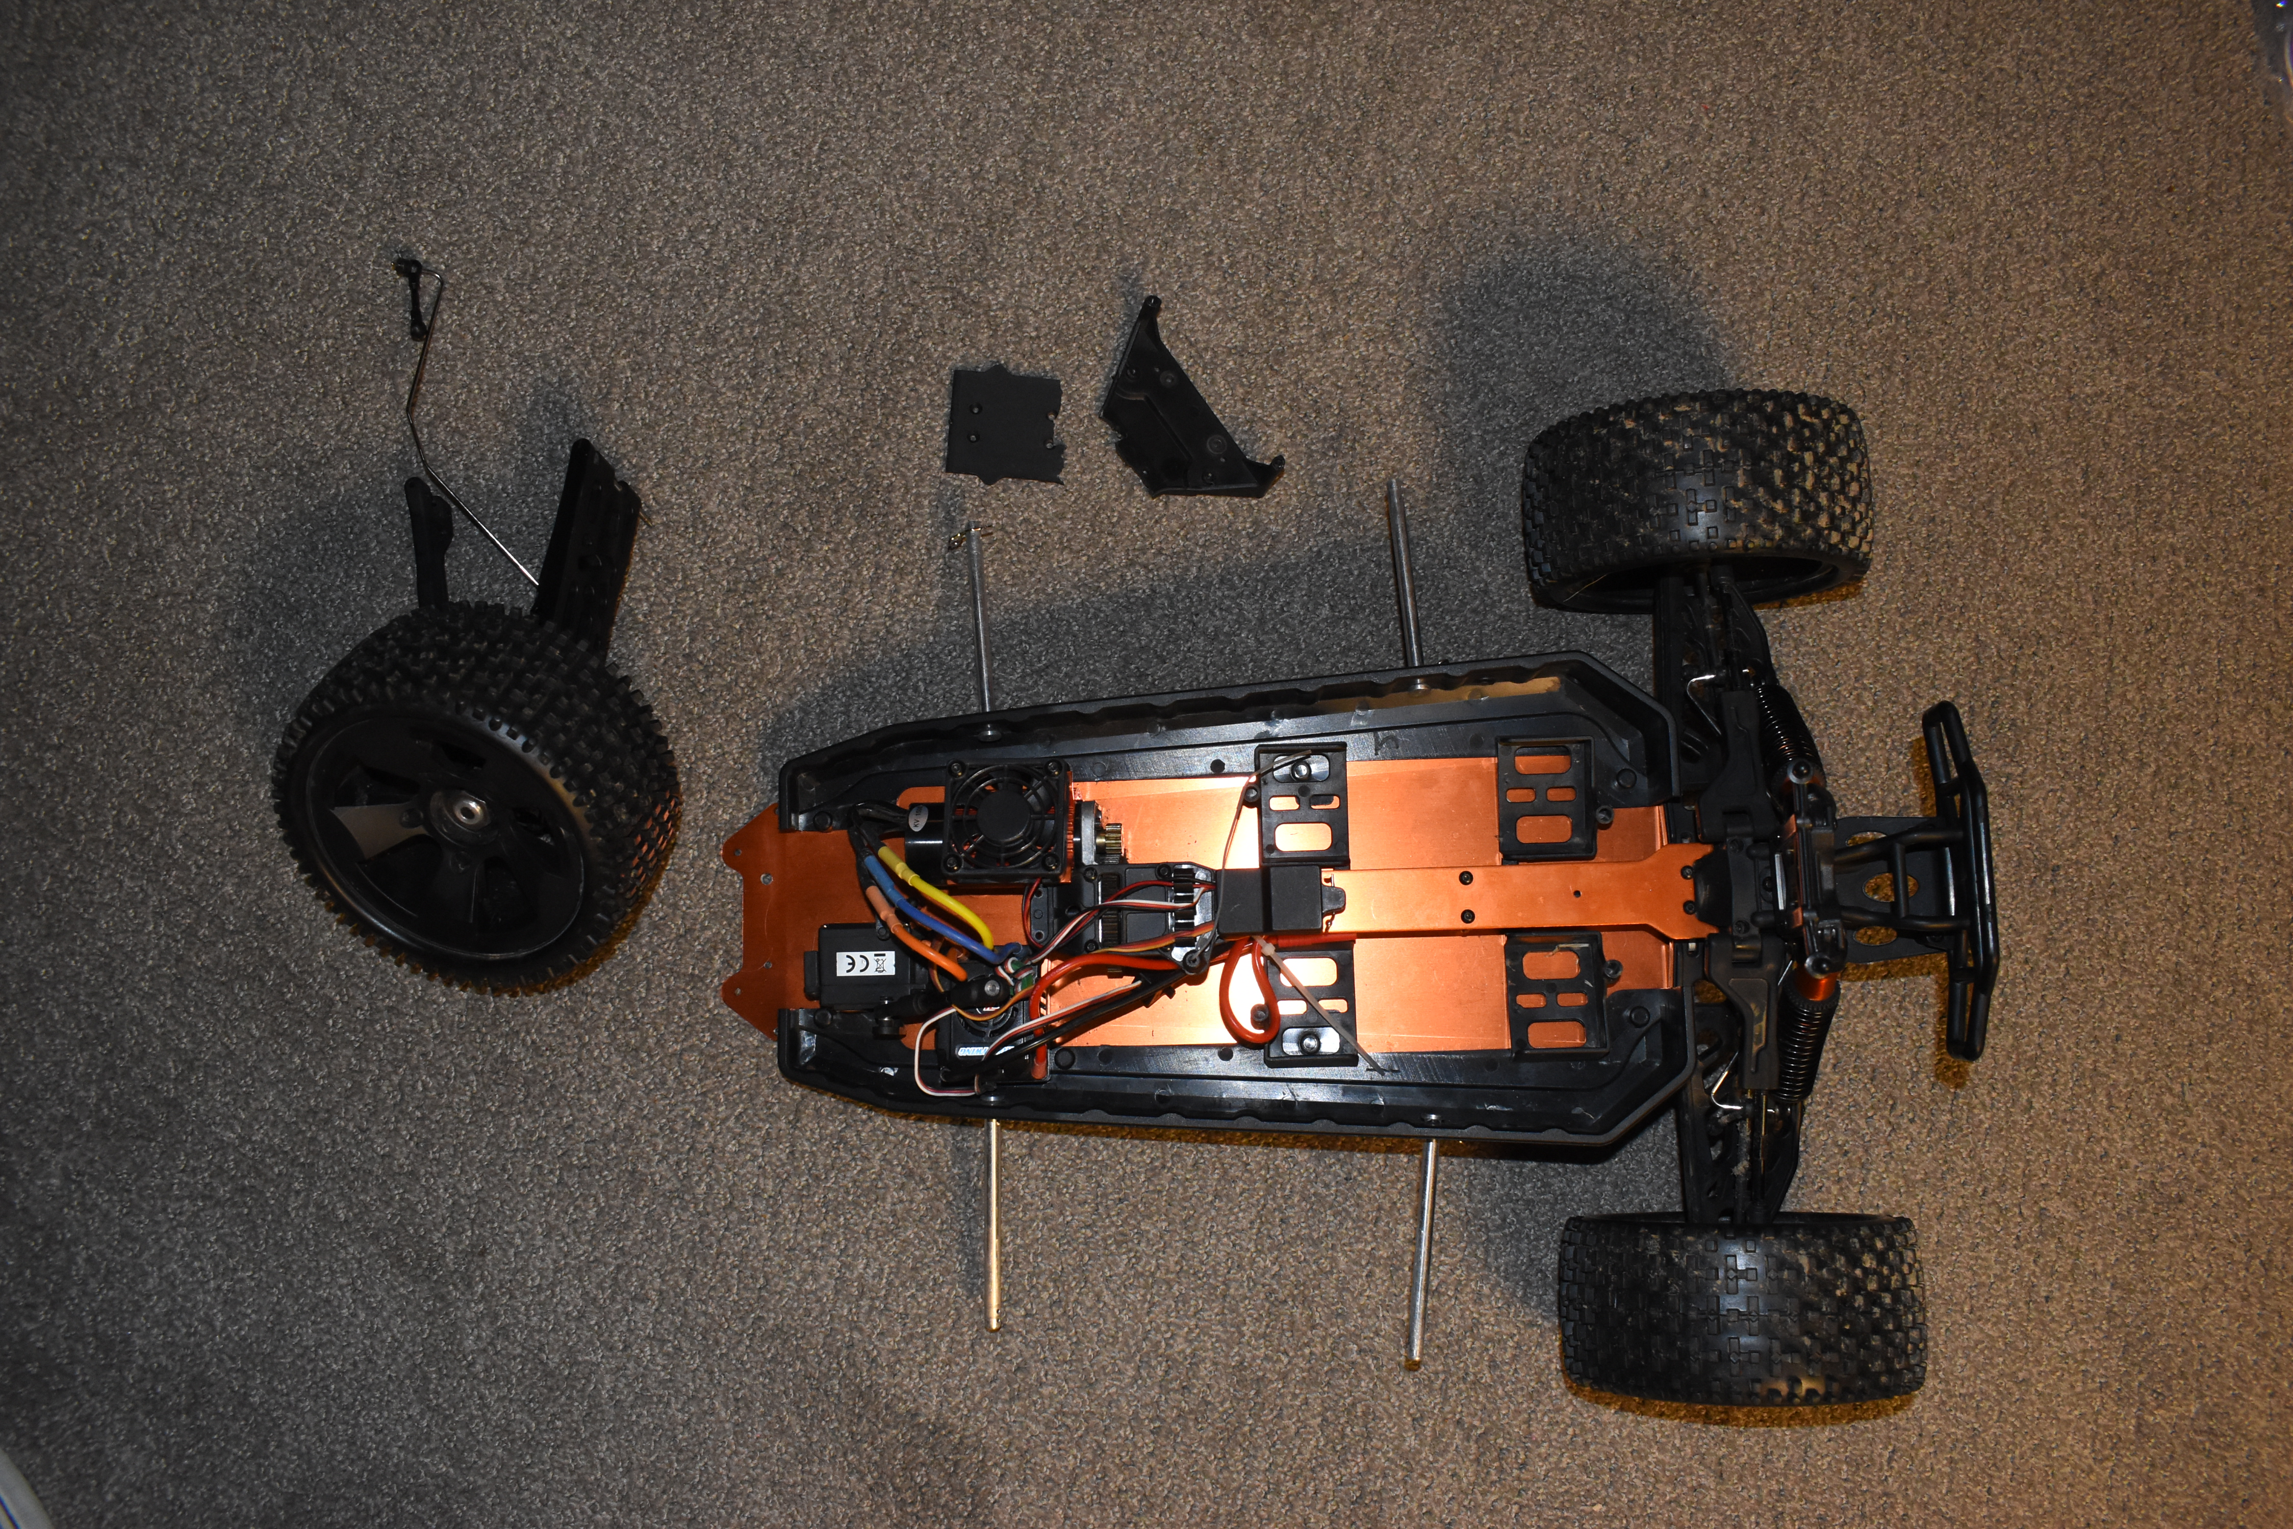
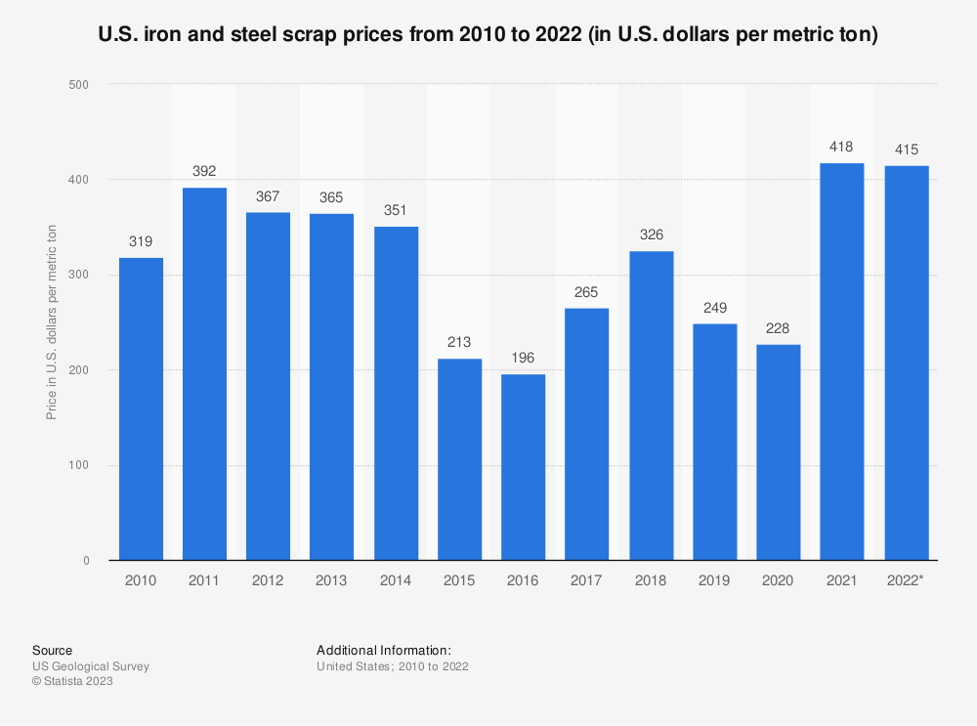
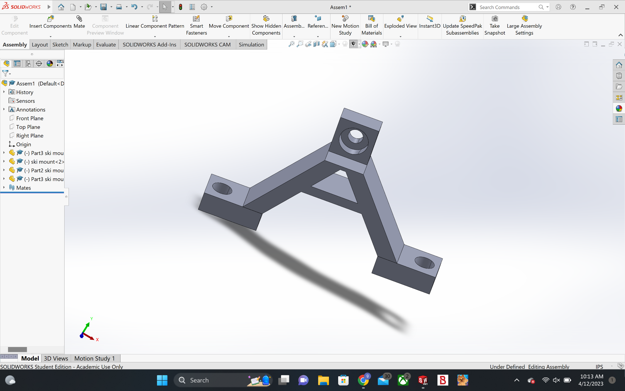
Trash vs. Technology
Drew Gulley // Gio Ionfrida // Paul Marino
Goals
Results
Introduction
Recycle metal and use it to create something fresh and new
Reduce trash waste, particularly steel scrap, to preserve our environment
Create an open and accessible business offering solutions for fixing everyday object
Offer cheaper/affordable options for item repairs through 3D printing
Behold! Our final product! We were able to maintain the wires and frame of the car, meaning that the only necessary fixes were external.
Test drive was successful
Ski attachments for snowy environments attached perfectly
  Unable to test due to weather
Body linkage pieces we printed fit well
Despite not including the plastic cover that it came in with the box, the car looks sleek and clean
We are Trash vs. Technology, a business that puts a fun twist on recycling tricky materials that shouldn't be wasted!
As a starting point, we were able to revamp and remodel a trashed RC Car.
Research Points
“3D printing has many advantages over traditional manufacturing that make the additive manufacturing process ideal for many prototyping and industrial applications.”
- HUBS, a Protolab Company
Conclusions
In experimental terms, we concluded that 3D printing was a cheap and easy way to put this car back together. Although we had access, that others do not, it still proved to be an efficient way to stop putting those complex materials in the RC car to waste. We hope to further improve this project by continuing it with other trashed materials and the use of 3D printing.
Process
“The Global Remote Control Toy Car Market size was estimated at USD 212.56 million in 2020 and expected to reach USD 240.37 million in 2021, at a CAGR of 13.51% to reach USD 516.18 million by 2027.”
- ResearchAndMarkets.com
Measurements & SolidWorks modeling
3D print preventing the front axis from rotating the wheels
3D printed ski attachments, with corresponding printed mount piece (see below)
Touch-ups and final assembly
Contacts
      Benjamin Mitchell – Benjamin.Mitchell@unh.edu
      Elizabeth Mamros - Elizabeth.Mamros@unh.edu
      Drew Gulley – drew.gulley@unh.edu
      Gio Ionfrida – Giovanni.Ionfrida@unh.edu
      Paul Marino – pam1050@unh.edu

