Slide 1

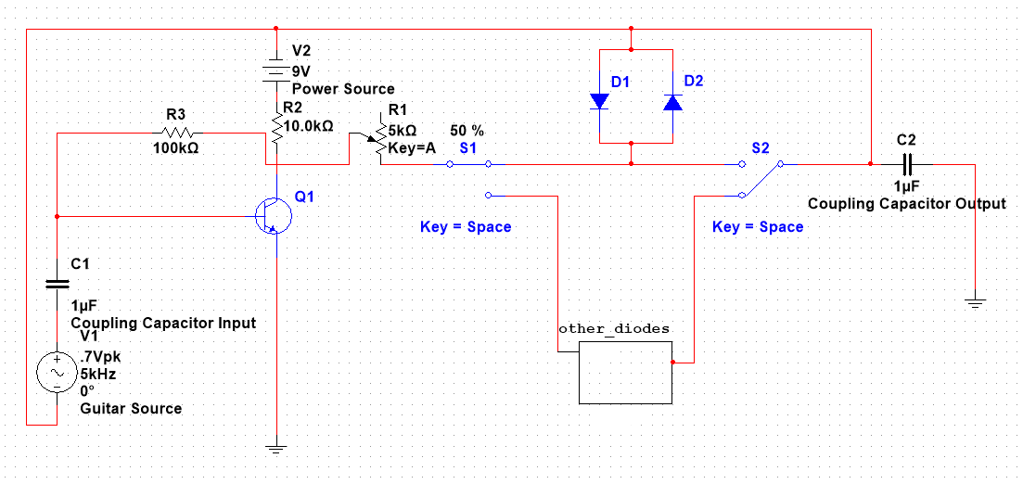
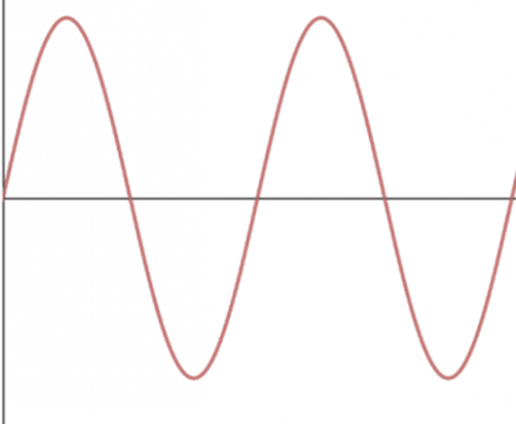
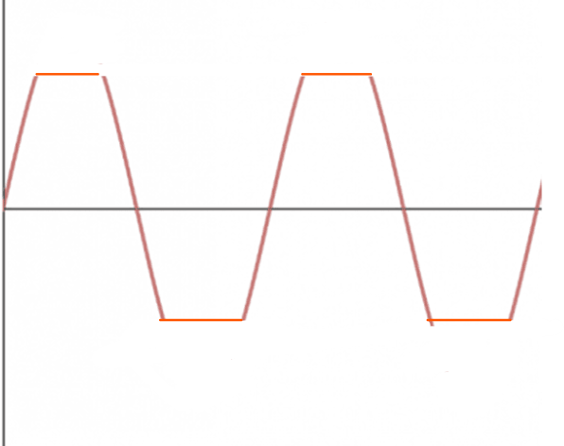
Building a Device for Guitar Distortion
Poster Subtitle Goes Here
Colin Casey
University of New Hampshire
Introduction
Results
Difficulties
The device I built is a circuit meant to distort the noise outputted by an electric guitar. It does this by taking the output of an electric guitar and distorting it with a configuration of diodes. These diodes affect the sine wave of the electric guitar’s output and can influence its shape, this affecting the final sound of the guitar.
The building of the circuit was not a clear and cut process. Small non-electrolytic capacitors were needed to convert the AC current from the guitar to a DC current for the circuit. The resistors were needed to control the flow of the current through the circuit and keep it relatively low. The transistor was used to combine the guitar voltage and battery voltage in a way that controlled the voltage through the rest of the circuit. Various forms of diode clipping were used, including different types of diodes and different configurations.
One of the major issues encountered during the design process was placing the diode clipping configuration in series with the rest of the circuit. This lead to many flaws including no distortion on the output, so after some testing was done the idea to put the diode clipping configuration in parallel was introduced with success. There were also issues with implementing the transistor that were fixed with research.
Method for Distortion
The main method for distorting the AC signal from the guitar’s output is a method called diode clipping. Diode clipping is taking two or more diodes and setting them against each other in a configuration, then placing that configuration in parallel with the output signal. This changes the sine waves produced by the guitar, influencing the noise they make as an output
Unclipped Sine Wave Clipped Sine Wave
Contacts
.
References
      For more information contact: colin.casey@unh.edu
      (603) 213 - 4737
Zayden, K. (2021, July 16). How to identify the 3 pins of a transistor correctly: Transistor testing methods in step-by-step - electronics tutorials. KNOVHOV. Retrieved April 12, 2023, from https://knovhov.com/identify-the-pins-of-a-transistor/

