Slide 1
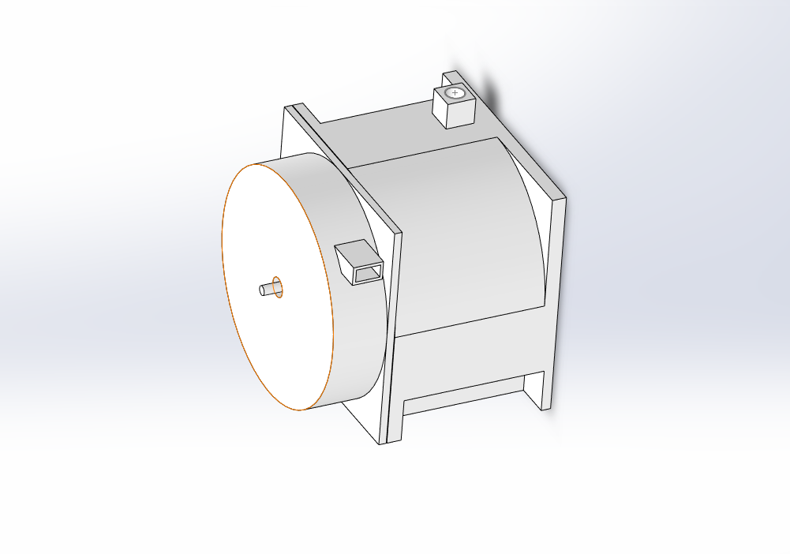
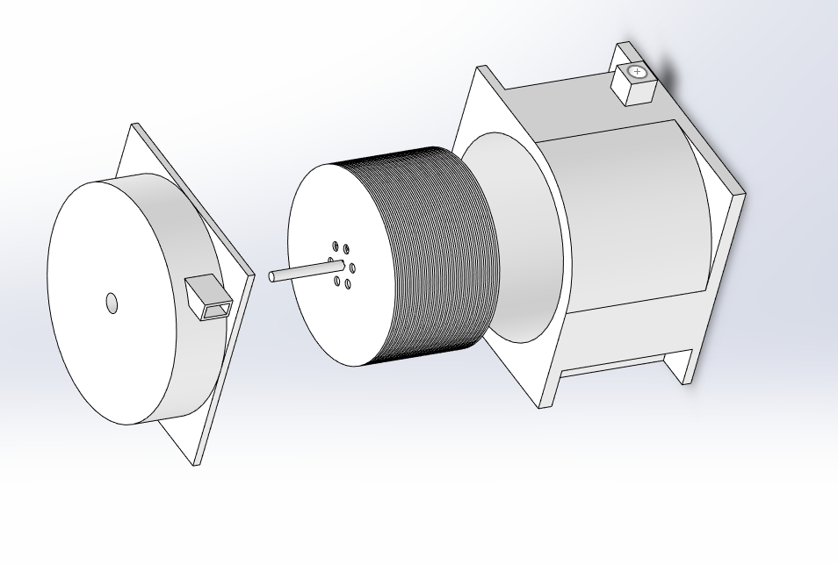
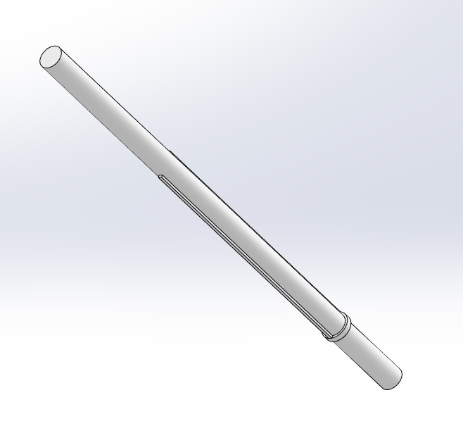
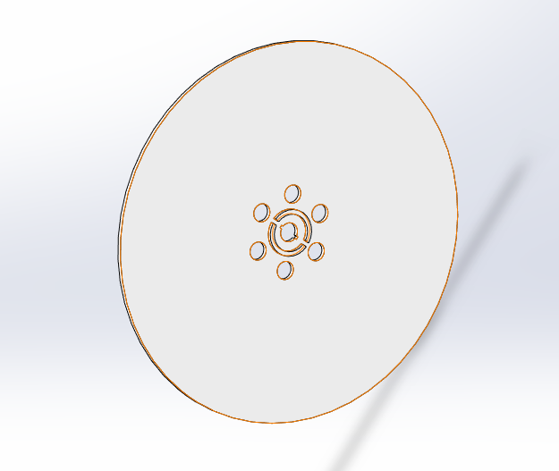
Tesla Turbine Ian Stewart University of New Hampshire
Introduction
Results
Discussion
The Tesla turbine and scope
Tesla turbine
Patent in 1913
Does not have airfoils like bladed turbines
Works from surface cohesion also known as the boundary layer effect
Has some advantages over normal turbines
Does not create turbulence
Since turbulence is where conventional turbines lose most of their efficiency, theoretically this would make tesla turbines more efficient.
Can be used in reverse, (air or liquid can be pumped through either way)
Pictures of the 3D CAD model of the Tesla turbine
This Project was ultimately successful in creating a Tesla turbine.
It is notable how easy it was with access to a 3D printer, as most of the parts were printed as ABS plastic. Only a few cheap components such as ball bearings and the connection for the pressurized air needed to be ordered online.
The process, even the computer modeling part of the project was very personally involved and having a physical activity to create and demonstrate made this vastly more engaging that a test would have been
----------------------------------------------------------------
The main reason I personally join innovation scholars is that it did give this opportunity to do a hands-on project which is unfortunately rare.
Within the cited study is when asked if the test orientated classroom, (aka a class that studies via textbooks) was a large part of the being disengaged a vast majority of boys agreed that not having hands on and physical learning played a role of them disengaging and underperforming.
Turbine case
Air Inlet
Air Outlet
Purpose
While this project is not scientifically proving anything rather show what a great opportunity hands on learning can be, while the possible problems this can be a solution to are an afterthought of having an engaging and fun activity.
Tesla originally designed the Tesla turbine as a more efficient innovation on centrifugal pumps, his design is centripetal and the air or liquid moves inward rather than being flung outward.
Providing a physical project of any kind is a vastly more engaging process and with commercial access to things like 3D printers, Manufacturing isn’t confined to machine shops anymore
References
. Author links open overlay panelRohaty Mohd Majzub a, et al. “Boys' Underachievement: Causes and Strategies.” Procedia - Social and Behavioral Sciences, Elsevier, 6 May 2010, https://www.sciencedirect.com/science/article/pii/S1877042810005227.
Main Shaft
Turbine Disks

