Slide 1


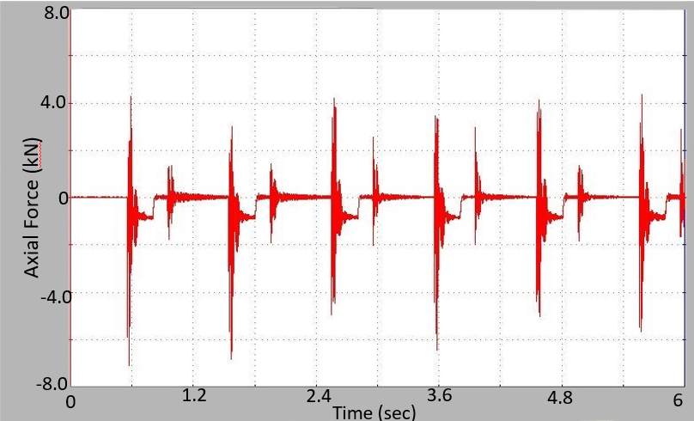
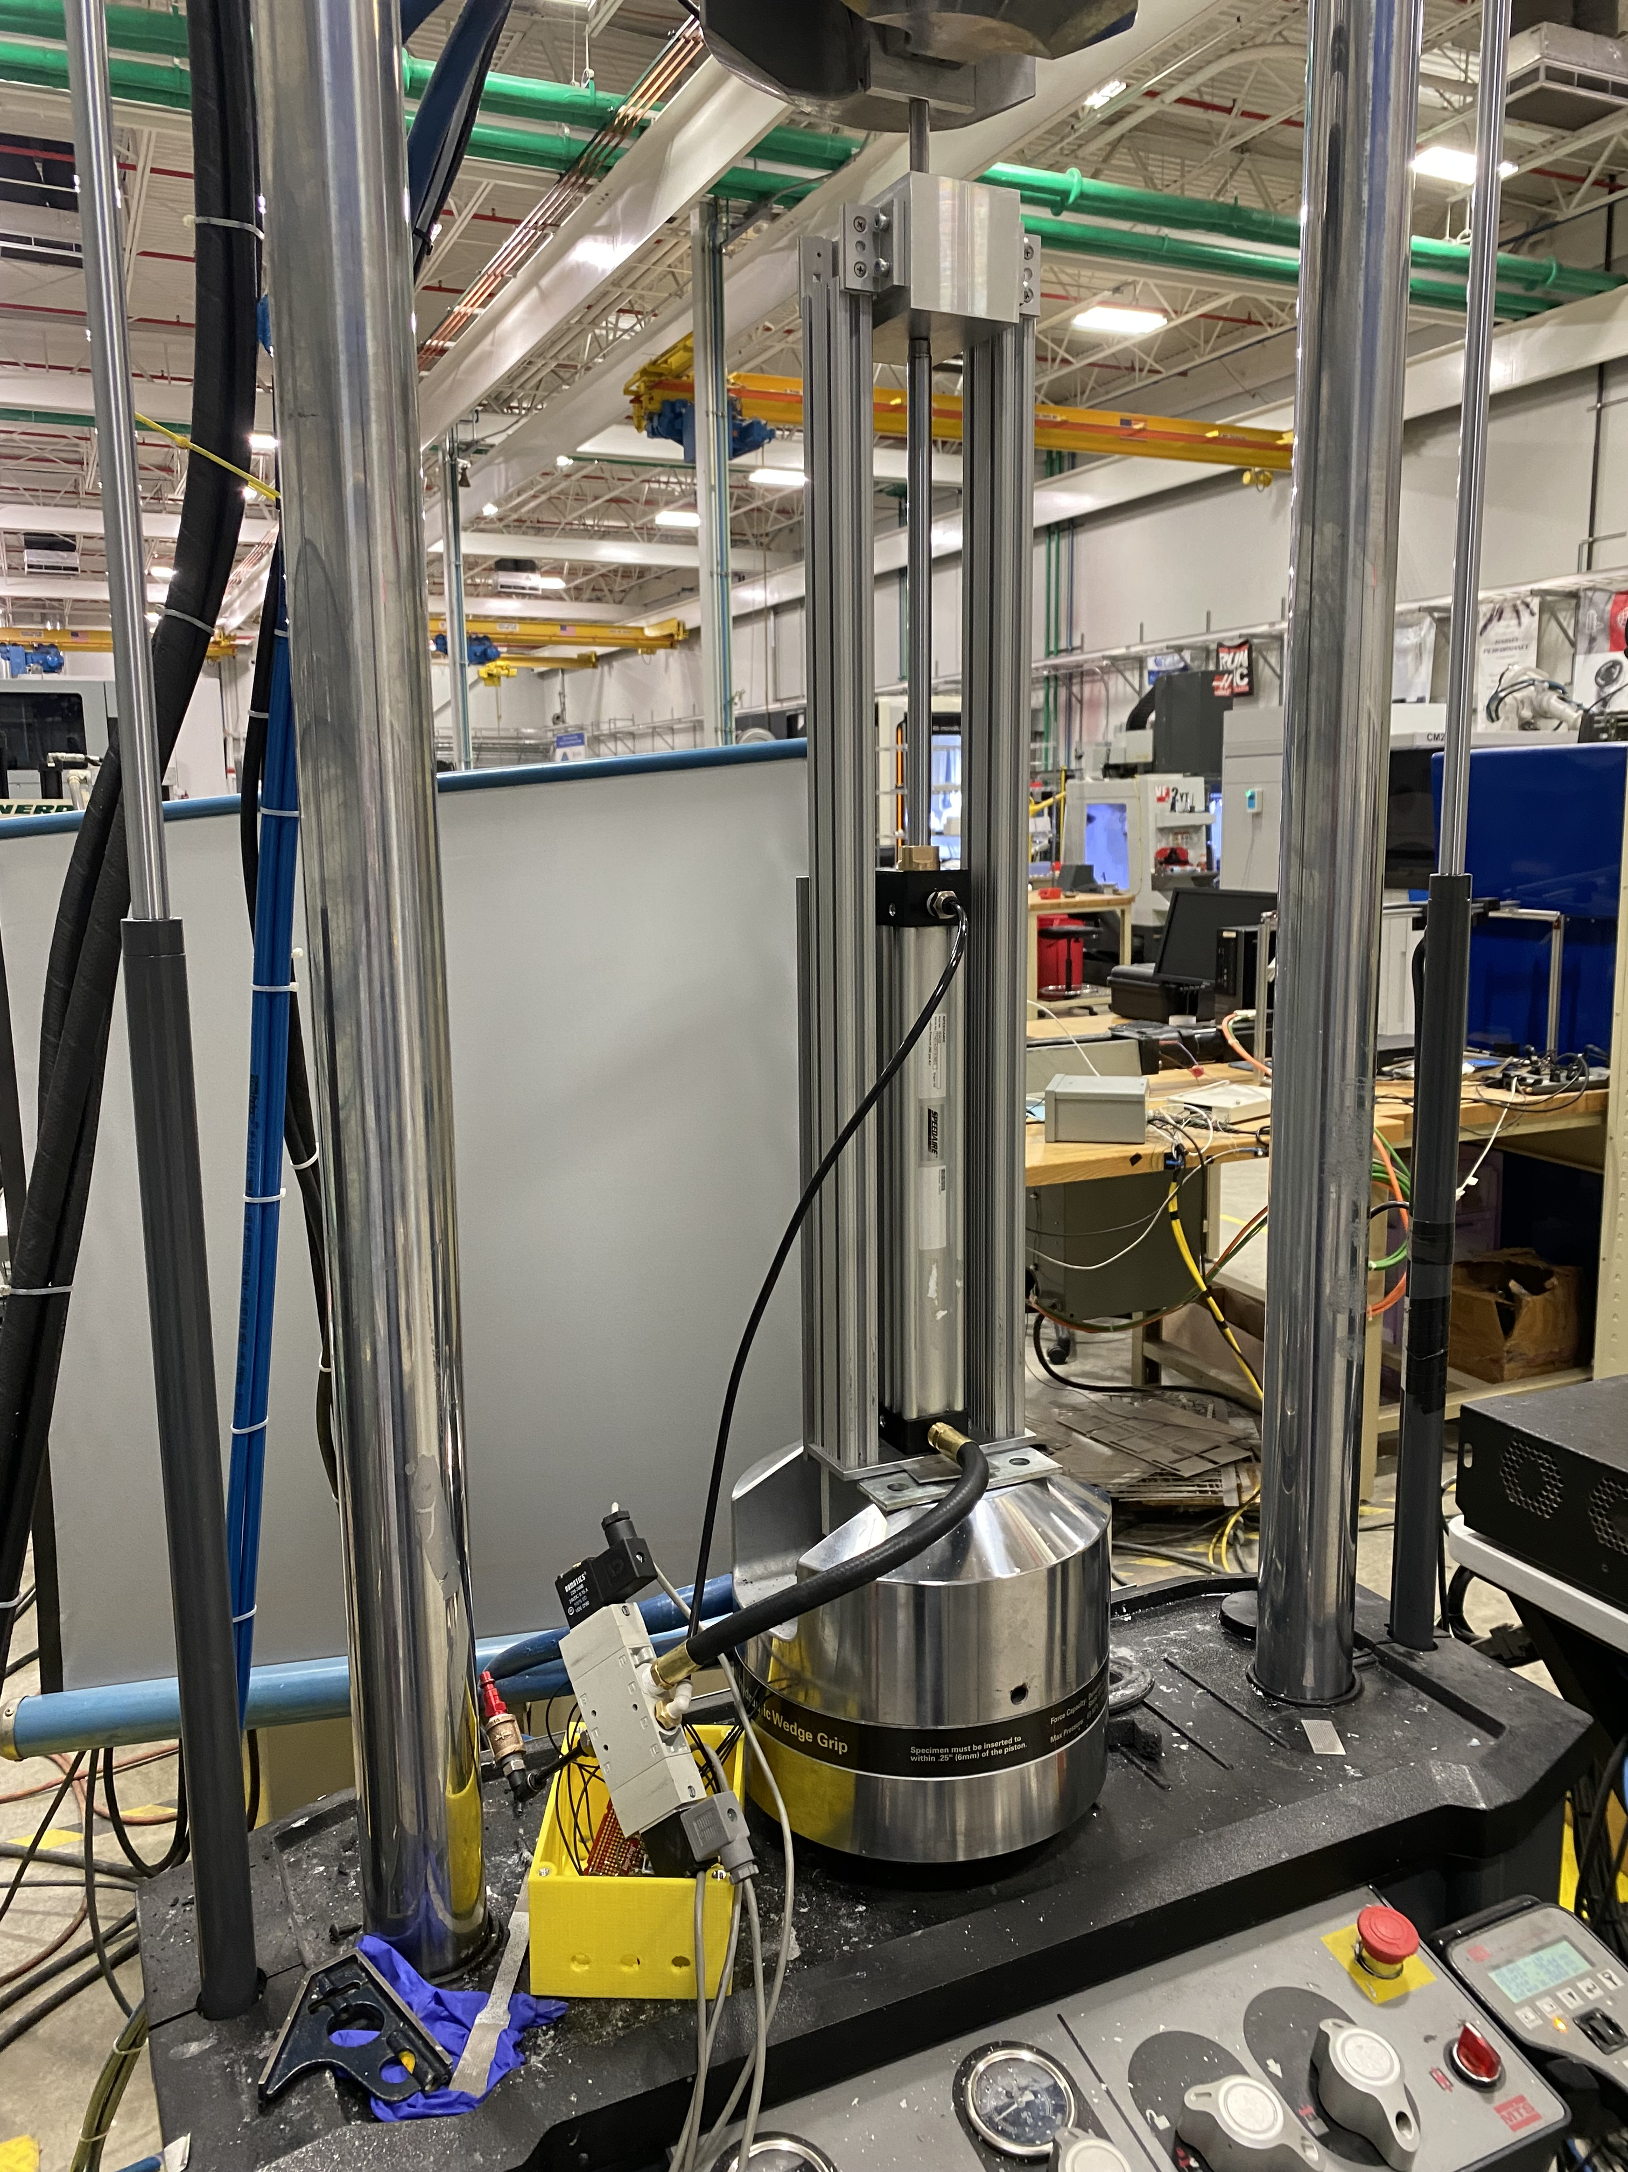
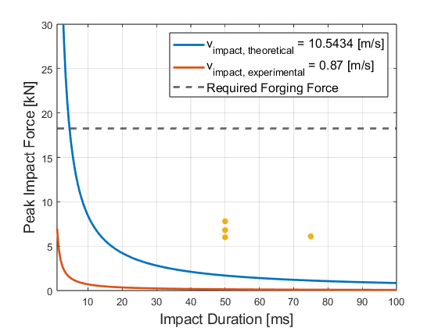
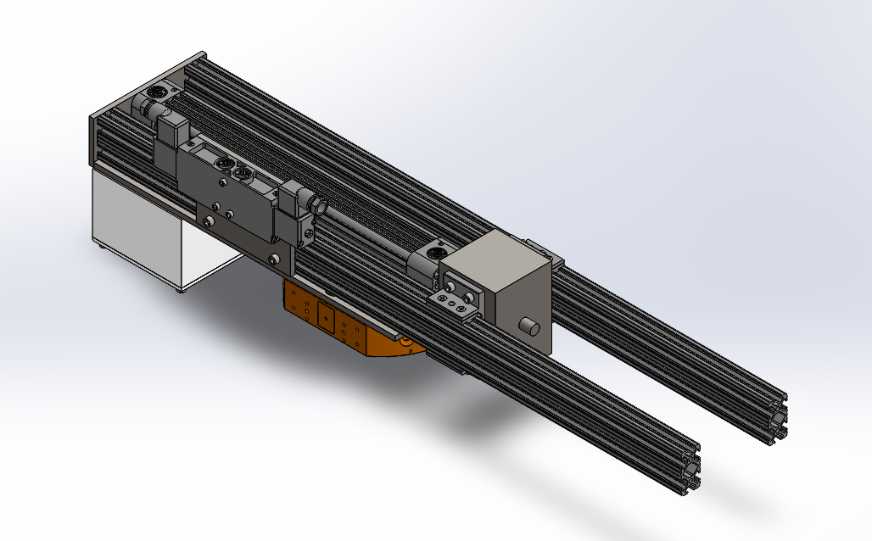
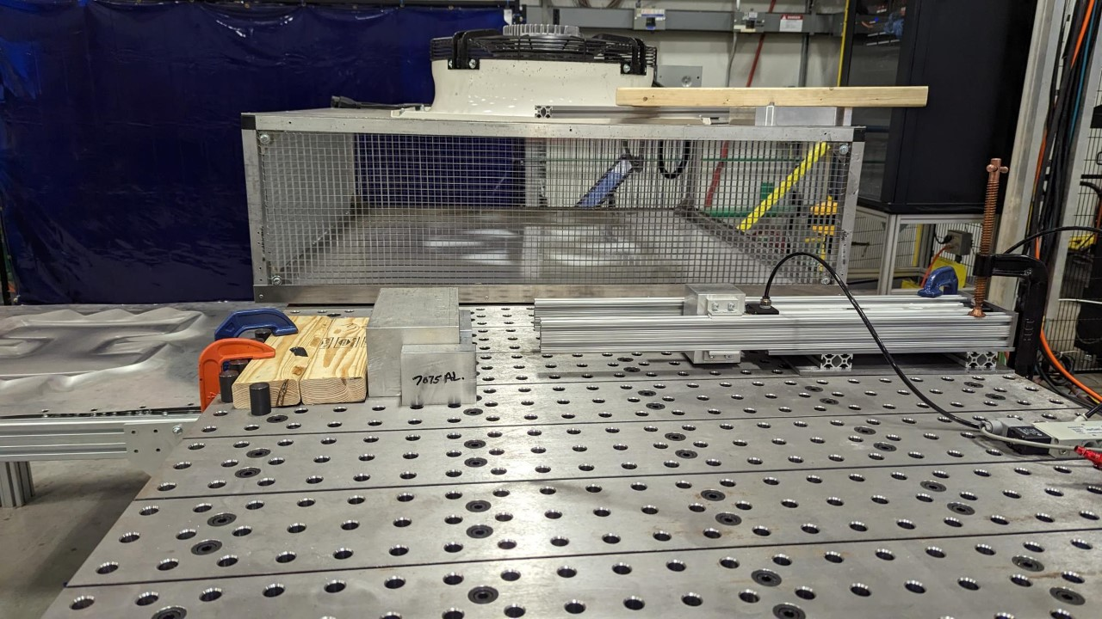
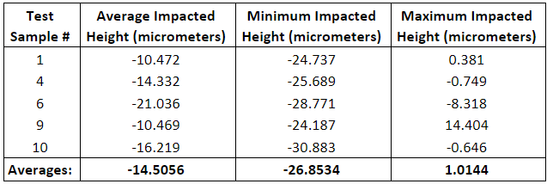
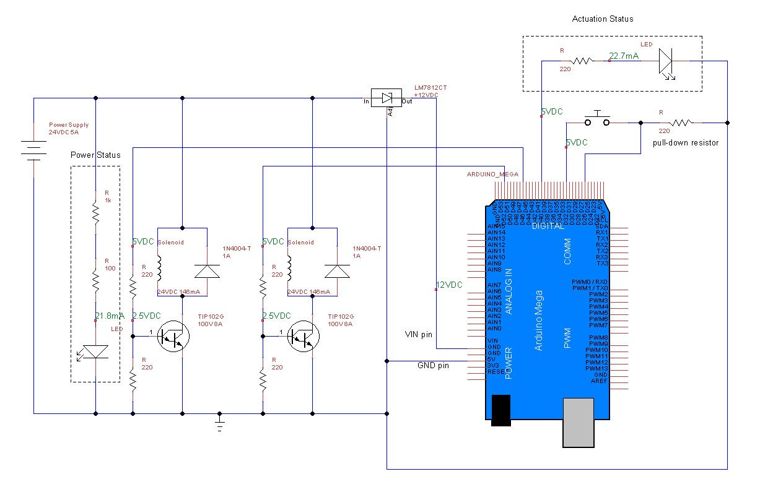
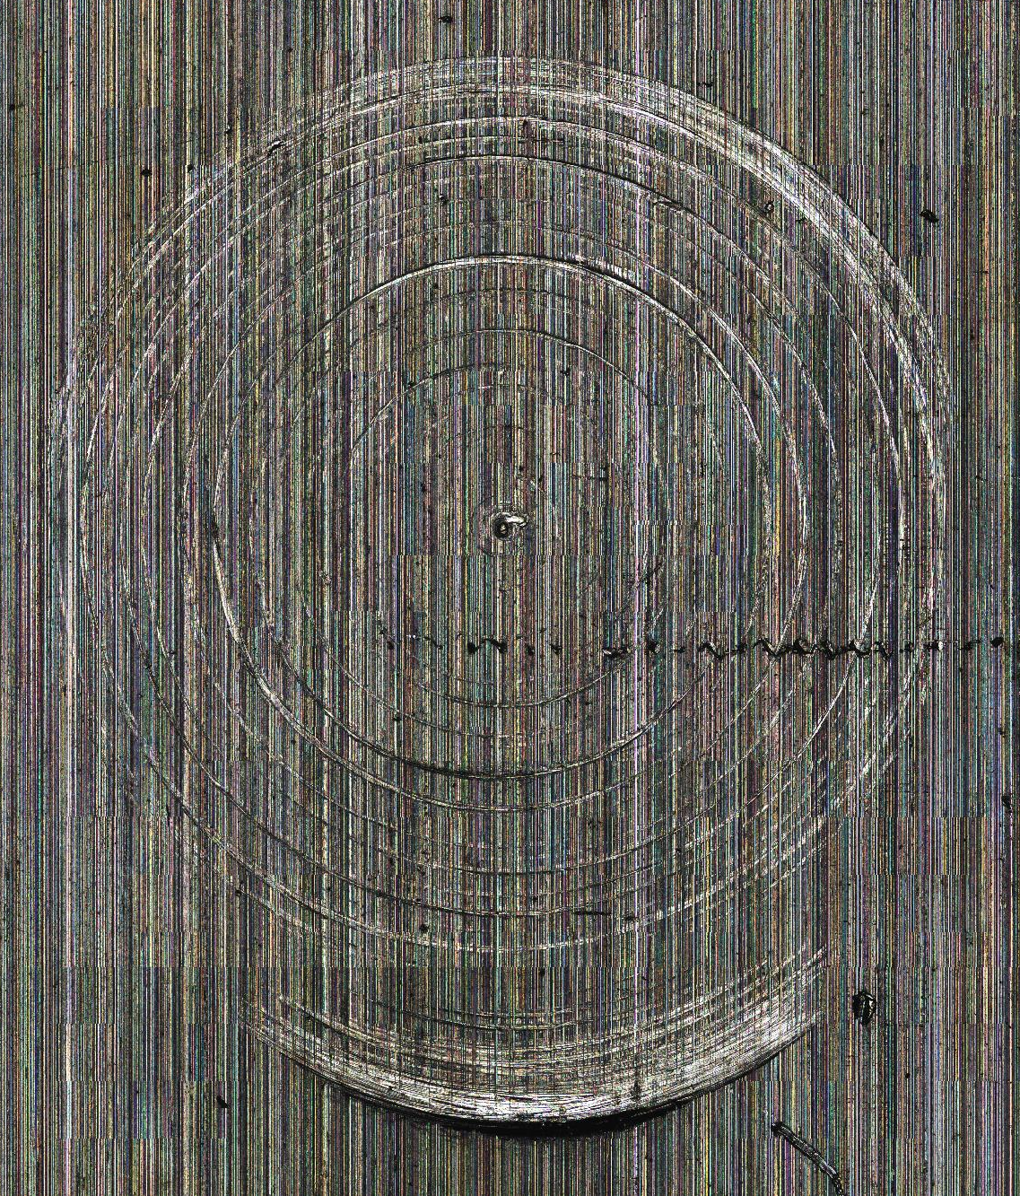
Robotic Blacksmithing in Space
Ian Connor, Rebecca Dorzens, Garrett Mallard, Avonlea Westhoff
Department of Mechanical Engineering, University of New Hampshire, Durham, NH 03824
Advisor: Dr. Brad Kinsey
Introduction
Testing and Analysis
Theoretical Calculations vs
Experimental Results
The goal of the Robotic Blacksmithing project is to produce a robotic end effector attachment for forging an aluminum composite produced through friction stir additive (FSA) manufacturing by research collaborators at Baylor University. The current material suffers from internal voids and rough surfaces. Robotic blacksmithing will be used to remove these defects from the FSA material and improve its mechanical properties.
The Material Test System (MTS) is used to test material properties by suppling a controlled force.
The MTS was chosen because it has a high-capacity load cell which could be used to measure the impact force created by the mechanism.
Instead of the MTS machine supplying a force onto a specimen, this experiment involves applying a force onto the MTS's load cell, which can measure the force generated and transmits this data to the MTS machine's control software.
The pneumatic cylinder created a repeatable average impact force of approximately 6.014 kN.
The maximum force from one strike was 7.813 kN (1756 pounds) of force. This was approximately 10kN short of the goal for deformation. That gives a stress of 61.67 MPa.
The measured impact duration was significantly longer than expected, averaging approximately 56.25 ms.
Criteria and Constraints:
Overcome yield strength of Baylor material (114 MPa)
Weight limit: 150 kg (Maximum payload of KUKA robot)
Design
The mechanism is composed of a pneumatic cylinder (1), hammer mass (2), exchangeable impactor (3), support rails (4), and an electronics enclosure (5).
The pneumatic cylinder operates at 115 psi and propels a 2.84 kg hammer mass over its 12 in stroke length to ideally achieve an impact velocity of approximately 10.54 m/s.
The impactor has a circular cross section of 0.5-inch diameter to concentrate the impact force and overcome the workpiece yield strength of 114 MPa.
5
3
Figure 3: Force Plot from MTS Landmark 370.25
Image 1: MTS Experiment Setup
Testing and Analysis
Figure 2: Mechanism Assembly Model
The second testing section observed the device's ability to deform metal.
The device was oriented horizontally and actuated to impact 0.5-inch-thick samples of 6061-T6 aluminum.
The impacted areas were later observed using the Olympus confocal microscope at the University Instrumentation Center.
The impacted area was manually isolated in the analysis software.
  The average height and maximum and minimum heights of that specified area were measured.
  The heights are in reference to the unaffected surrounding area that is also averaged to create the reference plane.
Figure 4: Theoretical and Experimental Peak Impact Force
2
The total assembly mass is 11.3 kg.
A quick-change connector for the KUKA KR150 robotic arm is bolted to the mechanism’s back plate (6).
Conclusions and Next Steps
1
4
6
Purchase a high-capacity load cell with a high sampling rate.
  Few load cells available had a high enough force capacity and sampling rate for the desired impact force and actuation speed.
  The MTS was able to output data, however, it is not designed for impact testing.
  Replace the support rails with linear rails and bearings to reduce friction.
The team would like to do deformation testing with Baylor University's FSA material.
Adapt the device for the lunar atmosphere.
Figure 1: Mechanism Final Assembly
Electronics Schematic
A double acting solenoid valve is used to control the pneumatic cylinder.
This valve is actuated using an open loop control system with an Arduino UNO R3 microcontroller.
The control system and valve are powered using a standard 120 VAC wall plug.
The controller cycles the pneumatic cylinder at a frequency of 1 cycle per second.
As an added safety precaution, the pneumatic cylinder will always return to its retracted position when the cycle is stopped.
Acknowledgements
Table 1: Deformation Results
New Hampshire Space Grant Consortium
Dr. Brad Kinsey (Project Advisor)
John Olson Center for Advanced Manufacturing
Nathan Daigle (Manufacturing Engineer, Olson Center)
Shawn Banker (Director, University Instrumentation Center)
James Abare (Senior Electronics Engineer, Technical Service Center)
Scott Campbell (Senior Machinist, Technical Service Center)
Deformation Results
Some samples produced complete rings of impact while others only produced crescent-shaped impacts. This may be due to the chamfer on the end of the impactor or if the impactor was not perfectly perpendicular with the sample.
Since the forces produced exceeded the Baylor material but not the 6061-T6 aluminum, the impact deformation was not large.
Five samples were selected to observe with the microscope (see sample 4 in Image 2).
The average deformed height change was 14.5 micrometers with the 0.5-inch impactor onto 6061 aluminum (see Table 1).
References
Varat, M. S., & Husher, S. E. (n.d.). Crash Pulse Modeling for Vehicle Safety Research. Retrieved April 14, 2023, from https://www.nhtsa.gov/sites/nhtsa.gov/files/18esv-000501.pdf
Richer, E., & Hurmuzlu, Y. (1999). A high performance pneumatic force actuator system: Part I—nonlinear mathematical model. Journal of Dynamic Systems, Measurement, and Control, 122(3), 416–425. https://doi.org/10.1115/1.1286336
Figure 3: Electrical Schematic for Solenoid Valve Control System
Image 2: Test Sample 4
Notes:
Do we want to reference the Baylor material or aluminum (do we have the graph with the baylor force?

