Slide 1
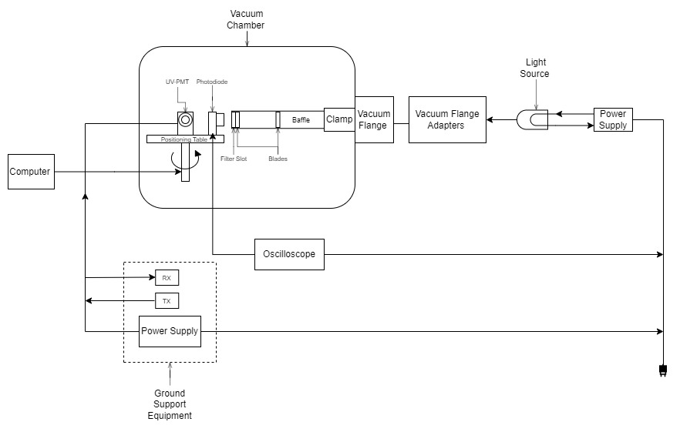
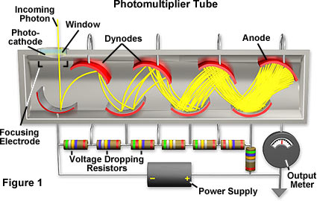
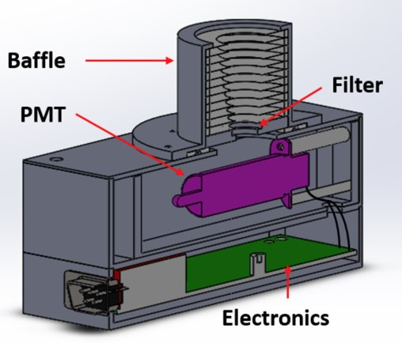
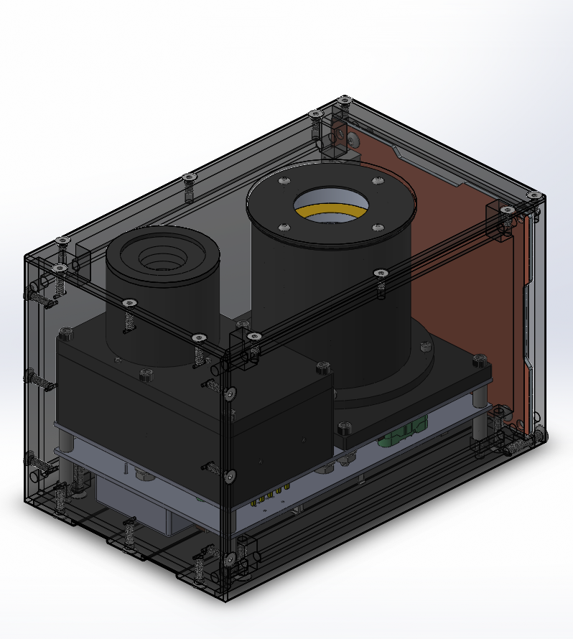
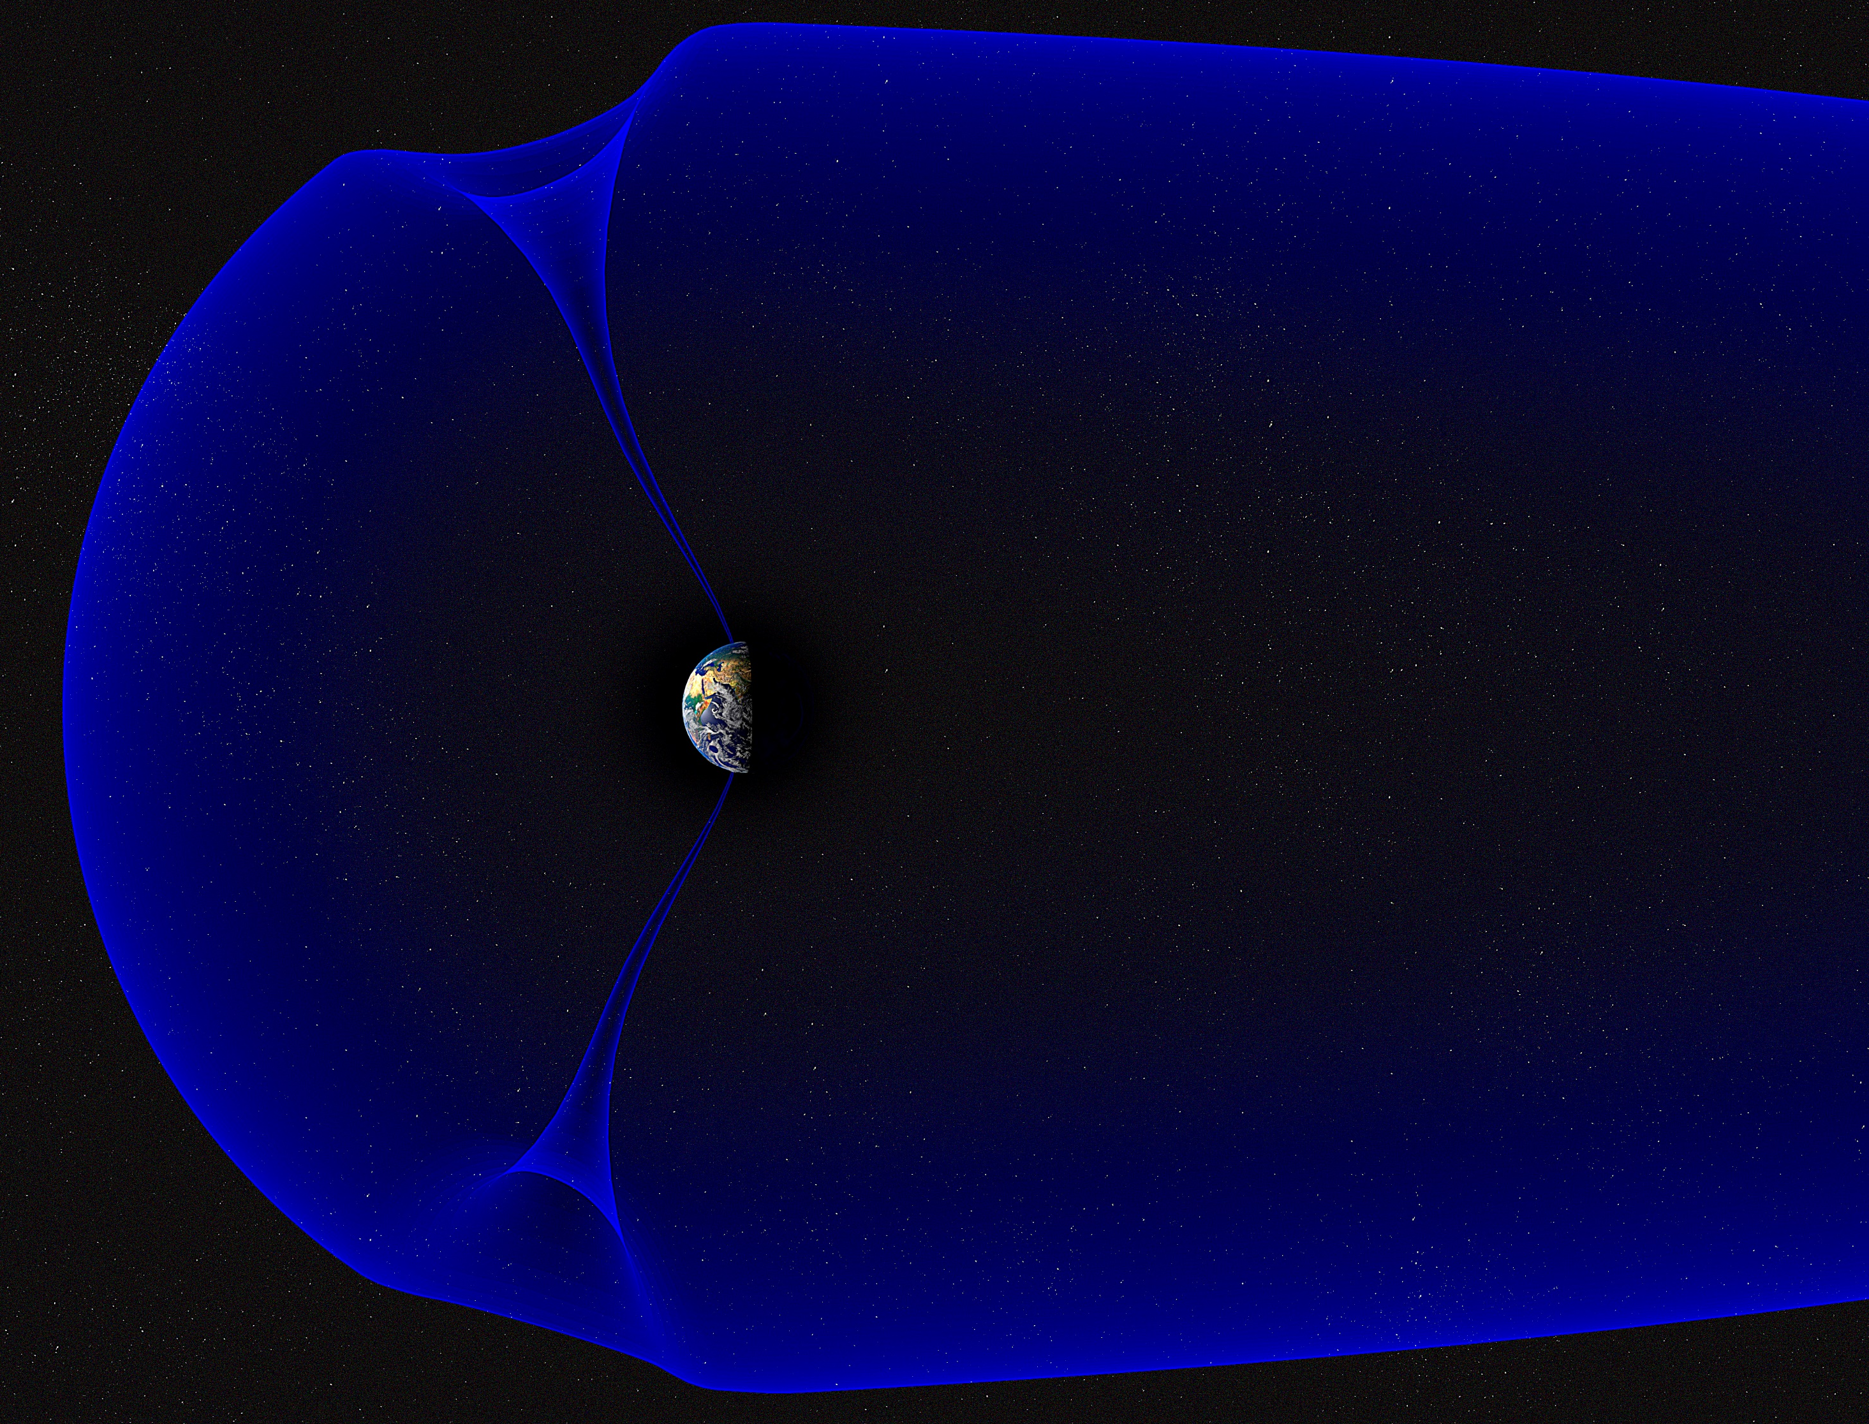
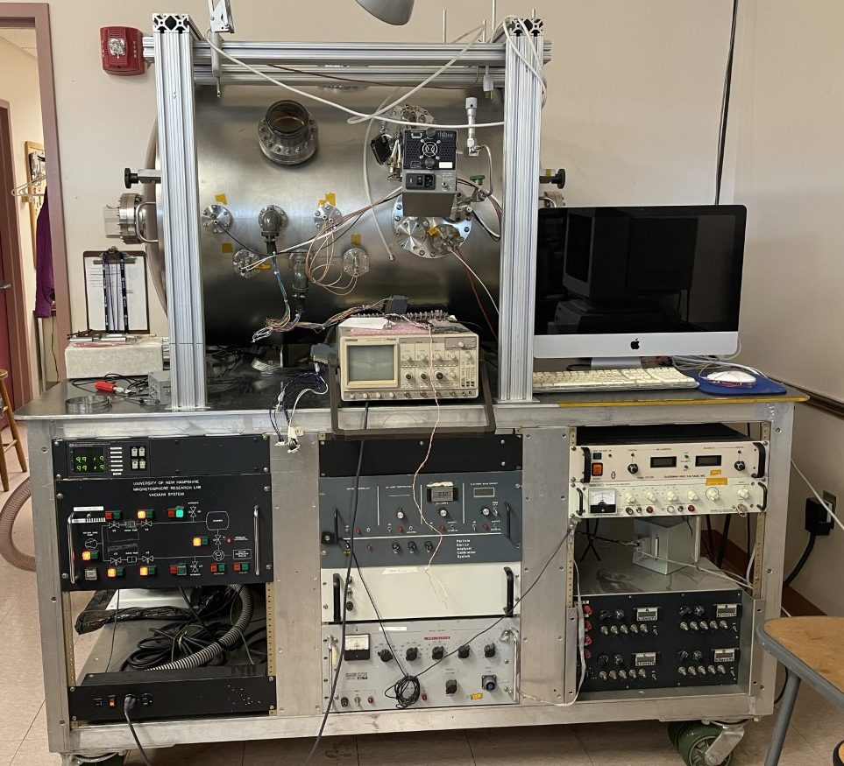
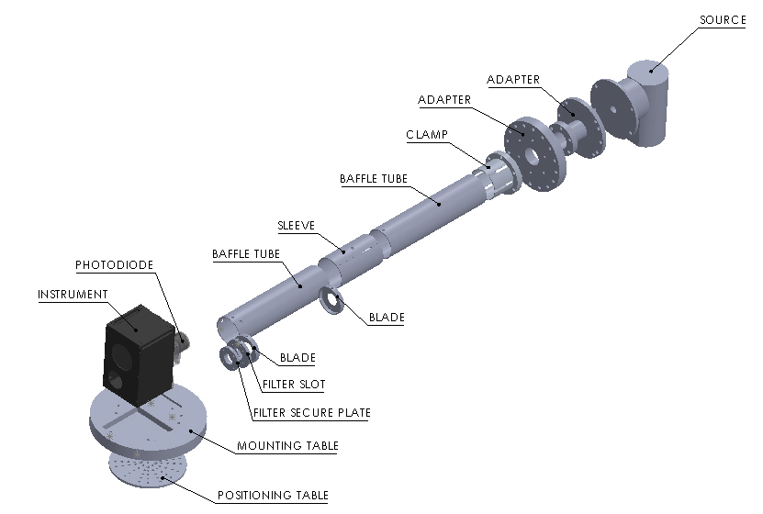
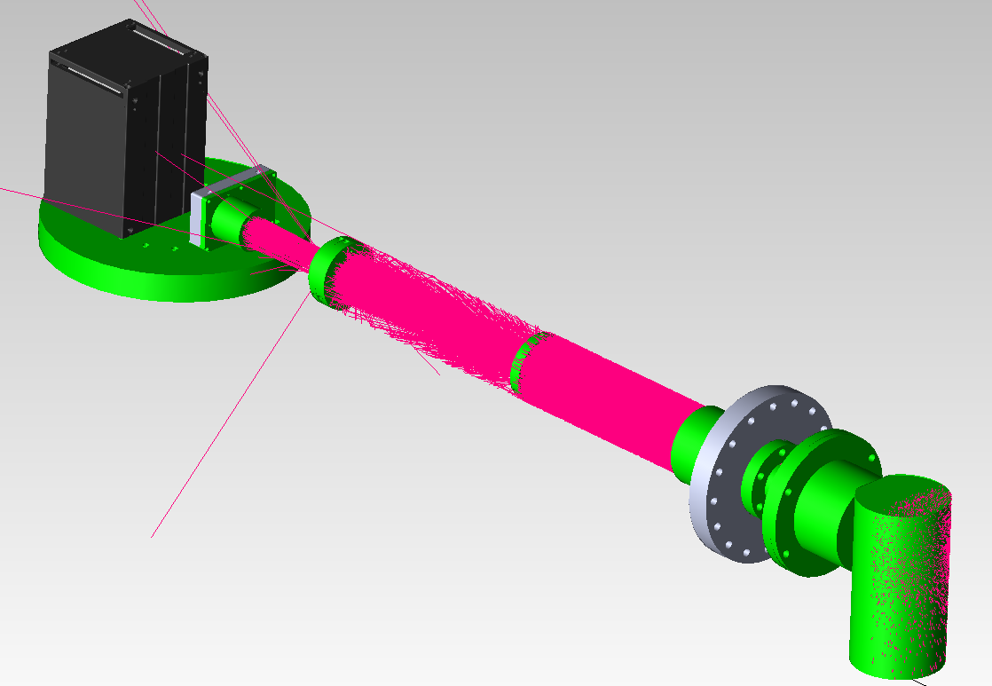
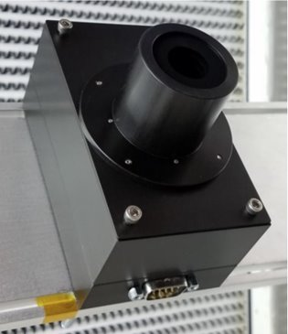
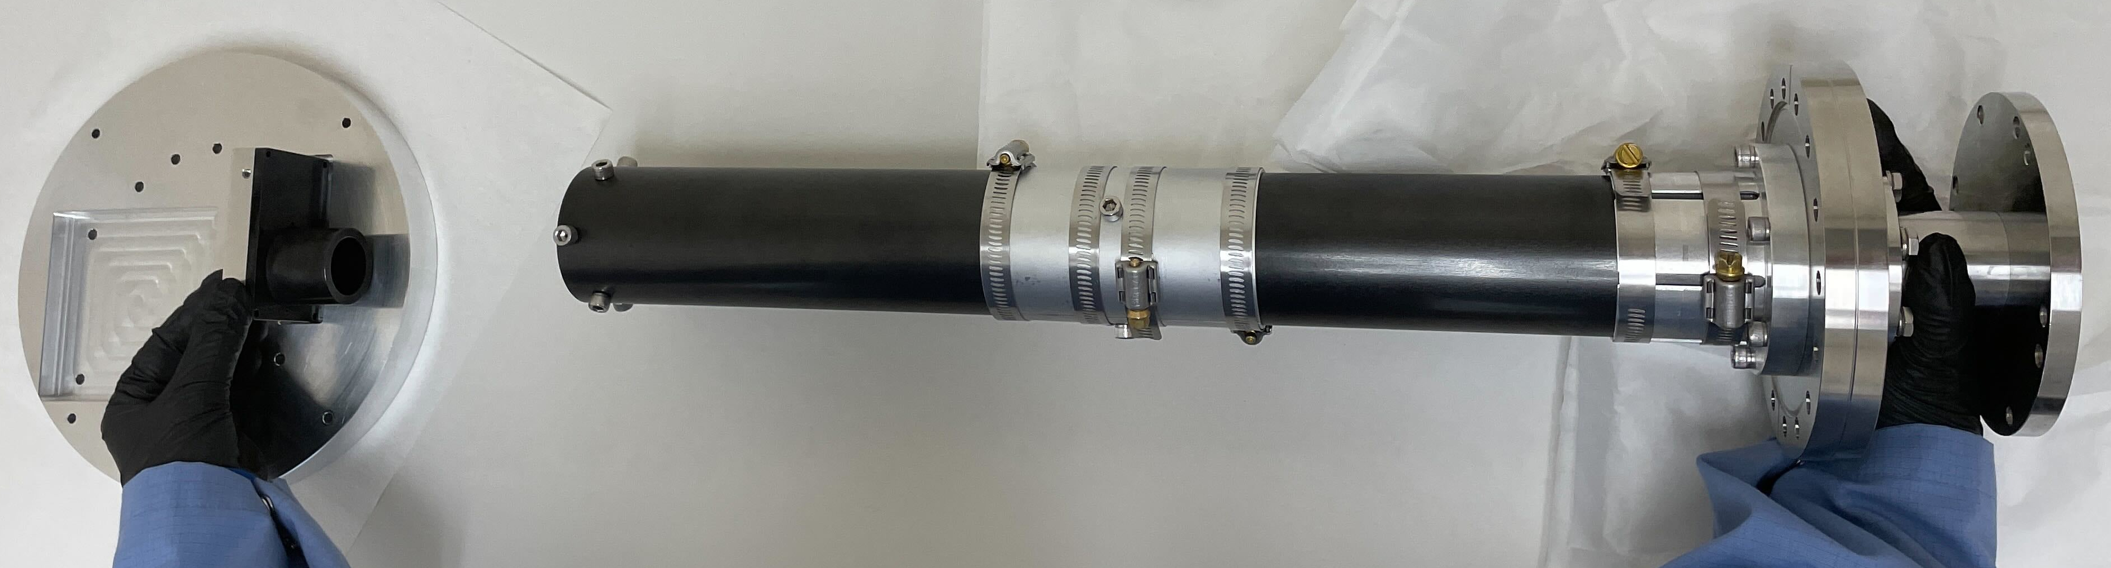
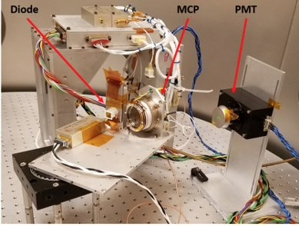
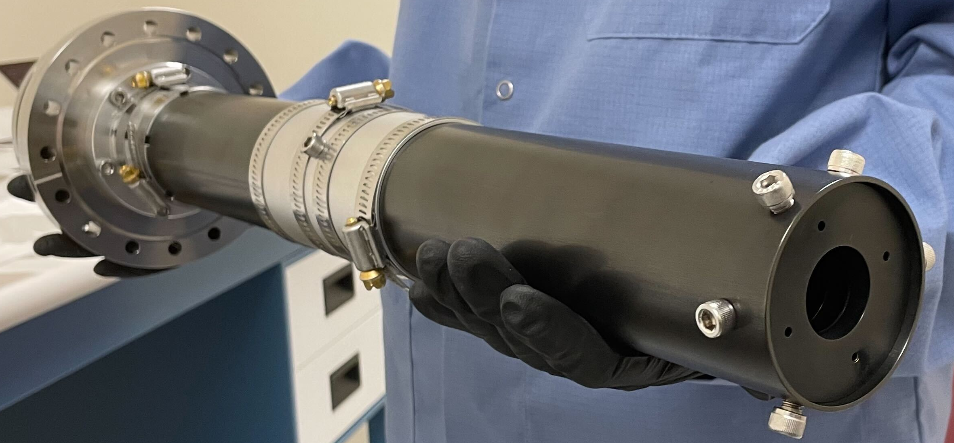
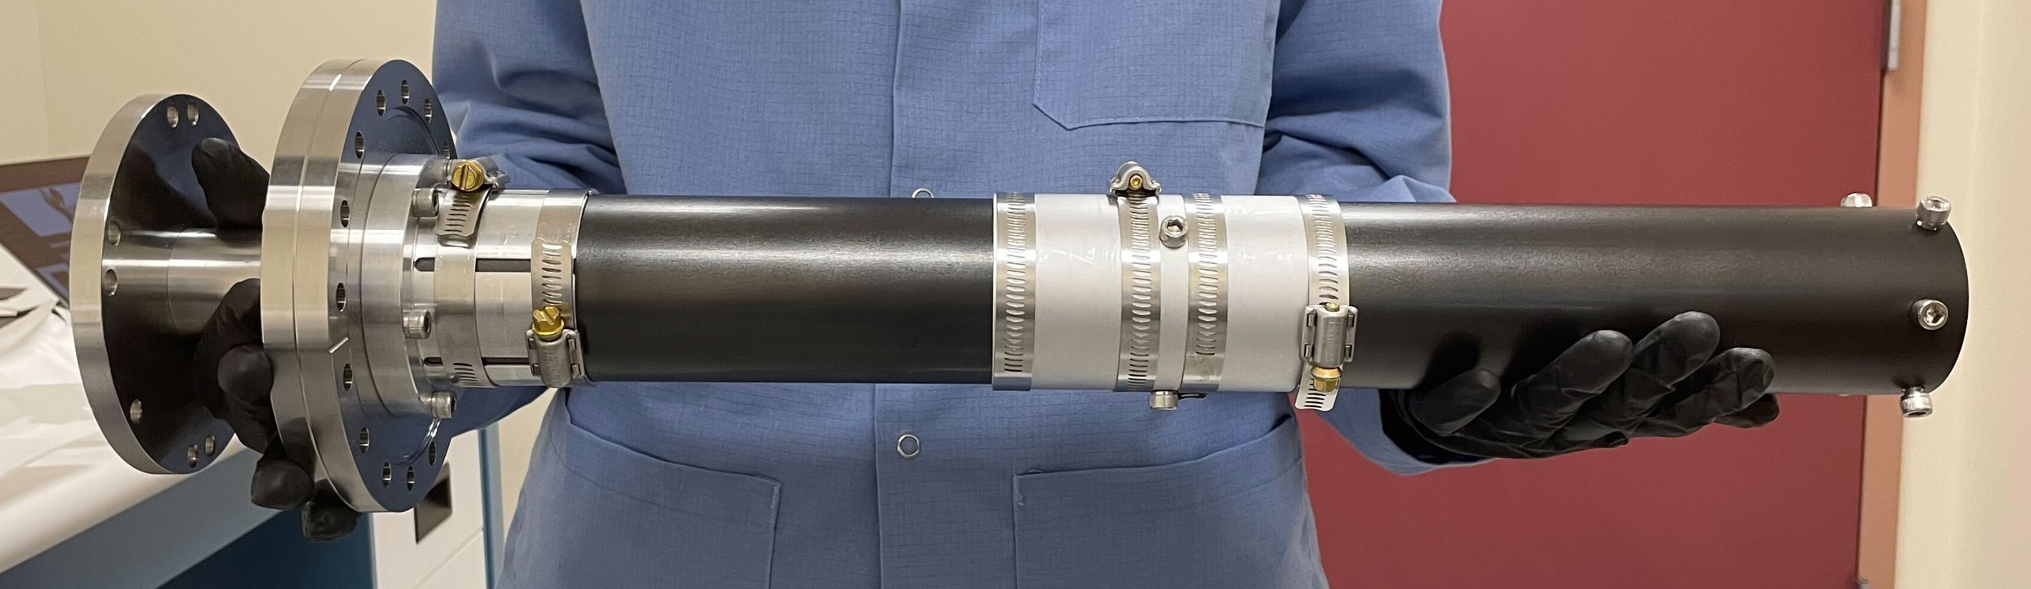
3UCubed: Calibration of Ultraviolet Photomultiplier Tube
Kelly Bisson
INTRODUCTION
REQUIREMENTS
THE UV-PMT
The 3UCubed project is a 3U CubeSat being developed by the University of New Hampshire, Sonoma State University, and Howard University as a part of NASA IMAP student collaboration. This project consists of a multidisciplinary team of undergraduate students from all three universities. The mission goal of 3UCubed is to understand how the Earth’s polar upper atmosphere (‘the thermosphere’ in the auroral and cusp regions) responds to particle precipitation and varying conditions associated with solar wind forcing and internal magnetospheric processes. The CubeSat includes two instruments with rocket heritage, an Ultraviolet photomultiplier tube (UV-PMT) to measure neutral atomic oxygen emissions and an Electron Retarding Potential Analyzer (ERPA) to measure energetic precipitating electrons. In order to successfully analyze the data collected by the UV-PMT once launched into the orbit, the sensor response must be calibrated to accurately measure oxygen emissions.
Calibration of the UV-PMT requires:
To be performed in a vacuum to test V(Vacuum)UV wavelengths
Design mechanical parts for vacuum
Allow for cross calibration
Allow for variability in flux
Have a known input
  Source containing known output spectrum
  Collimate light from source to instrument sensor
  Ultra black coat collimator to eliminate glaring and reflection
The UV-PMT measures spectral emissions of neutral atomic oxygen. The device collects photons on the photocathode and transforms them to electrons by photoelectric effect. These electrons are then cascaded through a series of dynodes that exponentially increase the number of electrons at successive dynodes.​ At the end of the dynode chain is an anode. The large number of electrons that reach the anode creates a sharp pulse of current.​ The current produced is directly related to the photoelectron ​flux [Ref 1]. The ​device is filtered ​to seek UV ​emissions of ​Oxygen at 130.4 ​nm and 135.6 nm​.​
PC/104 Board
DESIGN
UV-PMT
ERPA
To achieve the calibration requirements, the following design was drafted in CAD, and simulated in raytracing software; once the simulation results were satisfactory, the parts were machined, coated, assembled, and are being installed in the vacuum chamber. Raytracing simulations aided in finalizing the design and analyzing the percent of light reaching the photomultiplier tube
Power Board
Signal Board
BACKGROUND
FUTURE WORK
Mission
The region of interest for 3UCubed is Earth's cusps, where the magnetic field lines dip toward the surface of the planet. This is where the UV-PMT will be observing Oxygen emissions.
Instrument
The first UV-PMT was flown on SCIFER-2 (2008) and an updated design was flown on RENU (2012) and RENU2 (2015). UV emissions of Oxygen at 130.4 nm and 135.6 nm were successfully measured.
Calibration
The RENU2 model UV-PMT was calibrated at UMass Lowell using a gas light source, a monochromator, an MCP detector and NIST calibrated photodiode inside a vacuum chamber.
UNH
Assembly of design will take place in vacuum chamber in Morse Hall
The first calibration is scheduled to take place in May
Initially the engineering model of the UV-PMT will be calibrated
Out of House
Following main round of testing, the photodiode will be swapped for a NIST calibrated photodiode
An additional calibration is planned to occur at the Naval Research Lab in Washington D.C.
The additional calibration will be conducted by students from Howard University
A monochromator will be used to signal out the specific wavelengths we are interested in, 130.4 nm and 135.5 nm.
IMPLEMENTATION
The baffle parts are black coated and assembled. The baffle is being installed in the vacuum chamber.
ACKNOWLEDGMENT
CHALLENGES
Special thanks to all who contributed to the 3UCubed mission including the 3UCubed team, Marc Lessard, Noé Lugaz, Sanjeev Mehta, Bruce Fritz, Mark Widholm, Laura Peticolas, and Phil Demaine.
Cost restrictions
Time restrictions
  NIST calibration for photodiode
  Black coating
    Finding reasonable lead times
    Lead times kept being delayed
REFERENCES
Fine Structure in the Ionosphere, Bruce Fritz 2018

