Slide 1
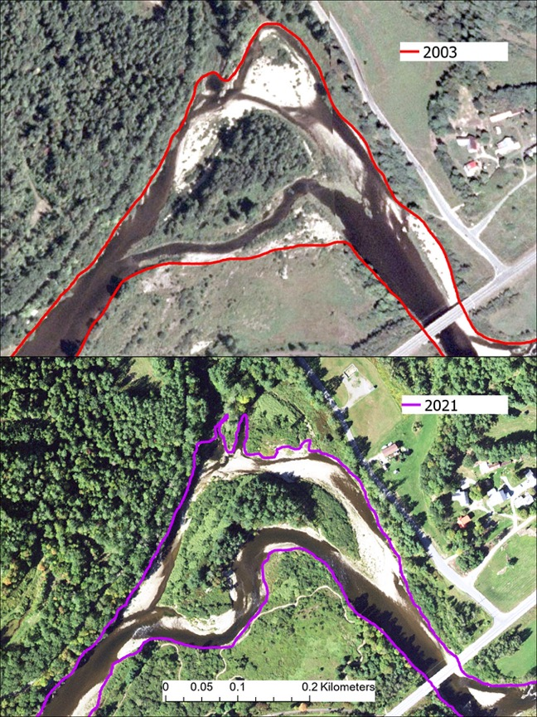
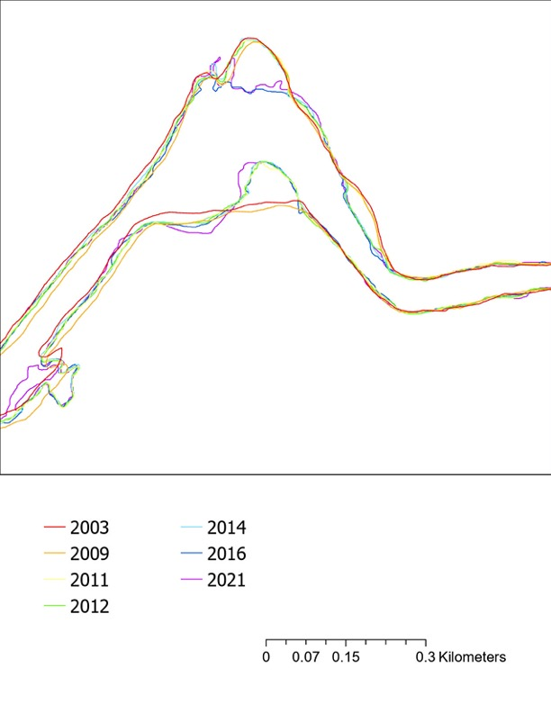
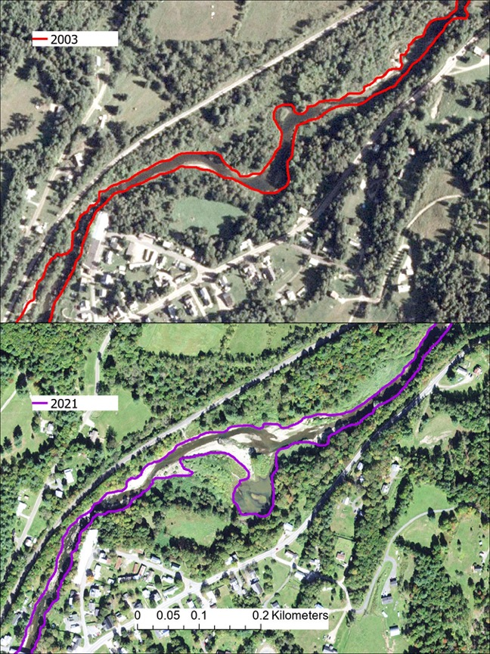
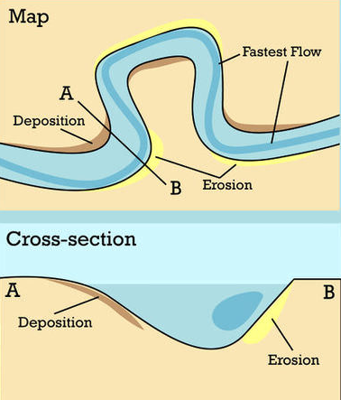
Analyzing the Rate of Historical River Change in New England
Samantha Beck, Trevor Fenoff and Anne Lightbody
Department of Earth Sciences, University of New Hampshire
background
River Delineations
River channels change over time by erosion and deposition, which can damage infrastructure along the bank. This study analyzed riverbank change in New England to determine whether rivers change continuously at the same rate or episodically in response to large flood events.
Methods
Bankfull Width
Low-Flow Width
Ammonoosuc River
The position of riverbanks was delineated using ArcGIS Pro at a scale of 1:2500 on USDA NAIP orthorectified and georeferenced aerial images for years from 2003 to 2021. Each delineation was then compared to the next using a program that calculates the summed erosion and deposition for each segment of the river.
Dog River
Figure 1: Erosion often occurs on the outside of bends, while deposition usually occurs on the inside of bends. During floods, river levels rise to the banks, located at the edge of vegetation. Figure modified from CK-12.org.
Figure 3: Bankfull delineations of the Dog and Ammonoosuc Rivers for seven image dates.
Study area
Results
conclusions
Rivers in Northern New England migrate at an average rate of 3 meters per year.
Change is greater during large flood events such as Hurricane Irene, which occurred in 2011.
Delineating rivers from aerial imagery is more robust in larger channels and where the bank vegetation is herbaceous. Accurate assessment of river change using aerial images requires georeferencing.
River managers could use historical migration rates to characterize fluvial erosion hazards, which could be exacerbated by climate and land use change.
Ammonoosuc River
Figure 2: The location of the Dog River watershed (93 mi²) in Washington County, VT, and the Ammonoosuc River watershed (402 mi²) in Grafton County, NH, overlain by delineated portions of the Dog (width 20 m, length 23 km) and the Ammonoosuc (width 50 m, length 40 km). Watershed outline from USGS Streamstats.
Dog River
Figure 4: (A) Average annual channel change for study rivers between image dates (dashed grey lines). (B) Peak annual streamflow for study rivers.

