Slide 1

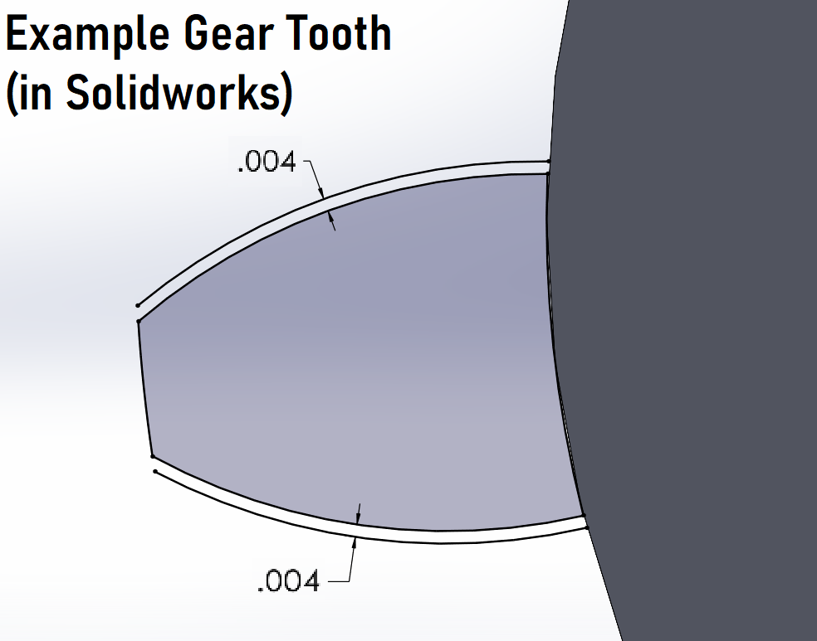
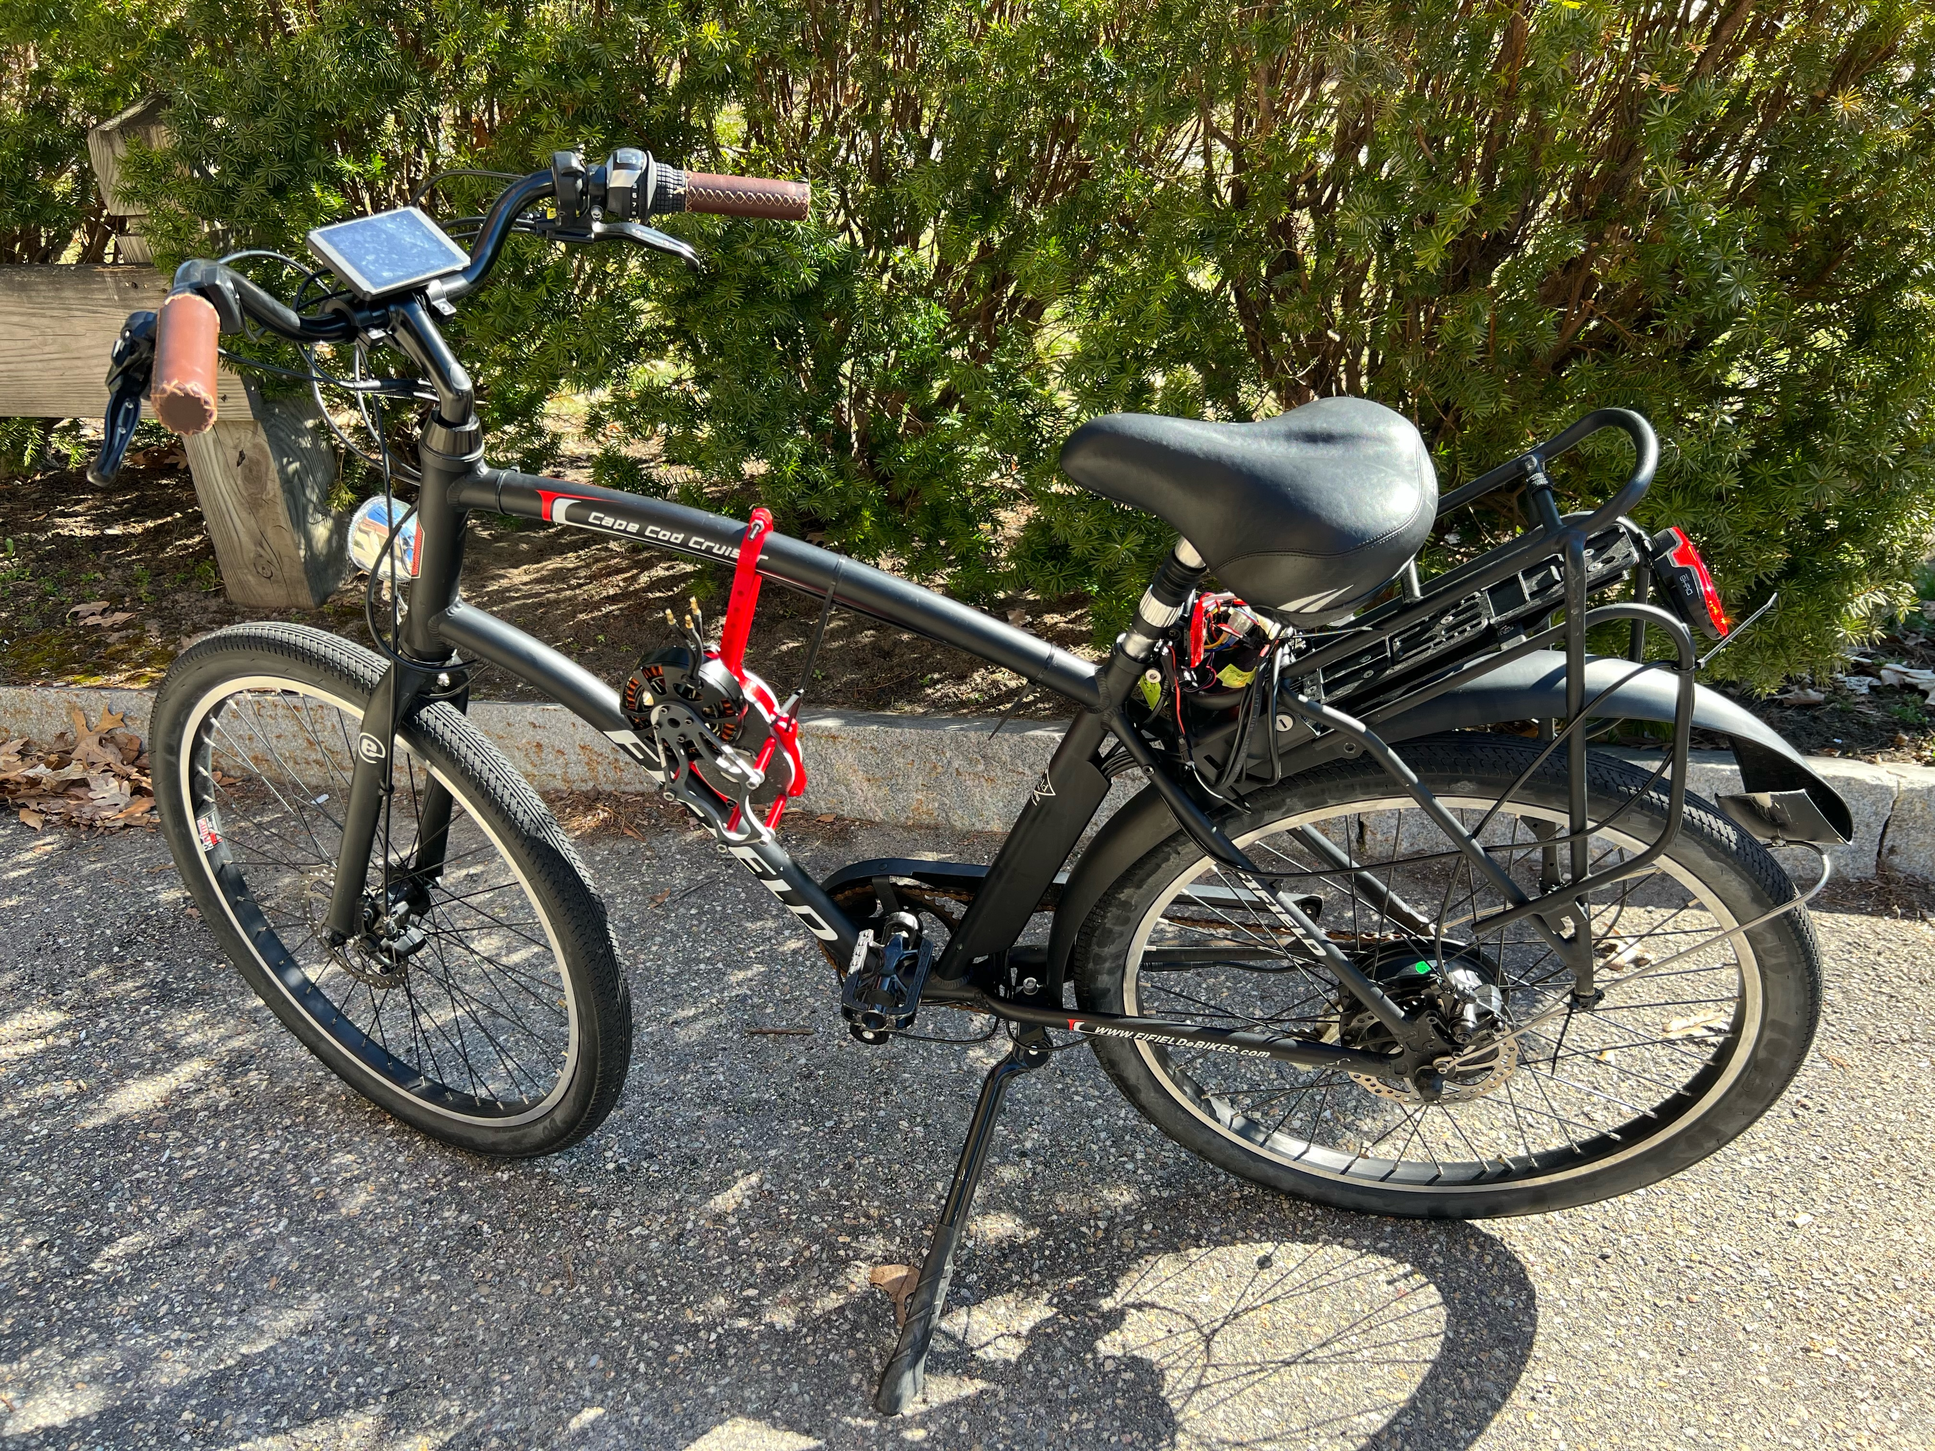
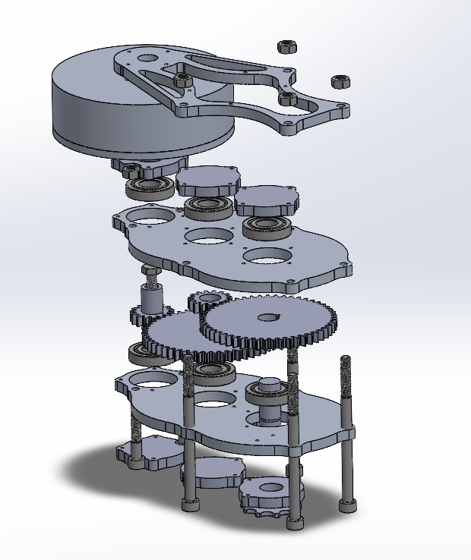
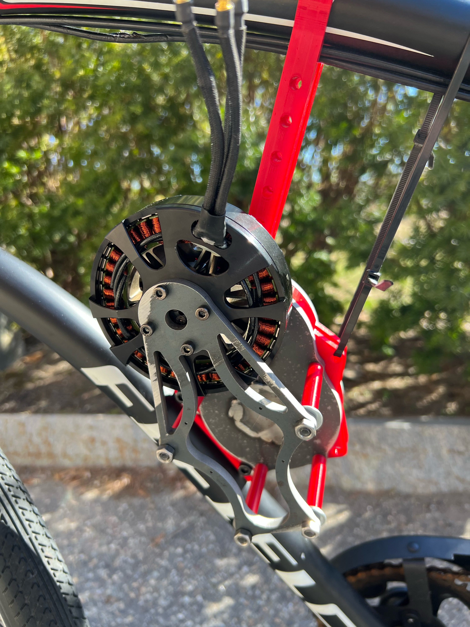
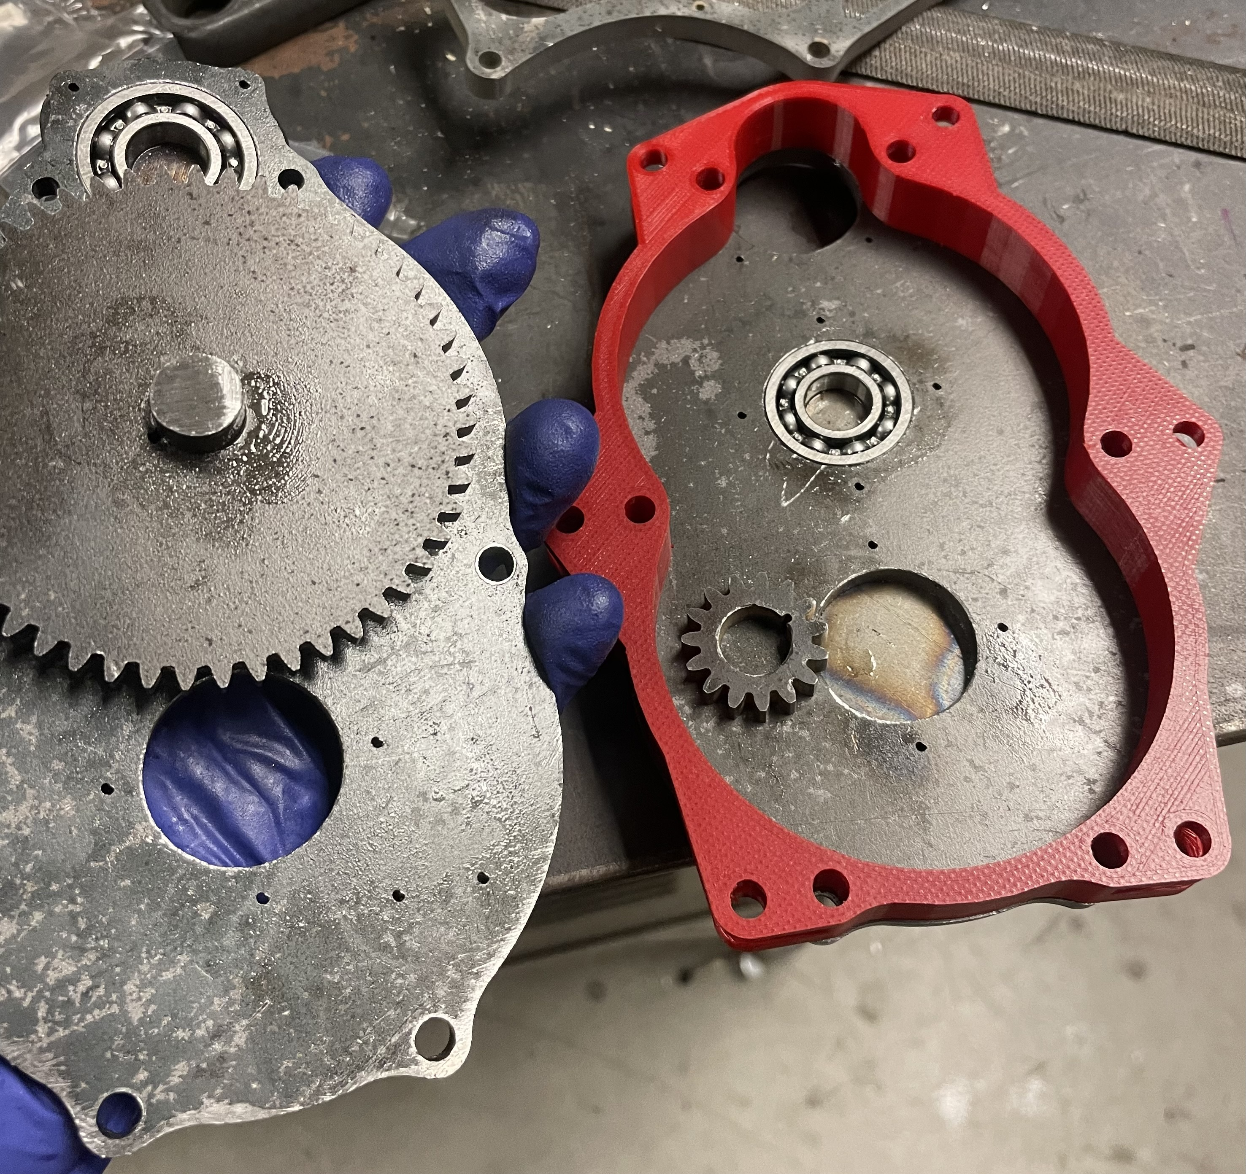
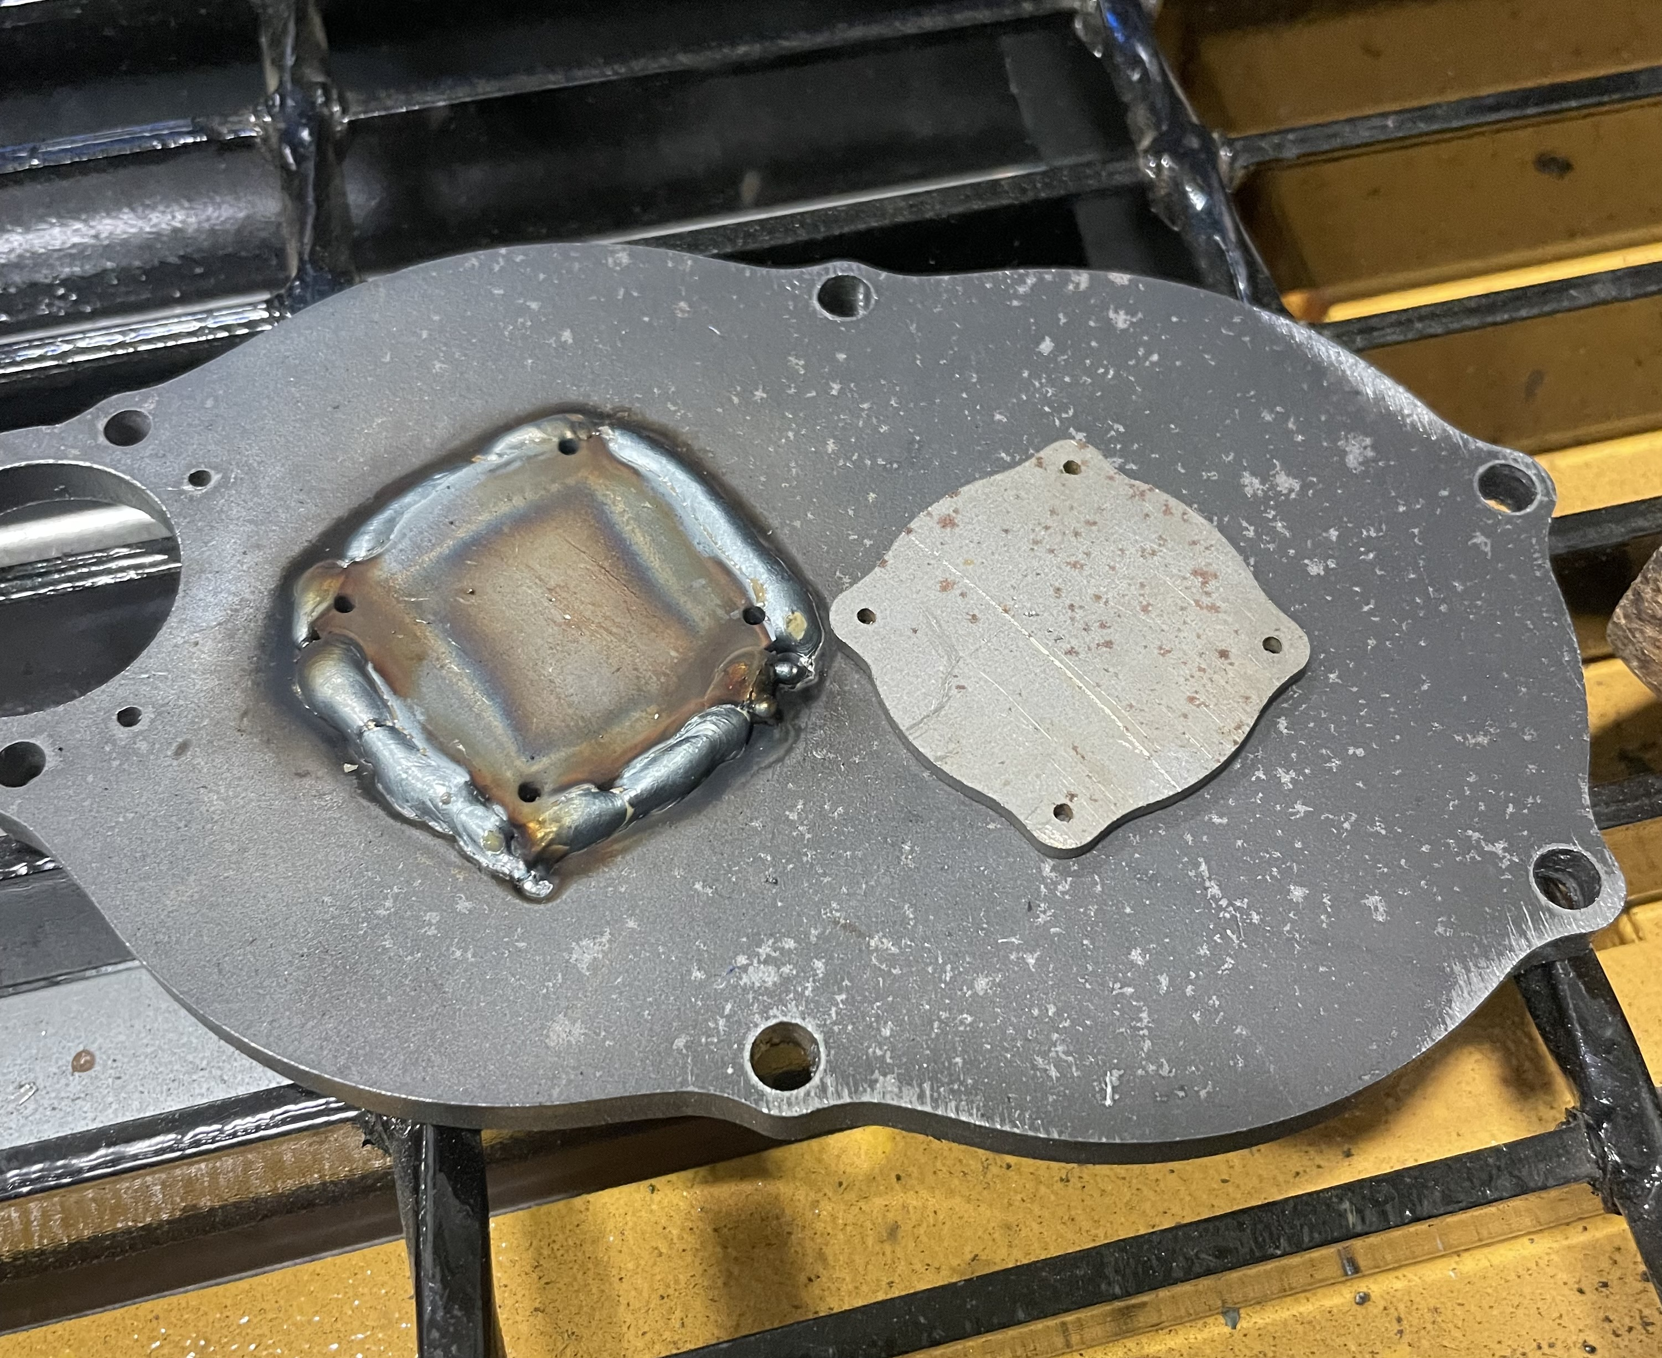
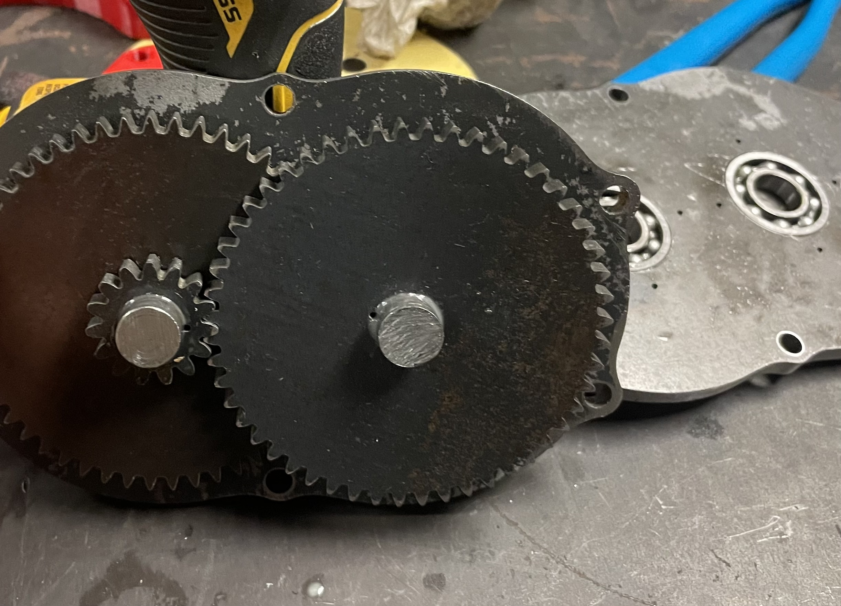
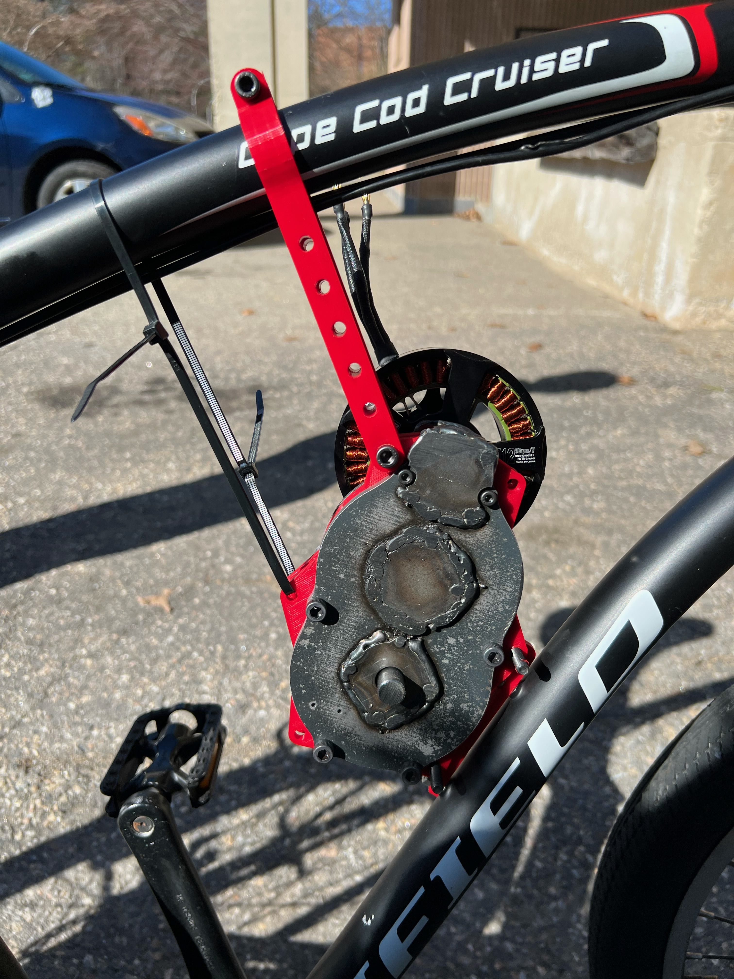
Modular E-Bike Powertrain
Our Research in Electric Drivetrains
Matt McCoy, Sam Harms, Joe Aubut
Department of Mechanical Engineering, University of New Hampshire
Introduction
Methods & Manufacturing
Results & Discussion
The three of us took the innovation scholars "advanced manufacturing" class this year, and for our final research project decided to make a self-contained electric bike drive unit. We chose the existing water bottle holder location as our mounting point, and our drive output sprocket connects right into the standard gears on the bike. This design minimizes modifications needed to the bike while providing adequate power and ideal gear ratios to assist the rider at various speeds.
One of our first design considerations was how to achieve the gear down. We decided on "straight cut" spur gears, which are noisier and weaker than typical transmission helical gears, but far easier to produce, as they contain only 2D geometry. A primary design criteria of ours was ease of manufacture, and this design enabled us to
Overall, many of our design decisions, including the improvisations, worked out well. After completing our construction, we serviced the bike's brakes, and tried it out. Compared to other E-bikes, we noticed a significant improvement in throttle response, due to the simple electronics, and power from the large motor. From our testing it seems the ability to use multiple gear ratios is extremely helpful. This provides much finer control of electric assist at low speeds, and more torque at higher speeds, however the pedal connection was cumbersome to use.
A significant part of the research aspect of this project was in the manufacturing. As freshman engineering
students, none of us had a particularly large
amount of manufacturing experience, and as
a result wanted to investigate the challenge
of producing a product like this from the
ground-up as best we could.
Due to the amount of time and resources
we had available; our production ended up
being more fabrication heavy than expected.
The waterjet introduced imprecision, so we
needed to redrill every bolt hole, as well as
machine the bearing holes out by hand.
Accomplishing this task manually introduced
room for error, and we all learned a substantial amount about tolerances and fits. One bearing slot was too tight, the and others too loose. We needed to modify shafts to prevent gear slip. Welding sped up some parts of the process, but also introduced heat deformation which was not something we were prepared for.
Our product is functional; however, it could use some quality-of-life improvements given more time to conduct testing and modify designs. We would ideally improve the chain connection system and use better machining for the gear-shaft interface to reduce vibrations. Overall, though, we were impressed with the results and hope to improve it in the near future. The use of selectable gearing especially is something that introduces a new experience to electric bikes that we haven't seen much of and would like to explore further.
Parts/Materials Selection
We got the bike for this project
free from someone local to us. It's a bit
unstable at speed but had the right
amount of space to experiment with
design.
We chose a compact 50-volt
brushless motor, driven by a standard
electronic speed controller. Coming
in at 2500 watts, it’s a bit over-spec,
which should lead to a long service life, good performance, and less wear on components.
Continuing down to the transmission, we used quarter inch steel where strength was required, and 3d-printed parts with high infill for the rest.
Finally, for the output, we used an existing sprocket from another project, modified to suit our needs, and a lengthened chain to accommodate the electric assist.
quickly produce parts using the waterjet, rather than by machining. We added a 0.004-inch tolerance on the gear teeth to account for any imprecision and prevent binding. Our CAD files are also equation-driven, allowing for quick and easy modifications to dial in the gear size.
We initially intended to machine the two case halves from aluminum stock, but later re-evaluated and switched to a 3-piece design, utilizing 2 steel "end plates" with a polymer spacer between them (spacer not shown in exploded view). These end plates contain the shaft
bearings, as well as containing the
shafts and bearings within the
assembly horizontally through welded
on "end caps." Large shafts, press fit
gears, and ball bearings ensure
Transmission design
One of the most essential parts of an electric drivetrain is the main gear reduction. Most electric motors, ours included, operate across a wide RPM range, the upper end of which requiring a gear down to be usable at the speeds of a bike or car.
stability and durability within the transmission. Large case bolts and stiff spacers keep the motor secure
To provide input to the speed controller, we used a
Auto makers such as Tesla typically use between a 7:1 and 11:1 gear down, for our application we ended up with 11.56:1 from double stacked 3.4:1 gear sets. In combination with the existing gears on the bike, this ensures we can operate the motor at efficient speeds and maintain responsiveness.
servo tester with a 3D printed control lever, acting as a throttle. This gives sufficiently accurate control and easily mounts to the handlebars of the bike. Powering the motor are two 6 cell lithium-polymer drone batteries, with a capacity of 6,000mAh each. We connected them in series to gain more efficiency at the higher voltage of 50.4 volts.

