Slide 1


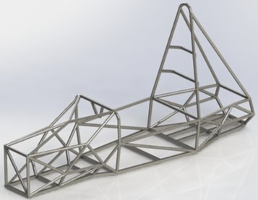
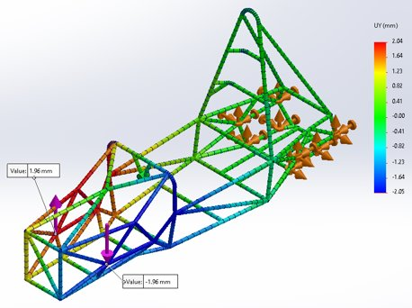

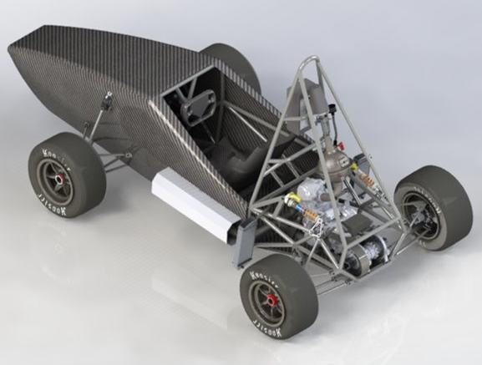
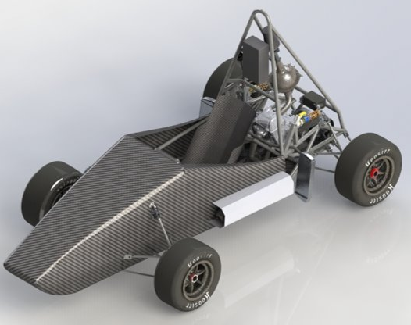
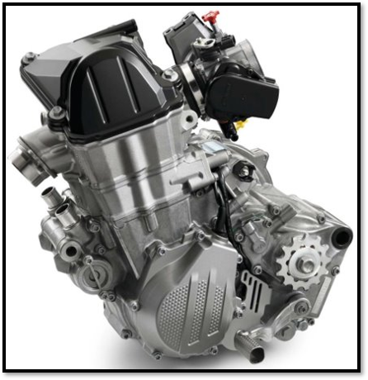
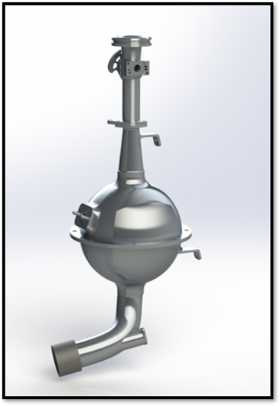
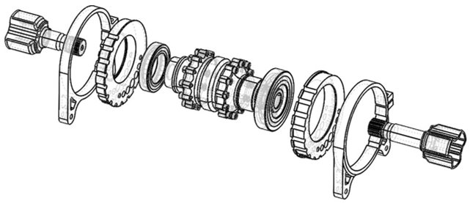
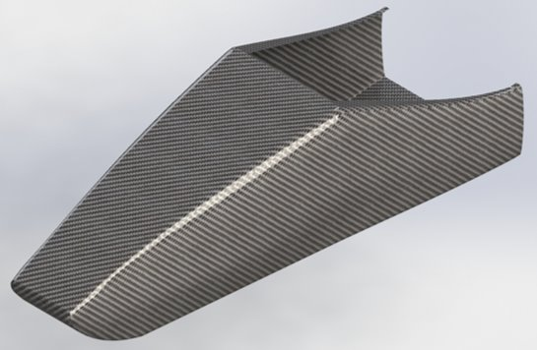
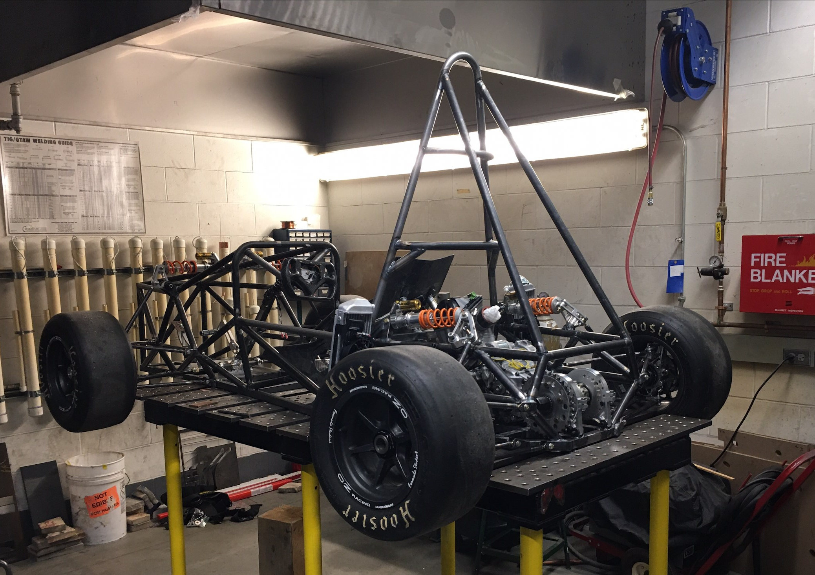
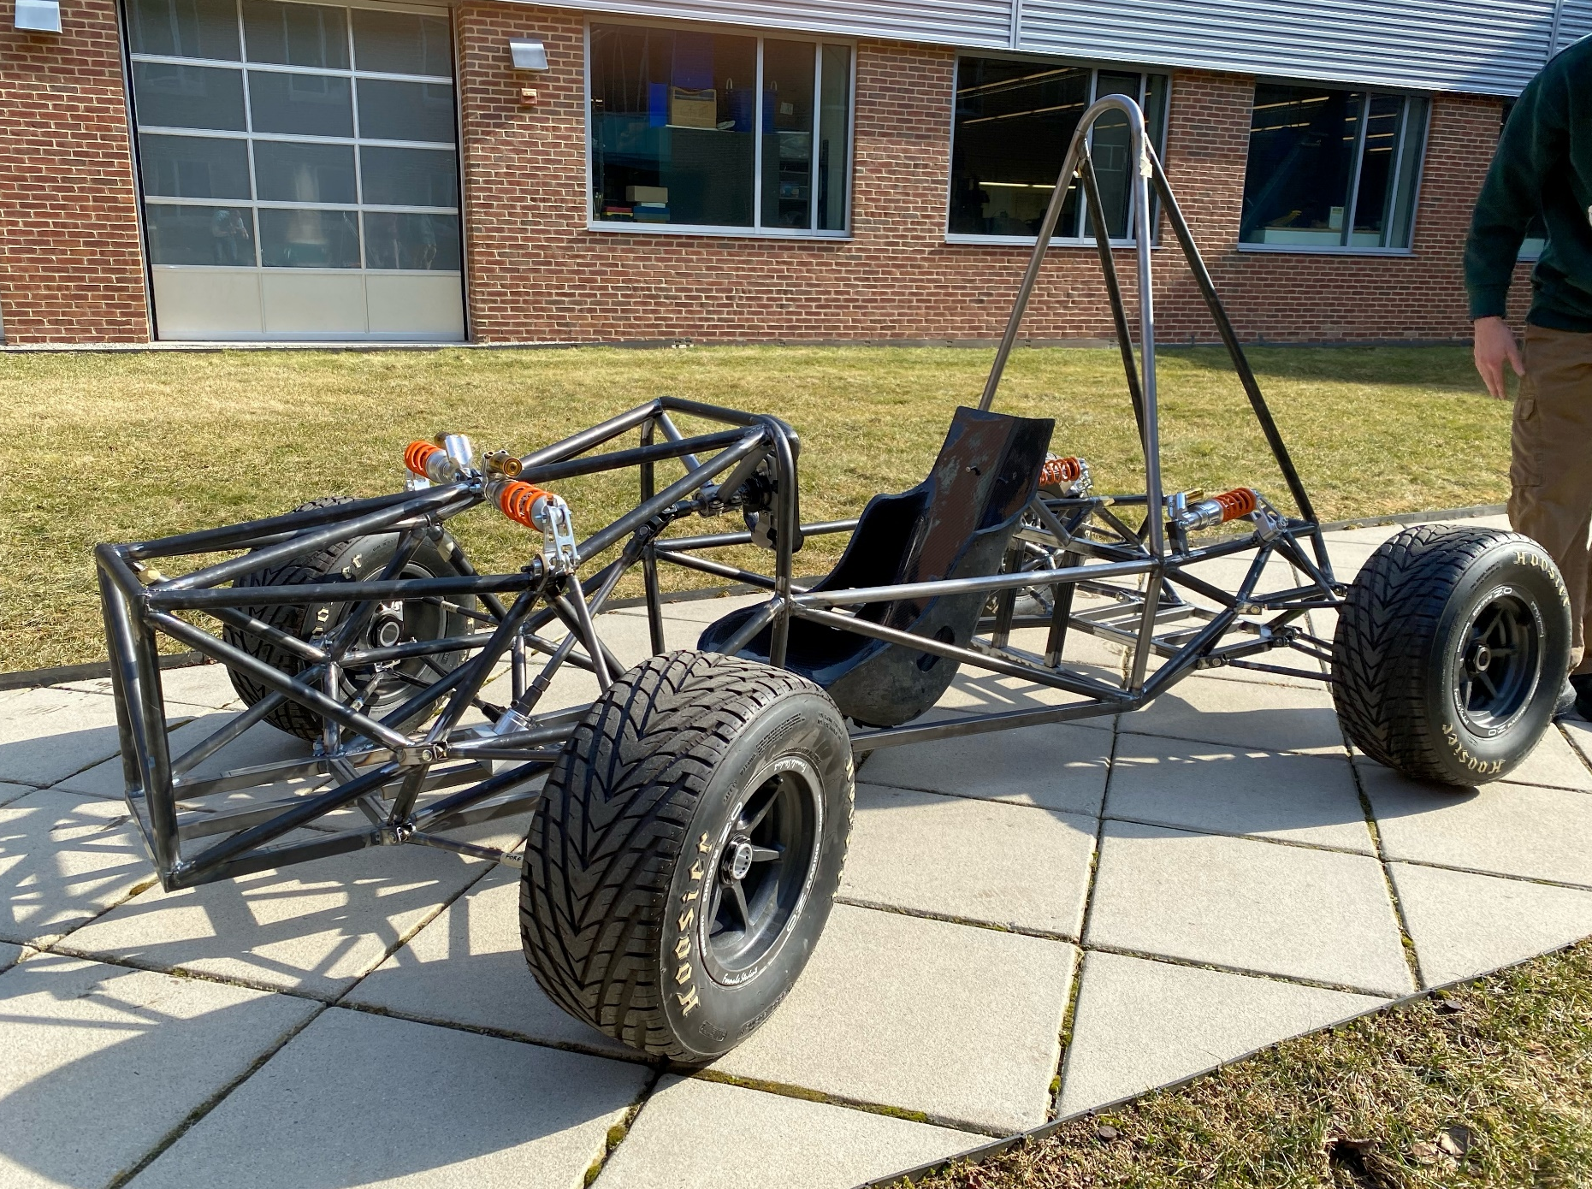
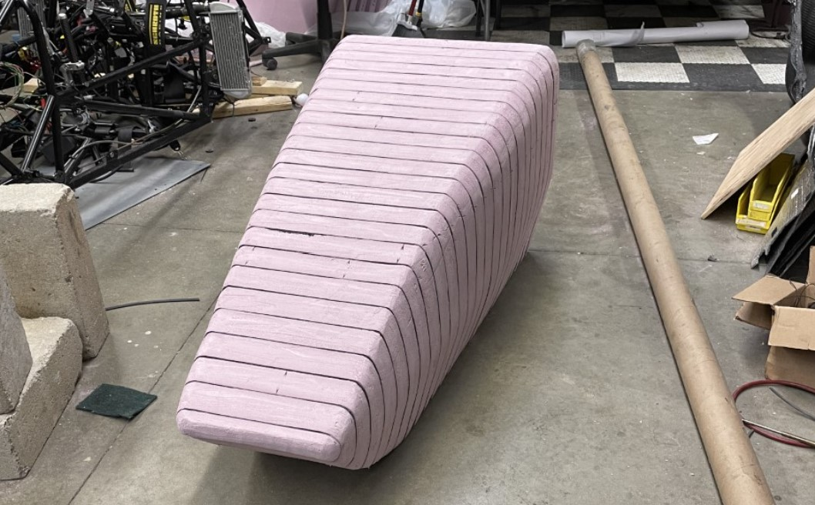
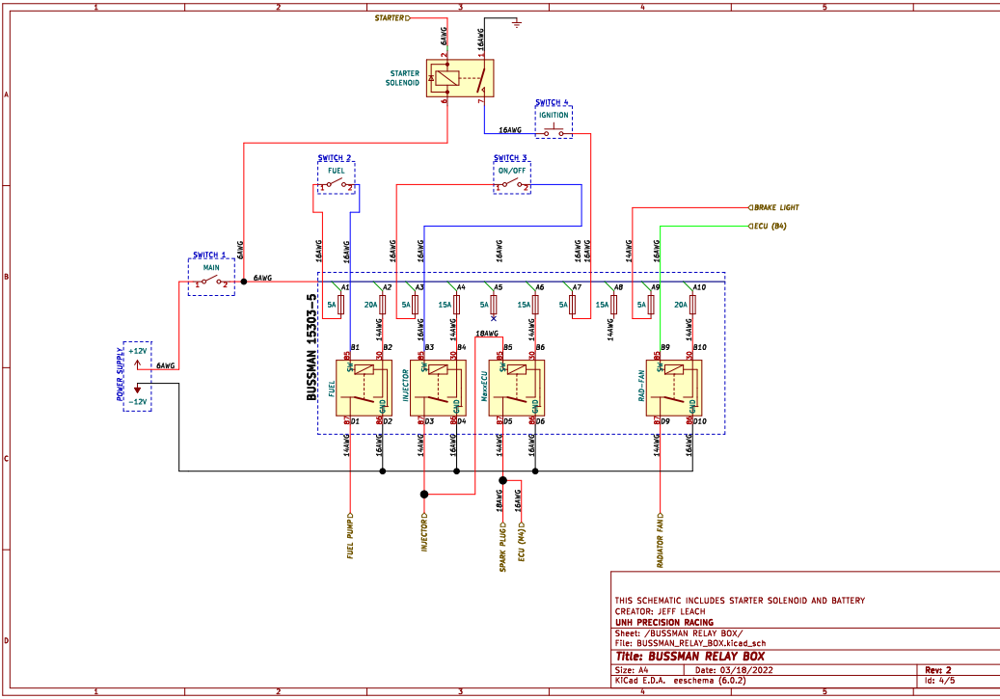
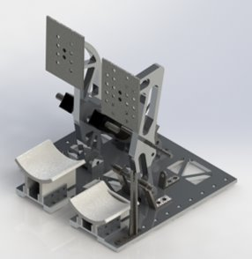
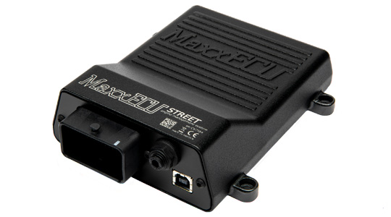
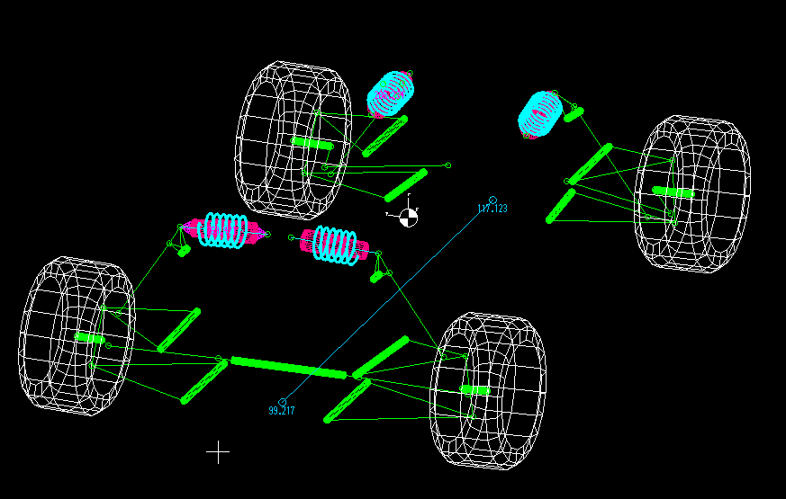
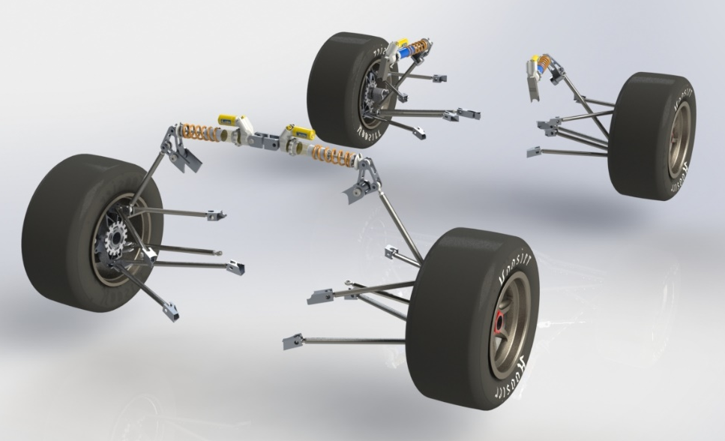
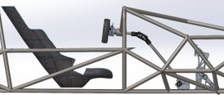
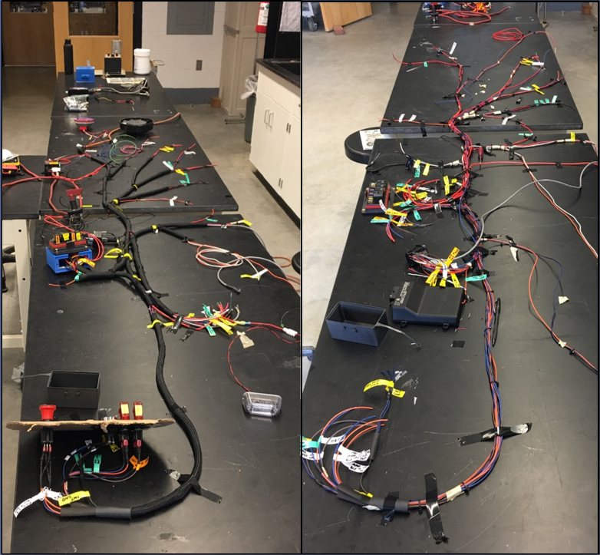
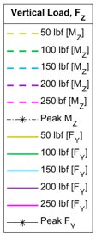
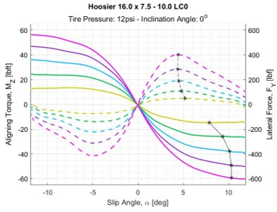
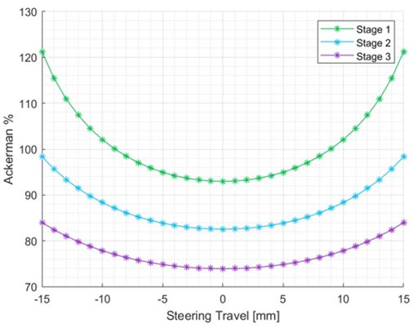
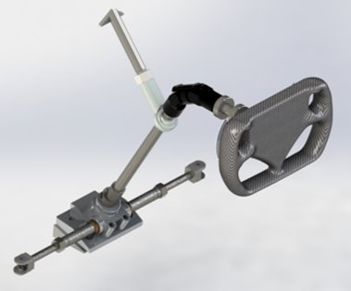
UNH Precision Racing Team 2022-2023
Powertrain
College of Engineering and Physical Sciences
Mechanical Engineering Department
Frame
Engine
  2016 KTM 450 SX-F
  Max Torque : 34lb-ft @ 7000 RPM
  Max Power: 53 HP @ 9500 RPM
  Naturally aspirated, 100 Octane
  High torque at low RPM's and linear power curve makes driving easier for inexperienced drivers
Drivetrain
  Chain Drive
  Drexler Limited Slip Differential
  RCV Half-Shafts
  Aluminum differential designed to allow tightening of the chain using an eccentric disk concept, various locking points.
Intake Manifold
  3000 cc plenum
  Utilize AT Power's FSAE throttle body with built in restriction diameter
  Made from 3D printed titanium.
  Runner length of 264 mm with a single 42 lb./hr. injector firing directly at the intake valves.
Team Members
Project Managers: Kiana Sherman, Jordan Oligny
Controls: Sam Tower, Robert Scammon, Nick Gould, Connor Floyd
Frame: Kiana Sherman, Luke Waterman
Electronics: Kiana Sherman, Maxwell Szczapa
Powertrain: Maxwell Szczapa, Dan Dos Santos
Suspension: Jordan Oligny
Bodywork: Emmett O'Brien, Sean Leahy
Faculty Advisor: Todd Gross
Design Goals
  Torsional stiffness greater than 1750 [Nm/deg]
  Maintain weight less than 100 lbs
  Effectively maximize space for the driver, powertrain, suspension, and controls
  Meet all structural qualifications outlined by the SAE structural equivalency survey
  Minimize deflection to increase driver safety
Manufactured design
  TIG welded AISI 1020 steel tube members
  Torsional stiffness equal to 1,853 [Nm/deg]
  Weight of manufactured frame equal to 90lbs
  Allows for optimal suspension attachment
  Fits a driver of the 95th percentile
  Adheres to SAE rules to ensure driver safety
Bodywork
Process breakdown
  Design bodywork/nosecone in SOLIDWORKS around chassis & suspension
  Create mold for bodywork panels and nose cone out of foam
  Carbon fiber wet layup with vacuum bagging
  Attach bodywork to chassis using quick release quarter-turn fasteners
Mold construction and materials
  XPS Insulation Foam
  Bondo Body Filler
  Hexcel Fiberglass Plain Weave 2.1oz/71gsm
Carbon fiber layup with vacuum bagging:
  Carbon Fiber Fabric - 4x4 twill 3k 8.3oz/281gsm Toray T300
  Thin- 2:1 two-part thin epoxy resin system
Suspension
Purpose
  Maximize tire contact patch with road
  Control axle load transfer and stiffness between front and rear axle
  Minimize roll center migration, increase stability/predictability
  Select coilover to achieve desired ride frequency and roll rate
  Adjustability: static camber, ride height, toe angle
Geometry Selection
  Double wishbone, Short-Long Arm (SLA), pushrod actuated
  Rear bell-crank repositioned out-of-plane to improve packaging
Component Modeling & FEA
  SolidWorks 3D modeling - FEA and kinematics in MATLAB & LOTUS Shark
  Calspan tire data used to predict dynamic forces
Manufacturing
  Waterjet in Olson Center, machining in CEPS machine shop, TIG welding
Electronics
Controls
Engine Management
  MaxxECU STREET standalone Engine control unit
  Single injection for better trigger sensing and atomization
  Variable Reluctance crankshaft position sensor
  Ignition cut for launch control and shifting
Wiring Harness
  Schematics created in KiCad
  Breaker protected circuits for easy reset and short protection
  Bussman relay/fuse box for improved organization and trouble shooting
  Deutsch connectors for IP67 protection and high cycle life
  Crimped wire connections for greater strength than solder
Pedal Assembly
  6061-T6 Aluminum components withstand 2000N (450 lb-f) force from the driver.
  Vertically mounted master cylinders optimize packaging, braking force, and pedal travel.
Safety Considerations
  6-point harness holds driver securely in place.
  No part of the driver can contact the ground.
  Impact attenuator on the front of the car absorbs impact forces.
Steering Column
  Utilizes double universal joint designed for automotive steering shafts
  Rack mounted behind the front axle to improve Ackermann Steering.
Cooling
  Dual radiators on sides of car increase cooling.
Brakes
  Racing quality rotors, calipers, lines, and pads increase braking capabilities.

