Slide 1
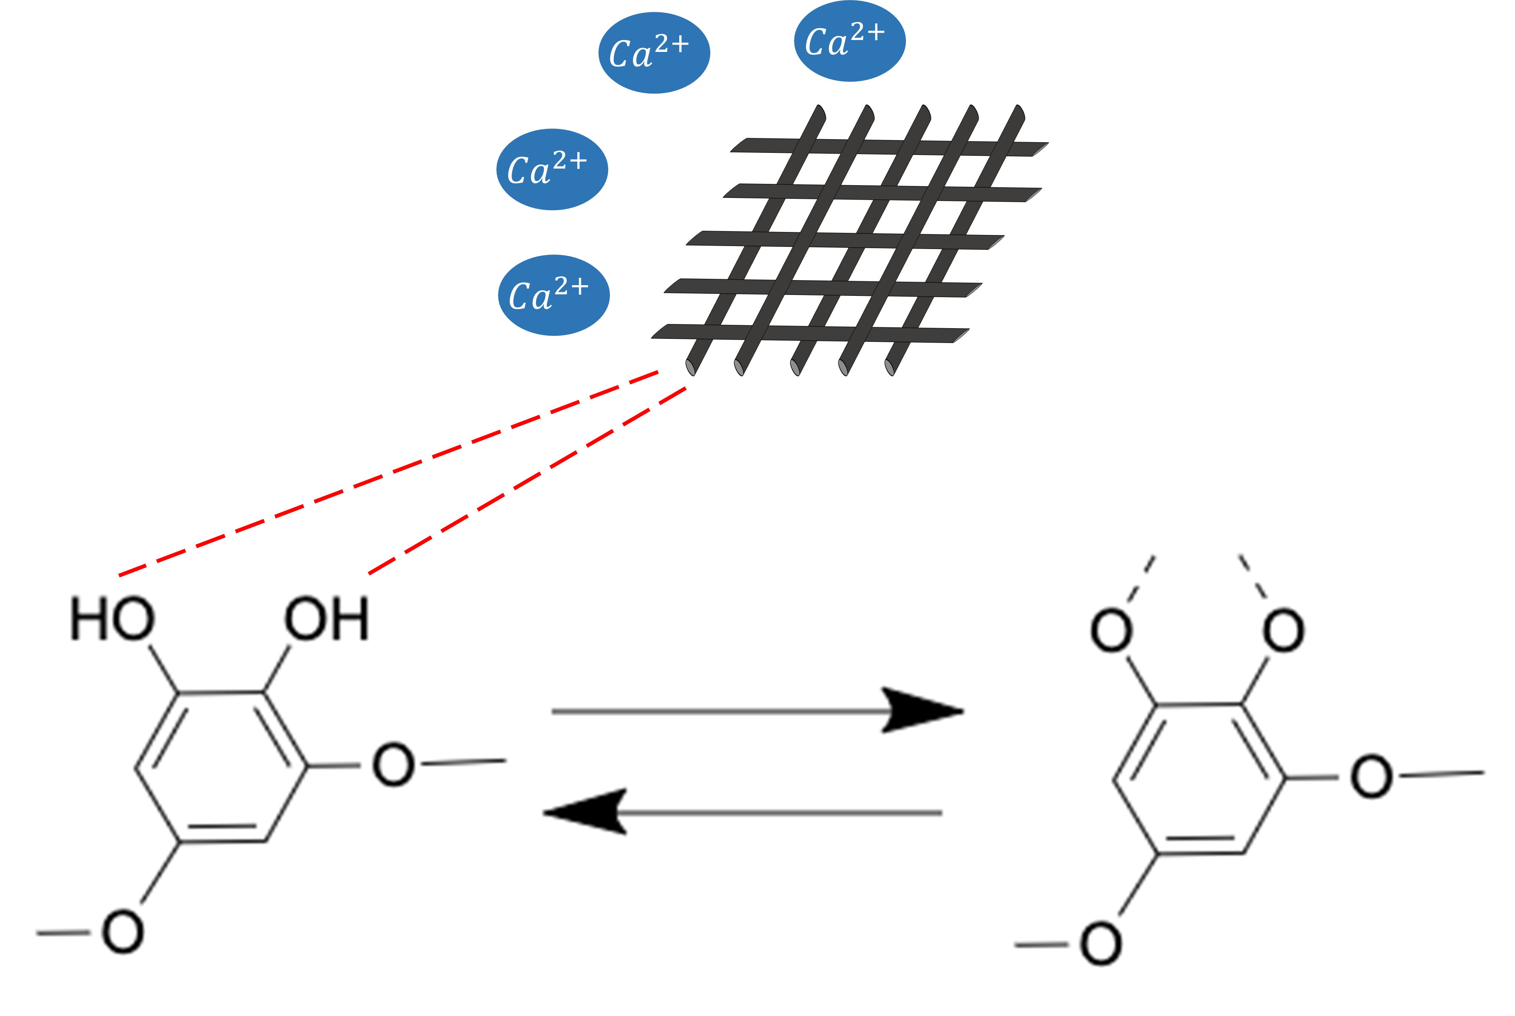
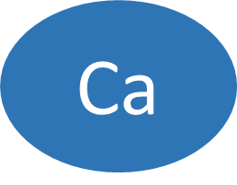
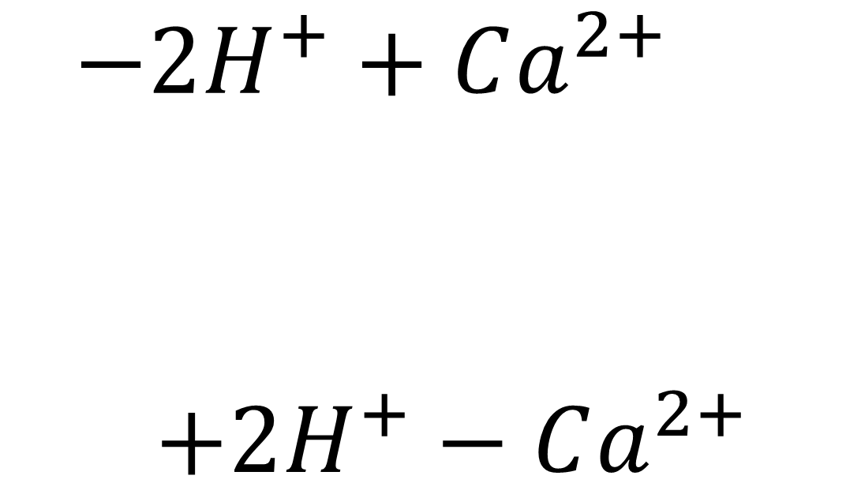
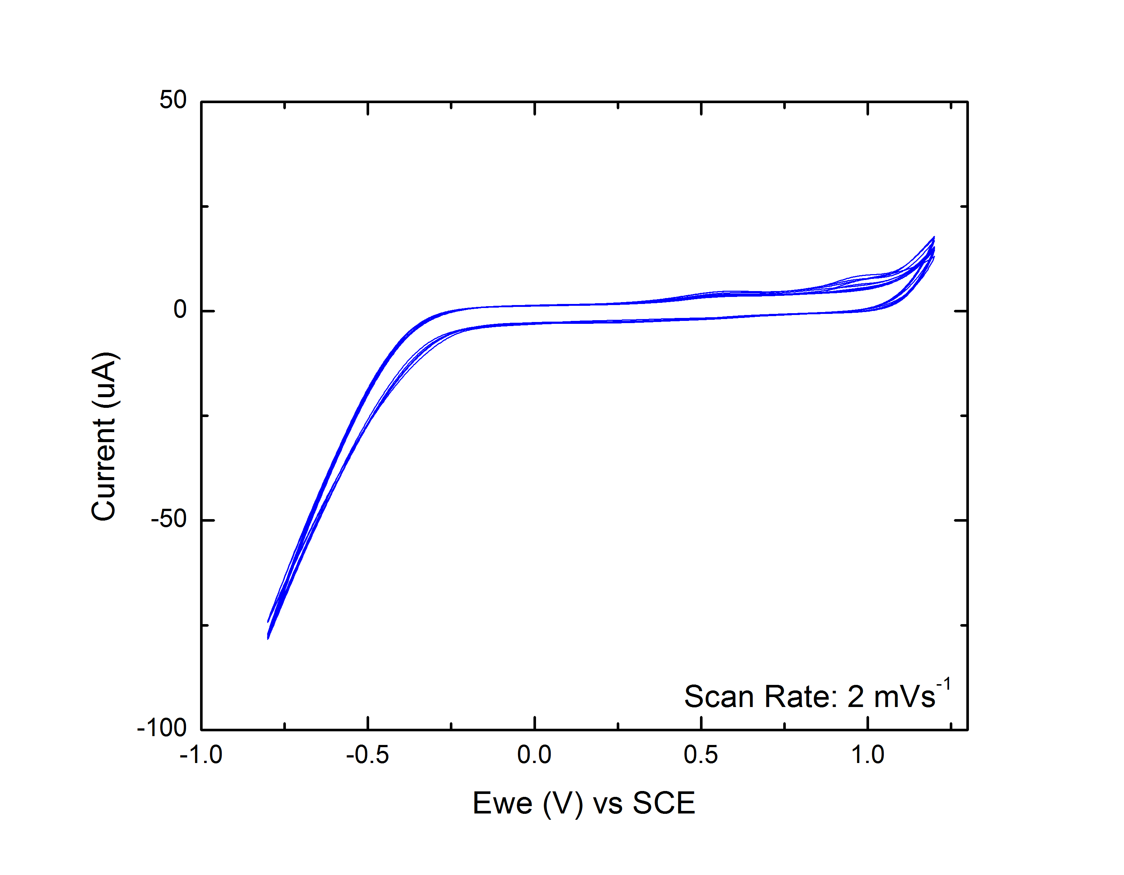
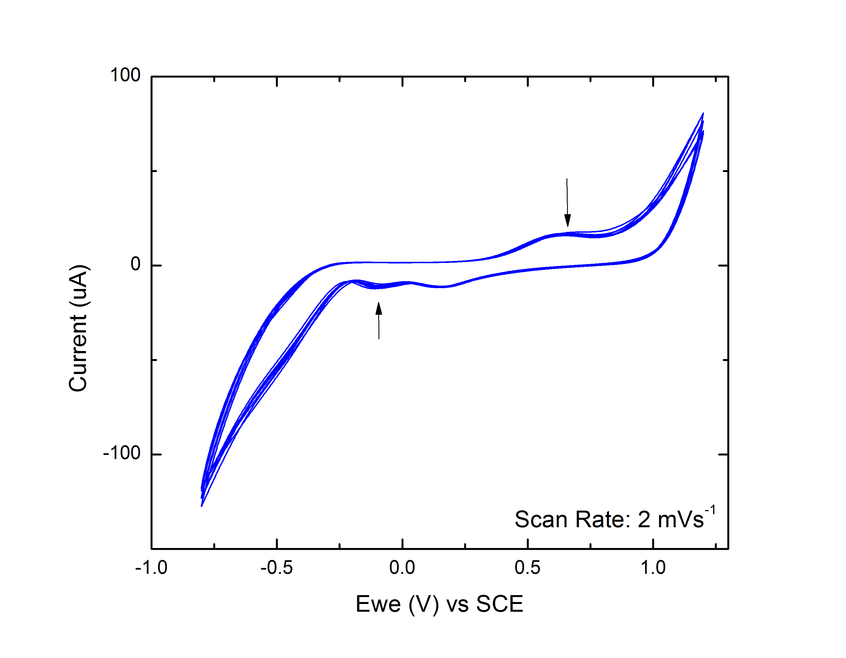
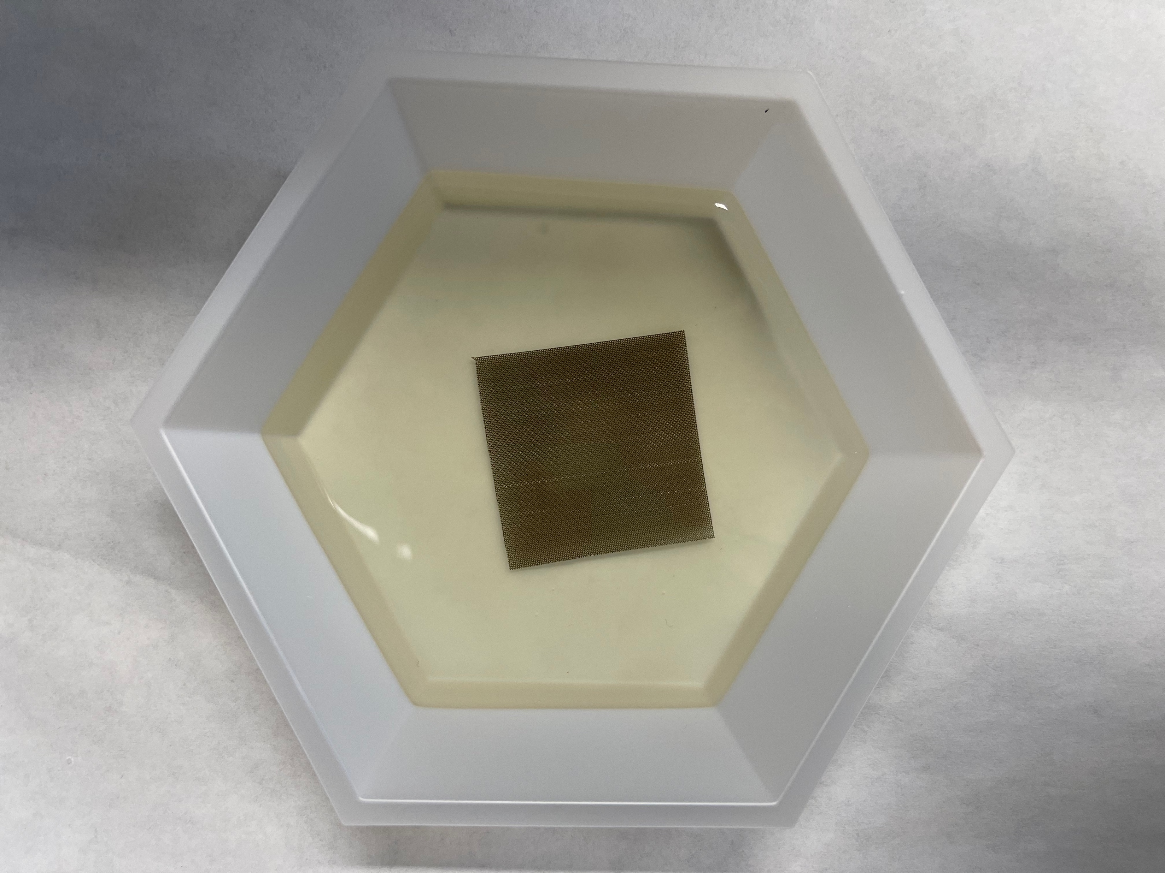
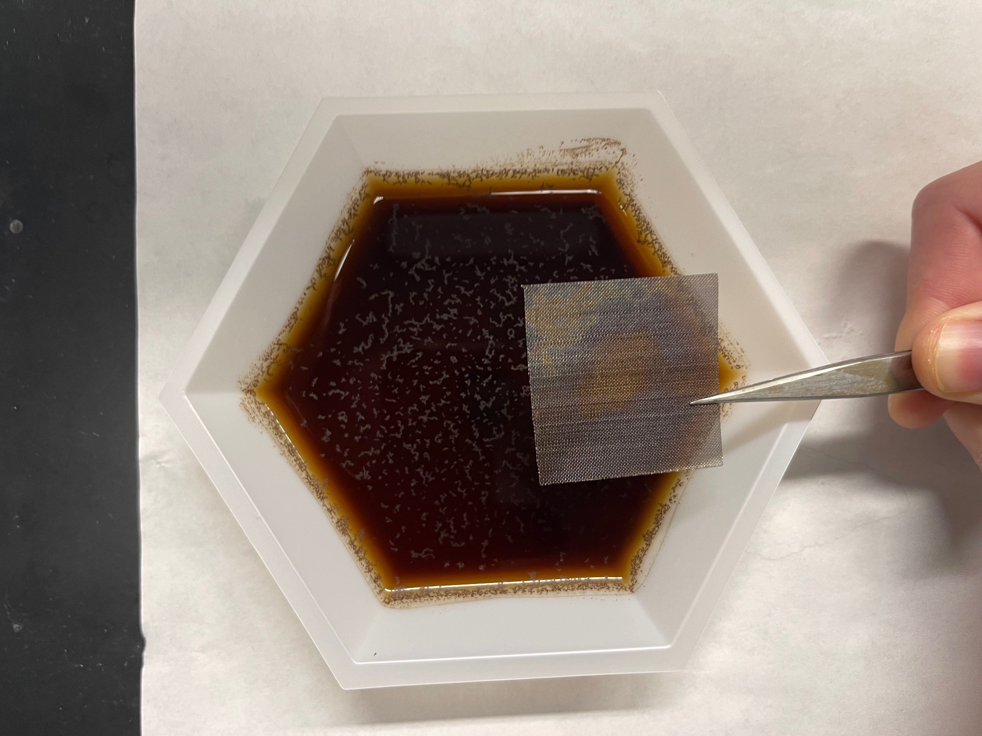
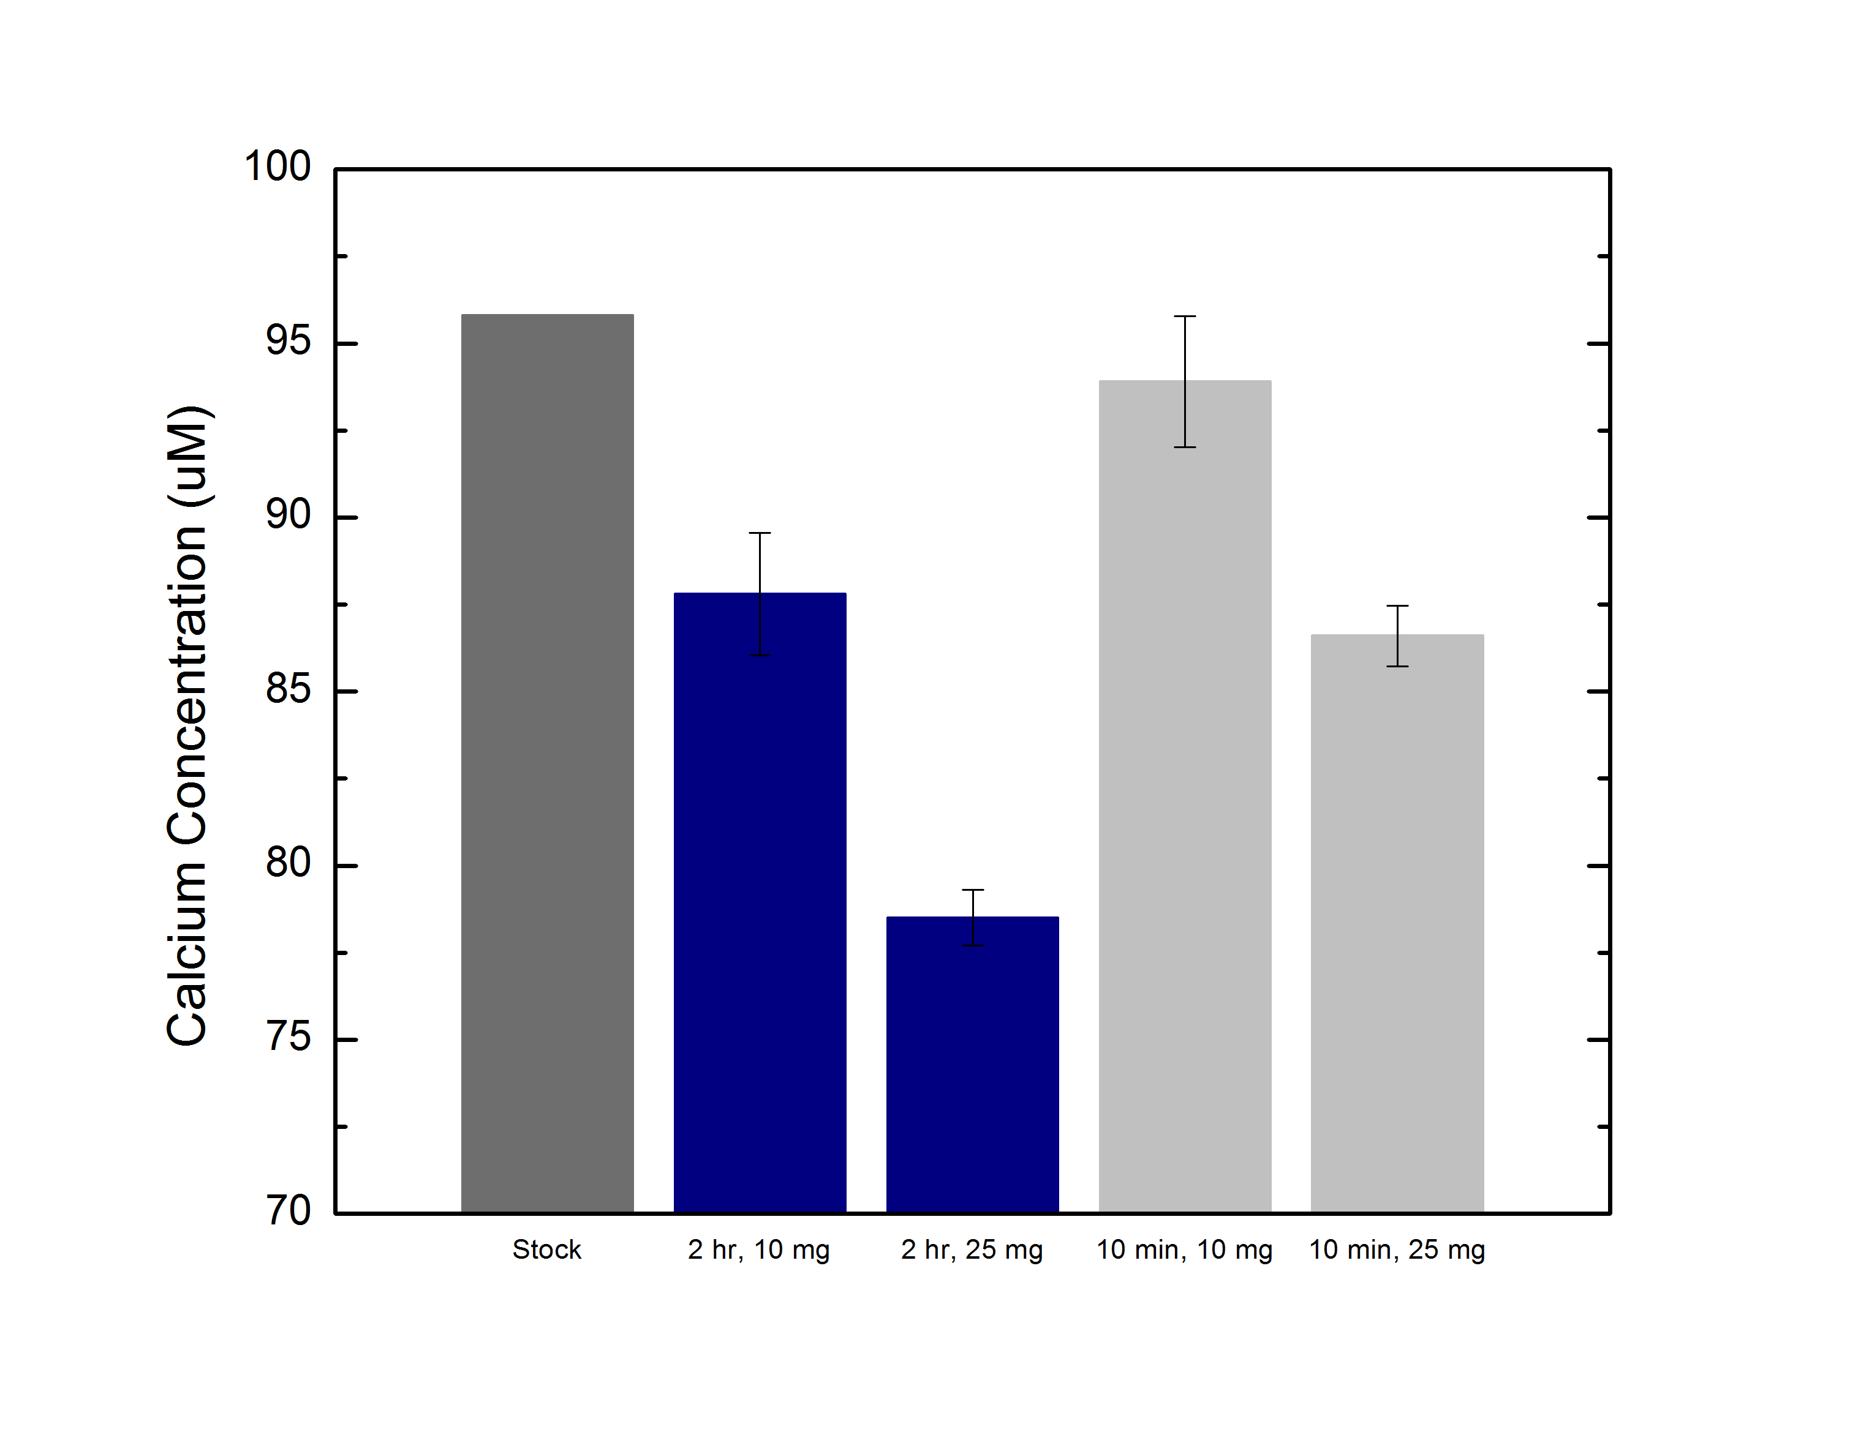
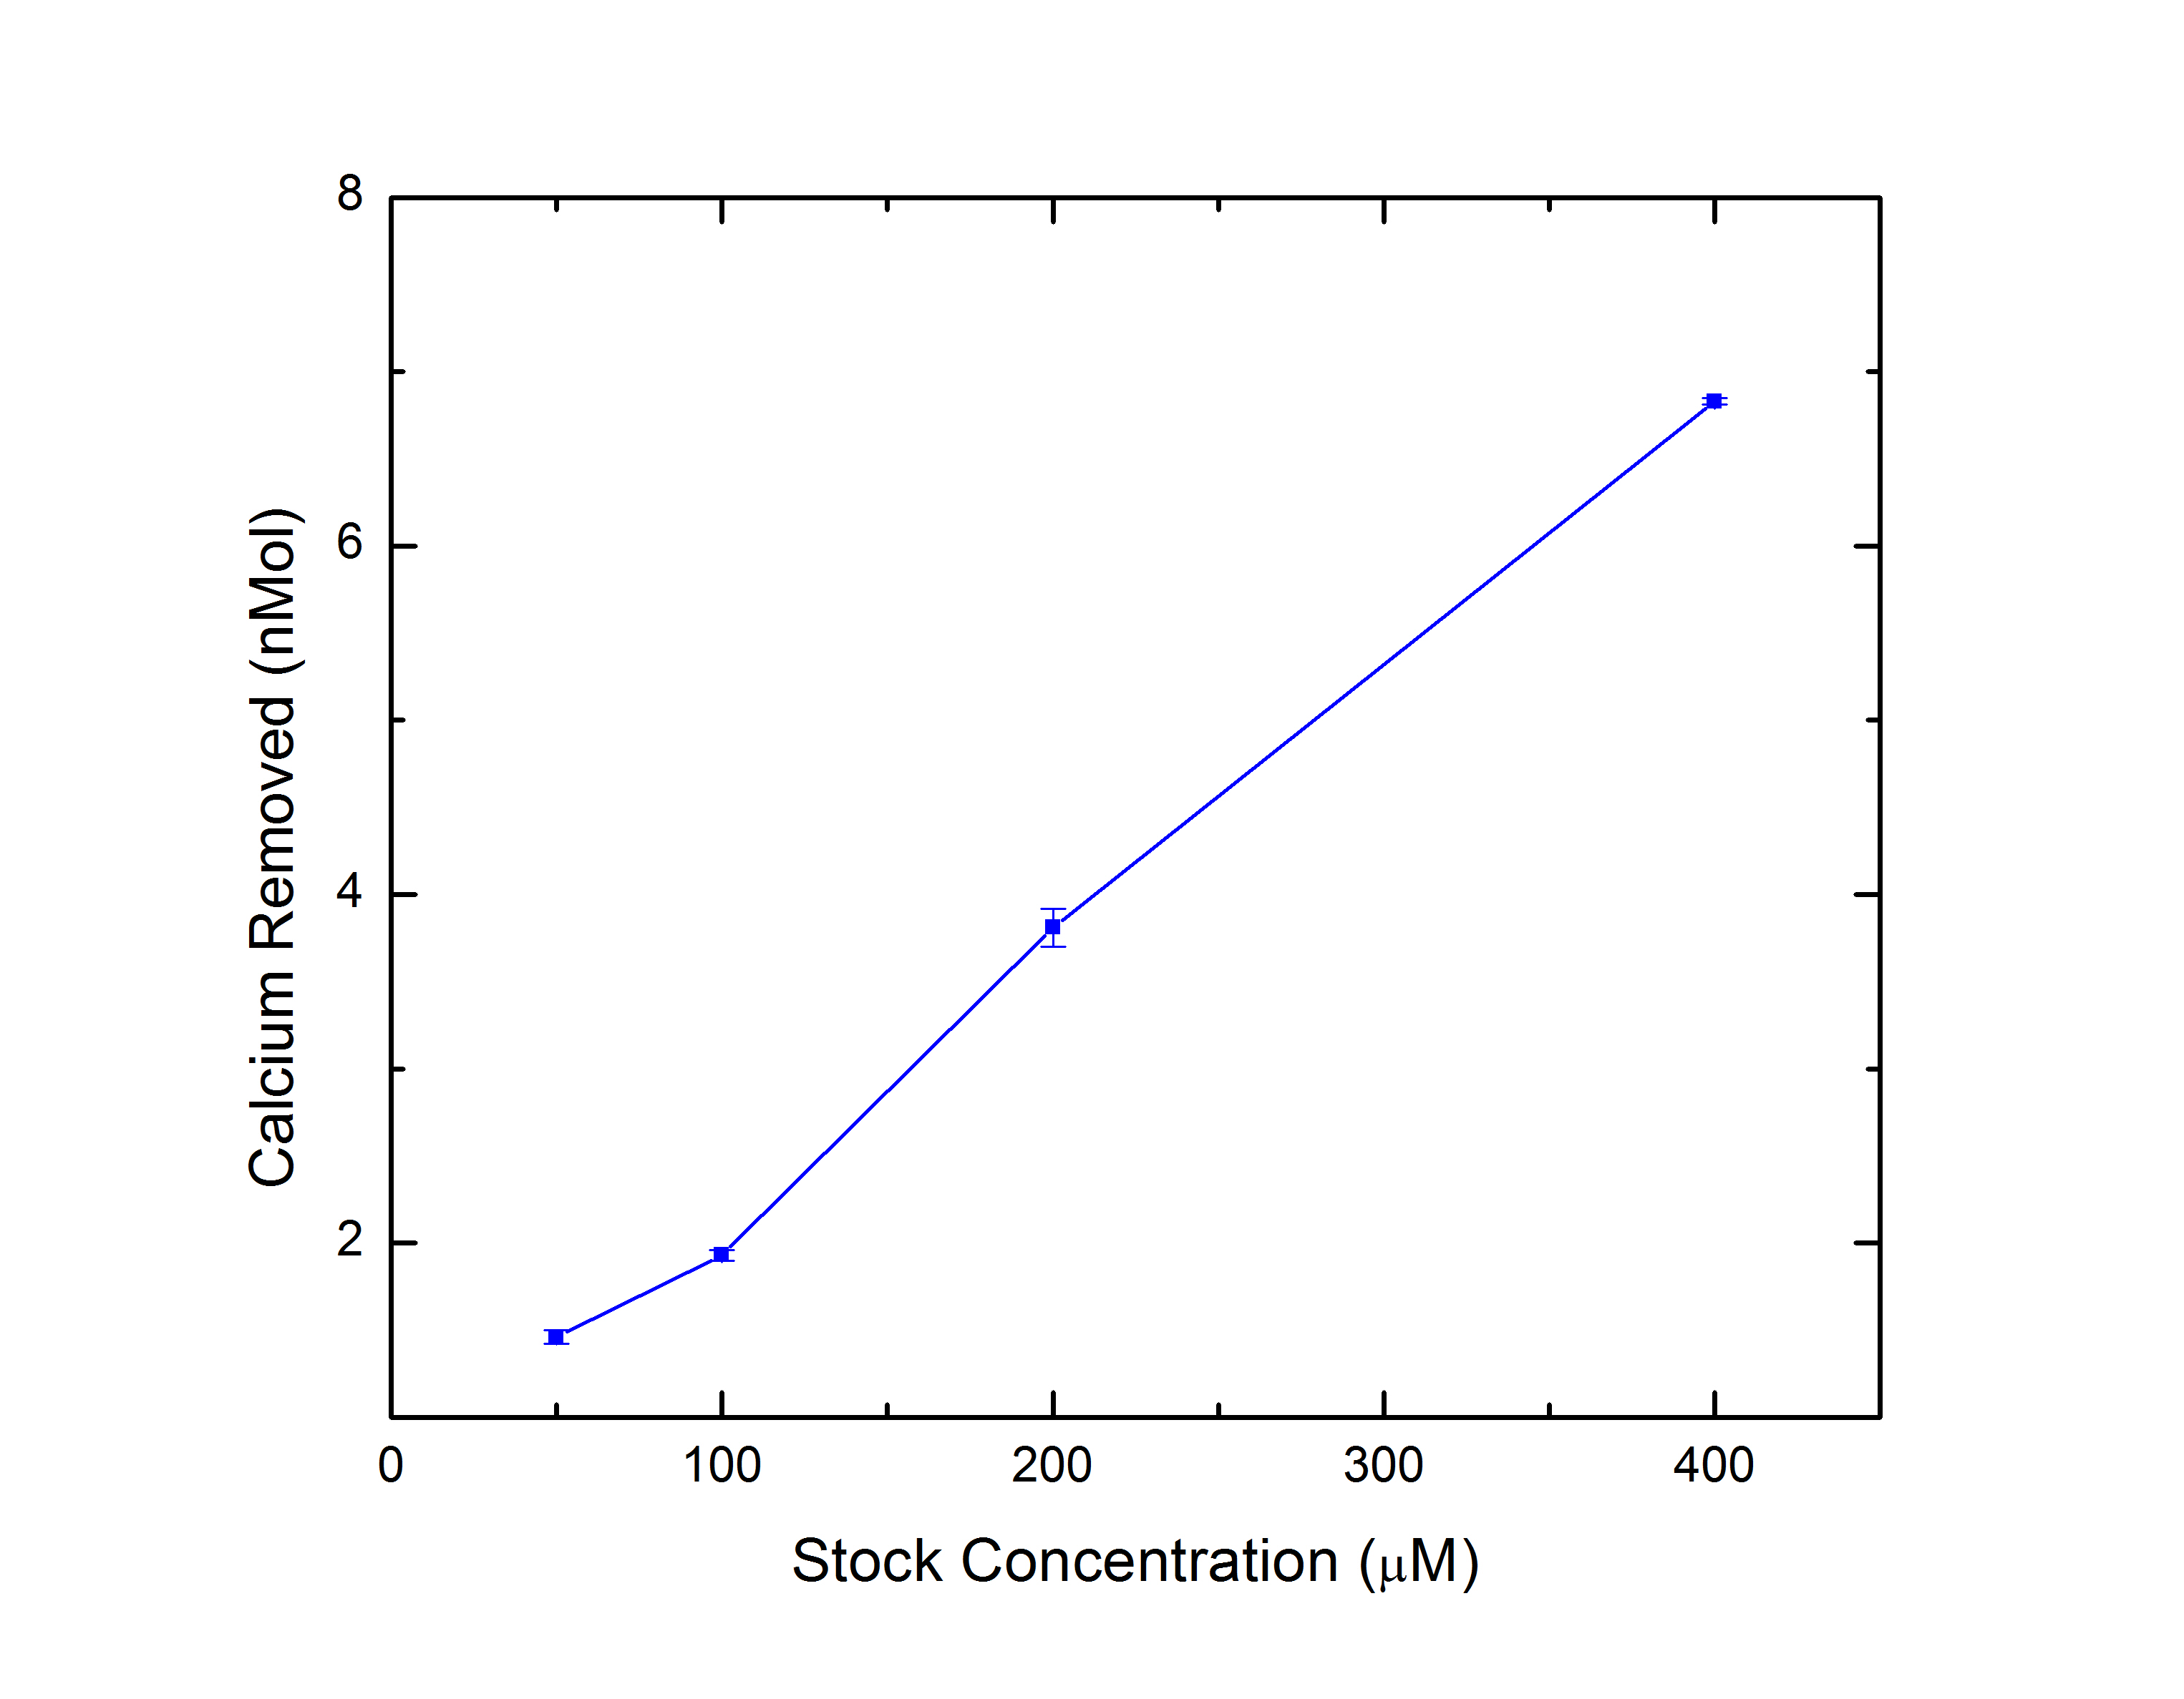
Lithium Purification Using Bioinspired Redox-Active Pyrogallol Matthew Libby and Dr. Young Jo Kim Department of Chemical Engineering, University of New Hampshire, Durham, NH 03824
Introduction
Coating Analysis
Proposed Mechanism
The increasing demand for lithium in the automotive industry has led to an expected market growth of 24% annually until 2030.
Approximately 60% of the world's lithium supply exists in salt flats in south America. These flats contain 100 – 1000 ${mgL}^{−1}$ lithium, as well as an abundance of Na, K, Mg and Ca ions. Due to comparable thermodynamics, these ions are hard to separate.
PyroGallol (PG), a redox active organic compound, has the potential to bind to these ions for use in separation processes
t = 0 Days
t = 1 Day
t = 2 Days
t = 3 Days
Visual Images
Methods
SEM Images
Synthesis of Poly-Pyrogallol (PPG)
Conclusions and Future Work
Pyrogallol is auto-oxidatively polymerized in an aqueous phosphate buffered saline solution (PBS, pH = 7.4)
2 mg pyrogallol per mL PBS was stirred at ambient conditions for 24 hours yielding an orange powder
5 cm by 5cm of stainless-steel mesh was immersed in the PG-PBS and allowed to mix for 24 hours
20 $μ$m
20 $μ$m
20 $μ$m
20 $μ$m
While an exact thickness has not yet been determined, 3 coating cycles of PPG is sufficient for ion removal.
As seen in the CV graphs, the presence of the cathodic and anodic peaks corresponds to the reduction and oxidation of OH functional groups, and therefore, the proposed binding and release of ions in solution.
Using PPG powder, approximately 5 millimoles calcium can be removed per mole of PPG. Additionally, a 2-hour exchange removed 4 times more calcium than the 10 minute, suggesting a slow equilibration.
At low concentrations, PPG coated mesh can remove up to 10% of the moles of calcium in solution, and moles removed linearly increases with concentration.
Future work will include investigation of the adsorption of lithium ions and comparing the selectivity of lithium and calcium in a mixed solution. Additionally, the reusability of these membranes will be studied.
Electrochemical Analysis
Bare Mesh
PPG Coated Mesh
Synthesis of Redox Active Membrane
Acknowledgements
Electrochemical Characterization
Ion Removal Results
Thank you to Dr. Young Jo Kim and Dr. Zhen Tian for their expertise and support throughout this process
The UNH Department of Chemical Engineering, UNH University Instrumentation Center, Hamel Center for Undergraduate Research
In a $Ca(NO_{3})_{2}$ electrolyte solution, cyclic voltammetry was performed using a 2 cm by 1 cm piece of bare mesh or PPG coated mesh as the working electrode with a platinum counter electrode and Ag/AgCl reference electrode
PPG Powder Trials
Coated Mesh Trials
Fluorometric Assay Measurements
References
[1 ] Greim, P., et. al. Assessment of lithium criticality in the global energy transition and addressing policy gaps in transportation. Nat Commun
[2]Yasin Orooji et. al. Recent advances in nanomaterial development for lithium ion-sieving technologies
[3] Tian, Z, et. al. Synthesis of biologically derived poly(pyrogallol) nanofibers for antibacterial applications

