Slide 1


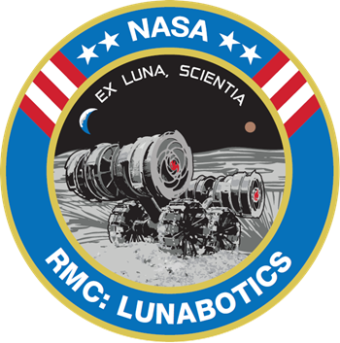






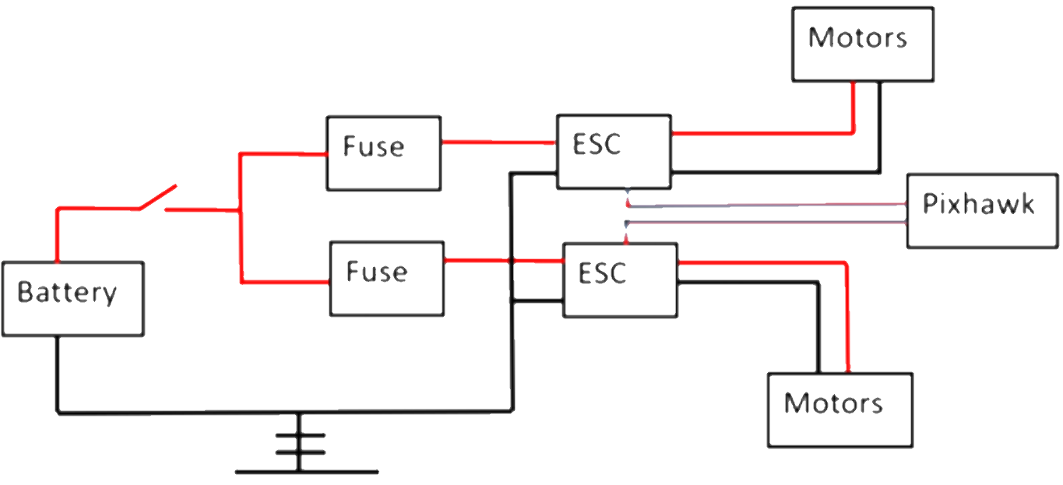


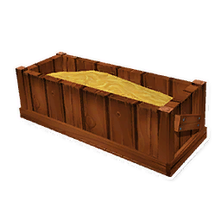

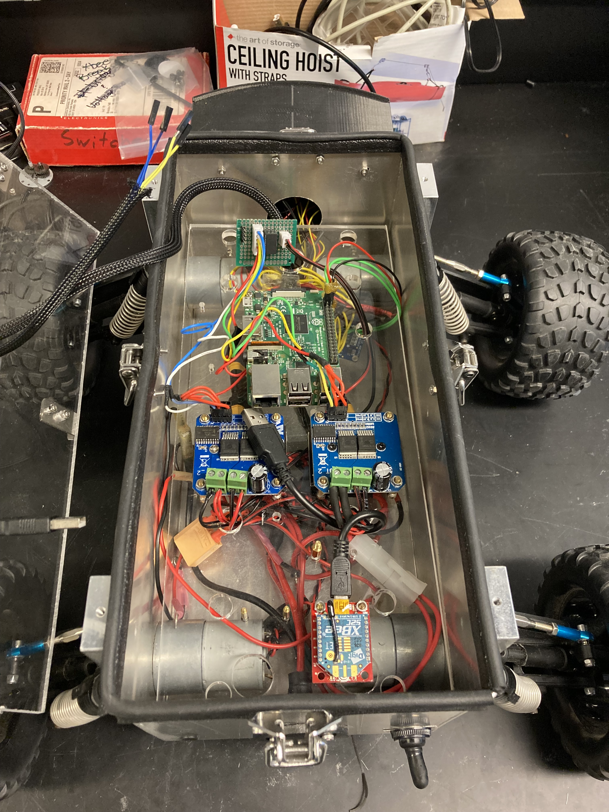
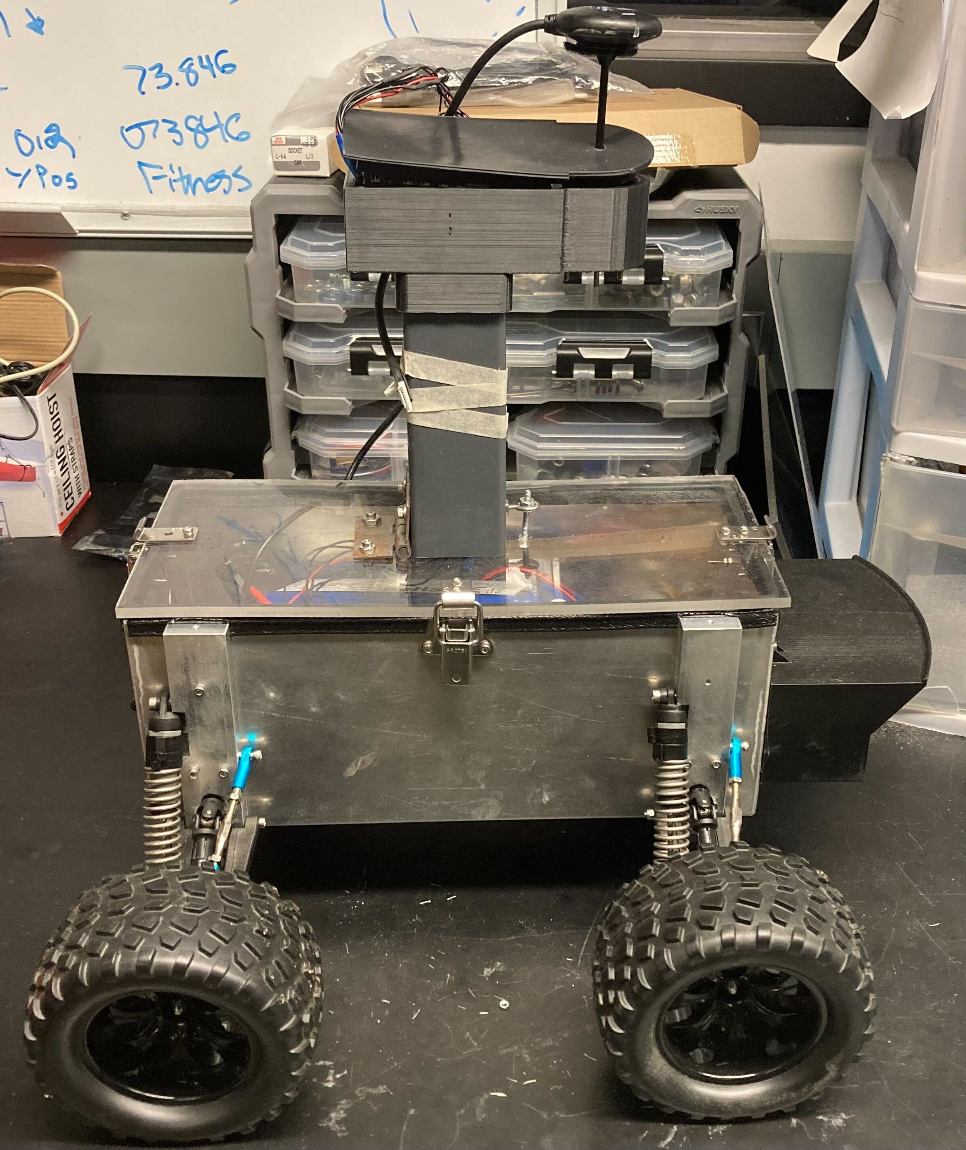
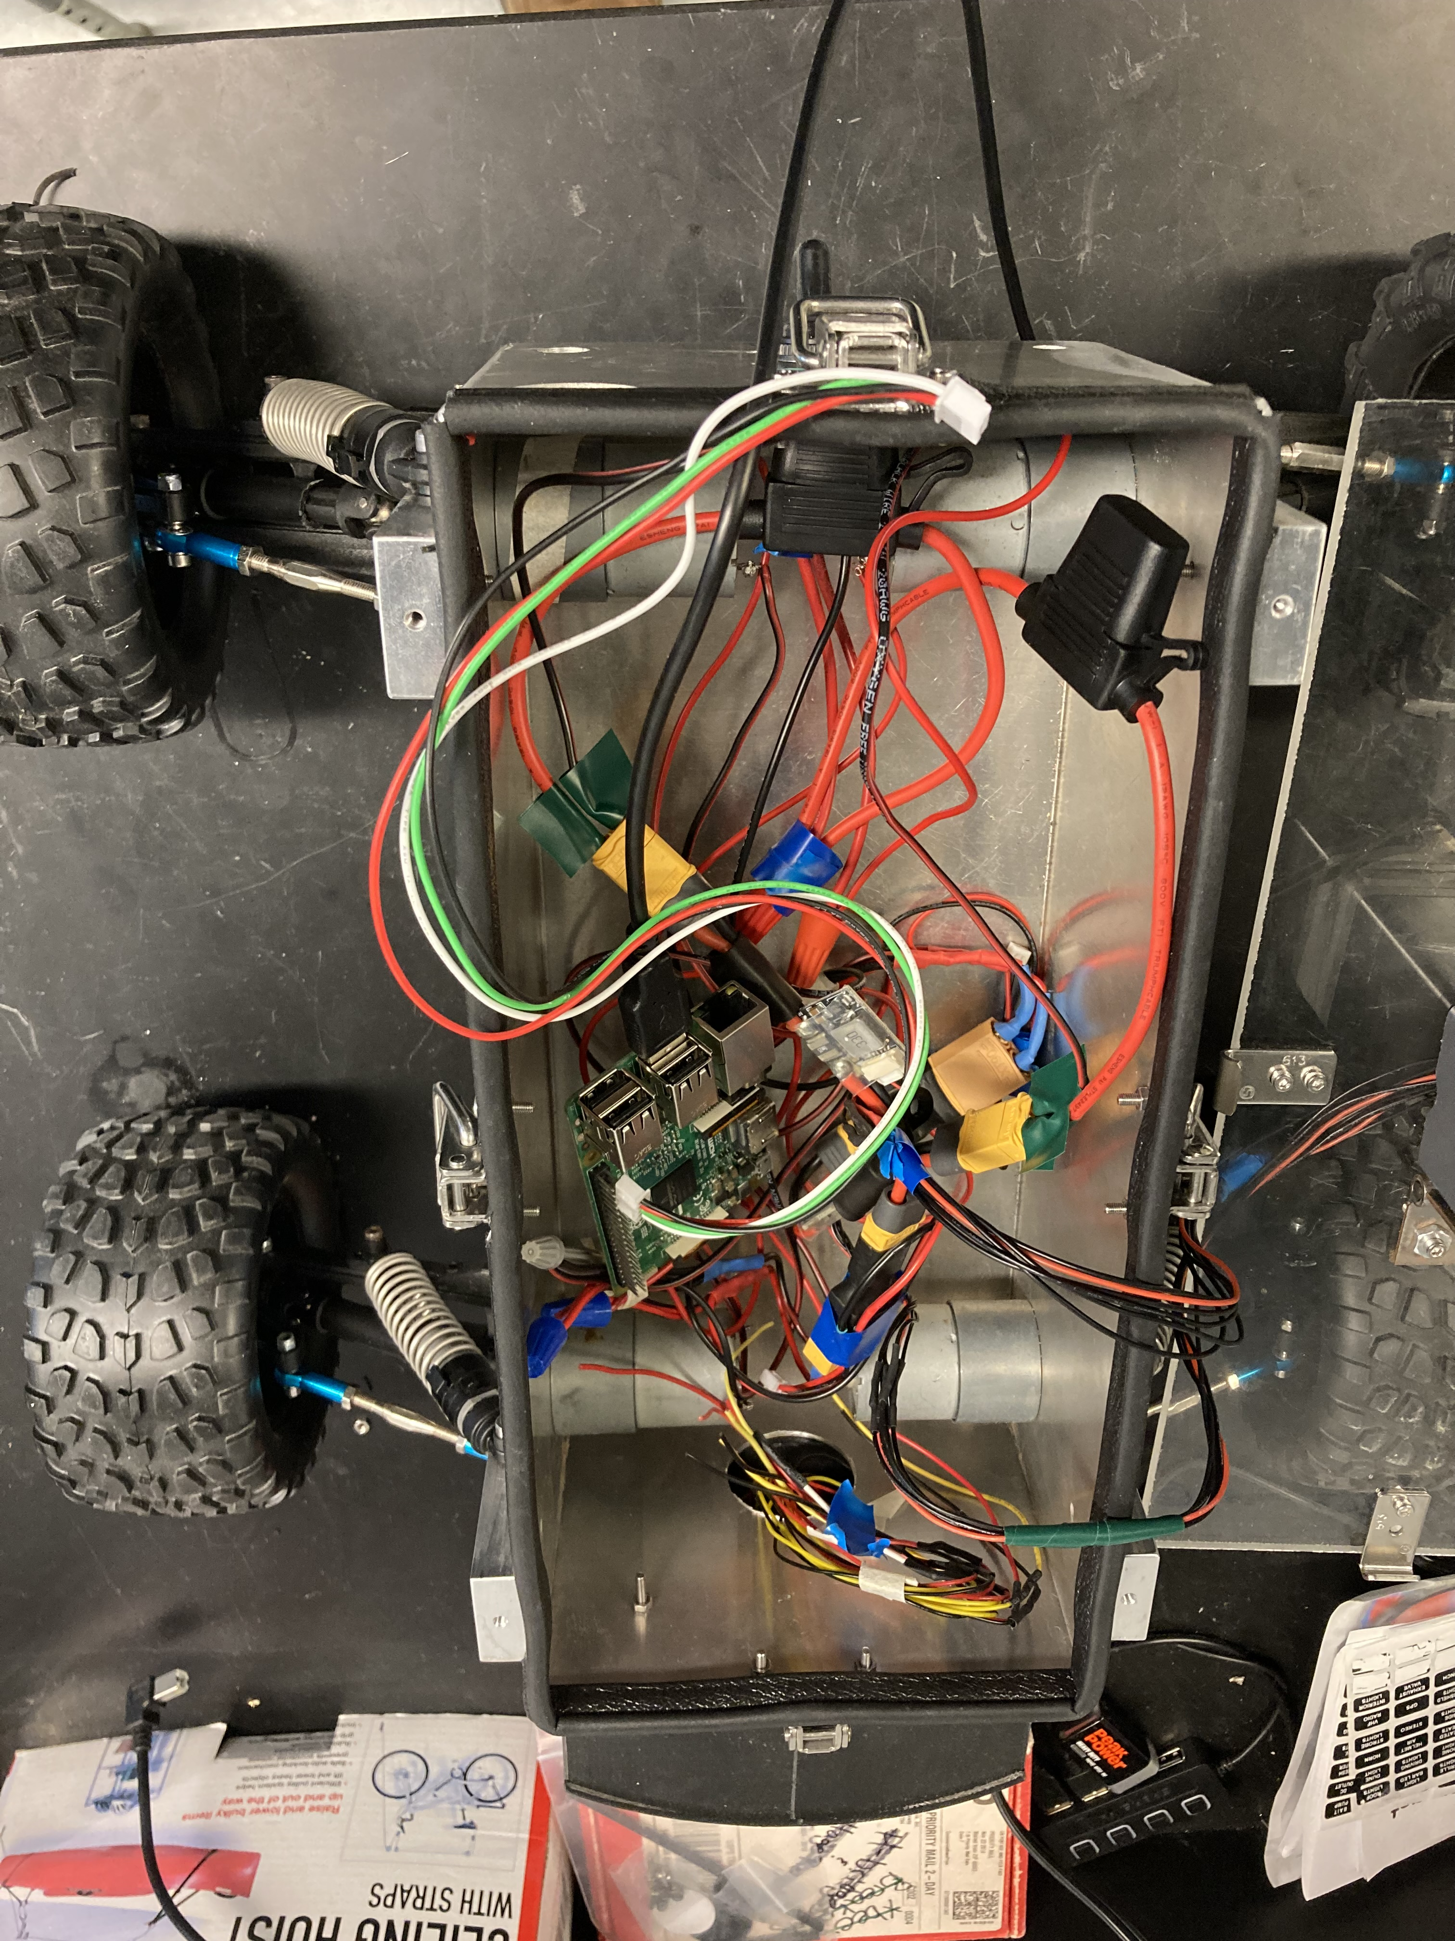
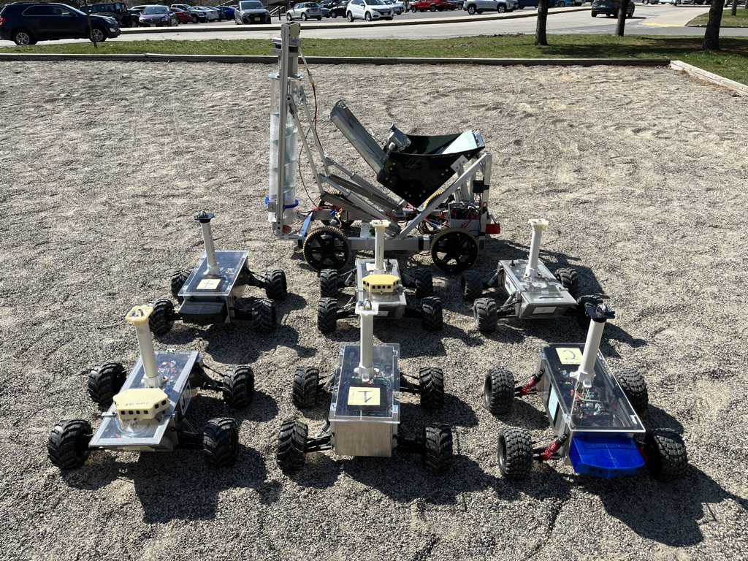
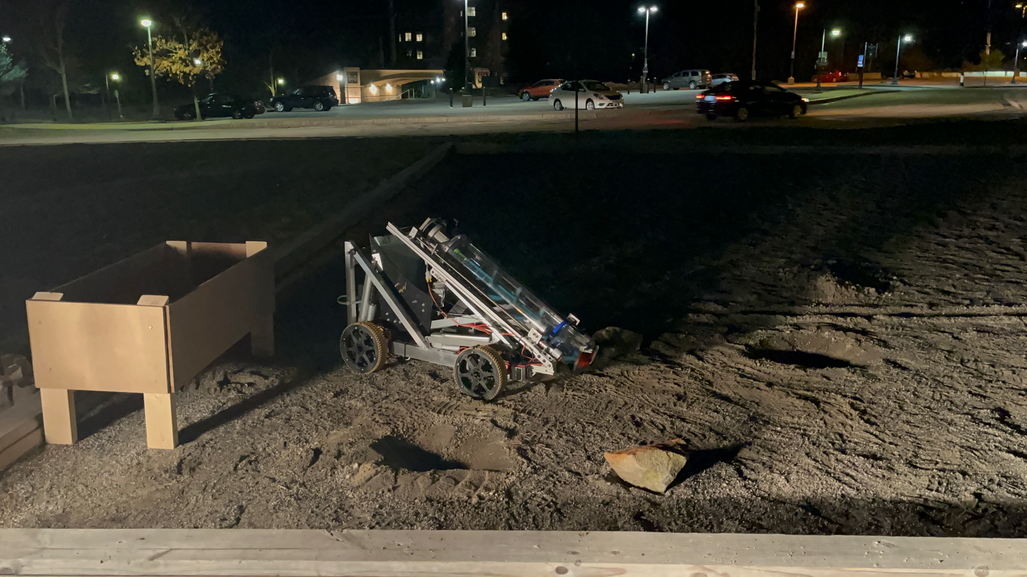
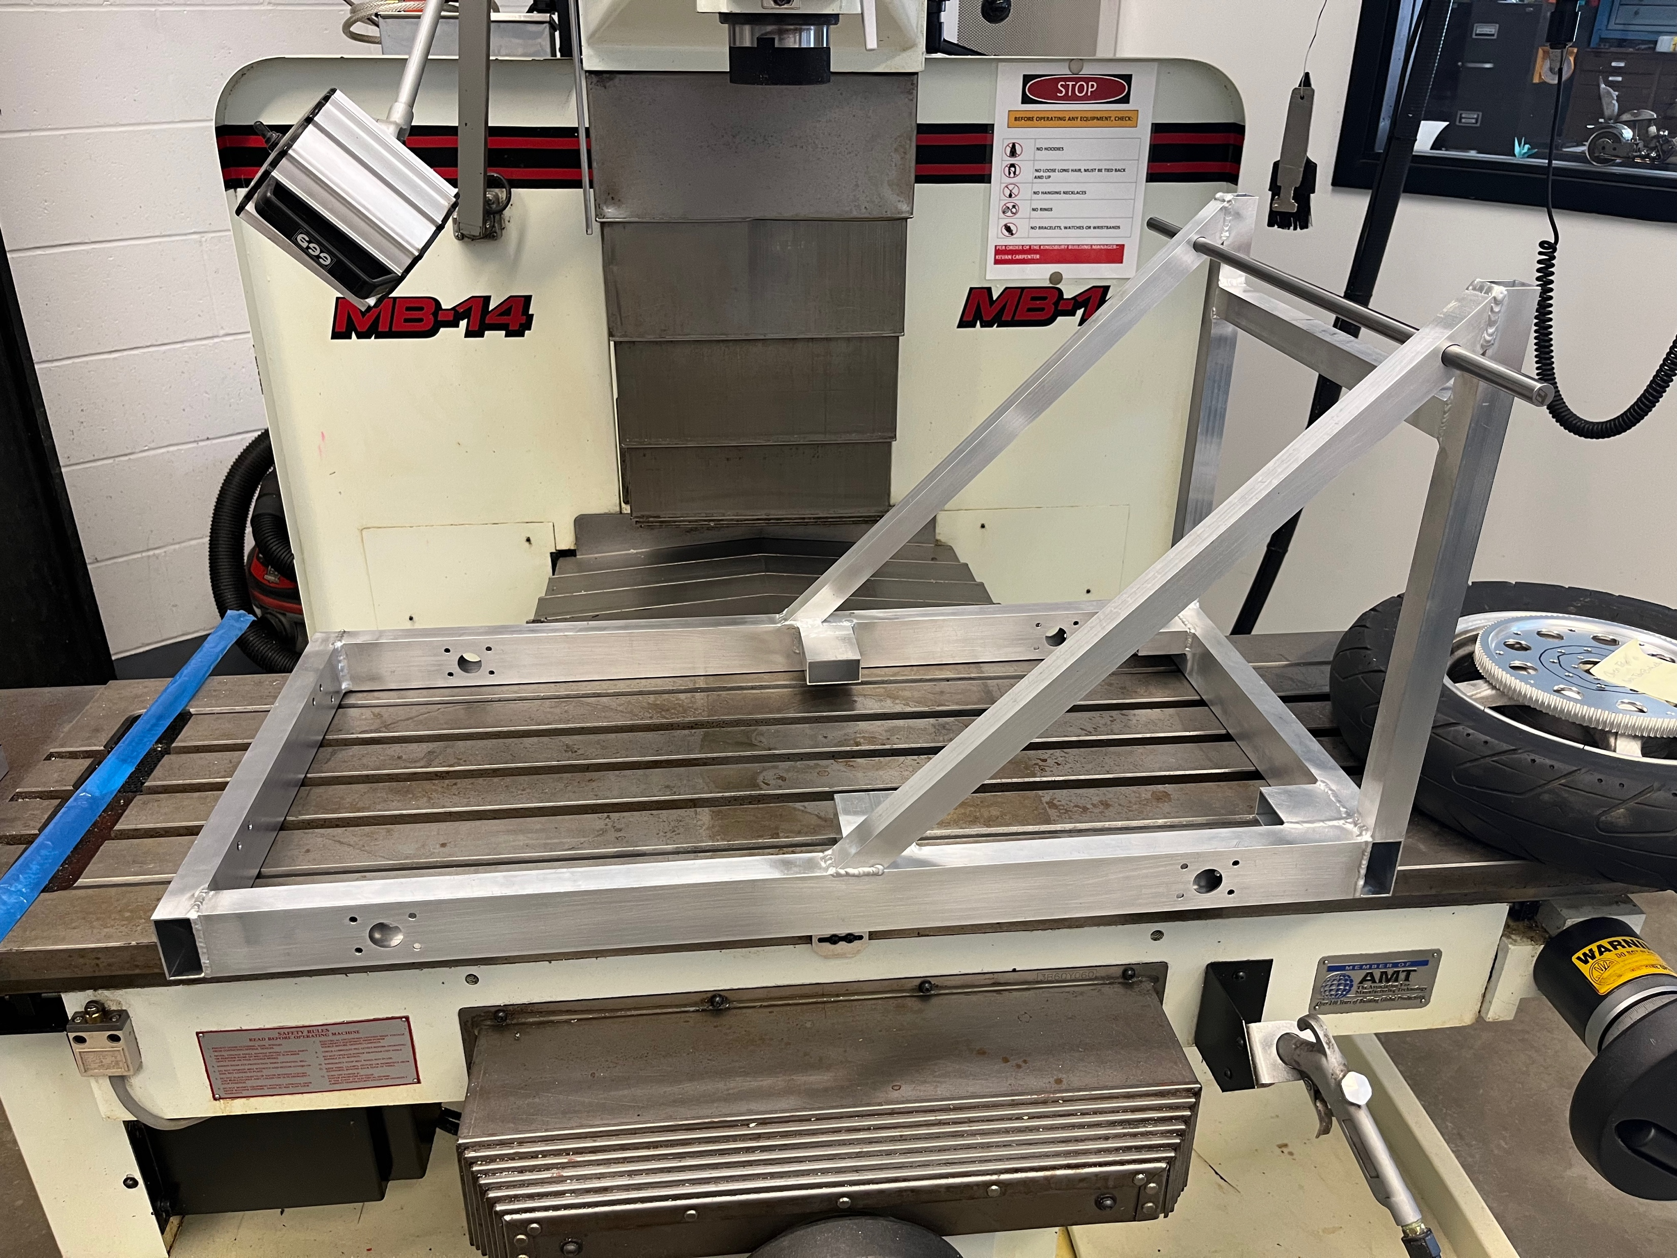
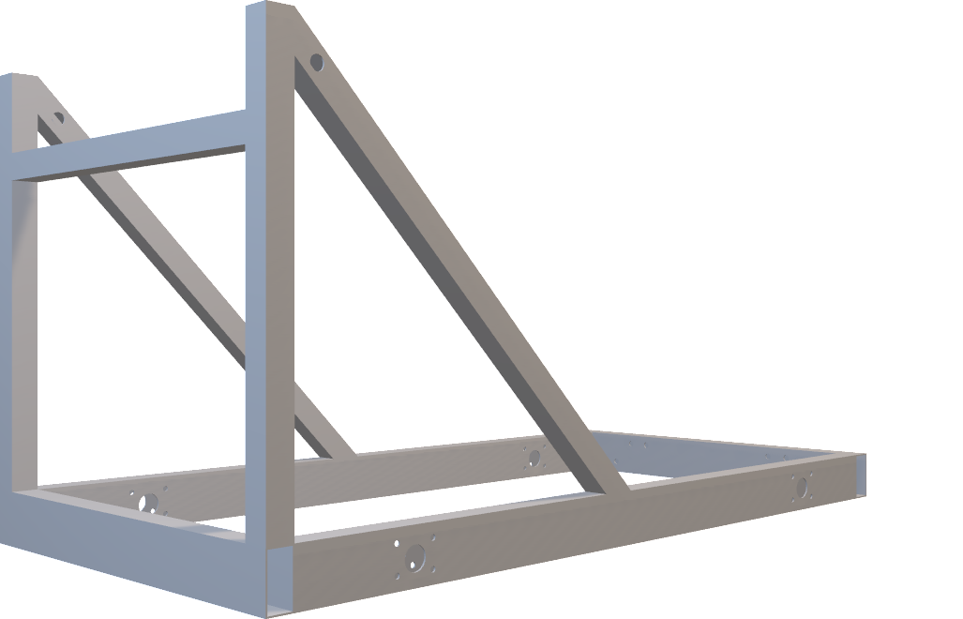
Special Thanks to: Scott Campbell and Beswick Engineering
Faculty Advisor: Dr. May-Win Thein, Ph.D.
Graduate Advisors: ChanLing Beswick and Patrick Shore
LunaCats Mechanical Engineering Team:
Ben Brockway, Cam Charette, James Ennis
NavSwarm Mechanical Engineering Team:
Peter Yankowski, Hayden Herrick, and Owen Payeur
Computer Science Team:
Nathan Logan, Nikhil Bala, and José Navarro
Introduction
Software
NavSwarm
UNH LunaCats and ET NavSwarm became LunaSwarm
Goal: Develop an Autonomous Robotic Extraterrestrial Surface Prospecting and Mining system
Aim to integrate the LunaBot and the NavSwarm rovers into a cohesive system
NavSwarm rovers will scan the surface using LIDAR to create a map
LunaBot will use the mapped surface to navigate and mine
NASA RMC
Annual competition to design, build, and test a robot
Robots are tested on a simulated lunar surface
Mine and deposit rocks and gravel within a 15-minute window
Some level of autonomy is required
General Information
Focus on introducing autonomy to a previously manually controlled robot
Autonomy is guided by an integrated camera that detects a target
Robot is still fully remote controllable in the case that autonomy fails
Remote Control Functions
Python code used for both controller and robot’s Raspberry Pi
API used to send signals through private WiFi network between controller and robot
WiFi network consists of two long range routers to achieve the required range
Goal
Create a swarm of rovers to perform autonomous tasks as a swarm
Methods
A Pixhawk is used to control the rover and use GPS location services
A Raspberry Pi is used to run the particle swarm optimization code
Autonomous movement guided by particle swarm optimization, LIDAR, and GPS
This Year’s Development
Electrical system was upgraded to cut down on size, complexity, and cost
The electrical system was updated to reflect the one shown below
Pixhawk’s were reconfigured to match the new electrical control system
Integration With LunaCats
Provide a testing platform for current LunaCat autonomy
Work towards deploying a swarm equipped with LIDAR sensor to map the RMC competition field
Work towards navigating the LunaCat robot using the mapped LIDAR field
Possibly utilize a swarm to either mine or deposit material
Complete swarm integration with no “main” robot
User interacts with client app on laptop
Server (Raspberry Pi) receives signal
Autonomy Design
Client sends signals to server through private router
Server processes requests and controls robot
Mechanical and Electrical Design for Autonomy
Talon SRX ESCs were picked specifically for their ability to send data back to the Raspberry Pi
Modular gearboxes were chosen for the capability of installing encoders
The frame was designed with place to mount cameras or other sensors in mind
Future work: Install limit switches to improve the dumping and mining autonomy
LunaCats
Drivetrain & Wiring
Each wheel is driven directly by a separate motor
Last year’s design used a chain and sprocket system between the motors and the wheels
An Arduino and a Raspberry Pi work as the brains of the robot
ESC’s control most of the functions of the robot
Separate wiring system is required for the auger
Wiring was upgraded to be more robust
Depositing
Bucket is made from a welded aluminum frame and sheet metal
The bucket is moved by one actuator; last year used two actuators
Last year’s bucket design was made of polycarbonate that was heavier and weaker
Mining
The auger is surrounded by a polycarbonate tube to retain material
Linear screws move the auger down through the regolith
This year incorporated a new polycarbonate tube
The bucket – auger interface was revised to improve gravel retention
Engage
auto-dump
Camera detects
target face plate
Orient robot to face
the face plate
Lower bucket
Raise bucket to
dump
Move forward until
distance to
receptacle is 0
Old Wiring Harness
Difficult to understand without a high level of electrical engineering experience
Numerous points of failure
Difficult to find points of failure and to fix
Expensive
Requires a lot of space
New Wiring Harness
Easy to understand without a high level of electrical engineering experience
Reduced points of failure
Increased ability to diagnose and repair failures
Cheaper and smaller
Auto-dump Sequence Logic
Autonomy
Focused on writing code to make the material depositing sequence autonomous
Utilized camera to recognize a target
Target is mounted on depositing trough
Target is identified, then the robot orients to face it, then the robot drives to it, and then when close enough, dumps the material
User initiates the sequence through the client application
Code is executed on the server (robot)
Processing is done on the server to avoid data being transmitted through the network after the sequence is initiated

