Slide 1

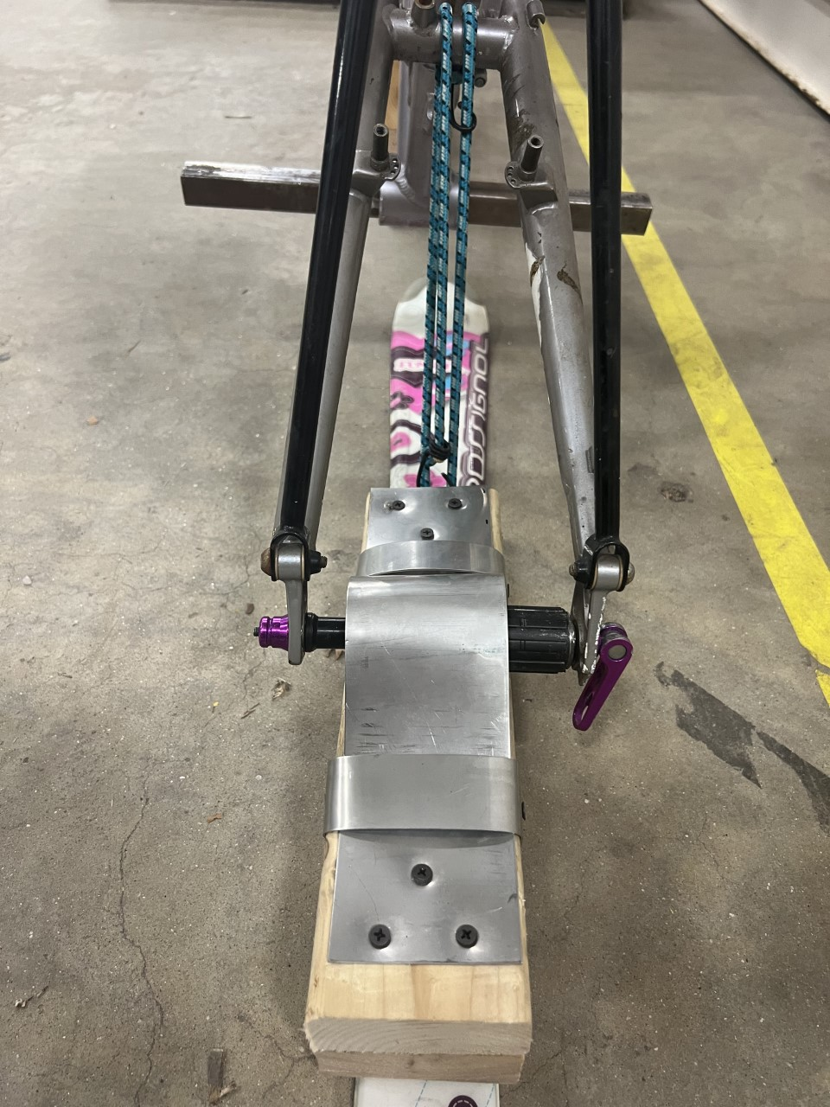
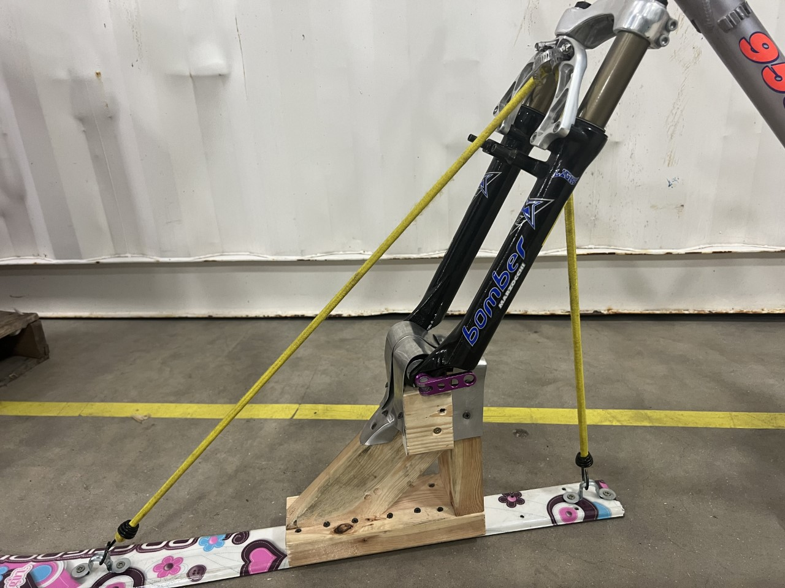

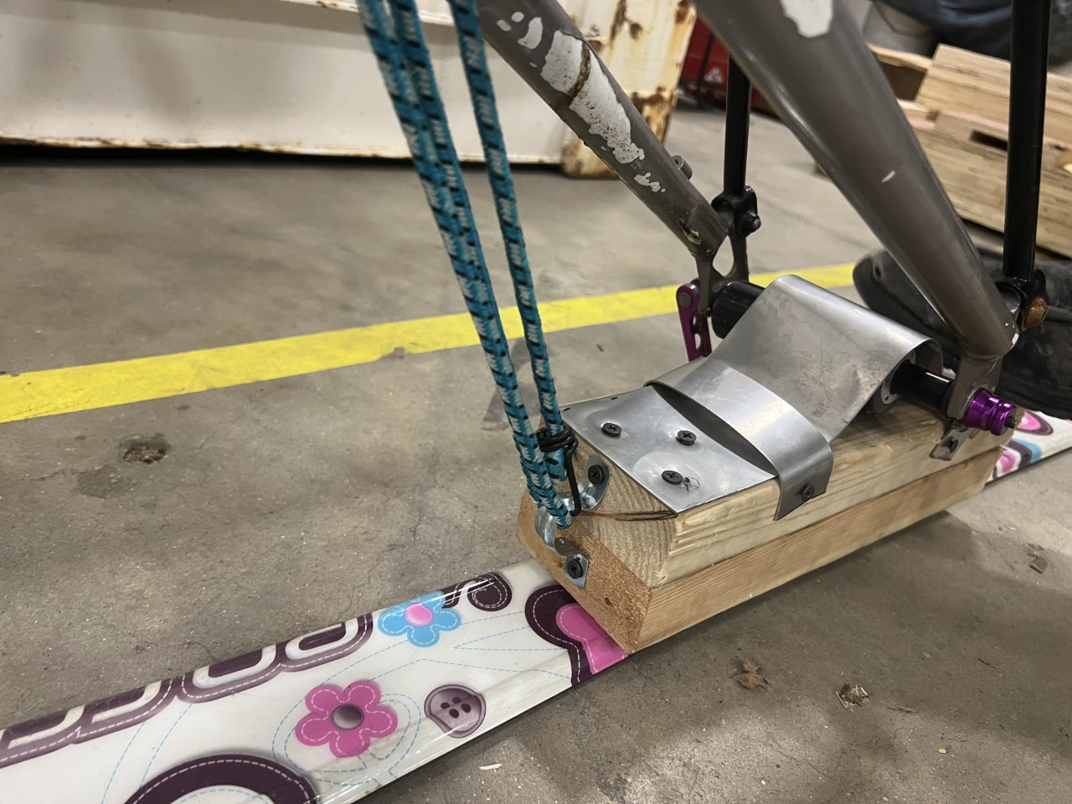
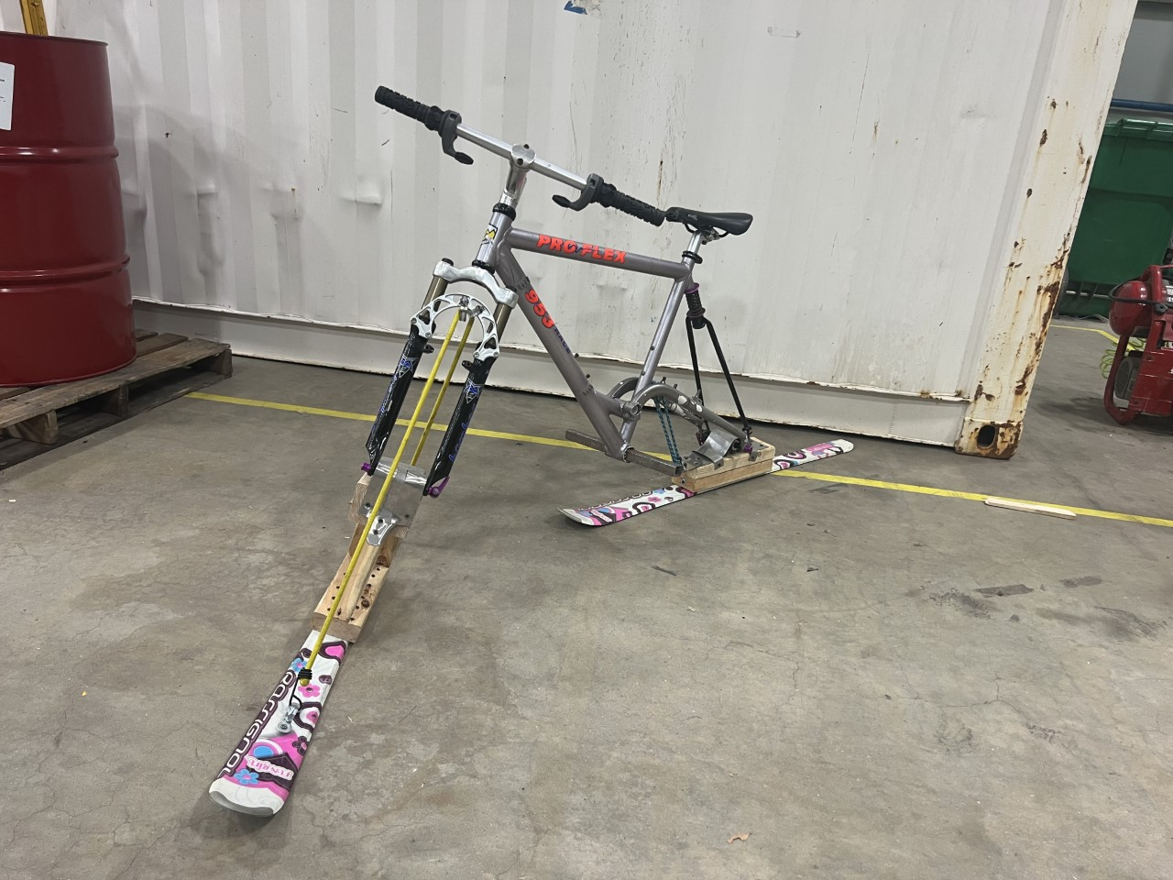
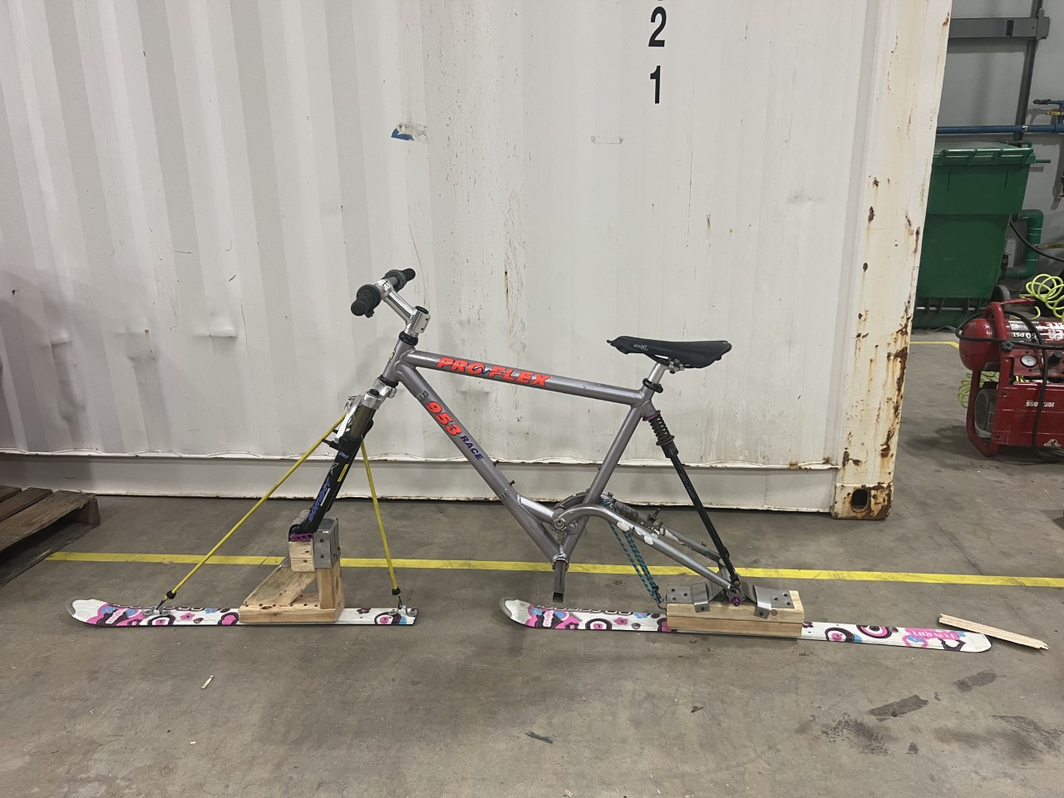
Ski Bicycle
Wyatt Mclaughlin, Willy Warr, Mechanical Engineering, University of New Hampshire
background
methods
results
Ski Bicycles are a new emerging variant of the already huge ski and snowboard industry.
Price point is a major factor holding this product type back from reaching a broader audience within skiing and snowboarding communities. Accessibility is already an issue in the ski and board industry.
Current market leaders price their products upwards of $2,500, with some reaching even as high as $8,000. This simply isn't affordable for most and is disheartening for others who would want to try, such as ourselves.
Our goal was to construct one of these with as low a budget as possible, and originally wanted to investigate leaf spring material testing, but time ran out and we pivoted to a "proof-of-concept" on DIY production using materials most people can find for cheap, or even free.
Our Bicycle frame was sources locally for free from a friend of our project advisor.
The skis were sourced from a trash pile.
Everything else we found around the shop that we were working in.
Avoiding the fracturing of the mounting components was crucial, and while we had stress-test failures in prototyping those problems were remedied in our current version.
Dual (Full) suspension, a wide foot peg, and pivoting front and back brackets for a smooth ride over difficult terrain.
Quick release hub for compact storage and ease of use.
Results
conclusions
In the end, we proved to ourselves and hopefully others that DIY is absolutely the way to go in terms of creating something for cheap to get into a sport without the barrier to entry.
In the future, we would love to produce a more permanent attachment system, using CNC. This would make the product viable for longer term use.

