Slide 1
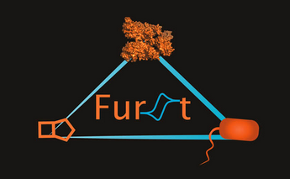
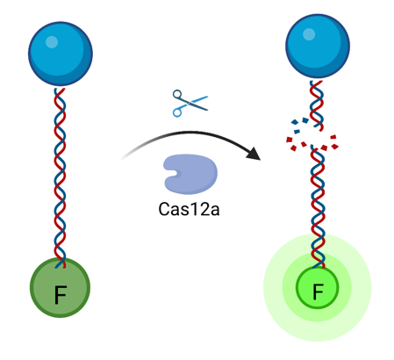
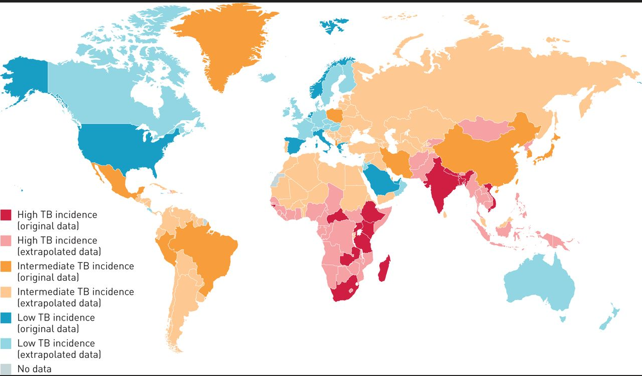
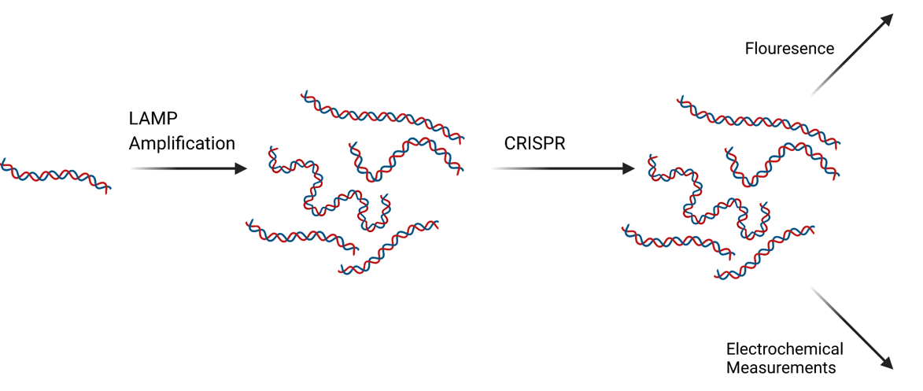
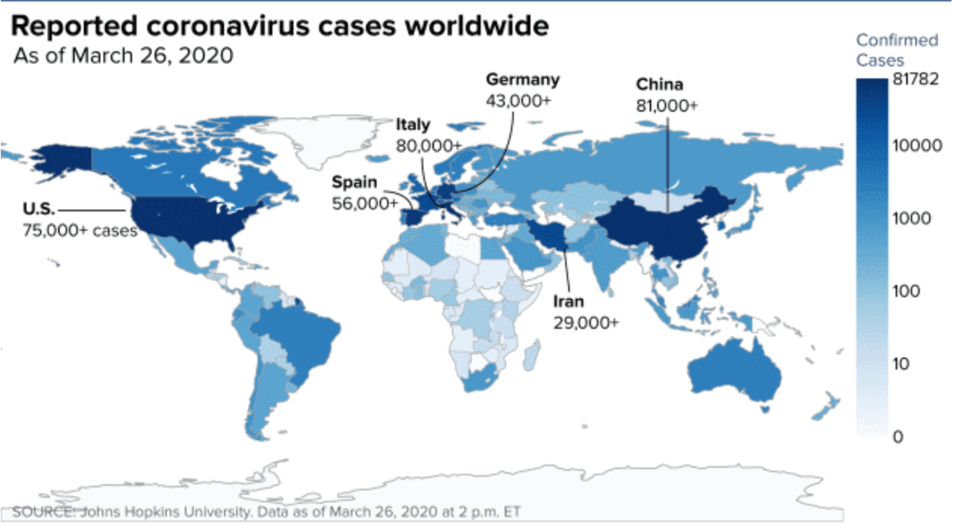
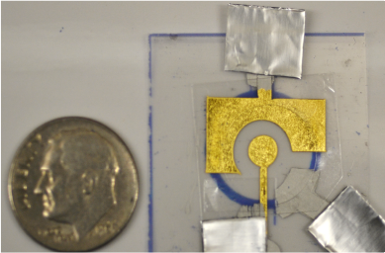
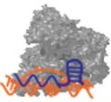
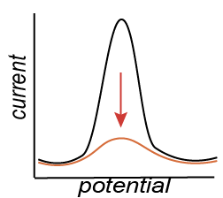
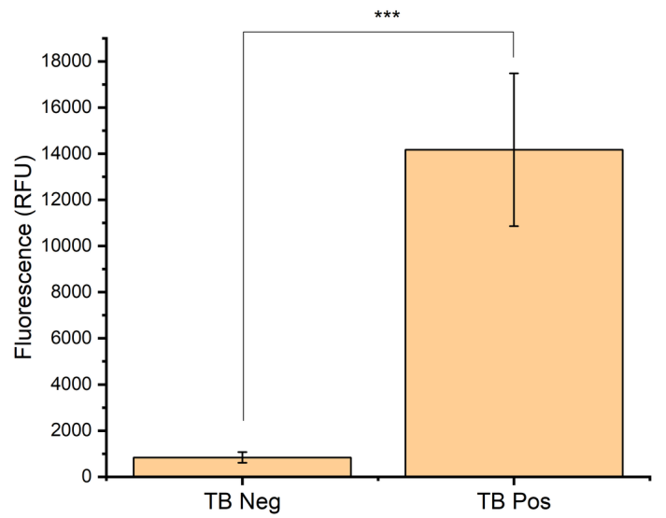
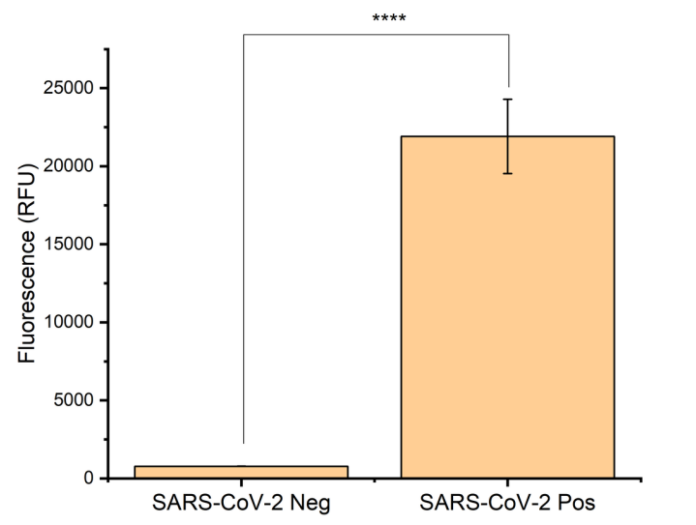
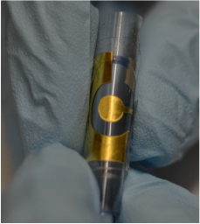
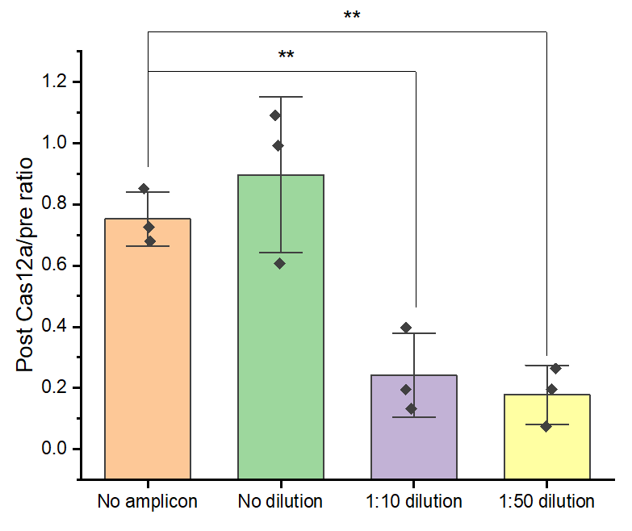
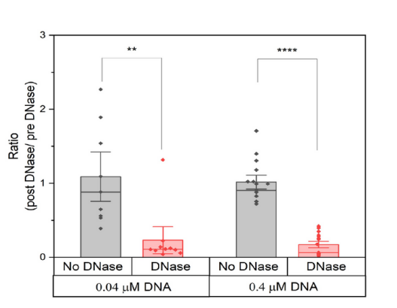
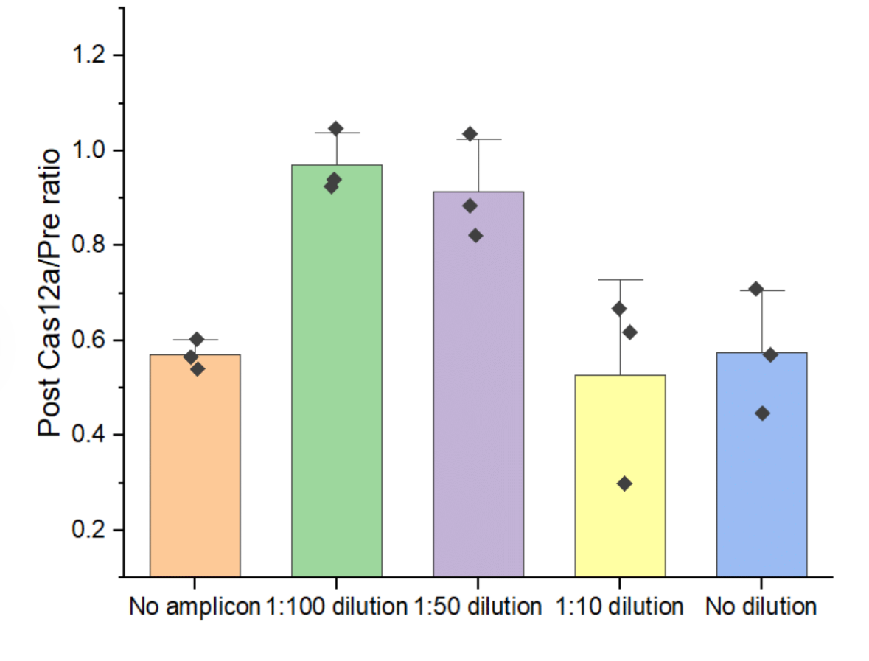
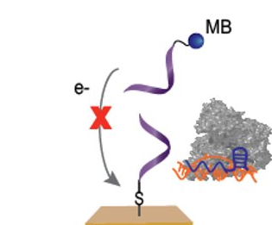
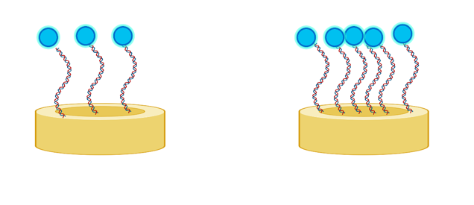
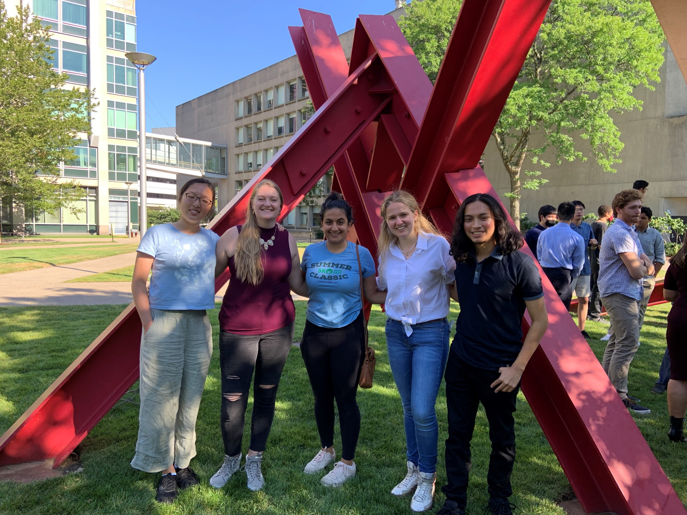
Low-Cost Gold-Leaf Sensing Platform for Detection of Infectious Diseases
Katherine Austin¹, Joshua Chaj Ulloa², Marieke De Bock³, Xingcheng Zhou⁴, Marjon Zamani⁴, Ariel Furst⁴
¹University of New Hampshire, Department of Chemical Engineering, Durham, NH
²University of Texas, Department of Chemical Engineering, San Antonio, TX
³Imperial College of London, Department of Chemical Engineering, London, England
⁴Massachusetts Institute of Technology, Department of Chemical Engineering, Cambridge, MA
Background
Sensor Fabrication and Methodology
Introduction
Sensor Fabrication and Methodology
Current COVID-19 and tuberculosis (TB) tests are expensive ($15-$35) and require trained laboratory personnel, making them unrealistic for low-resource settings (LRS)
3 million COVID-19 deaths in 2020 and 1.6 million deaths due to TB
Solution: affordable gold leaf biosensors
Gold-leaf and CRISPR Cas12a with electrochemical detection allows for low cost (~$0.50/electrode), specific detection
Signal observed after CRISPR Cas12a cleavage of surface bound Methylene Blue DNA
COVID-19 Cases Worldwide
Flouresence Measurements
Initial Viral DNA
Electrochemical
Measurements
LAMP Amplification
CRISPR Reaction
TB Incidence Worldwide
Cohen, Adam, et al. “The Global Prevalence of Latent Tuberculosis: A Systematic Review and Meta-Analysis.” European Respiratory Society, European Respiratory Society, 1 Sept. 2019
Feuer, Will. “Worldwide Coronavirus Cases Top 500,000, Doubling in Just over a Week.” CNBC, CNBC, 26 Mar. 2020
“The True Death Toll of COVID-19: Estimating Global Excess Mortality.” World Health Organization, World Health Organization
“Tuberculosis (TB).” World Health Organization, World Health Organization
CRISPR Based Disease Detection
Surface Optimization
Workflow and Amplicon Validation
Single and Multiplexed Electrochemical Detection
Key: ** p<0.01, *** p< 0.001, **** p<0.0001
e⁻
e⁻
TB Amplicon Verification SARS-CoV-2 Amplicon
Verification
Surface Optimization Procedure
Fluorescence positive flouresence control to confirm expected amplicon cleavage by Cas12a
Amplicons introduced to Cas12a, and gRNA followed by electrode: enzyme cuts MB DNA causing SWV signal decrease
Optimization of surface by investigating different concentrations of surface bound MB DNA probe
DNAse is used as it’s well studied for DNA cleavage and can thereby function as a control
Goal: Does surface concentration of DNA probe impact electrochemical measurements and is there an optimal concentration to work with?
Surface Probe Optimization
0.04 µM MB DNA
0.4 µM MB DNA
TB Electrochemical Detection
SARS-CoV-2 Electrochemical Detection
Created with BioRender.com
Conclusions
Acknowledgments & Funding
Conclusions
Acknowledgments & Funding
We were able to show successful creation of amplicons via LAMP as seen with fluorescence
Statistically significant signal decreases were observed with TB amplicons at 1:10 dilution and 1:50 dilution as compared to control of no amplicons
Funding from the Summer Undergraduate Research Fellowship (SURF USA) by the Hamel Center for Undergraduate Research at the University of New Hampshire
All the support from everyone in the Furst and SEEDS labs

