Slide 1

Full-Bodied Support:
How We Embolden Women in Graduate School
Meaghan Dittrich
@meaghandittrich | Meaghan.Dittrich@unh.edu
Notes:
Impetus for doing this presentation/study in the first place - I’ve been through so many life events while doing my PhD and it’s been a struggle to keep up with everything. I’ve slowed down on my dissertation because I have a full time job and a one year old baby, along with many other things that take attention away from writing. But I’m lucky. I have had a LOT of support over the years of my program. I want to talk today a little bit about the amazing support I’ve encountered, the kind of support that other graduate women are looking for, share with you some data collected from a survey about how other women have struggled and needed support, and then maybe address ways we can better advocate for women in graduate school. I’ll also hand out a copy of the survey that I distributed for this study [PASS AROUND SURVEY COPIES]

Slide 2
What an Advisor Can do
Personal Narrative - my advisor’s support through:
Death of a parent
Wedding/Marriage
Miscarriage
Baby shower
Childbirth
Parenting
Professional development
Economic awareness and advocacy
Notes:
First, in a manner of bragging, I suppose, I’d like to share my own personal experience - a success story, if you will; because we hear so few of those - about the support my advisor has given me over the course of my graduate program. I won’t get into all of these, but I’ll share a few details on some. This isn’t a comprehensive list of what she’s done to encourage me, but it includes my major life events and some of the most important moments that I’ve needed her.
Dad’s death - coming to class the day it happened
Wedding - coming to the ceremony, hosting a pot-luck celebration
Miscarriage - calling to talk about options (D&C); flowers, lunch at The Library with Larry
Baby shower - hosting potluck at her house
Childbirth - coming to visit me while at the hospital during a VERY difficult birthing experience
Parenting - offering to babysit
Professional development - being supportive and encouraging when I had the opportunity for full-time employment while I was working on my dissertation; offering to help with Ellie while attending the FemRhets conference; offering to find time to write together so I can continue working on my dissertation; not putting pressure on me to set unreasonable time management expectations on my writing, especially when I have a full-time job and a baby
Economic support - finding/offering extra teaching opportunities, finding outside funding sources for her grads wherever she can
The problem is that what my advisor has done for me is not institutionalized. She isn’t required to do ANY of this. So I remain in a position of privilege, whereas, ideally, this would be the norm.

Slide 3
A Place of Privilege
My daughter is with me today for several reasons:
The opportunity to spend time with her
Proving to myself
Normalizing working mothers bringing their children to work
I want to be an example for my daughter
Encouragement from others
Fellow panelists
My advisor
She’s cute and I like showing her off
Notes:
So I recognize my privilege. I recognize that my daughter is with me today because I have amazing support and the reasons I wanted her with me today are the following:
I love her and I want to spend time with her. I spent my last conference in October away from her for five days and didn’t want to turn around one month later and do the same thing again. Then offered $800 the day I’m traveling home at the airport to take a later flight, I had to take it because that meant one month of day care paid for, but another day I wouldn’t be seeing her. I spent the rest of the wait in the airport crying. If daycare wasn’t so expensive, I wouldn’t need to have taken that money and I could have made my original flight. But I couldn’t pass up that opportunity to pay for a month of Ellie’s day care. I justified it: one day of emotional labor for one month of day care cost. When you’re a working mother you feel guilty for all the time you aren’t with your child. And of course you feel guilty when you’re with them for all the work you “should” be doing
I want to prove I can do this. Don’t we always want to prove “we can do it all”? The fact that we feel this way is problematic in the first place - who said we have to do it all? But we want to, right? Because we don’t want to look “weak”
I want to normalize the experience of working mothers bringing their children with them. This should be acceptable. ALWAYS. EVERYWHERE. As a mother we often ask: when is my child an acceptable accessory? How often can I bring my baby to work? To writing groups? To social outings? We worry about “bothering” others. We worry about social norms and stigmas.
I want to be an example for my daughter. I want this to be normal for her. I want her to see me at work. I want her to know that I’m more than her mother, that I have many identities and my research and professional life is one of those identities
Encouragement from others - my therapist told me to start taking my daughter to more things; faculty members told me they did it and I should set an example for other moms and normalize/ it’s ok to bring your child; co-workers encouraged me as well
I am able to rely on the help of my fellow panelists here today who are making sure she doesn’t get into mischief while I’m giving this talk.
I am able to rely on the help and support of my advisor who flew with me and shared a car rental and who is currently presenting right now.
She’s cute and I like showing her off

Slide 4
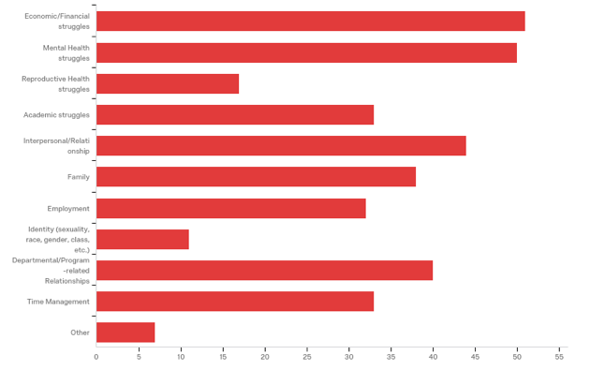
Notes:
But many women don’t have these benefits, nor this kind of support or encouragement, especially as graduate students. I’m lucky. So many women go through so many of these life events and MORE during their graduate programs. Here is some data from a survey I’ve conducted just in the past few weeks. I’m hoping more women continue to participate and I continue to collect the writings of these women who tell me about the struggles they’ve gone through and how we can better help them continue their work as scholars in their fields. This data is very fresh, so forgive the brief surface-level analysis at the moment. I intend to study these responses much further. This first slide shows, out of 193 respondents to my survey, what sort of struggles and challenges graduate women have faced during the course of their graduate degrees. Participants were able to select however manny applied. You can see that the two most common struggles were with economic or financial concerns, as well as mental health issues.

Slide 5
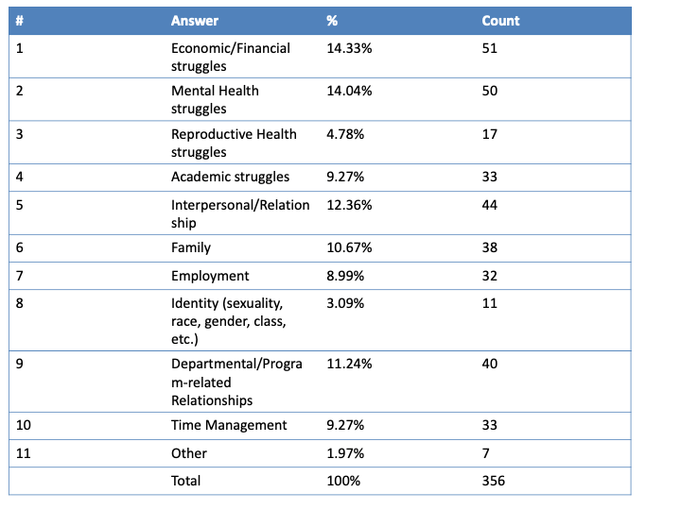
Notes:
This chart gives you a better sense of those numbers

Slide 6
“Feeling that I need to go above and beyond within my future career in order to be treated equally/fairly as a woman. Also feeling that I need to justify myself for pursuing a graduate degree because I am a woman.”
“Mental health issues, including anxiety, depression, panic attacks, and fatigue, imposter syndrome, inability to figure out how to be both a successful wife and a successful academic/graduate student, sexism and bias within interactions with professors, etc.”
“As a woman, I feel as though I am relied upon for too much unpaid labor.”
“I think the biggest thing is that I struggle to project any kind of authority and that what little authority I do have is mitigated by awkwardness of being a woman in a masculine space.”
Notes:
You’ll see a lot of women echoing some of the sentiments I mentioned earlier when talking about why I want my daughter Elliott with me here today. Guilt, wanting to prove ourselves, etc. Out of 193 responses, I can’t possibly go through all the amazing stories people shared with me, but I’ll give you a taste: Generally speaking, respondents reported that they desire more support from the institutional and programmatic levels. While many women like me have reported some great support from their (often female) advisors, there are some who still have significantly negative experiences with their advisors. Since advisor support is not an institutionalized requirement or clear expectation of faculty, the burden falls on the individual faculty member to lend what support they can when support should be more universal and distributed between faculty and program/institution.

Slide 7
“--sexual harassment by (tenured) male faculty
--male graduate student making dozens of comments about my appearance and once, literally, calling me the sexiest woman he'd ever seen *while we were at a conference*
--male undergraduate students asking me out
--being sought after for labor that takes emotional intelligence without financial compensation on a near weekly basis
--overall, knowing that in my role as an admin in the writing program, if I don't "smile and wave" I'm unapproachable to intimidating, but my male counterpart is a serious and smart academic.”
Notes:
This one respondent gave me a bullet list. So many women report feeling overwhelmed by the expectations - that they felt they needed to do more to prove themselves as serious academics, but were still belittled and condescended to. So so many reported feeling as though they take on more emotional labor than their male counterparts.

Slide 8

“Academic life is predominantly a man’s world. Women remain on the periphery, and children are all but absent. American universities consistently publish glowing reports stating their commitment to diversity, often showing statistics of female hires as proof of success, but the facts remain: university women make up disproportionately large numbers of temporary (adjunct and non-tenure-track) faculty, while the majority of permanent, tenure-track positions are granted to men. And women who do achieve tenure-track placement tend to report slow advancement, income disparity, and lack of job satisfaction compared to their male colleagues” (xix).
Notes:
Recently I’ve been reading from this collection, Mama, PhD, which has been encouraging and dispiriting all at once. This first quote is from their introduction [READ QUOTE].

Slide 9
“Motherhood is Easy; Graduate School is Hard” by Tedra Osell:
“Women in graduate school [shouldn’t] have to worry that somehow ‘asking’ for accommodation will stigmatize them if a clear, thorough, and well-publicized policy makes it plain that the university is staking part of its reputation on supporting all its graduate students. We all know about the sources of grad student anxiety... Knowing that your department and university have your back.. [and] with your corner of the academic world behind you - as they should be; you wouldn’t have gotten this far if they didn’t believe in your work - the message is yes, you can be both an aspiring professor and a person” (234).
“Above all, I hope that they help graduate student-parents stop feeling like they need to remain ‘in the closet,’ as one woman describes it. Material support is vital; without it, good intentions are just lip service” (235).
Notes:
This second and third quote is from a chapter titled “Motherhood is Easy; Graduate School is Hard” by Tedra Osell. [READ QUOTES]. I realize this mostly just speaks to the “mother” demographic of the experiences expressed in my study, but I’m hoping these sentiments ring true for all graduate women: that we need to SUPPORT them.

Slide 10
Thank You

