Slide 1

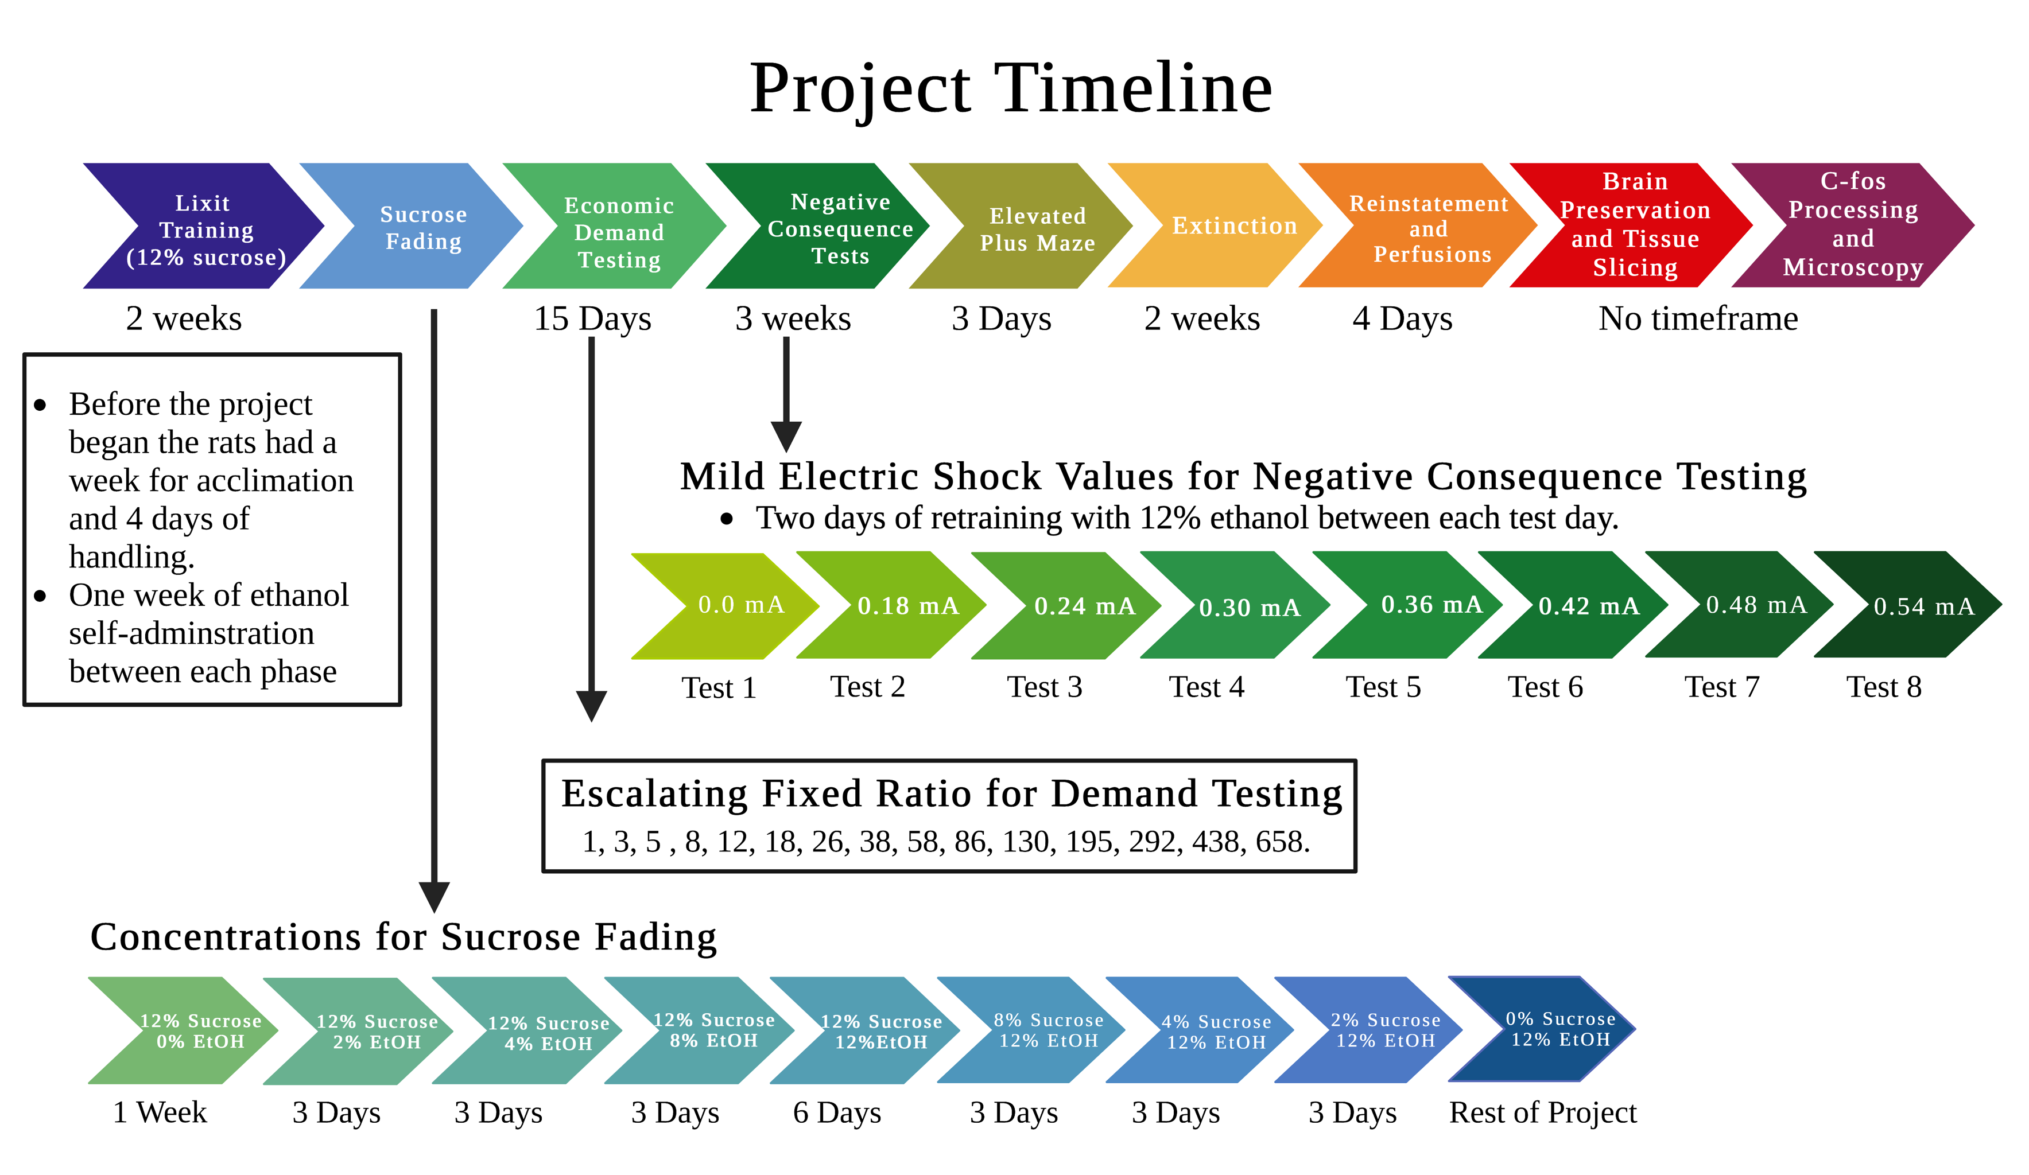
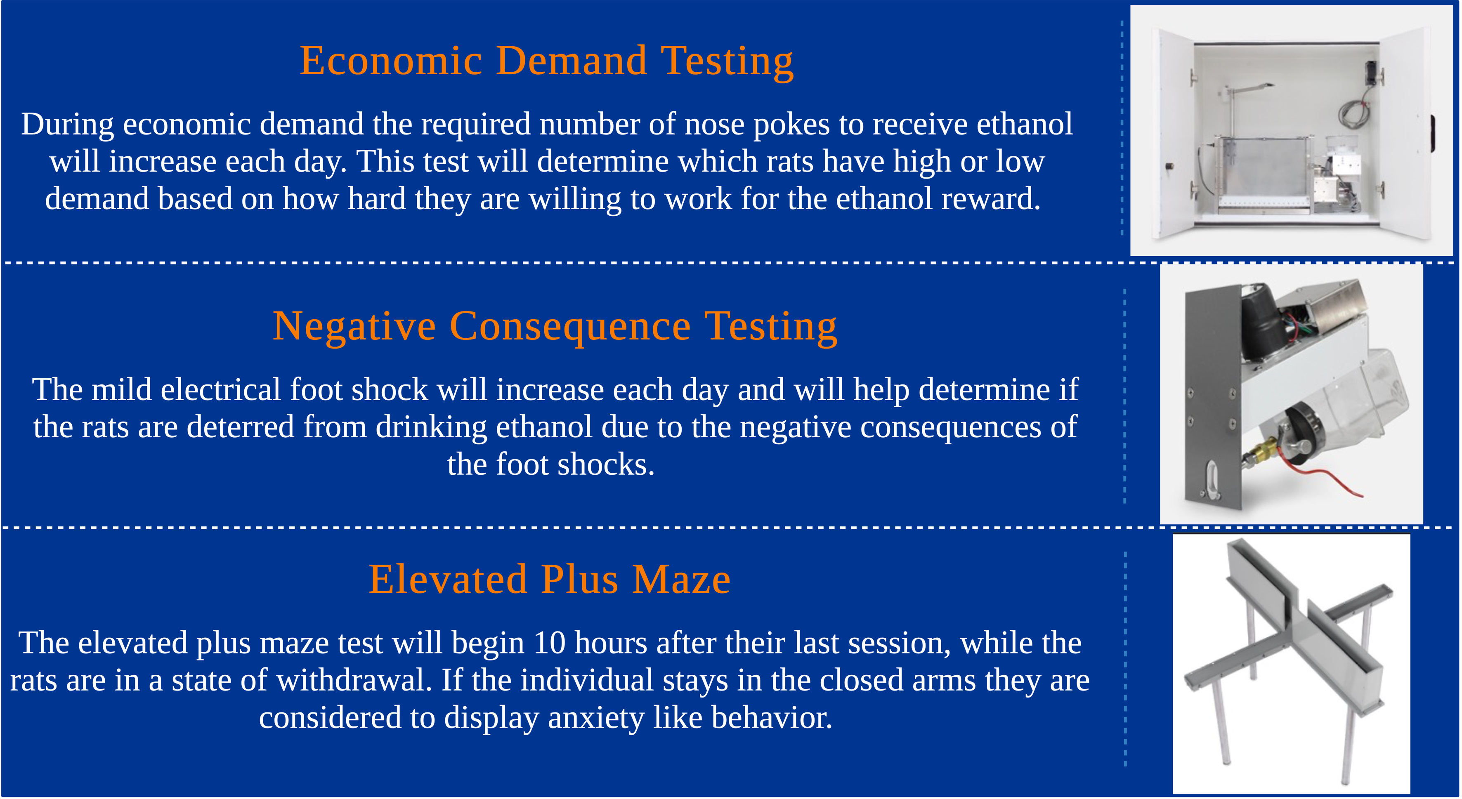
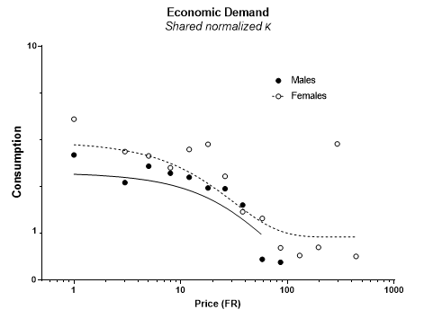
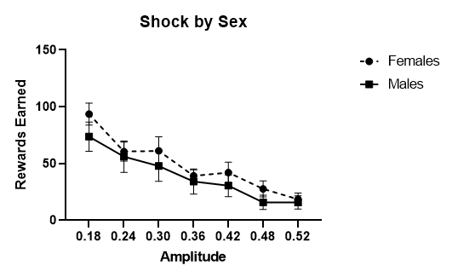
Individual Behavioral and Neurobiological Markers Associated with
Vulnerable to Alcohol Use Phenotype
Kelsey Alimandi², Hannah Manning³, Anna Kalinowski, Ethan O'Keefe, Haily Knapp, Blake Tower,
Megan Deane, Jessica Mulligan, Karina Babina, Sergios Charntikov¹
Department of Psychology¹, Department of Biological Sciences², Department of Molecular, Cellular, and Biomedical Sciences³
University of New Hampshire, Durham, NH 03824
Alcohol Use Disorder
Expected Results
Alcohol use disorder (AUD) is defined as a chronic brain disease characterized by excessive alcohol consumption, withdrawal symptoms (anxiety, depression, irritability), and continued use in the face of negative consequences (social, economic, legal, physical).¹
  18 million Americans have AUD.²
  It is estimated that the economic burden of alcohol consumption is $249 billion per year in the U.S.²
  5.3% of all global deaths are attributed to alcohol consumption. ³
One of the main obstacles of treating AUD is that it is a chronic relapsing disorder. Relapse can be triggered due to conditioned environmental cues that are associated with alcohol consumption such as the smell, environment, lighting, etc.⁴
We expect to see a distinct differentiation between rats with high demand for ethanol and low demand for ethanol.
We predict that rats with high demand for ethanol will persist more in the face of negative consequences and will show higher anxiety-like symptoms than those with low demand.
We expect to see a higher likelihood of reinstatement of ethanol-seeking behavior in rats that have high demand for ethanol, compared to those that have low demand.
We expect to see increased activity of brain regions involved in ethanol-use relapse in rats with high demand, compared to lower activity in rats with low demand for ethanol.
Next Steps
Ethanol Brain Regions
This study is the second replication in a series. Once this study is complete, a full behavioral data analysis will be completed, and the neurobiological data will be collected in the summer of 2023.
From this study, we are expecting to have a greater understanding of the brain regions involved in alcohol-use relapse, in the hopes of aiding future treatment research.
The data from these two replications will be published in a paper by Dr. Charntikov upon completion of the study.
Many brain regions are involved with alcohol use disorder (AUD), but different areas are engaged during separate phases of addiction (self-administrating alcohol, abstinence/withdrawals, relapse).
The following brain regions will be examined following cue-induced ethanol reinstatement, which is meant to mimic relapse in a human with AUD.
  Orbitofrontal Cortex⁵
  Ventral pallidum⁶
  Ventral tegmental area⁷
  Lateral Hypothalamus⁸
  Nucleus accumbens core and shell⁹
  Basolateral amygdala⁹
  Prefrontal Cortex⁹
  Hippocampus⁹
Acknowledgements
Thank you to the UNH Hamel Center for Undergraduate Research for funding this project. Thank you to graduate student Anna Kalinowski, and undergraduate students Ethan O'Keefe, Haily Knapp, Blake Tower, Megan Deane, Karina Babina, and Jessica Mulligan for their contributions to the project. Thank you to Dr. Charntikov for being the principal investigator for this project. This study was partially supported by NIGMS (GM113131) grant.
Innovation
Expected Results
Unlike past studies that have focused on group and gender differences this study will analyze the individual differences in ethanol self-administration.
We aim to interpret ethanol self-administration on an individual level to determine a vulnerable to alcohol used endophenotype.
This project is implementing a long access self-administration model, which is rarely used in previous literature. By exposing subjects to ethanol for an extended period we hope to collect data that is more like alcohol use disorder.
References
Yale Medicine. 2022. Alcohol Use Disorder (March 30, 2023). Retrieved from https://www.yalemedicine.org/conditions/alcohol-use-disorder.
Medline Plus. 2019. Alcohol Use Disorder (AUD) (September 26, 2022). Retrieved from https://medlineplus.gov/alcoholusedisorderaud.html.
Centers for Disease Control and Prevention. 2022. Excessive Drinking is Draining the U.S. Economy. Retrieved from https://www.cdc.gov/alcohol/features/excessive-drinking.html.
World Health Organization. 2022. Alcohol. Retrieved from https://www.who.int/news-room/fact-sheets/detail/alcohol#:~:text=Worldwide%2C%203%20million%20deaths%20every,represents%205.3%25%20of%20all%20deaths..
Liu X. and F. Weiss. 2003. Stimulus conditioned to foot-shock stress reinstates alcohol seeking behavior in an animal model of relapse. Psychopharmacology 168: 184-191.
Bianchi, P.C., P.E. Carneiro de Oliveira, P. Palombo, R.M. Leao, H. Cogo-Moreira, C.S. Planeta, and F.C. Cruz. 2018. Functional inactivation of the orbitofrontal cortex disrupts context-induced reinstatement of alcohol seeking in rats. Drug and Alcohol Dependence 186: 102-112.
Prasad, Asheeta A., and Gavan P. McNally. “The Ventral Pallidum and Relapse in Alcohol Seeking.” British Journal of Pharmacology 177, no. 17 (September 2020): 3855–64.
Engleman, Eric A., Elizabeth J. Keen, Sydney S. Tilford, Richard J. Thielen, and Sandra L. Morzorati. “Ethanol Drinking Reduces Extracellular Dopamine Levels in the Posterior Ventral Tegmental Area of Nondependent Alcohol-Preferring Rats.” Alcohol (Fayetteville, N.Y.) 45, no. 6 (September 2011): 549–57.
Marchant, N. J., Kaganovsky, K., Shaham, Y., & Bossert, J. M. (2015). Role of corticostriatal circuits in context-induced reinstatement of drug seeking. Brain Research, 1628, 219–232. https://doi.org/10.1016/j.brainres.2014.09.004
Jupp, B., E. Krstew, G. Dezsi, and A.J. Lawrence. 2011. Discrete cue-conditioned alcohol-seeking after protracted abstinence: pattern of neural activation and involvement of orexin receptors. British Journal of Pharmacology 162: 880-889.
These graphs were plotted using behavioral data from the previous replication of this study. We are expecting the behavioral data from this study to follow similar trends.

