Slide 1
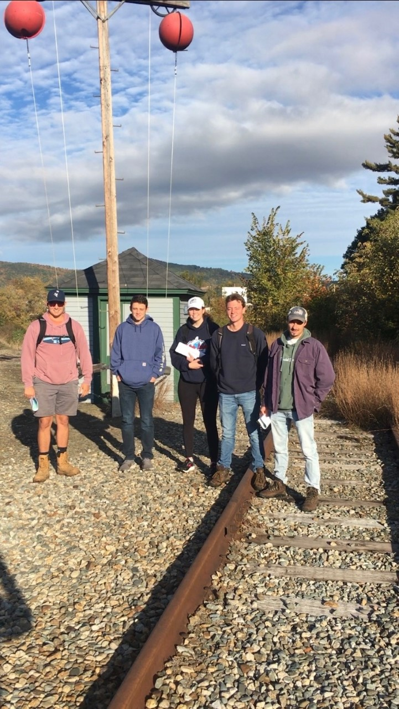
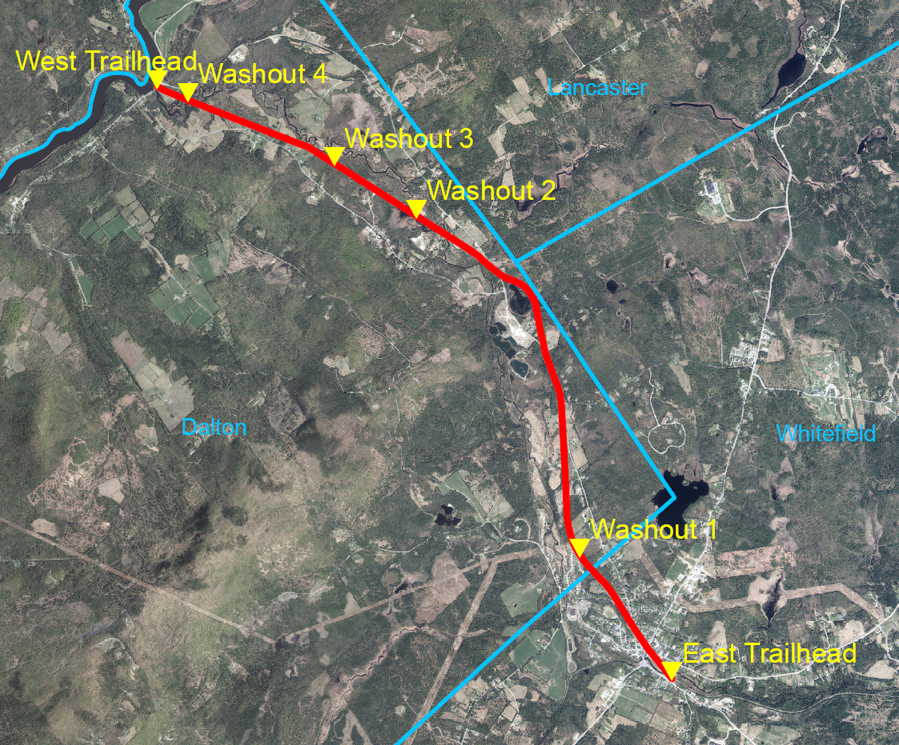
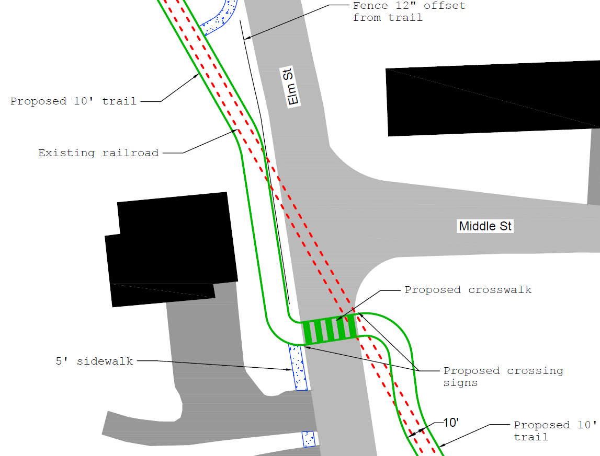
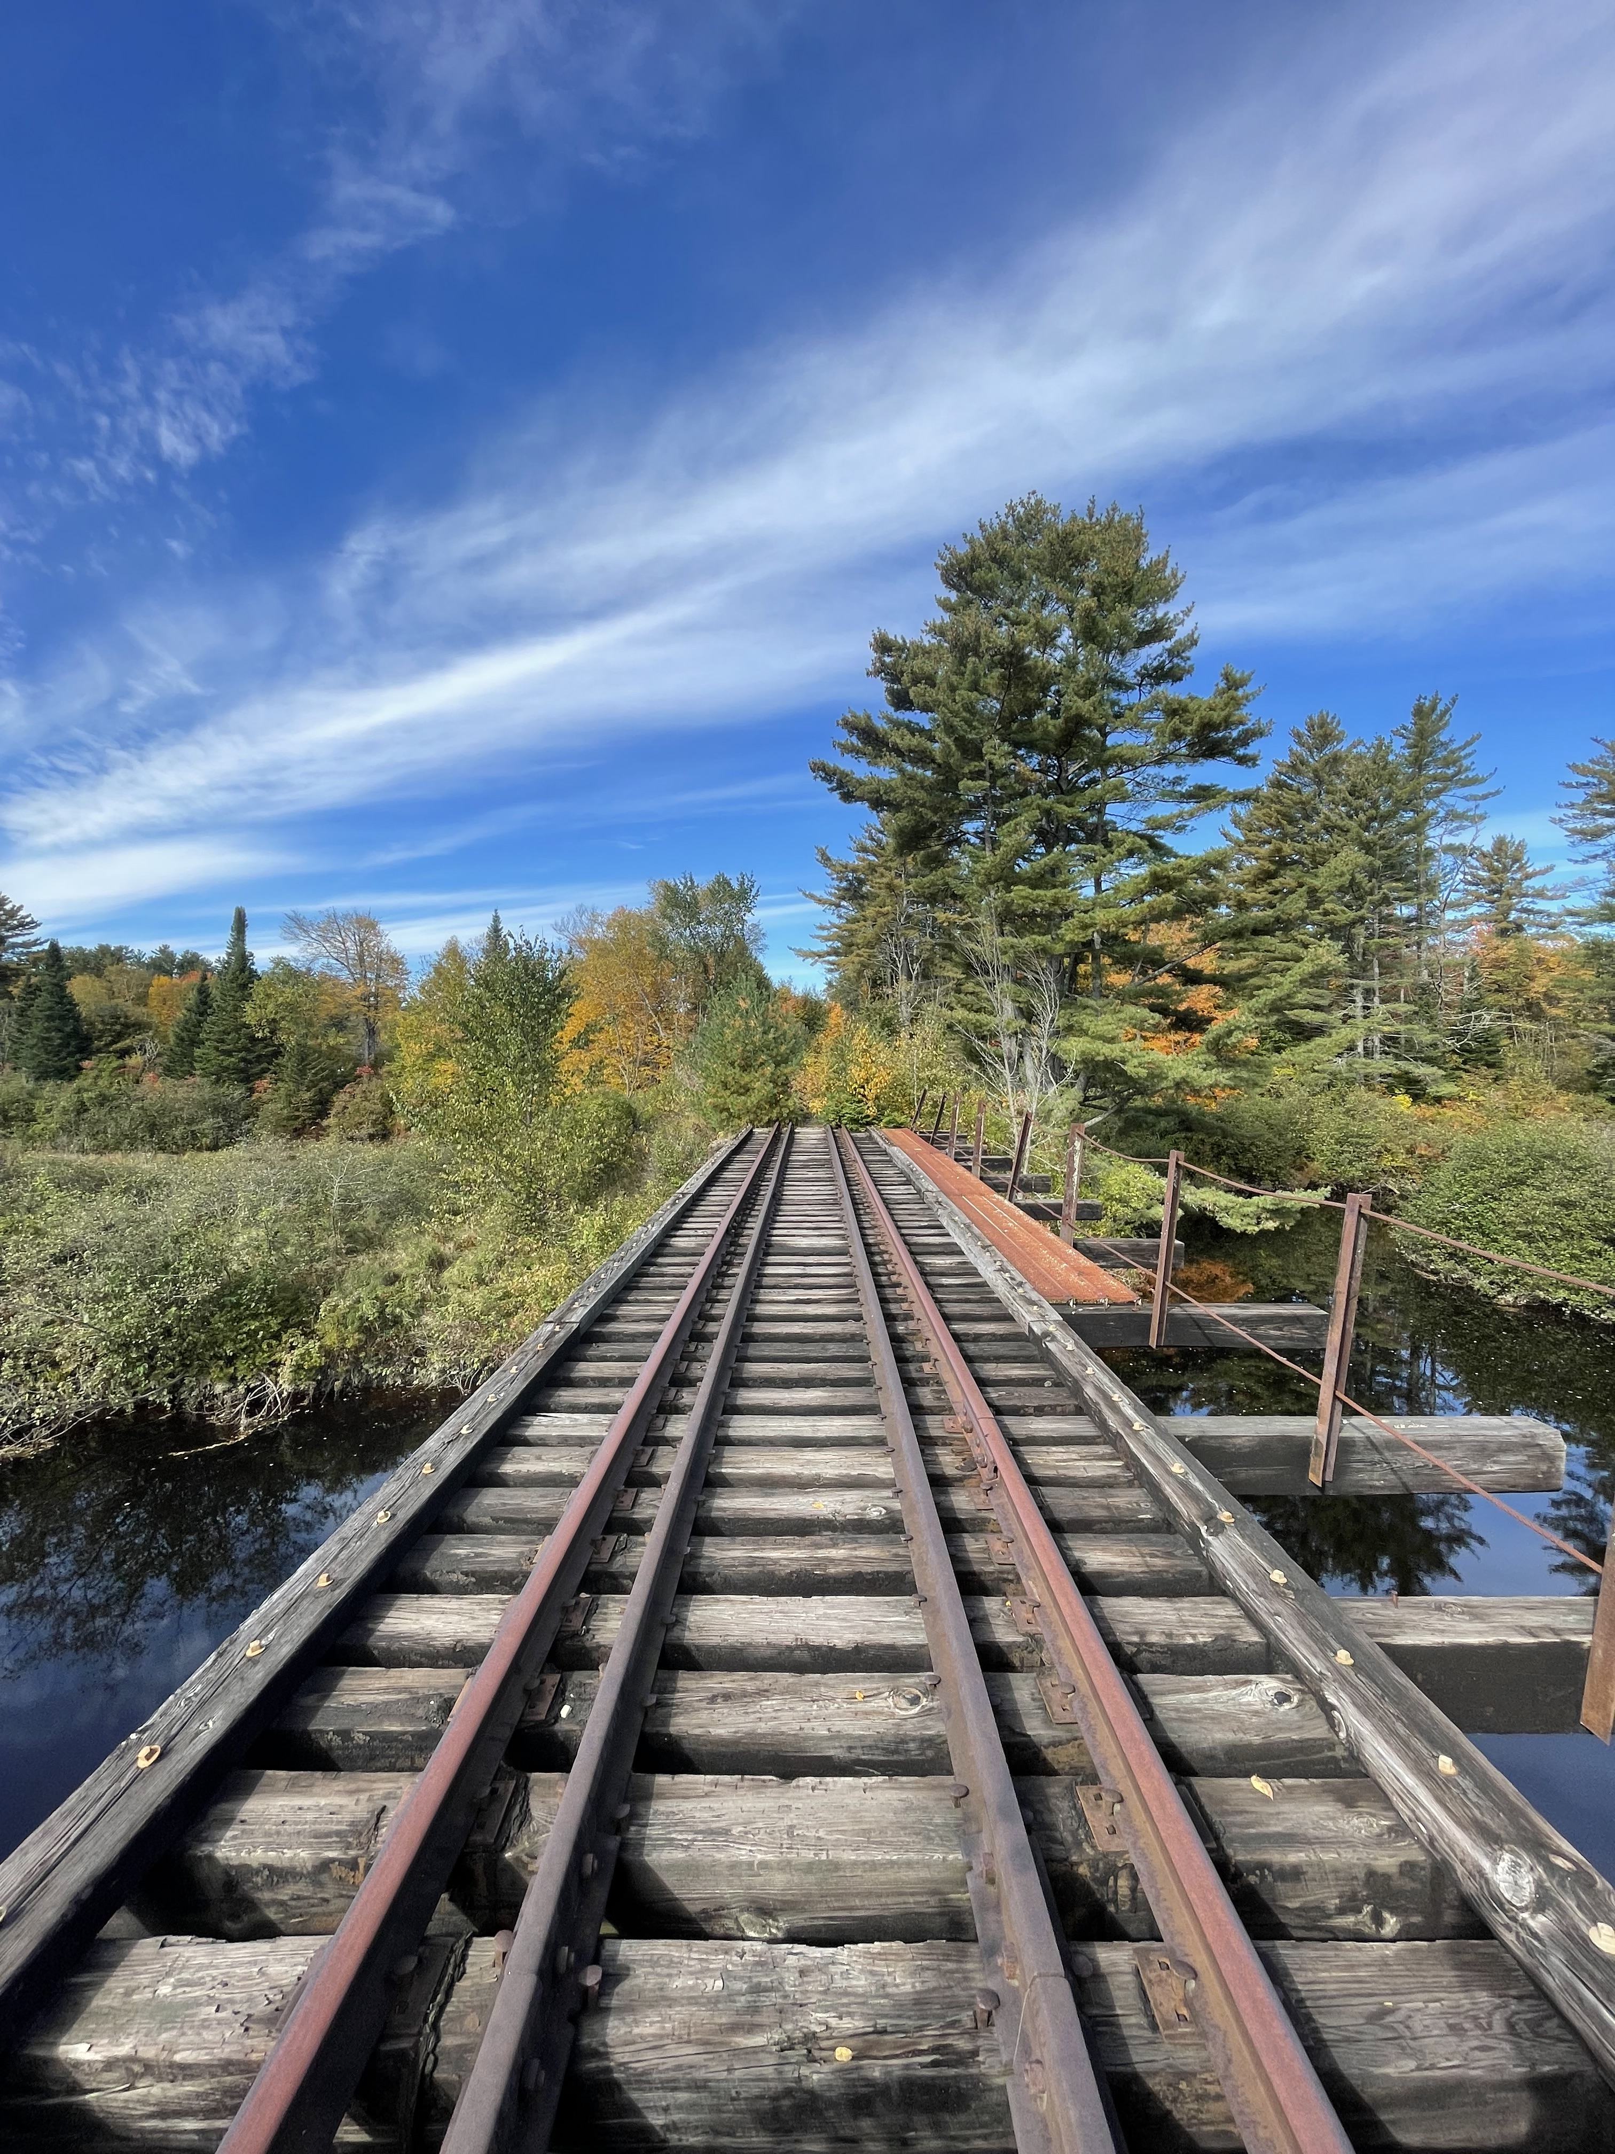
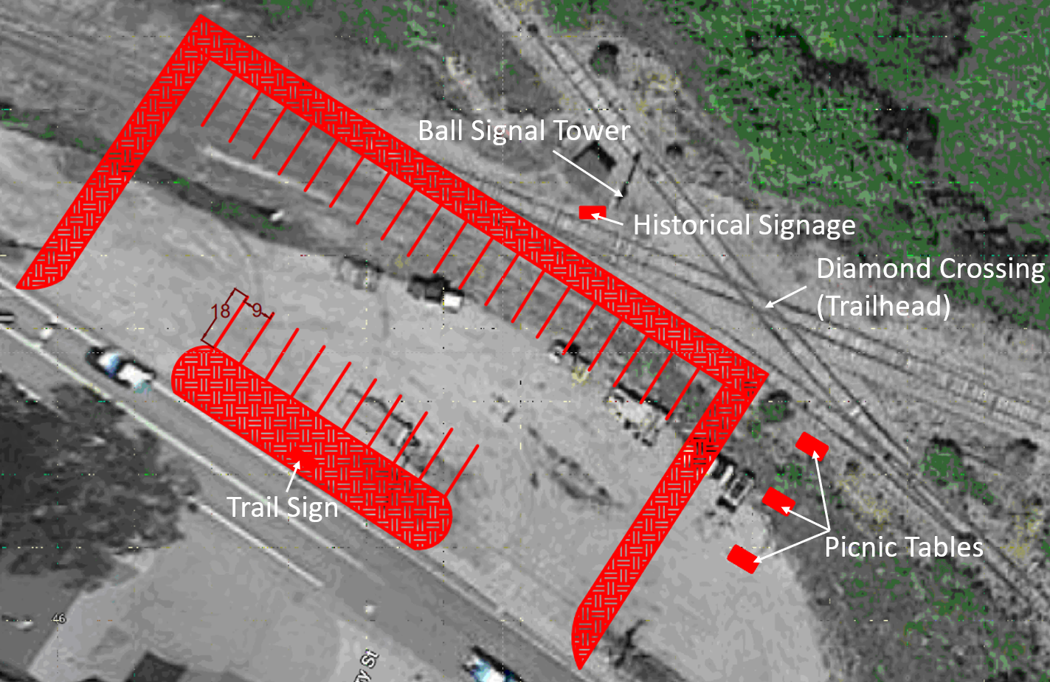
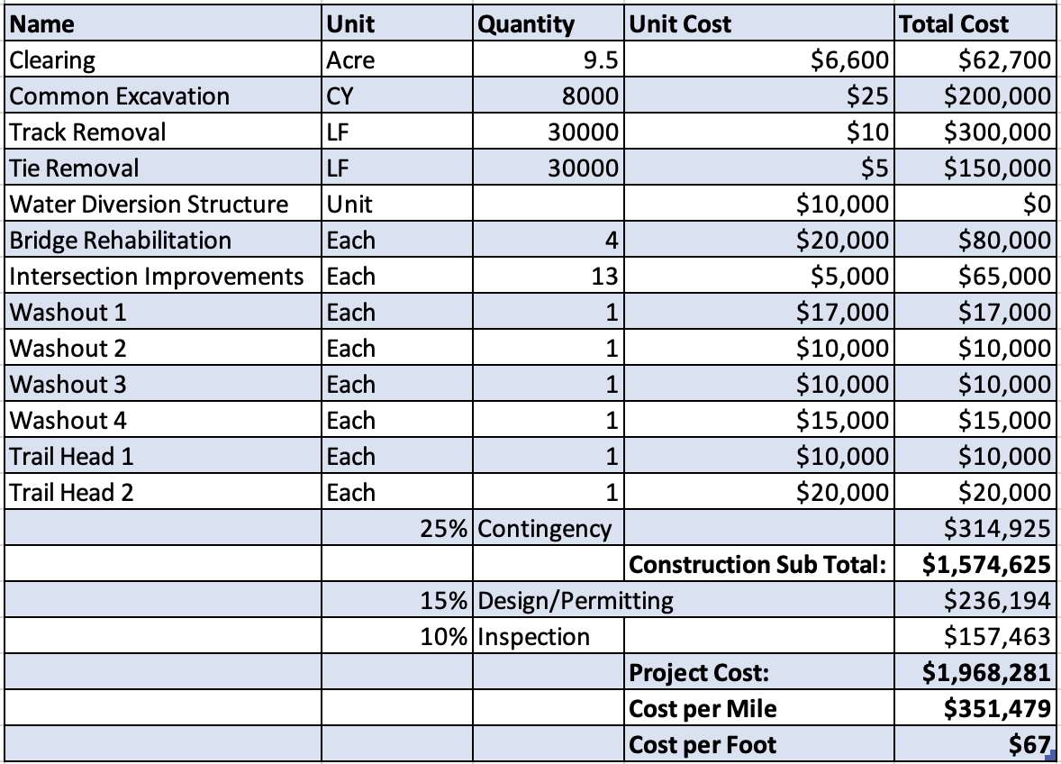
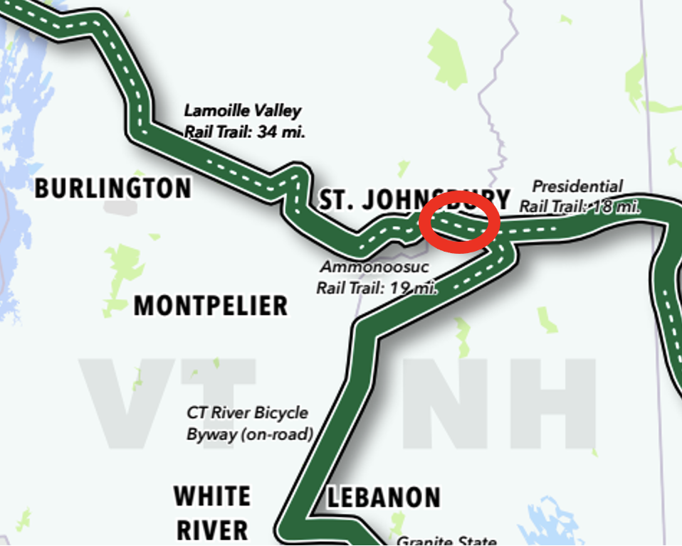
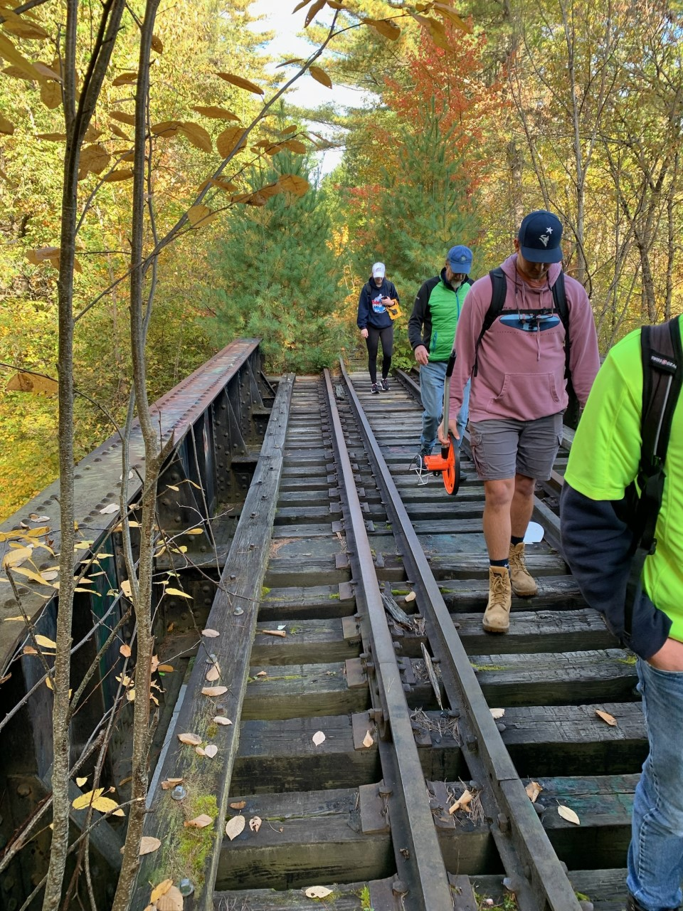
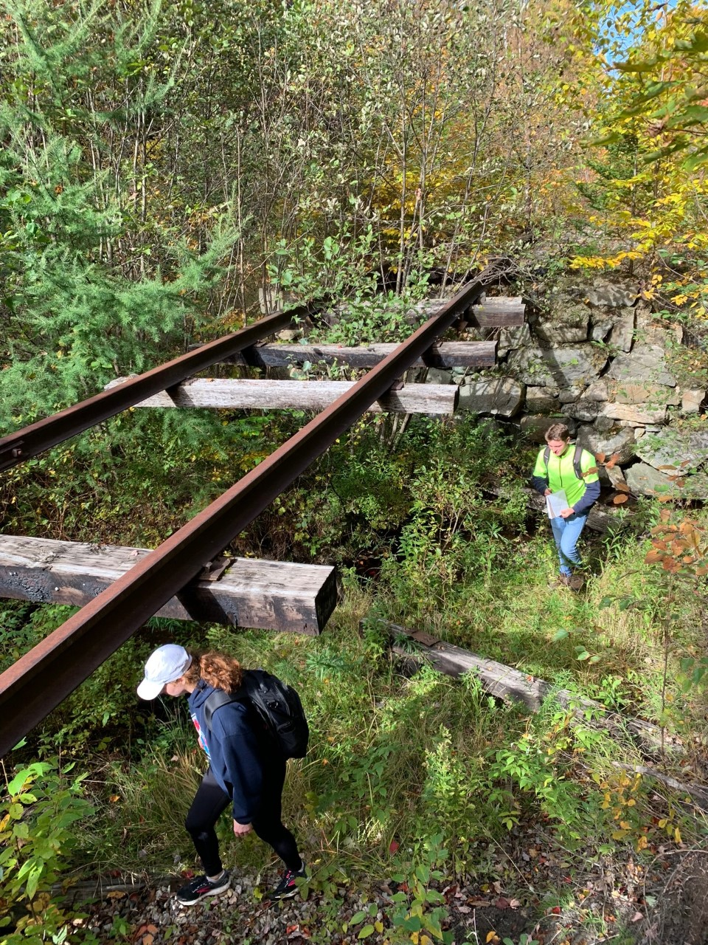
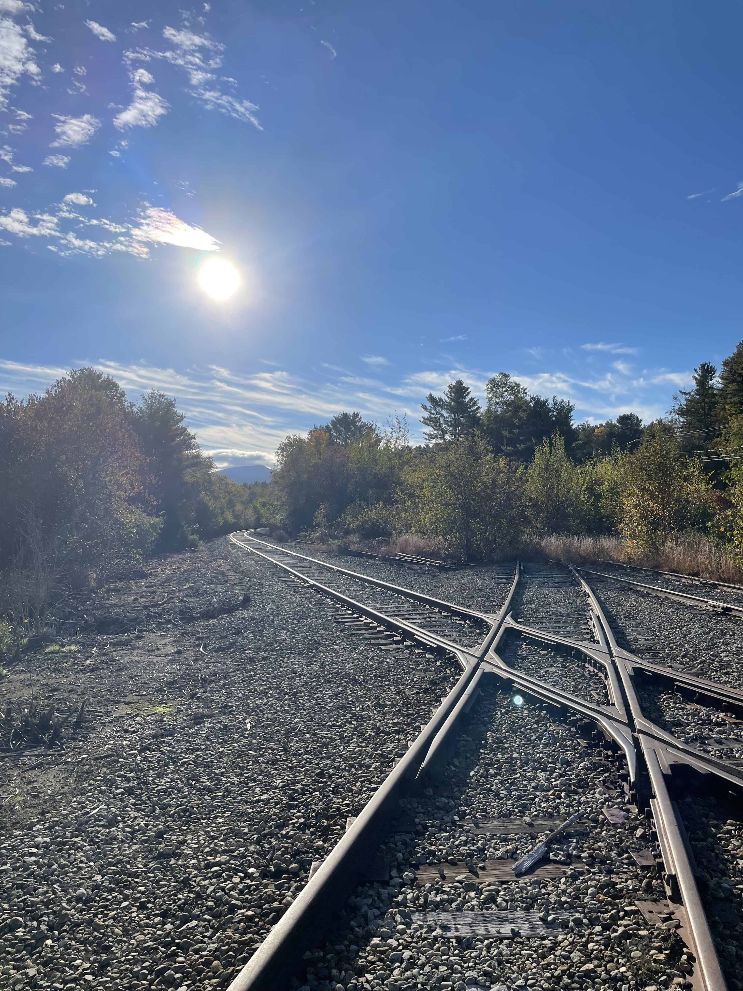
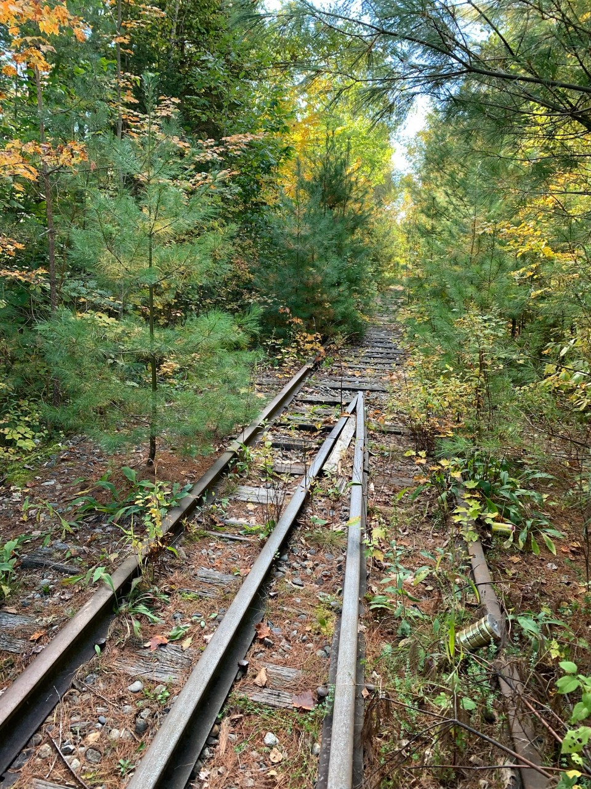
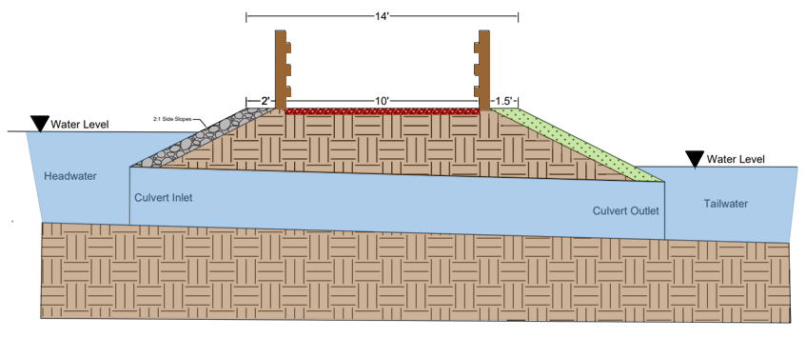
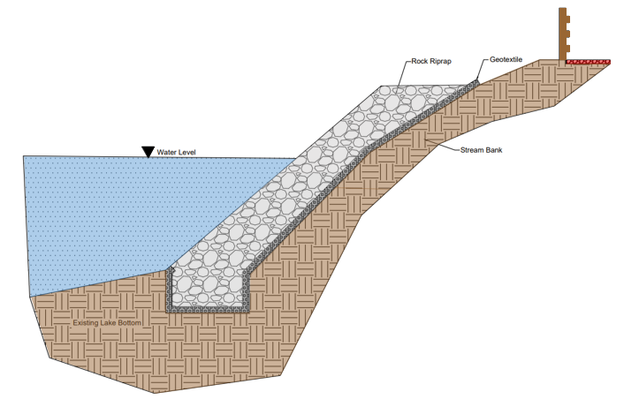
Twin State Railroad Rails-to-Trails Project Maggie Danehy, Nick Querrazzi, Jeremy Larkin, Evan Proulx & Patrick Gunter Civil & Environmental Engineering, University of New Hampshire, Durham, NH 03824
Abstract
Project Location
Typical Road Crossing
Overview:
Located in Dalton & Whitefield in Northern NH
Out of service since 1999
The railway is in disrepair after years of neglect
5.6-mile section of the Twin State Railroad into a 4-season recreational trail
Construct 10 ft wide stone dust path on former railway
The trail will cross the road at a 90-degree angle to increase safety for trail users by decreasing the crossing length and providing advanced signing and pavement markings.
Trailhead Parking Lot Design
Project Cost Estimate
Washouts
sTAMD Simulations
Site Visit
Existing and Proposed Trail
Caused by beavers clogging the culverts running beneath the rail bed and from riverbank erosion by the Johns River
Remove existing culverts Install new culverts with beaver deceivers
Reinforce riverbank with riprap and a geotextile layer
Existing Trail Conditions
Proposed Trail Cross Section
Culverts will be located at washout 1,2,&3
Riprap will be installed on trail bank where necessary
Fences will be put up along steep banks and riprap installation
10’ wide trail base made up of crushed stone
2:1 side slopes are optimal
Acknowledgements
Project Sponsors – Rob McConaghy, Marianne Borowski & Twin State Railroad Working Group
Dalton Ridge Runners – Wayne St. Hilaire, Gary Greenwood, and Allen Rexford
Project Advisors – Tony Puntin P.E. & Matt Low P.E.
Notes:
48 x 34 design/ permitting 15% cost estimate, delete “cost of”

