Slide 1

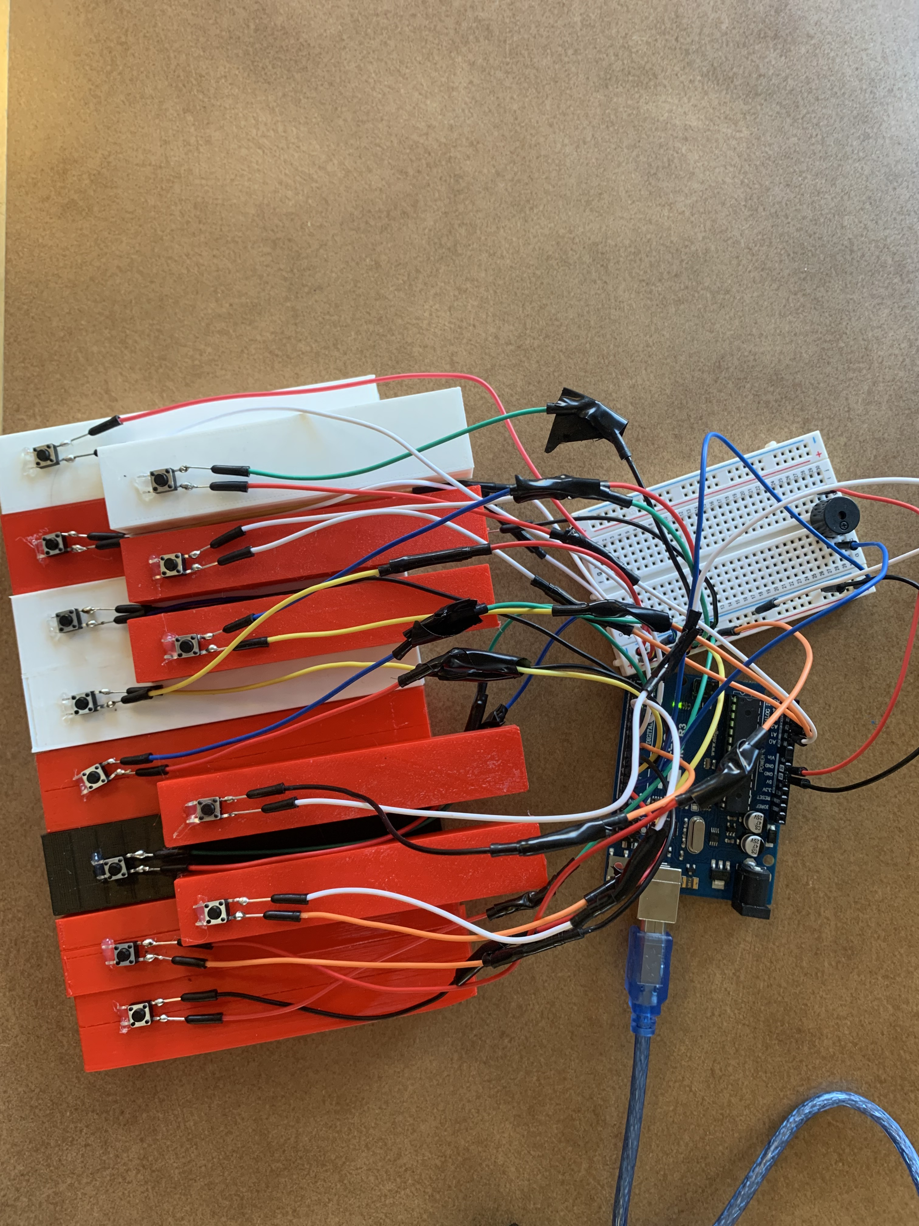
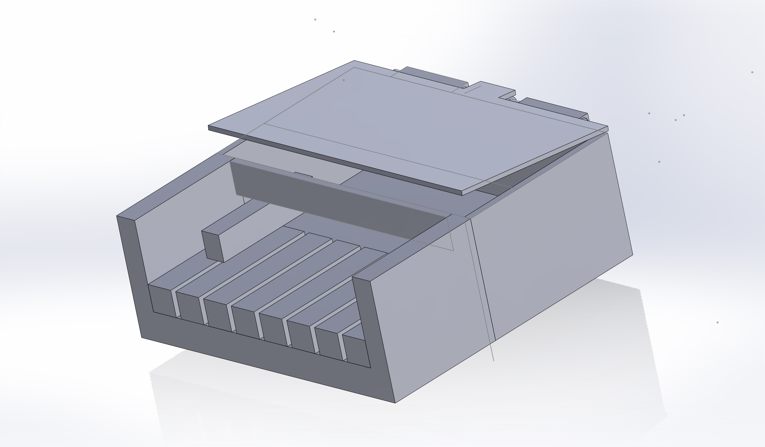
Miniature Keyboard
Jarrett Madru & Joshua Riley
Department of Chemical Engineering and Physics, University of New Hampshire
Introduction
Arduino (The Brain)
Conclusion
Our project intends to explore the viability of 3-D printing as a method of production for fields such as toys, general part production, etc.
In conclusion, we found that 3-D printing as a form of mass manufacturing to be impractical. Due to the following factors
The slow speed of 3-D printing.
The many small details (bed adhesion, temp, leveling) that can ruin a print.
Not ideal for mass manufacturing.
We found that 3-D printing is more useful for small hobbyist projects rather as a commercial method of production. Instead, we recommend that companies stick to tradition methods of plastic manufacturing that are currently utilized like injection molding.
Main Keyboard
Methods
Figure 2
To explore this idea, we decided to produce a
miniature keyboard utilizing:
An Ender-3 and Flash Forge Creator Pro Printer using PLA filament
An Arduino Uno and the accompanying Arduino IDE software
A Breadboard along with jumper wires and piezo buzzer
Solidworks 2022 Software
Results
We’ve been able to produce an Arduino code that can properly take the input that the buttons feed to the PCB to produce 13 equal tempered tones as a real piano/keyboard would. Additionally, we've been able to produce a design in SolidWorks that creates a working template for both the base and the keys themselves (Figure 1), and we with the help of those two and some hands-on construction and final, we were able to make our final product. We didn't end up using the base because of extraneous complications, and in order to reduce the scope of the project for the sake of practicality and getting it done in time, we restricted our keyboard to one octave, but the design and framework we made allows for this to easily be extended into something bigger had we been allowed more time for 3d printing and resources.
The Code
#define T_C 262
const int C = 10;
pinMode(LED, OUTPUT);
pinMode(C, INPUT);
digitalWrite(C,HIGH);
while(digitalRead(C) == LOW)
{
tone(Buzz,T_C);
digitalWrite(LED,HIGH);
}
This code was repeated for each of the 13 keys.
.
Figure 1

