Slide 1


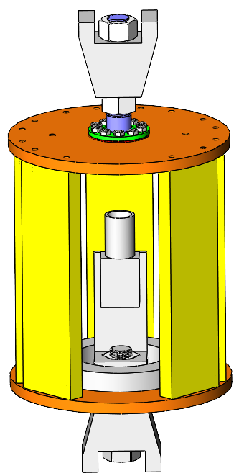
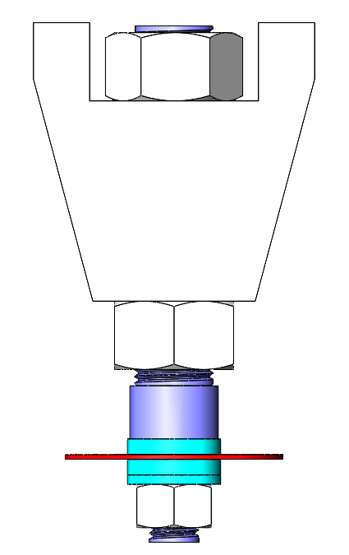
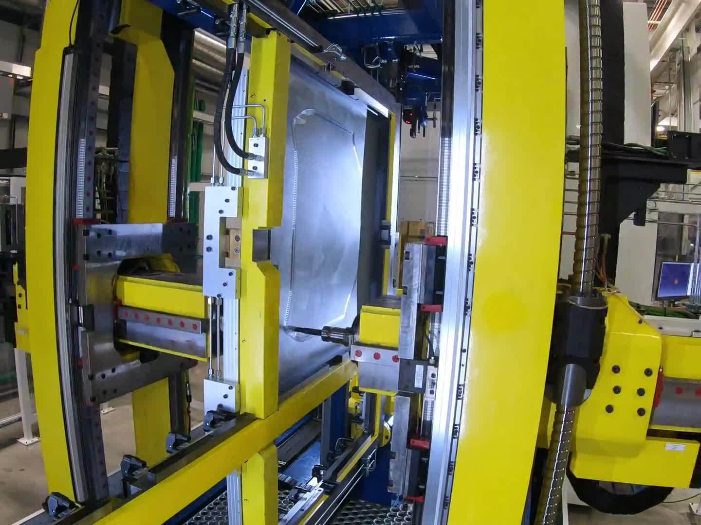
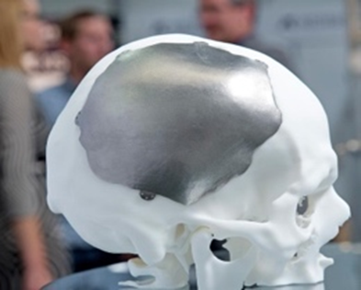
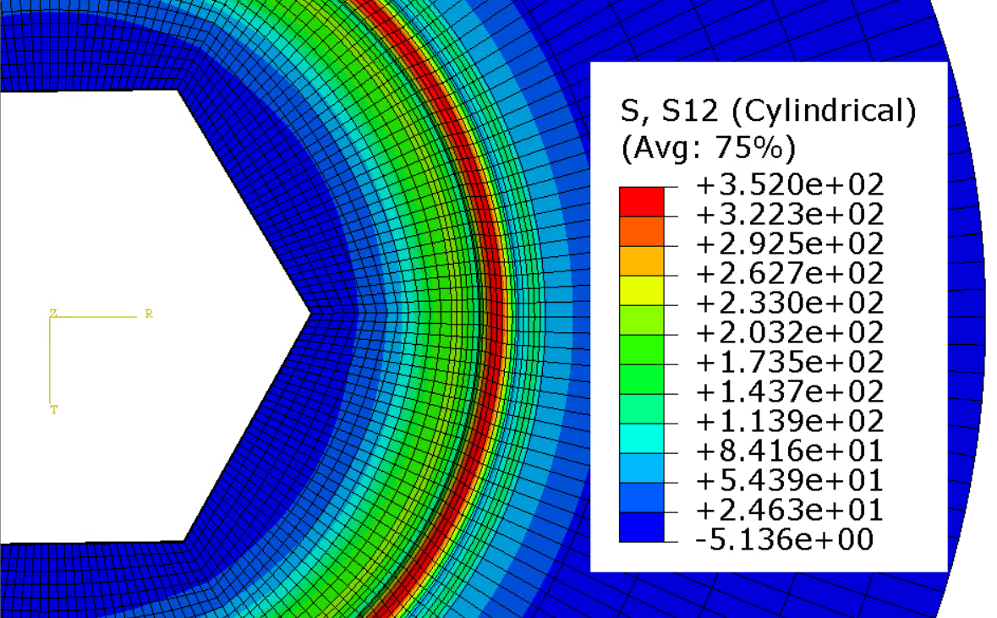
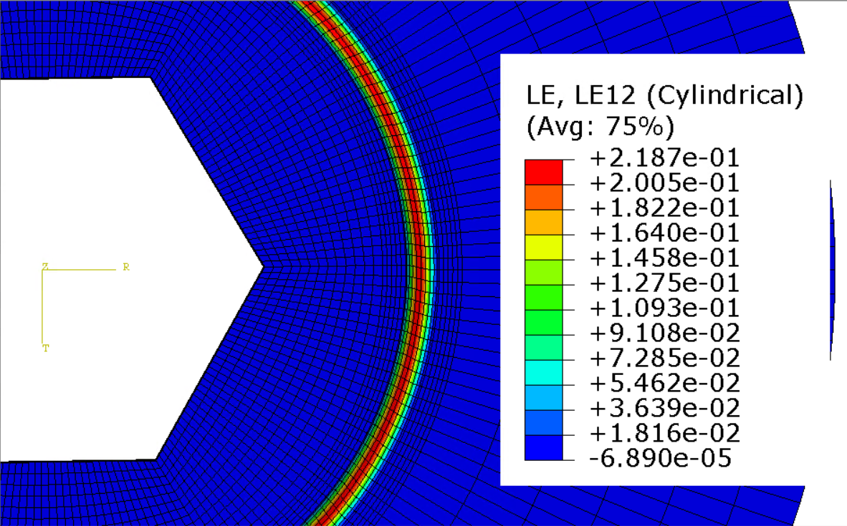
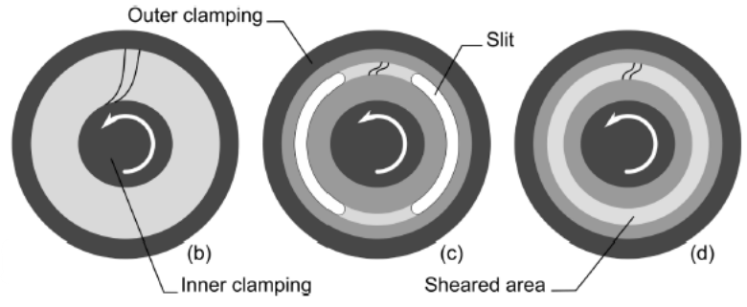
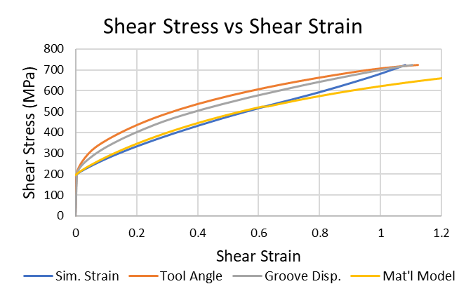
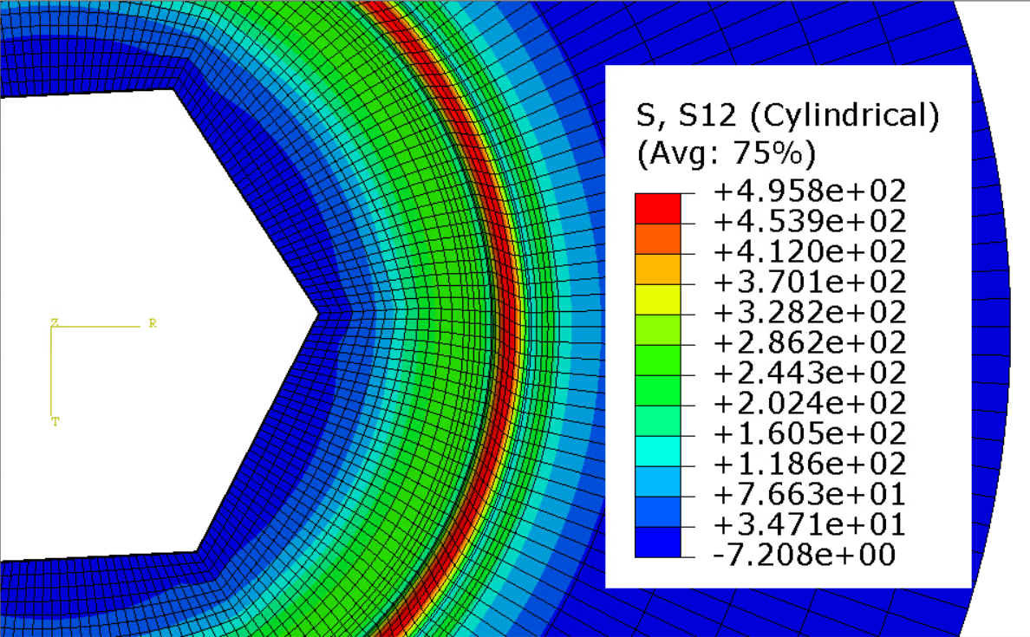
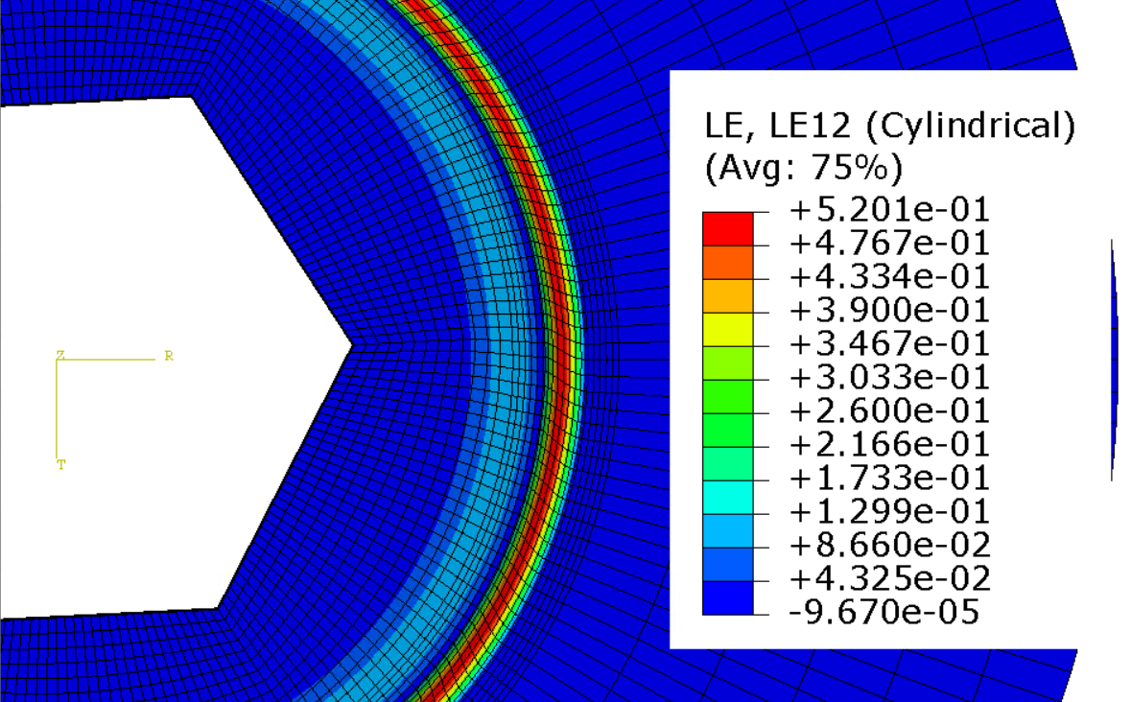



Development of In-Plane Torsion Testing Fixture and Experiment for Sheet Metal
Matthew Eaton
Department of Mechanical Engineering, University of New Hampshire, Durham, NH 03824
Advisor: Dr. Jinjin Ha
Objective
Design
Future Studies
Design a fixture and specimen for measuring shear stress-strain curve in sheet metal loaded in torsion
Should be capable of testing materials of varying strength and thickness
Perform finite element (FE) simulations to predict the elasto-plastic deformation and compare with physical testing
Specimen and fixture designed to test material up to 3 mm thick and 1500 MPa ultimate strength
MTS 809 used for testing has maximum torque of 2200 Nm
2D-digital image correlation (DIC) used to measure the strain field, Camera must be able to view groove head-on for 2D measurement
Equation used to determine specimen dimensions: $T_{s}=\left(2πR_{m}\right)t_{m}\left(\frac{σ_{u}}{\sqrt{3}}\right)R_{m} ,$where $T_{s}: torque, R_{m}$: gauge radius, $t_{m}$: gauge thickness, $σ_{u}$: ultimate strength
Abaqus FE simulations performed to find optimal central clamping mechanism: clamping force provided by 16 mm nut, with hex feature to provide additional resistance
Inner and outer clamping leave small exposed area around groove for stress to concentrate
Complete fabrication and assembly of fixture
Initial testing to validate fixture using mild steel
Testing 1.2 mm SS316L and CP-Ti. Results to be compared to simulations
Monotonic loading to various strains and failure
Cyclic loading: forward-reverse-forward to failure
Additional simulations of various loading conditions
Background
Shaft with hex feature and mating washers clamp in center
Shaft and washers to be heat treated and knurl on washer face
Outside clamped to top of “birdcage” base with room for DIC camera and lighting inside
Torque applied through base to outer area of specimen
Conclusions
Double-sided incremental forming (DSIF) is a flexible manufacturing process in which sheet metal is formed by two tools located each side of sheet with a preprogrammed tool path
Specimen
Analysis shows that fixture can test material up to 3 mm thick and 1500 MPa ultimate strength within machine constraints
Fixture designed to withstand highest possible torque. High stress parts to be heat treated
All methods of calculating stress-strain curve produce similar curves, direct simulation strain data produces closest curve to material model, comparable to strain measured via DIC
Difference due to strain occurring outside gauge area, nonuniform strain through gauge due to thickness variation
Tool angle and groove displacement estimations show higher stress due to assumption that all stress occurs within groove
Strain concentrates in groove as expected, mostly consistent at varying strain levels
Experimental data expected be comparable with simulation results
Compliance of the frame will need to be considered when analyzing experiments
Wedges fit in MTS grips
Used for prototyping in automotive industry
Desire to use for producing custom trauma hardware (e.g. cranial implant)
Produces high concentrated stress in parts
Desire to better understand material properties when programming machine path
Test needed to measure shear deformation
Shaft
Fixture Central Clamping
DIC Camera
Test Fixture
Dimensioned Specimen
Results
DSIF Machine at UNH Olson Center
Abaqus FE simulation using von Mises yield function and Hockett-Sherby hardening for SS316L
1.2 mm thick specimen, 0.6 mm deep groove
Rigid tool clamped to mimic shaft and washer, Rotation applied
Stress-strain curve for center of groove compared using multiple methods
Shear stress calculated from tool reaction moment: $τ=\frac{M}{r}/(2πrt)$
Cylindrical coordinate system created and shear strain extracted from simulation
Strain calculated from tool angle assuming uniform strain across groove: $γ=r\left(\frac{θ}{2}\right)/w$
Avg displacement of nodes at groove center measured, used to calculate strain$:γ=δ/\left(\frac{w}{2}\right)$
Methods compared with material model converted to shear
Plots of shear stress and shear strain shown for two distinct strain levels
Stress and strain concentrate in groove, consistent pattern regardless of strain
Maximum strain at center of groove
Cranial Implant
Acknowledgements
Similar tests developed using disc type specimen
Inner clamping twisted with respect to outer clamping
Groove mid-radius to concentrate stress
NSF Award # 1757371 – NH BioMade
Scott Campbell – Manufacturing of fixture parts
Kelly Danforth – Ordering and administration
Dr. Brad Kinsey – Additional advising
Shear Stress (MPa) and Strain ~22%
References
$τ$: shear stress
$γ$: shear strain
M: tool moment
$r$: gauge radius
$t$: gauge thickness
$w$: gauge width
$θ$: tool angle
$δ$: disp. along circ.
[1] Grolleau, V., Roth, C.C., & Mohr, D. (2022). Design of in-plane torsion experiment to characterize anisotropic plasticity and fracture under simple shear. International Journal of Solids and Structures, 236-237.
[2] Peng, W., Ou, H., & Becker, A. (2019). Double-Sided Incremental Forming: A Review. J. Manuf. Sci. Eng., 141(5). https://asmedigitalcollection.asme.org/manufacturingscience/article/141/5/050802/727269/Double-Sided-Incremental-Forming-A-Review
Specimen Examples [1]
Shear Stress (MPa) and Strain ~52%

