Slide 1

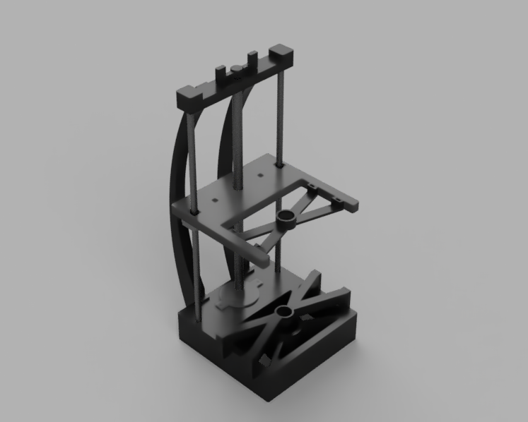
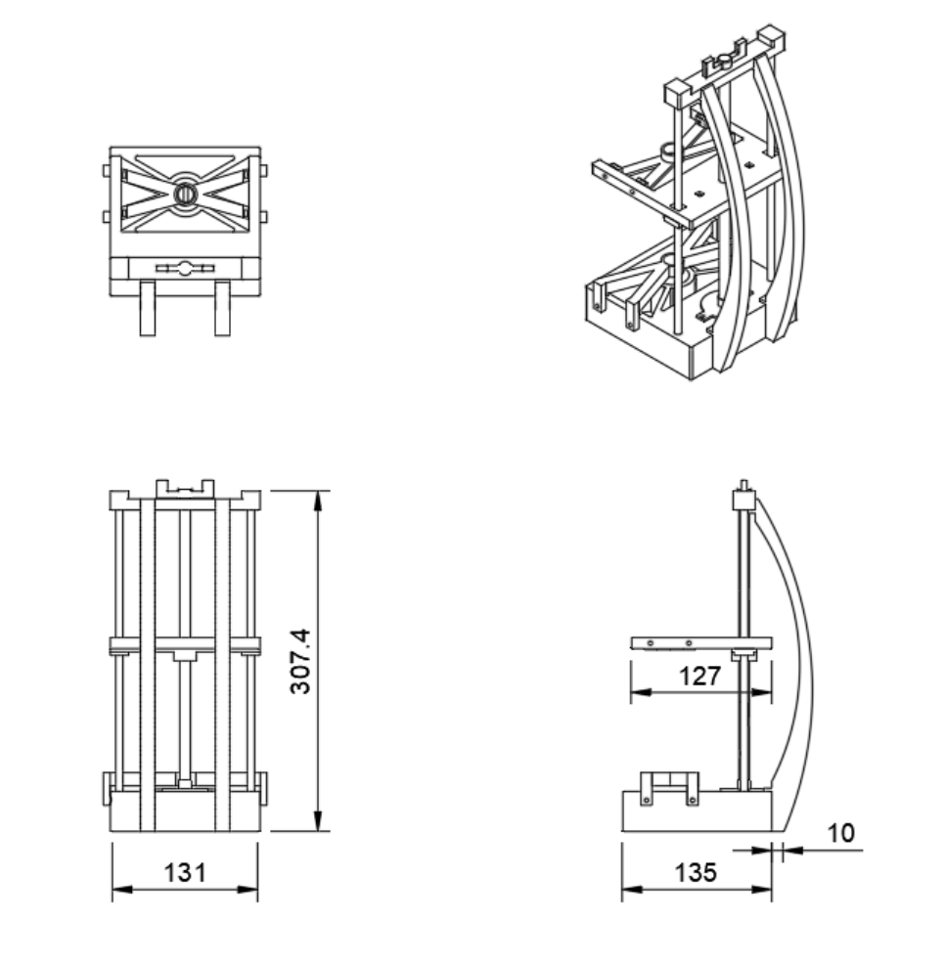
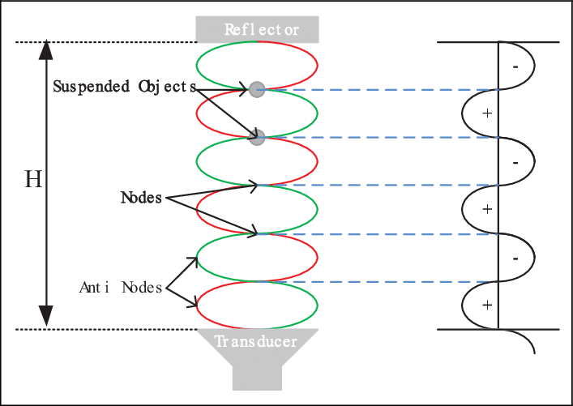
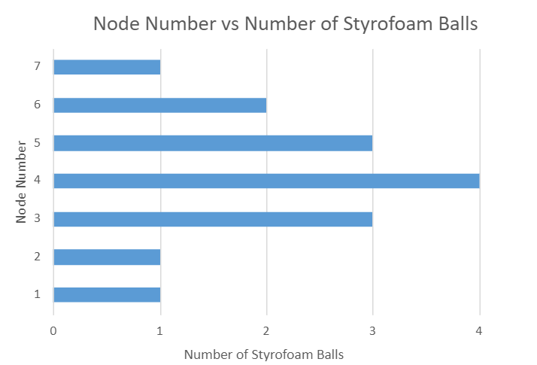
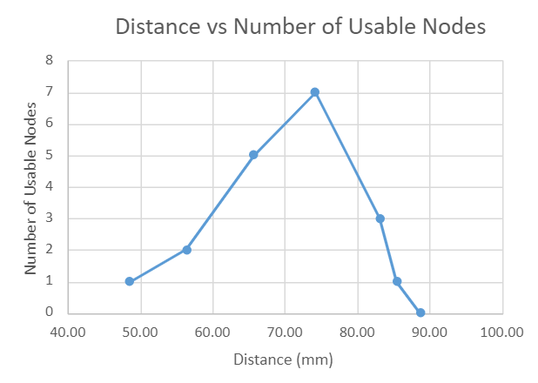
Ultrasonic Levitation
Pedro Doukas, Geo de Clermont, Connor Barnard, Mekan Annayev, Innovation Scholars, University of New Hampshire
background
Design
APPLICATIONS
Ultrasonic levitation is a way to suspend objects using high frequency (≈>25kHz) sound waves. The technique is based on the principle that sound waves can create pressure nodes and anti-nodes in a medium, allowing small objects to be trapped at a pressure node. This is achieved using a transducer made of piezoelectric materials, which undergo a physical deformation when an electrical signal is applied.
So far, ultrasonic levitation only works on objects a few millimeters in size.
Insects and other small creatures can be held in place, which allow us to carefully study them under a microscope without touching them.
Another example is levitating the small components used to build modern electronics. Using the levitation device to hold the components where even slight physical touch could cause damage.
In addition, Ultrasonic levitation can be used to manipulate even smaller things, such as living cells.
One particularly exciting application is in tissue engineering, in which scientists are trying to find ways of recreating skin or muscle.
Because of weight constraints use in a microgravity environment is more plausible.
A standing wave pattern is created when two identical waves interact with each other causing the low-pressure nodes and high-pressure anti-nodes to remain stationary.
Results
Observational Results:
The distance between the speakers and which node the object was in greatly affected the stability of the objects. Most notably the objects in the node directly in the middle between the speakers was always the most stable.
More speakers in the correct orientation increases the stability of the objects in the nodes.
Experimental Results:
Methods
Conclusions
We began by setting out to design a stand that would allow us to easily hold different arrangements of speakers and easily adjust the height between the speakers.
We 3d printed a modular design for the stand that allows us to easily design and implement new arrangements and orientations of speakers.
To easily adjust the distance between the speakers we implemented a design that was inspired by a 3d printer’s z axis control which uses a threaded rod and two supporting rods to allow for ease of movement in the z axis.
For controlling and outputting sine waves on a speaker, we used an Arduino connected to a stepper motor driver which allows us easily control the frequency and power output to the speakers.
The frequency used to levitate was 40 kHz. This was deemed to be an optimal value for our transducers, but other frequencies can also work.
Ultrasonic levitation has limitations on size and weight of objects limiting its uses to small lightweight items. It has possible uses in the fields of microprocessor manufacturing and the biomedical field. Data collection is difficult because of the many factors that change the levitation properties (temperature, pressure, etc.) this makes isolating variables difficult. Future research would require more precise measuring equipment and controlled environments. With continuing this research, we would explore how changing variables such as wavelength, frequency, temperature, pressure, and medium effect the weight one can lift with ultrasonic levitation, along with other properties.
Figure 1
Figure 2
Figure 1 shows how many objects were able to float inside a given node. Node 1 is the topmost node and Node 7 is the bottommost. Data was taken at the distance with the most usable nodes.
Figure 2 relates the distance between the speakers to the number of nodes that were able to levitate a Styrofoam ball. The data shows that there is a large range of distances viable for levitation.
The number of Styrofoam balls that can be levitated in a single node gives insight to how large of an object can be levitated in each node simultaneously. It also gives insight into how much weight each node can levitate at a time.
Each ball weighed an average of 28 micrograms. A max of four balls means that the levitation can support 112 micrograms.
References
Boullosa, R. R., et al. “An Ultrasonic Levitator.” Journal of Applied Research and Technology, Elsevier, 4 Mar. 2015, https://www.sciencedirect.com/science/article/pii/S166564231371592X#fig0040.
“Contactless Building Construction Could Happen With This New Levitation Device.” CNET, https://www.cnet.com/science/contactless-building-construction-could-happen-with-this-new-levitation-device/. Accessed 11 Apr. 2023.
Yang, Yuanyuan & Shen, Shihui & Lui, Kating & Lee, Kwanhoi & Chen, Junduo & Ding, Hao & Liu, Linquan & Lu, Haojian & Duan, Lihong & Wang, Chunbao & Shen, Yajing. (2017). Ultrasonic robotic system for noncontact small object manipulation based on Kinect gesture control. International Journal of Advanced Robotic Systems. 14. 172988141773873. 10.1177/1729881417738739.

Slide 2
This poster template provided courtesy of
UNH ESRC Poster Printing Services
Trust us to make your poster look GREAT!
Website: http://posters.unh.edu
Poster Guide: http://goo.gl/1E7TJY
DELETE THIS SLIDE BEFORE PRINTING

