Slide 1
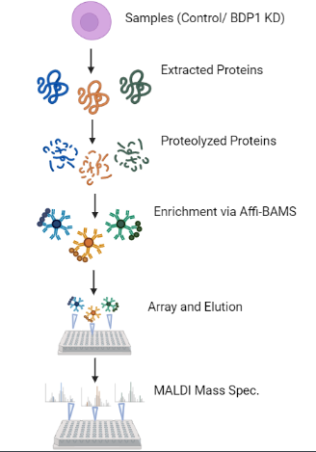
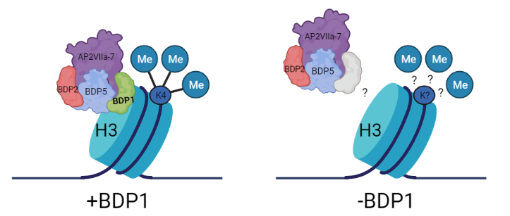
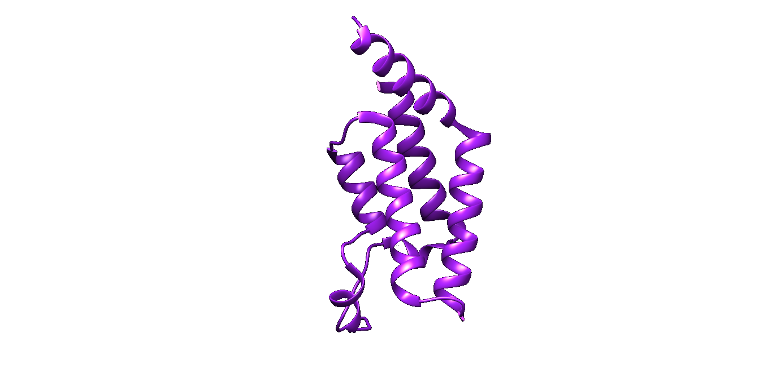
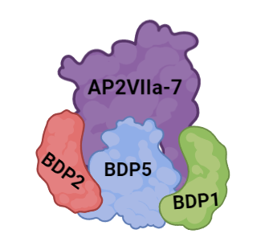
Bromodomain Proteins are Important Epigenetic Regulators in the Parasite Toxoplasma gondii
Joshua Berthiaume, Kendall Reidenbach, and Dr. Vicki Jeffers
Department of Molecular, Cellular, and Biomedical Sciences, University of New Hampshire, Durham, NH
Toxoplasma gondii
Hypothesis:
Prevalent parasite that infects approximately 25% of Americans
Immunocompromised and pregnant patients at high risk for disease complications
Currently no cure for chronic infection
Regulation of gene expression is critical for parasite to maintain infection in host
Understanding how Toxoplasma controls its gene expression can help to discovery of potential drug targets
TgBDP1 is recruited to chromatin to modulate methylation of histones
Figure 1. Toxoplasma Tachyzoites Growing in Human Fibroblasts
Figure 4. The Affect of TgBDP1 Loss on Histone Methylation is Unknown
Histone Modifications are Read by Bromodomains
Quantification of Histone H3 Methylation During BDP1 Knockdown
Figure 6. Affi-BAMS Schematic Adapted from (2)
Histone Modifications:
Post-translational modifications (PTMs) to histone proteins
→ Example: methylation, acetylation
Histone modifications can alter chromatin structure to affect gene expression
Bromodomain Proteins (BDPs):
Reader proteins for histone acetylation
Bind acetyl-lysine residues and recruit transcriptional machinery
Toxoplasma has six unique BDPs with unknown functions
Essential for parasite survival
→ Loss of TgBDP1 results in mass gene dysregulation
Western Blots:
Sensitive technique used to detect specific proteins from a sample of cells
Proteins are separated by size, and can be visualized using antibodies
Antibodies to three histone modifications involving methylation of H3K4 were used in samples with TgBDP1 intact and knocked down
H3K4 methylation was chosen because it is associated with transcriptional start sites in Toxoplasma
Due to sensitivity, samples need to be further quantified to confirm results
Summary and Future Work
Studying the role of essential protein, TgBDP1, and its role in Toxoplasma
TgBDP1 binds chromatin and recruits other histone-modifying factors such as methyltranferases to regulate gene expression
Western blots were performed to confirm presence of TgBDP1 at histone modification sites
In the future, this experiment can be repeated with the other five BDPs of unknown function
Knowing how BDPs regulate gene expression could further support the notion of them being future drug targets for disease
+ATC -ATC
+ATC -ATC
+ATC -ATC
15 kDa
15 kDa
15 kDa
Figure 2. Predicted TgBDP1 Protein Structure
H3K4me1 H3K4me2 H3K4me3
Acknowledgements
Figure 5: Western Blots Displaying Changes in Histone H3K4 Methylation during TgBDP1 Knockdown
- Supported by UNH CIBBR and CoRE Initiative
- Ghaith M. Hamza, Discovery Sciences, BioPharmaceutical R&D, AstraZeneca
- Dr. Don Wojchowski, UNH Molecular, Cellular & Biomedical Sciences
- Current and previous members of the Jeffers Lab
The BDP1 Complex Contains a Methyltransferase Domain
Precise Quantification of Histone PTMs
with Affi-BAMS
The predicted complex associated with BDP1 contains two other BDPs and the transcription factor AP2VIIa7
AP2VIIa7 contains a methyltransferase domain, which can modify methyl groups on proteins
It is suspected that TgBDP1 is recruiting this methyltransferase domain to modify methyl groups on histones
Affinity-Bead Assisted Mass Spectrometry
Highly specific
Combination of MALDI MS and immunoaffinity chromatography
Used to quantify proteins and their PTMs
Multiple proteins/PTMs can be analyzed simultaneously
Results will quantitatively show how loss of TgBDP1 affects histone modifications
References
1. Fleck, K., McNutt, S., Chu, F., & Jeffers, V. (2022, January 1). An apicomplexan bromodomain, TGBDP1 associates with diverse epigenetic factors to regulate essential transcriptional processes in Toxoplasma gondii. bioRxiv. Retrieved April 2, 2023, from https://www.biorxiv.org/content/10.1101/2022.12.24.521857v1
2. GM;Bergo VB;Mamaev S;Wojchowski DM;Toran P;Worsfold CR;Castaldi MP;Silva JC; (n.d.). Affinity-bead assisted mass spectrometry (AFFI-BAMS): A multiplexed microarray platform for targeted proteomics. International journal of molecular sciences. Retrieved April 2, 2023, from https://pubmed.ncbi.nlm.nih.gov/32188029/ Hamza
Figure 3. Predicted BDP1 Complex

