Slide 1
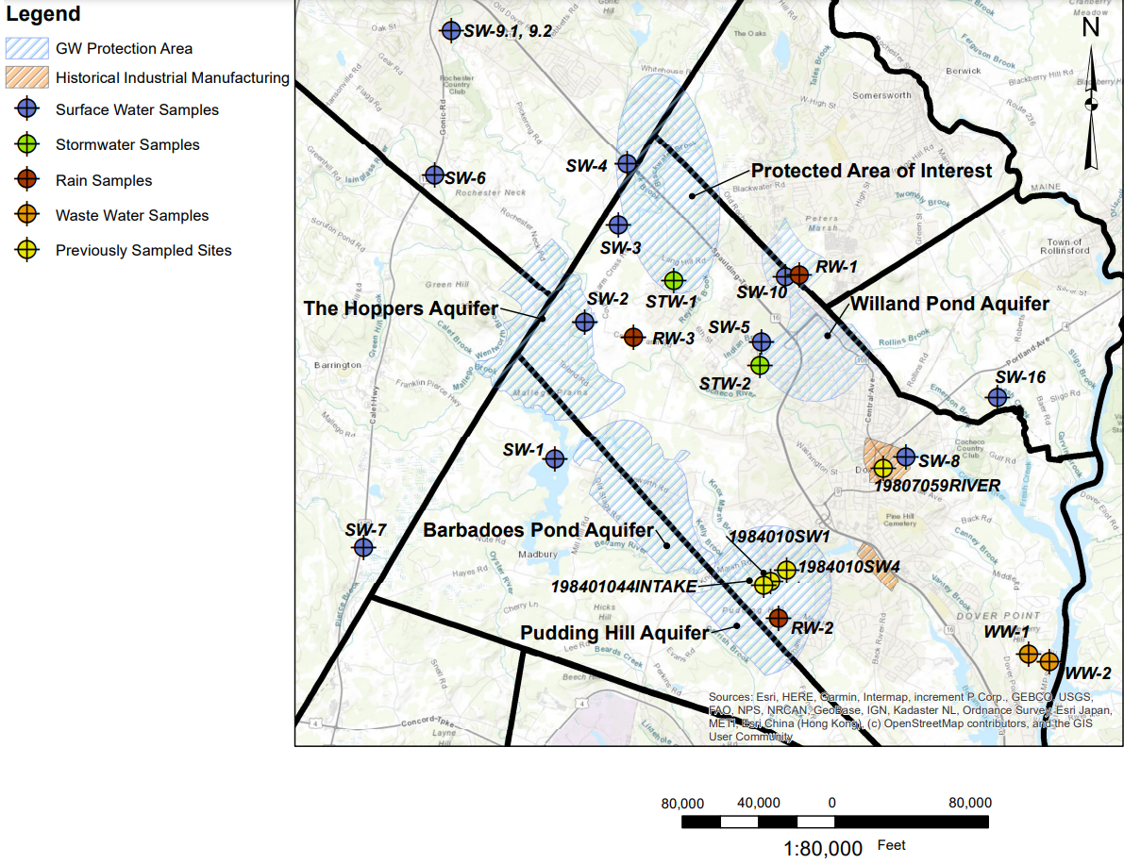
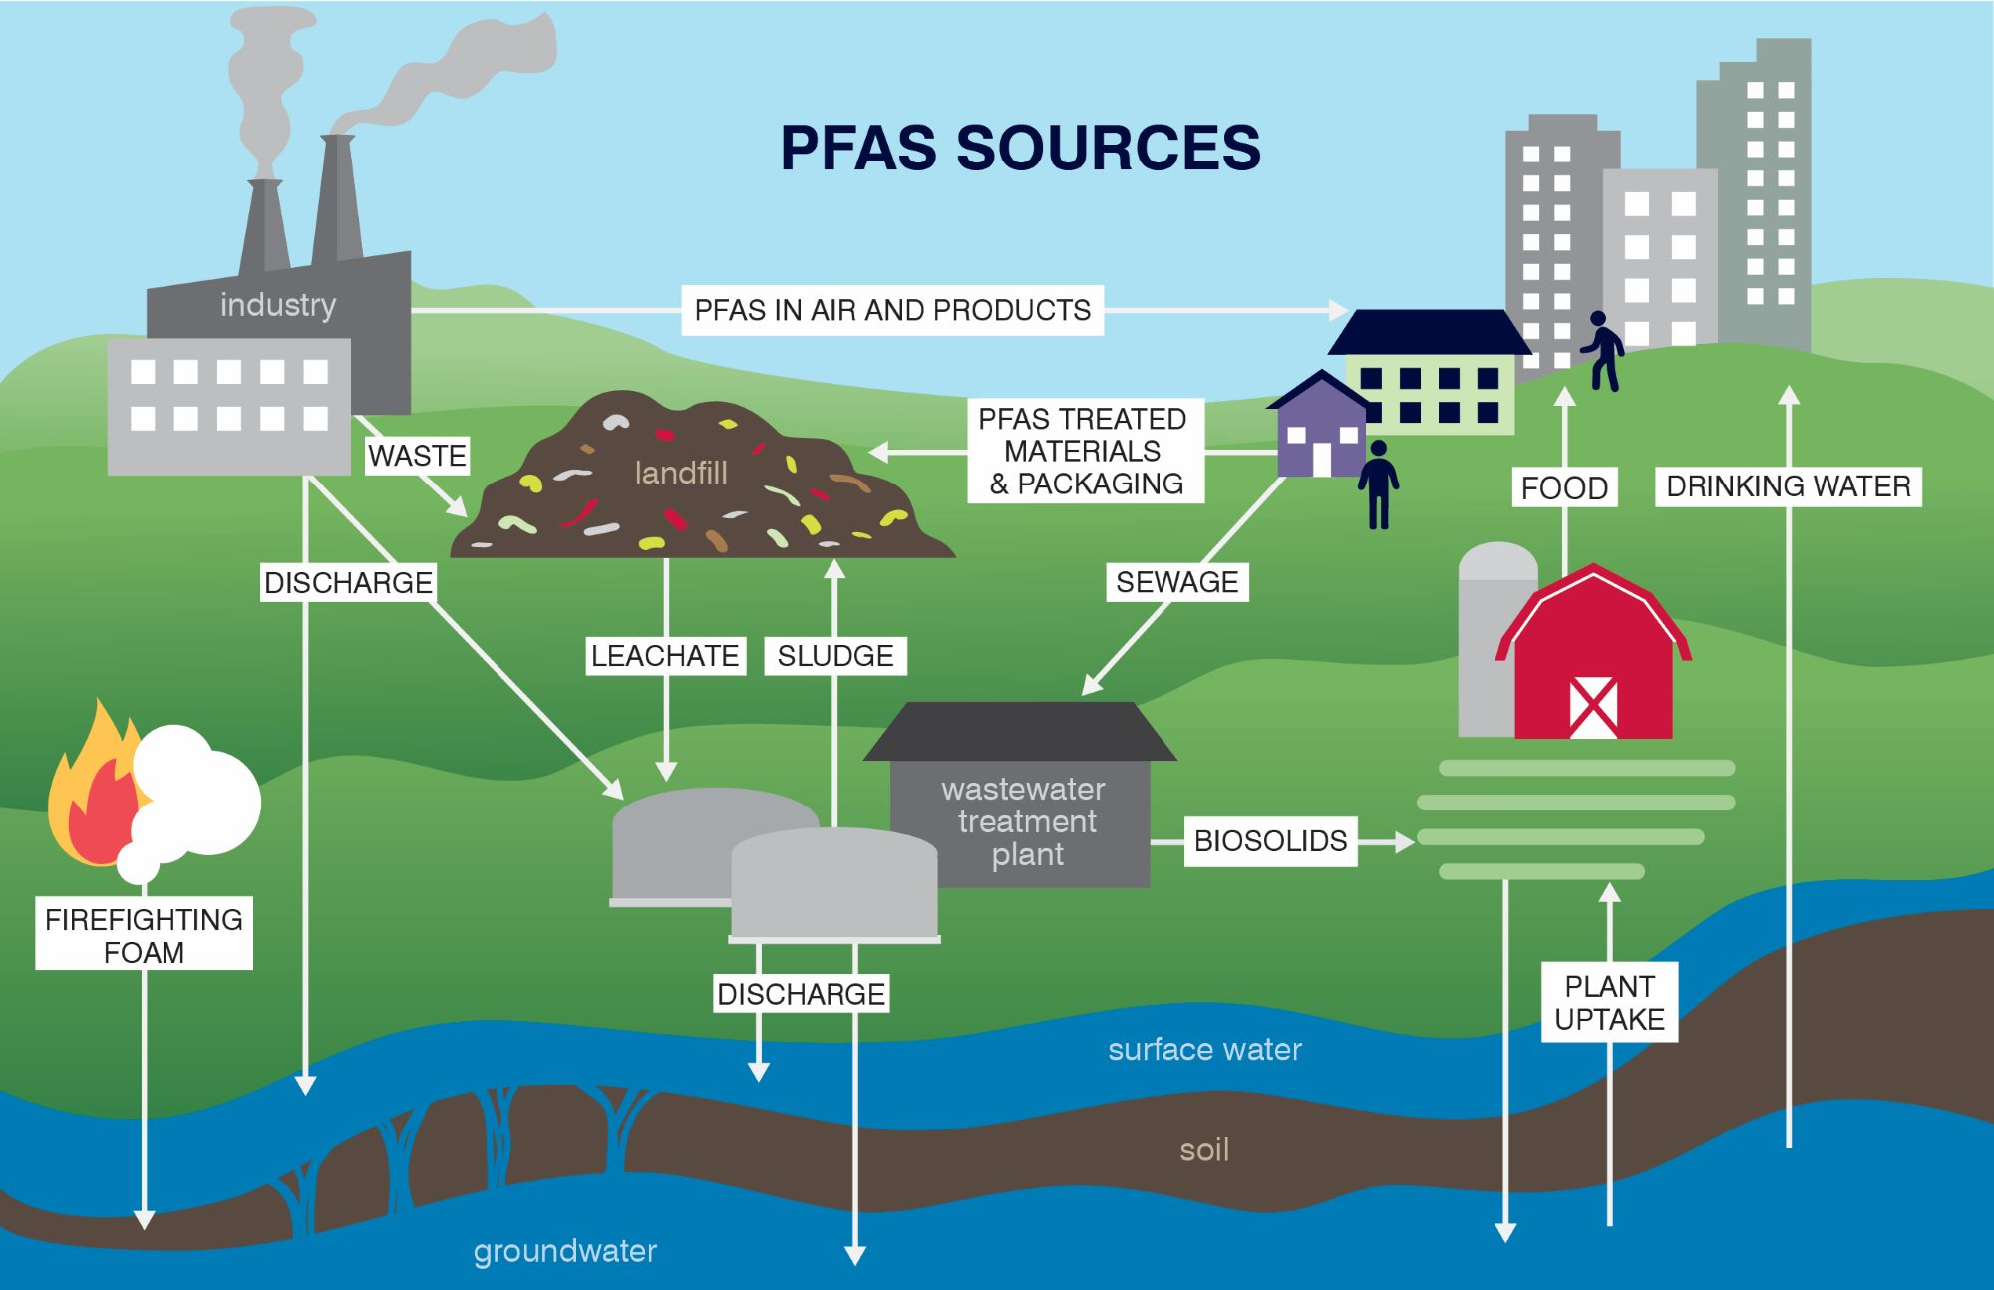
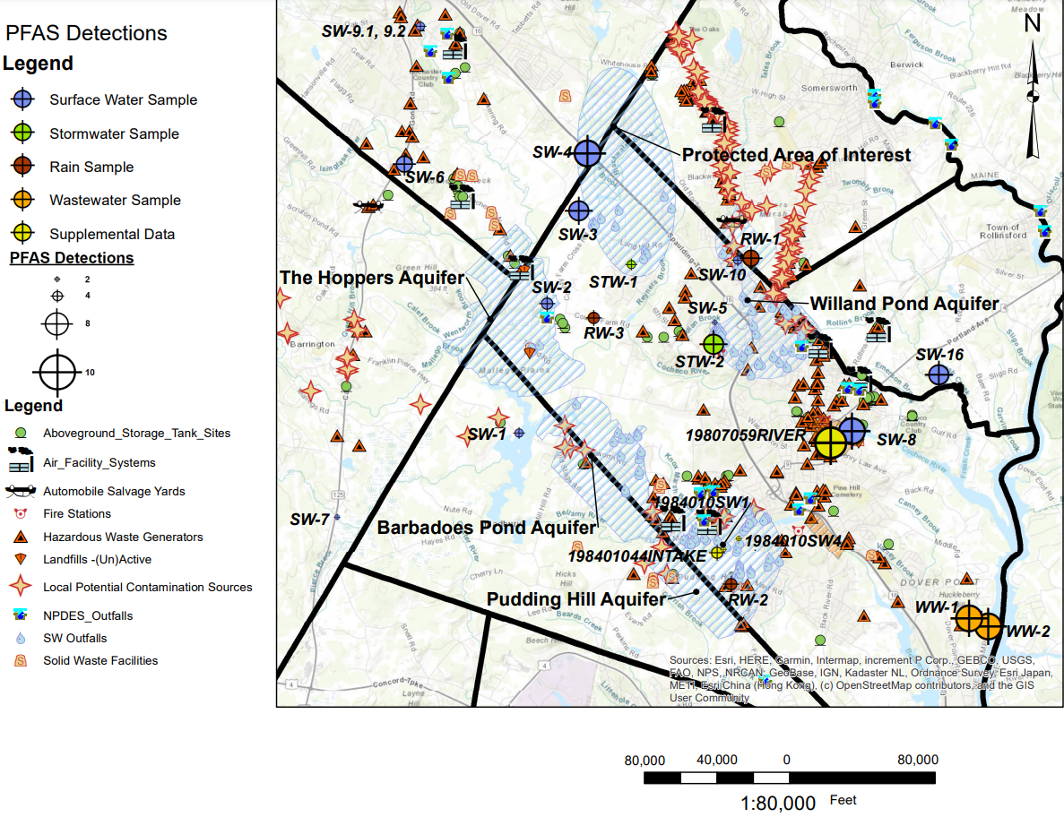
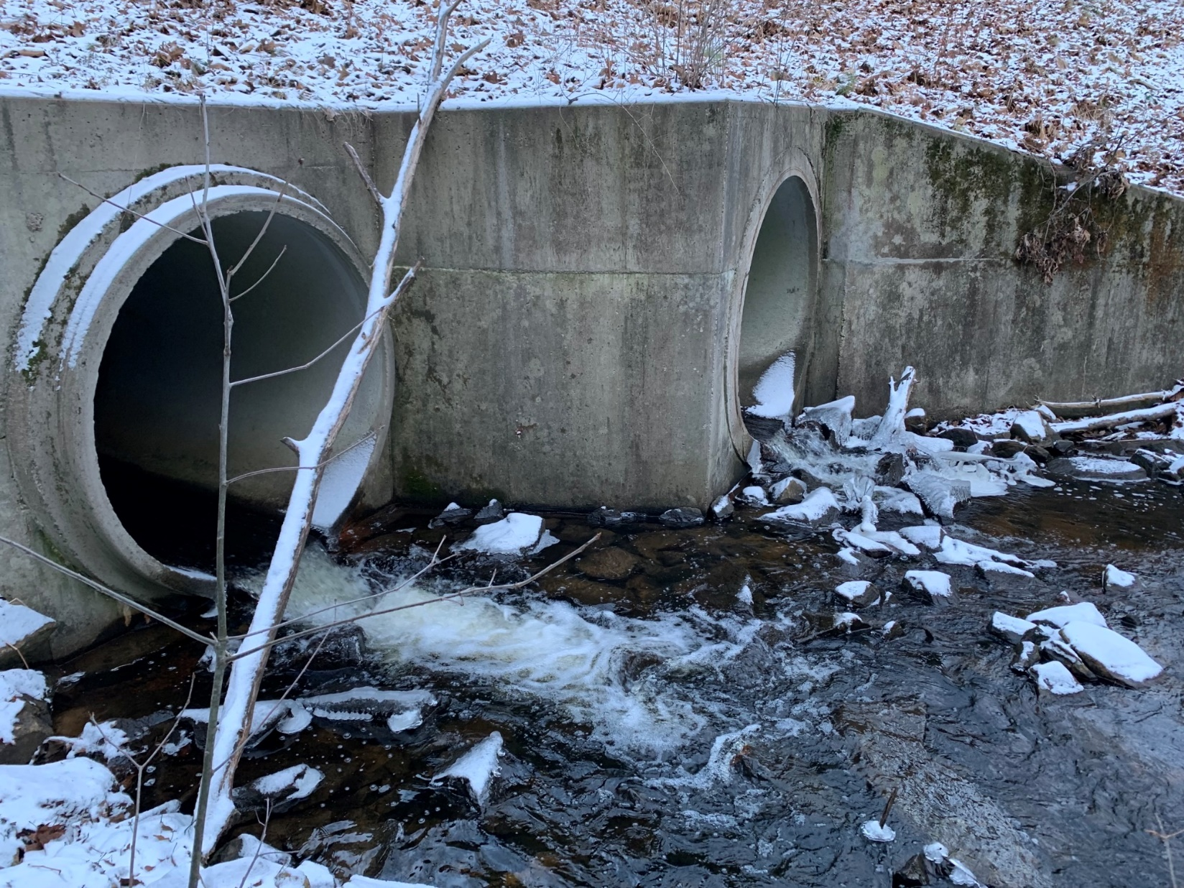
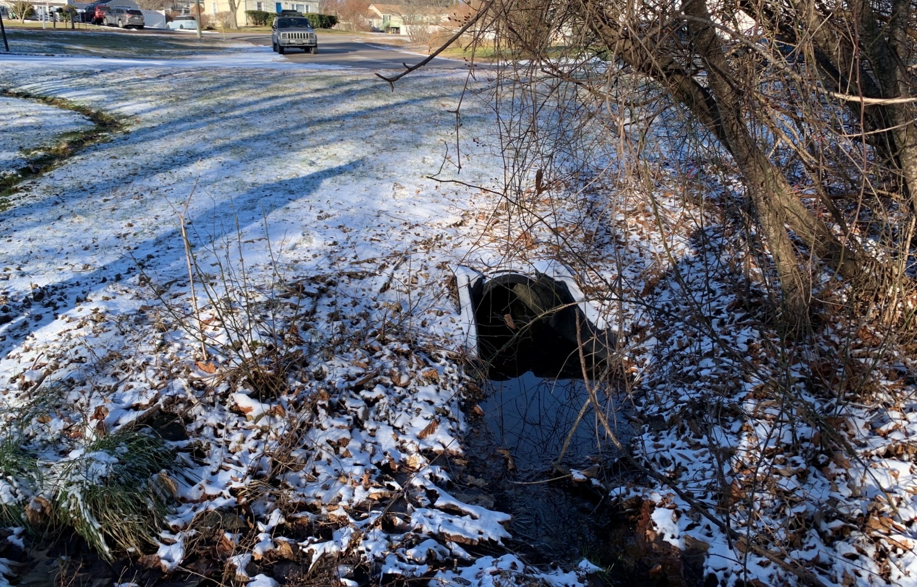
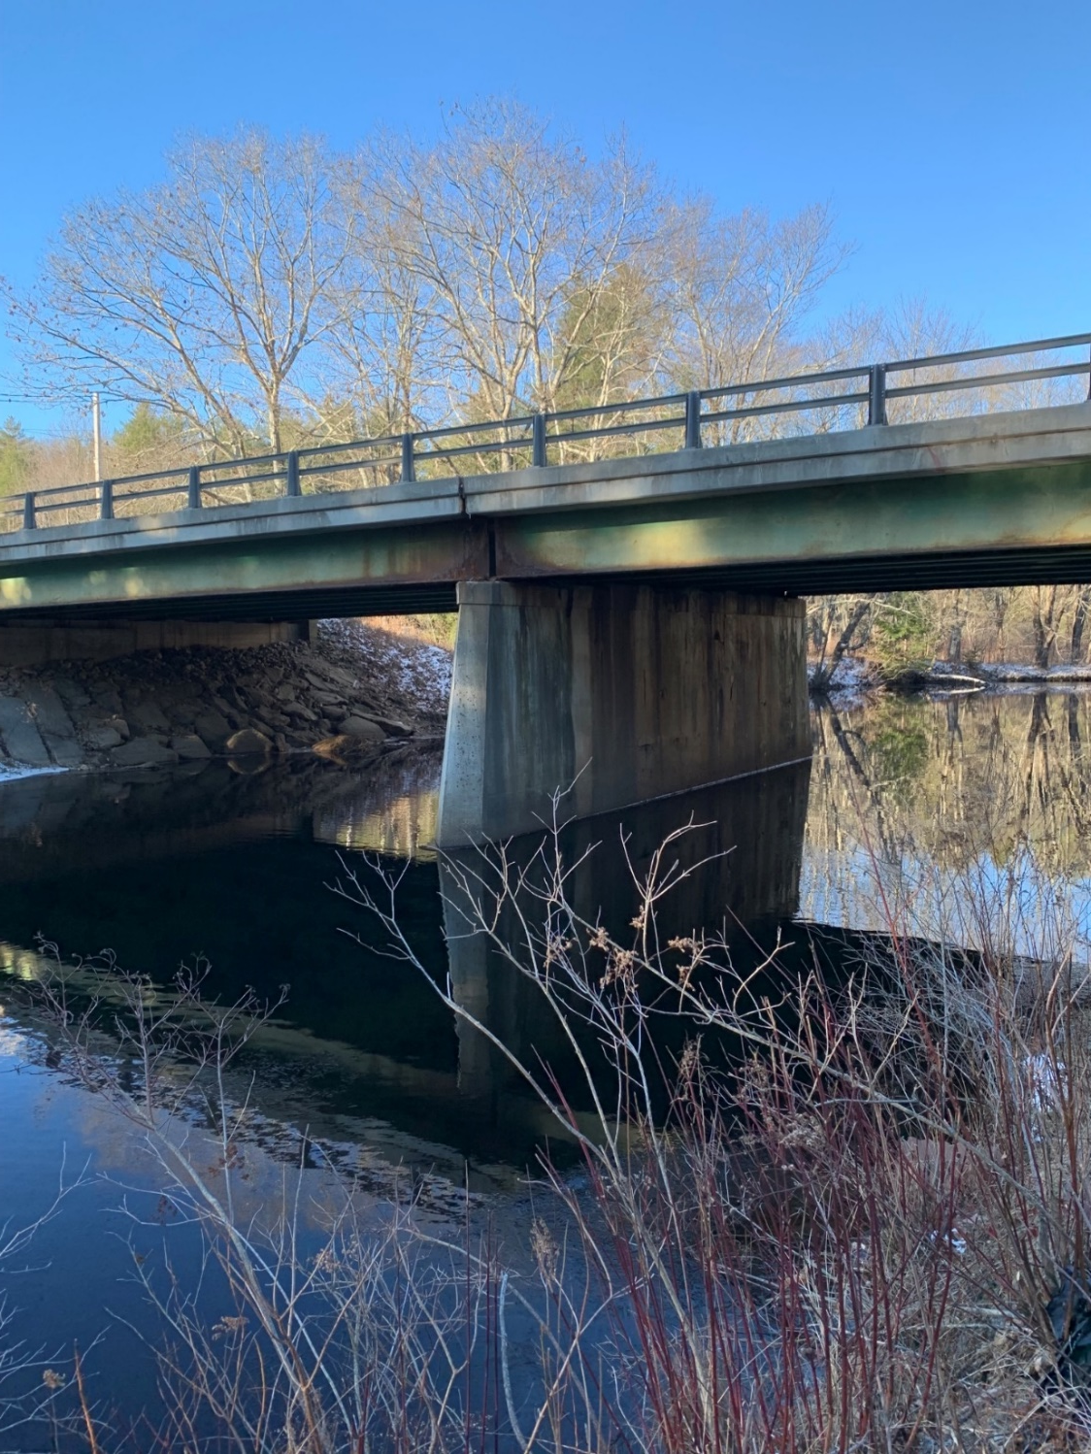
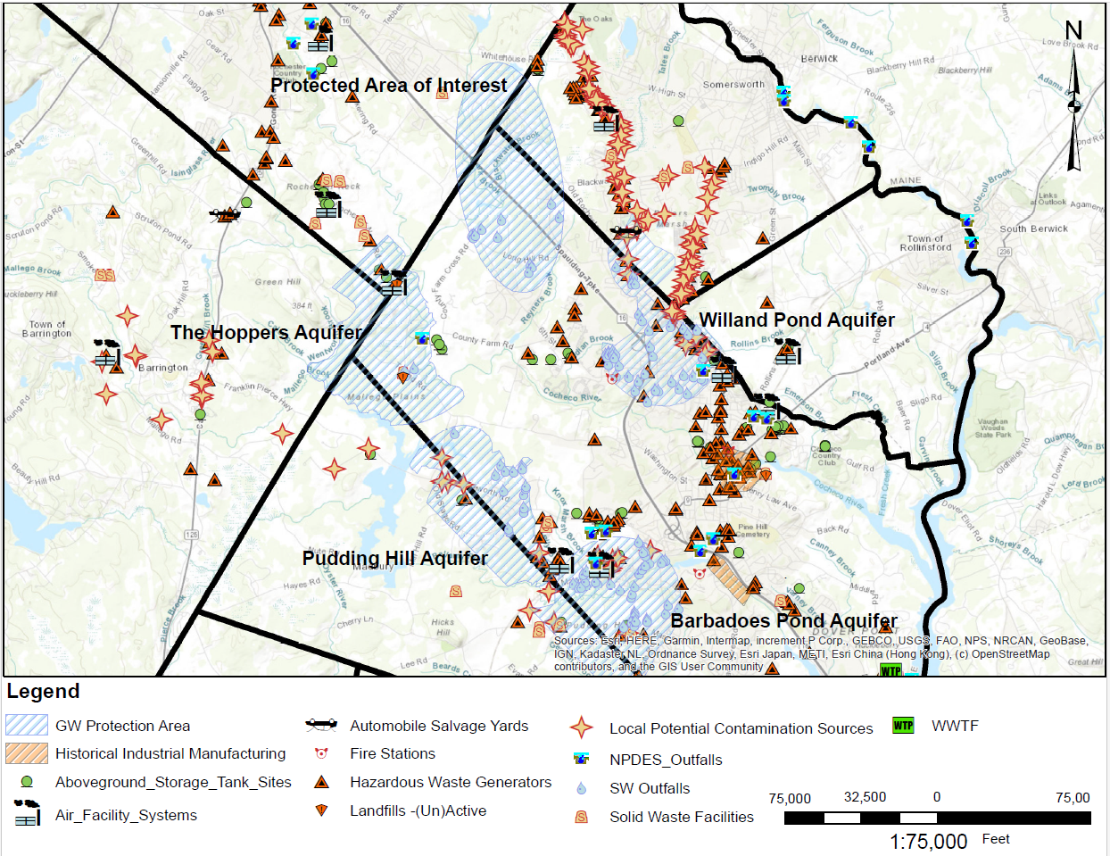
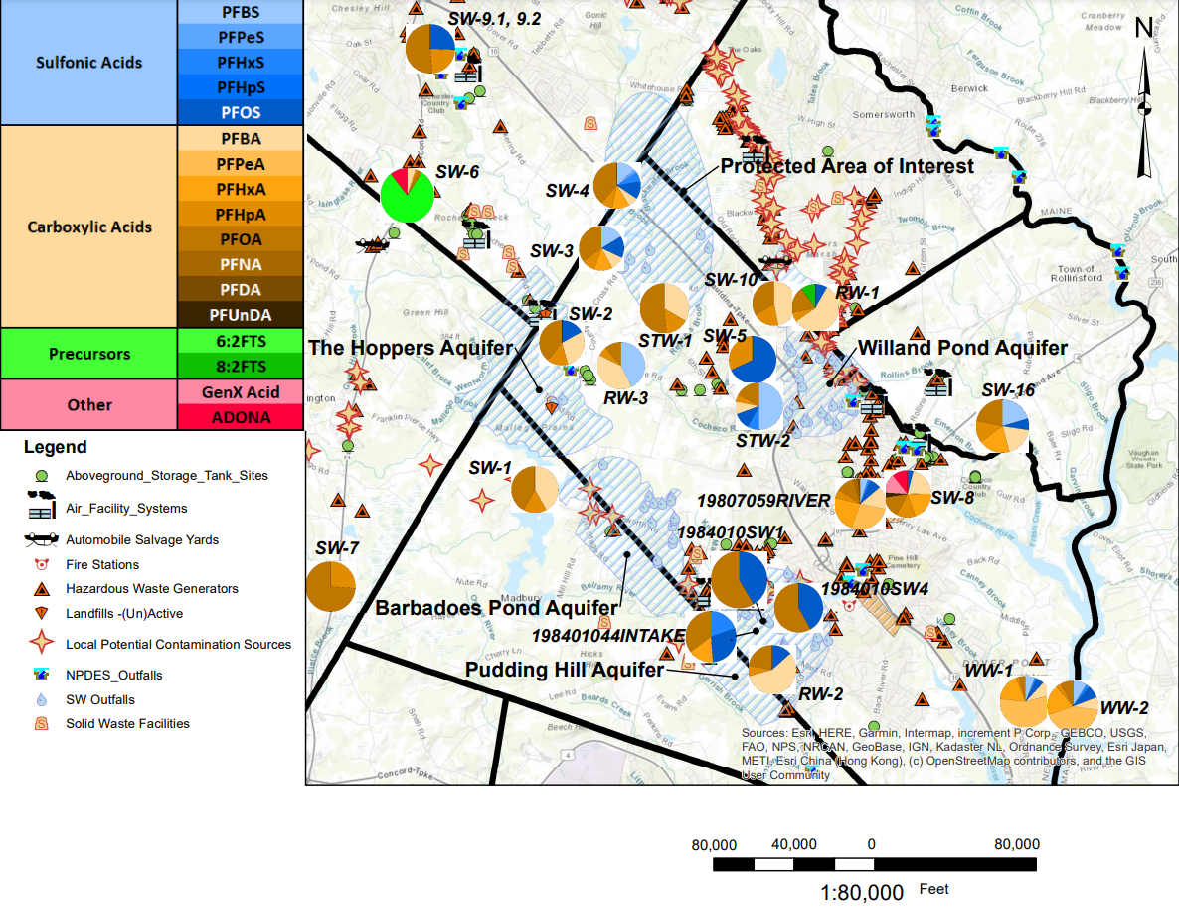
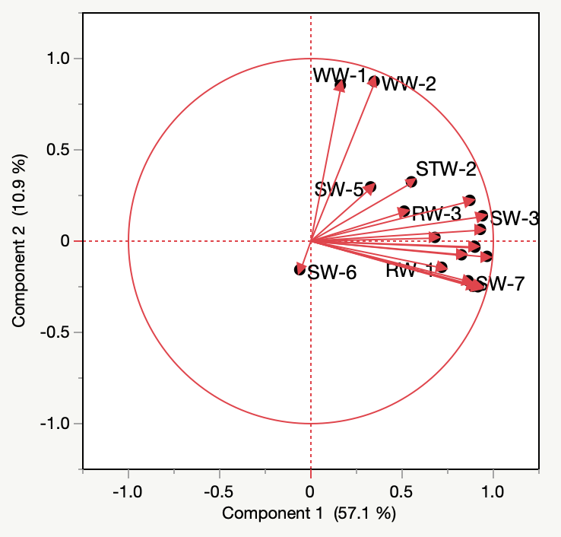
Dover, NH – Citywide Per- and Polyfluoroalkyl Substances (PFAS) Sampling Program Michael Bidonde, Briar Brogna, Max Fortin, Nathan Salas Civil and Environmental Engineering, University of New Hampshire, Durham, NH
Known for excellence.
Built on trust.
PFAS Background
Sampling Plan and Process
Observations
PFAS are a group of 10,000+ synthetic compounds that are used to make fluoropolymer products. The chemical structure of PFOA is displayed in Figure 1 below. Common PFAS sources in the environment include fire training/response sites, industrial sites, manufacturing plants, wastewater discharges, and landfills. Figure 2 below shows some routes that PFAS can take to enter the environment. Since these chemicals are resistive to degradation, they can remain in the environment for decades. Although the health effects of these chemicals are not well understood, studies do indicate that certain PFAS can have negative health effects.
Figure 4: Sampled Sites
Using Figure 3, existing PFAS sample data in Dover, and guidance from the project sponsors, the team made sampling recommendations for an initial round of sampling across Dover. This sampling included eleven surface water samples (SW), two stormwater samples (STW), three rainwater samples (RW), a sample at the influent of the wastewater treatment plant (WW-1), and a sample at the effluent of the wastewater treatment plant (WW-2). In order to capture the rainwater, the team designed, built, and deployed rainwater stations (depicted in the RW-3 field photo below). A field and equipment blank were taken to ensure no external PFAS were introduced to the samples. The samples were taken in mid-December 2022 and submitted to Absolute Resource Associates for the analysis of 29 PFAS using a Modified EPA Method 537.1.
In order to expand the data set, the team gathered available surface water PFAS sampling data from NHDES PFAS Data Mapper. These four additional sites are displayed with yellow markers in Figure 4.
PFAS were detected in each of the rainwater samples.
Composition of wastewater (WW) samples don’t match that of the surface water (SW) samples. This indicates that the source of PFAS in Dover’s WW is not dominated by SW. This also suggests that WW discharge signatures are not dominating the surface water signatures.
All six PFAS the EPA is proposing MCLs for have been detected in the surface water samples.
The Protected Area of Interest had more complex and higher concentrations than expected based on the proximity to identified potential sources in Figure 3.
There were some detections of 6:2 FTS, ADONA, and GenX Acid in SW-6 & SW-8 which were not detected in any of the other samples.
Figure 1: Perfluorooctanoic Acid (PFOA)
Long-Term Sampling Plan
pubchem.ncbi.nlm.nih.gov
Groundwater: The team was unable to sample any groundwater due to time and monetary constraints. Since Dover relies on primarily groundwater as a drinking water source and no groundwater data was collected in this project, the team recommends monitoring the groundwater in all groundwater protection zones in order to best prepare for complying with any future drinking water PFAS regulations. Since there were complex detections and high concentrations in the Protected Area of Interest, sampling the groundwater in this area could aid in determining if this is a viable location to use as a future drinking water source.
Surface Water: The team recommends resampling SW-1, SW-2, and SW-5. These three locations were easily accessible and represent the background concentration of PFAS found in surface waters in Dover. The team also recommends resampling SW-4, SW-6, and SW-8. These three all had either unusual detections or high concentrations that continual monitoring will be able to detect if these are constant conditions or were singular occurrences. On top of resampling those six locations, the team recommends sampling upstream of SW-6, SW-8, and the Protected Area of Interest in aims to track the source of these unusual detections and high concentrations.
Wastewater: Resampling both the influent and effluent of the wastewater treatment plant (WWTP) is important in order to identify the long-term role the Dover WWTP plays in the discharge of PFAS to receiving water bodies. The team also recommends sampling sewer lines that service residential areas and sewer lines that service industrial areas in order to track the source of PFAS in Dover’s wastewater.
Rainwater: Unfortunately, the team was unable to take an equipment blank of the rainwater stations. If further rainwater samples are taken with these devices the team highly recommends doing an equipment blank on these stations to ensure that no external PFAS are being introduced into the sample. Due to ease of access, the team is recommending to reuse the same locations to monitor precipitation events throughout different seasons to track trends.
Stormwater: Since the team was only able to collect two stormwater samples, no trends were able to be identified. This is why the team is recommending to take more stormwater samples at outfall locations that service numerous potential sources. Due to issues encountered in the field, the team recommends doing this type of sampling during or immediately after precipitation event. This will ensure there is both enough water to sample and the water hasn’t been stagnant and possibly accumulating PFAS.
Figure 2: Routes PFAS take to enter the Environment from Westonandsampson.com
Sampling Results
Field Sampling Photos
Project Purpose
Figure 5: Number of PFAS Detections at Each Sample Location
Due to the rising concerns regarding PFAS contamination, the City of Dover wanted to gather information about the concentrations of PFAS that exists throughout the City. It is important for Dover to know the concentrations of PFAS that exist in the environment so the city can plan to comply with future drinking water regulations and potentially wastewater regulations. The goal of this project was to create and implement an initial sampling plan to characterize PFAS concentrations throughout the city and then use the results gathered from the initial sampling to recommend a long-term monitoring plan for Dover.
SW-4: Clark Brooke immediately downstream of Route 16
STW-2: Stormwater outfall in mid-Dover
Table 2: EPA Proposed MCLs
Compound | Proposed MCLG | Proposed MCL
PFOA | Zero | 4.0 ppt
PFOS | Zero | 4.0 ppt
PFNA | 1.0 (unitless) Hazard Index | 1.0 (unitless) Hazard Index
PFHxS
PFBS
HFPO-DA (GenX Acid)
SW-6: Isinglass River downstream of Calef Hwy
Table 1: NHDES MCLs
PFAS | MCL (ppt)
PFOA | 12
PFOS | 15
PFHxS | 18
PFNA | 11
RW-3: Rainwater Station in the western part of Dover
Potential Sources
Figure 3: Potential Sources of PFAS in and around Dover
Figure 6: PFAS Composition at Each Sample Location
Principal Component Analysis
The team used JMP (a statistical analysis software) to perform a principal component analysis (PCA) on the sample results. Figure 7, is the loading plot from this analysis. This plot clusters samples with similar signatures. The results indicate that the signatures of WW-1 & WW-2 differ from the other surface water and rainwater samples. SW-6 also has a different signature than all other samples.
Figure 7: PCA Loading Plot
Acknowledgements
Dr. Paula Mouser – Professor at UNH (Project Faculty Advisor)
Ken Mavrogeorge, PE – City Engineer at the City of Dover (Project Sponsor)
James Wieck, PG – Associate Principal at GZA GeoEnvironmental, Inc. (Project Consultant)
References
EPA. (2023, March 14). EPA.com. Retrieved from Proposed PFAS National Primary Drinking Water Regulations: https://www.epa.gov/sdwa/and-polyfluoroalkyl-substances-pfas
Interstate Technology Regulatory Council. (2022, June). Retrieved from PFAS - Per- and Polyfluoroalkyl Substances: https://pfas-1.itrcweb.org/
New Hampshire Department of Environmental Services. (n.d.). NHDES PFAS Sampling. Retrieved from https://www.arcgis.com/apps/View/index.html?appid=66770bef141c43a98a445c54a17720e2&extent=-73.5743,42.5413,-69.6852,45.4489
New Hampshire Department of Environmental Services. (n.d.). OneStop Data Mapper. Retrieved from https://www4.des.state.nh.us/onestopdatamapper/onestopmapper.aspx

