Slide 1
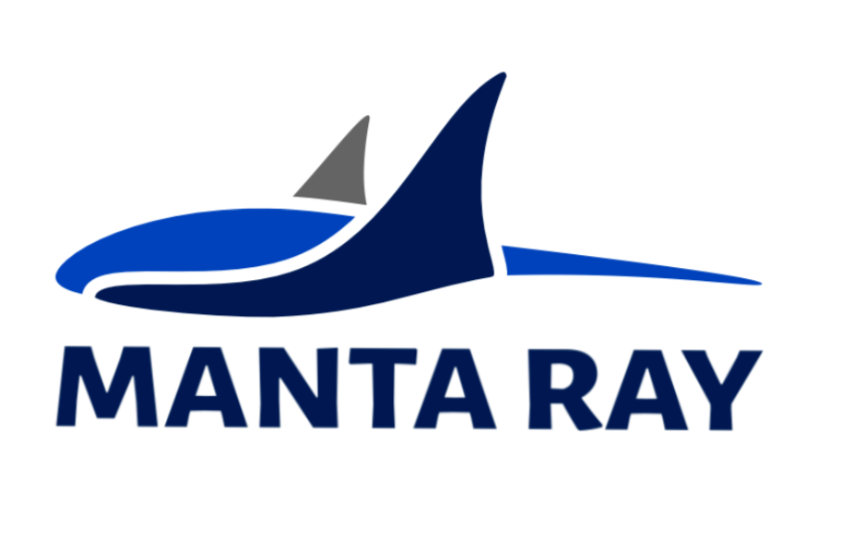
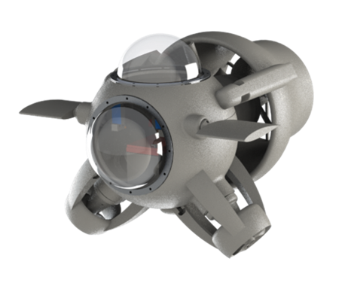
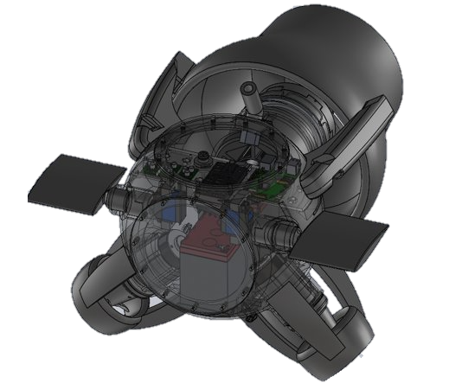
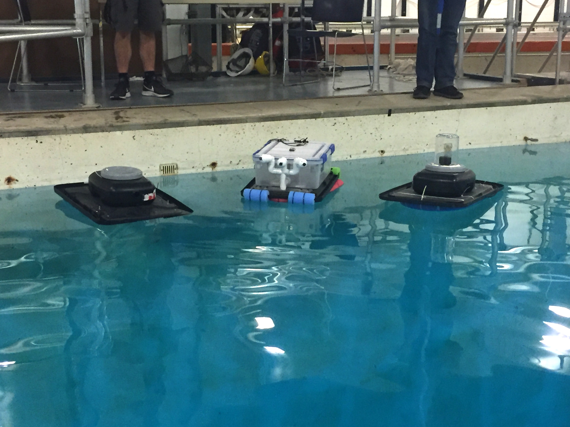
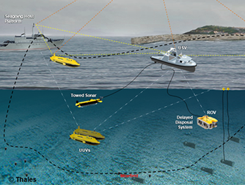
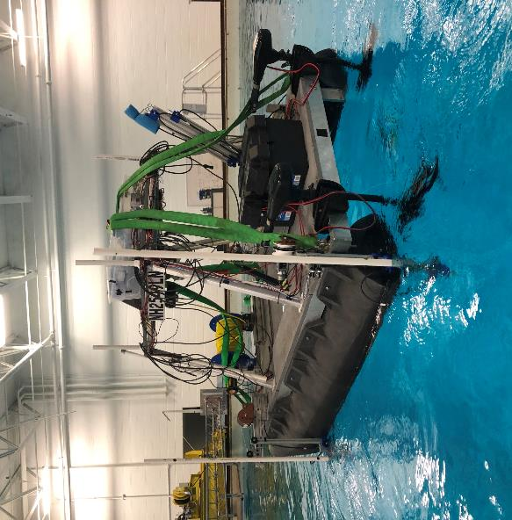
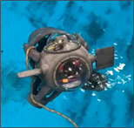
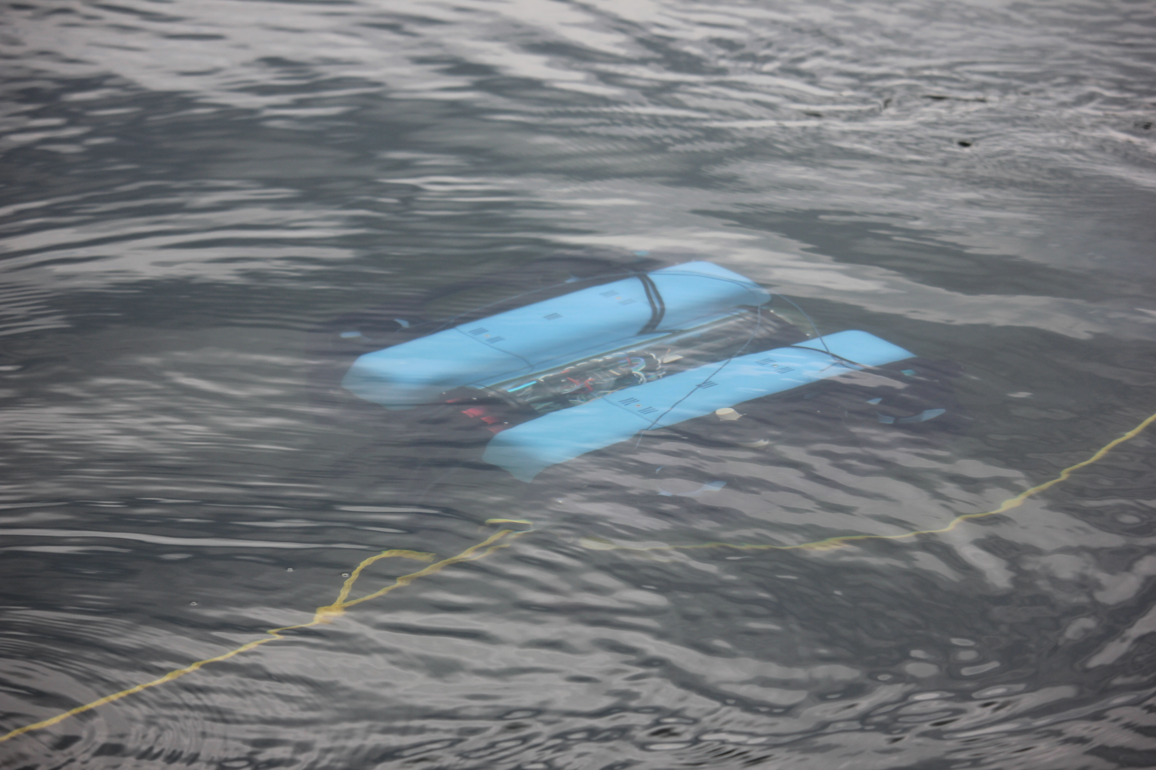
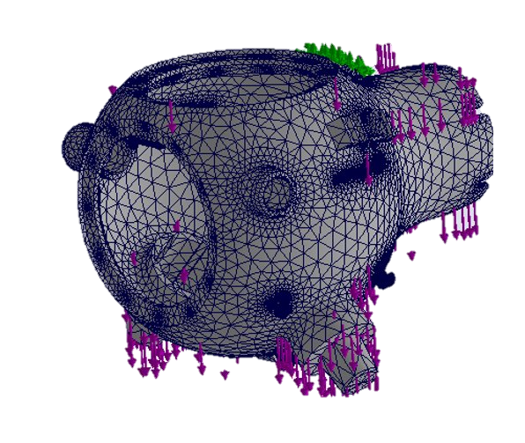
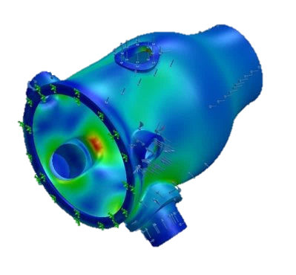
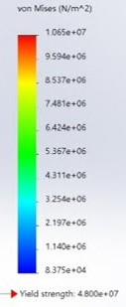
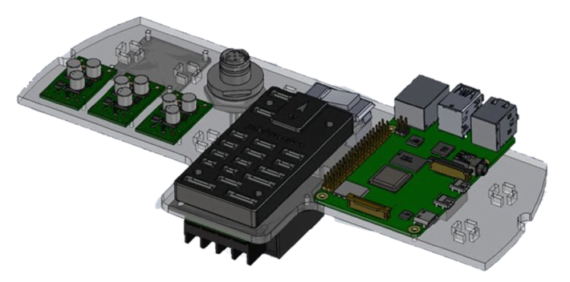
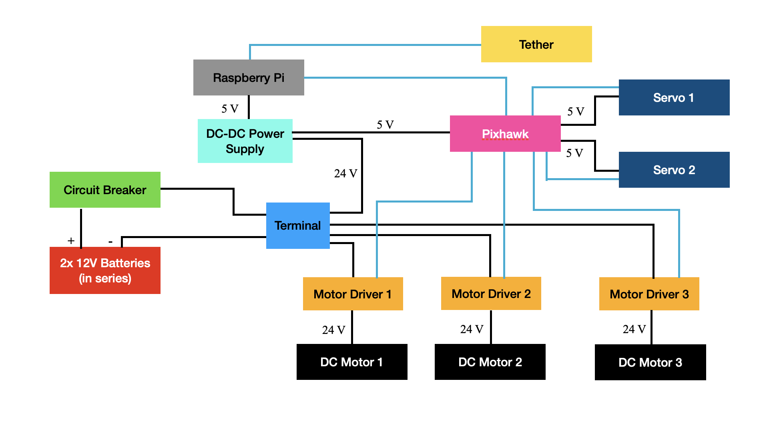
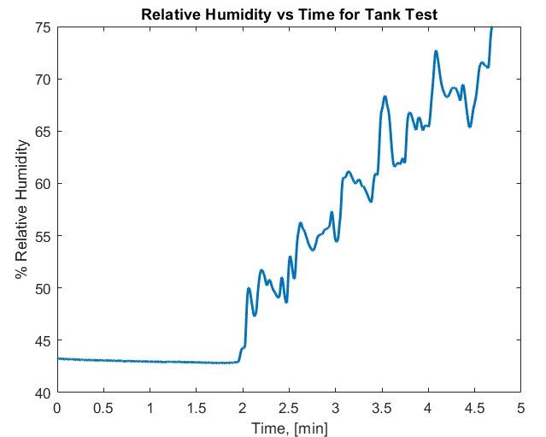
Marine and Naval Technological Advancements for Robotic AutonomY (MANTA RAY)
KRILL
Project Advisors: Dr. May-Win Thein, Dr. Yuri Rzhanov, Dr. Elizabeth Fairchild
Graduate Advisors: Ozzy Oruc, Hannah Arnholt, Nick Custer, Igor Vladimirov, Rich Randall, Chris Van Valkenburgh, Alex Cook Team Members: Kendall Boniecki, Annie Duong , Ian Lindberg, Colby Tuttle Department of Mechanical Engineering and Center for Ocean Engineering, University of New Hampshire, Durham, NH 03824
MANTA RAY Mission
KRILL Design
Results
Team MANTA RAY is an interdisciplinary project dedicated to creating, maintaining, and expanding a network of marine robots for seafloor mapping and underwater perception. The network began as just the autonomous surface vehicle (ASV) and unpiloted underwater vehicle (UUV) but has expanded to include a prototype of the ASV, known as TUPPS, and two kinds of remotely operated vehicles, known as Ghost Unpiloted Performance Platform Submersible (GUPPS) and KRILL. With these systems, students work to improve communication between vehicles, develop autonomous behaviors and algorithms, and upgrade existing mechanical systems to improve precision and performance.
Original design of KRILL provided by NUWC
Current KRILL Design
Waterproofing
Vulnerable components of original design were replaced
Conducted water tests at the surface and bottom of Chase tank
Newly designed gaskets and plates withstood water tests
Control Systems
KRILL was outfitted with new motor drivers
Custom version of ArduSub code created to allow operation of KRILL
Control and power components condensed into a single removable electronics board
Ballast
Determined the buoyancy force by conducting a test using Archimedes’ Principle
Calculated the needed ballast weight by subtracting the weight of KRILL from the buoyancy force
KRILL weighed in at a total of 37 lbs. with 14 lbs. of ballast
TUPPS
ASV
KRILL
UUV
GUPPS
FEA Design Study
FEA Analysis of Tether port
Hull Redesign
KRILL Mission and Goals
Future Work
KRILL is a UUV developed by the Naval Undersea Warfare Center Division Keyport (NUWC) designed to be modular, low-cost, portable. The prototype was 3D printed out of Nylon PA-12. The vehicle propulsion consists of three thrusters and two fins to control pitch, roll, and yaw control. The main uses for KRILL are communications, imaging, and data collection.
This year’s goal for KRILL is to waterproof the hull, redesign the electronics configuration, implement the controls system, and ballast for neutral buoyancy. Discussions with NUWC Keyport were ongoing throughout the year for design input and guidance.
Print hull redesign through NUWC, Keyport
Conduct further finite element analysis
Make it modular to fit within SLS printer
Ongoing communications would make it possible
Sensor Integration
Pressure
Optical/Vision
Humidity
Ballasting
Sensors would replace portion of front-end ballast
Remaining ballast made more permanent (e.g., epoxy filled with lead shot)
Controls
Modify ArduSub code to support sign-magnitude motor operation
An FE analysis was completed with a 100N traction force applied to the hull, which resulted in a factor of safety of .646. An eye-bolt was added to the exterior of the hull for retrieval purposes.
An FE analysis was completed for the current hull and the redesign hull at 150kPa (5.1m). The factor of safety for the redesigned hull was almost 3x greater than the current hull (4.51 and 1.55 respectively).
sTAMD Simulations
Waterproofing
Controls and Electronics Wiring Block Diagram
Water was leaking into the hull through the domes during preliminary submersion testing
Humidity sensor temporarily incorporated to detect leaking
New gaskets were designed and laser-cut
Acrylic domes were replaced with waterjet cut flat plates
Several successful submersion tests were performed after changes were implemented
Acknowledgements
This work was funded in part by New Hampshire Sea Grant's Workforce Development Project E/WFD-2, pursuant to National Oceanic and Atmospheric Administration Award No. NA22OAR4170124. This work was also funded by NEEC grants no.N00174-17-1-0002 and no.N00174-20-1-0006.
Special thanks to Dr. Martin Renken, Nicholas Samos, Eric Seeley, L. Ronnie Ross, and Thai Tran from NUWC Keyport Division
We would like to thank to UNH staff members John Ahern, Scott Campbell, and Wendy Goldstein as well as the Olson Center and UNH Makerspace.
References
[1] “Welcome to the Ardupilot Development Site — Dev Documentation” [Online]. Available: https://ardupilot.org/dev/index.html#. [Accessed: 12-Apr-2023].
[2] “Overview · Gitbook” [Online]. Available: https://www.ardusub.com/. [Accessed: 12-Apr-2023].
[3] 2019, “How Do I Calibrate the Relative Humidity Sensor?,” Technical Information Library [Online]. Available: https://www.vernier.com/til/4337. [Accessed: 13-Apr-2023].
[4] “Evaporation from a Water Surface” [Online]. Available: https://www.engineeringtoolbox.com/evaporation-water-surface-d_690.html. [Accessed: 13-Apr-2023].
An electronics board was designed in SolidWorks to hold the control and power components of KRILL including:
Raspberry Pi
Pixhawk 4
Motor drivers
DC-DC power supplies
KRILL is controlled using a laptop running QGroundControl
QGroundControl communicates with Raspberry Pi over tether
Raspberry Pi sends commands to Pixhawk via MAVLink protocol
Pixhawk outputs PWM signals to servos and motor drivers
Motor drivers send 24V power to motors using locked-antiphase controls
Relative Humidity measured by sensor during tank test. The sensor was calibrated using one-point calibration method with a percent error of 0.04%.

