Slide 1


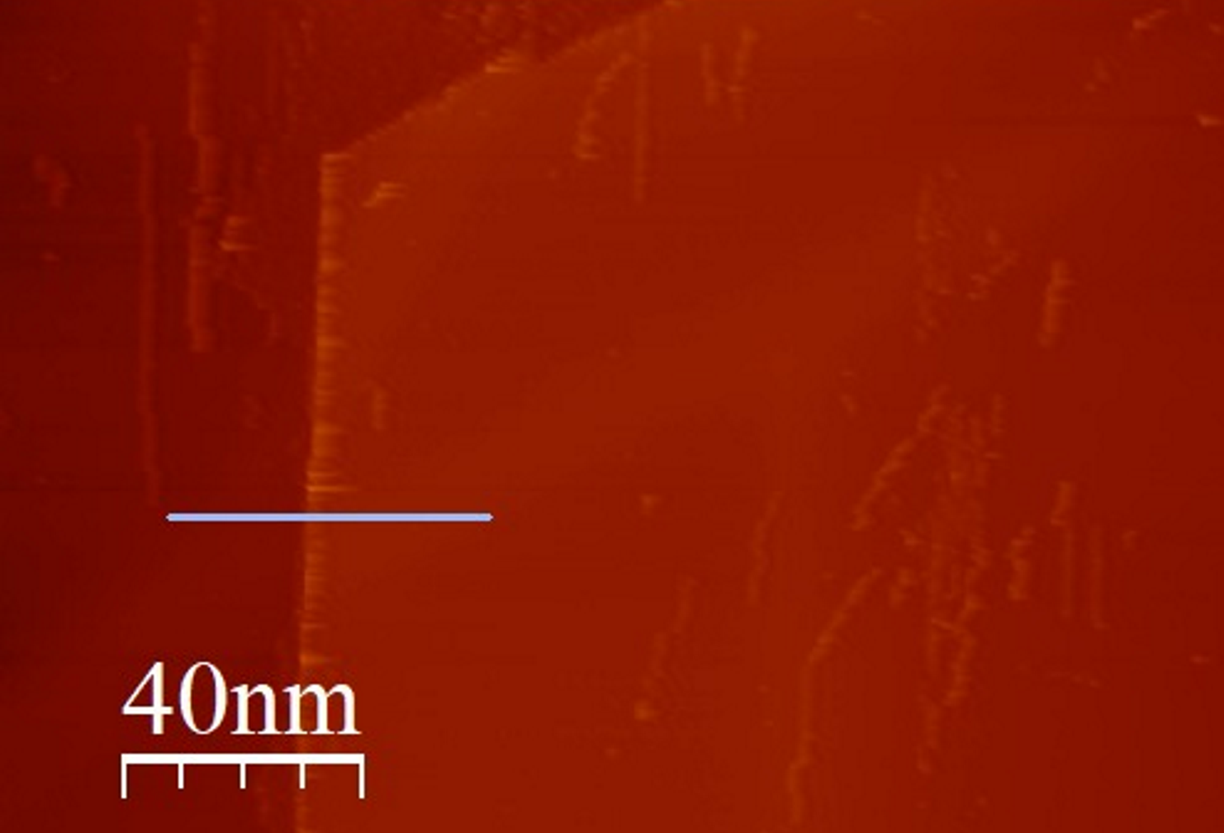
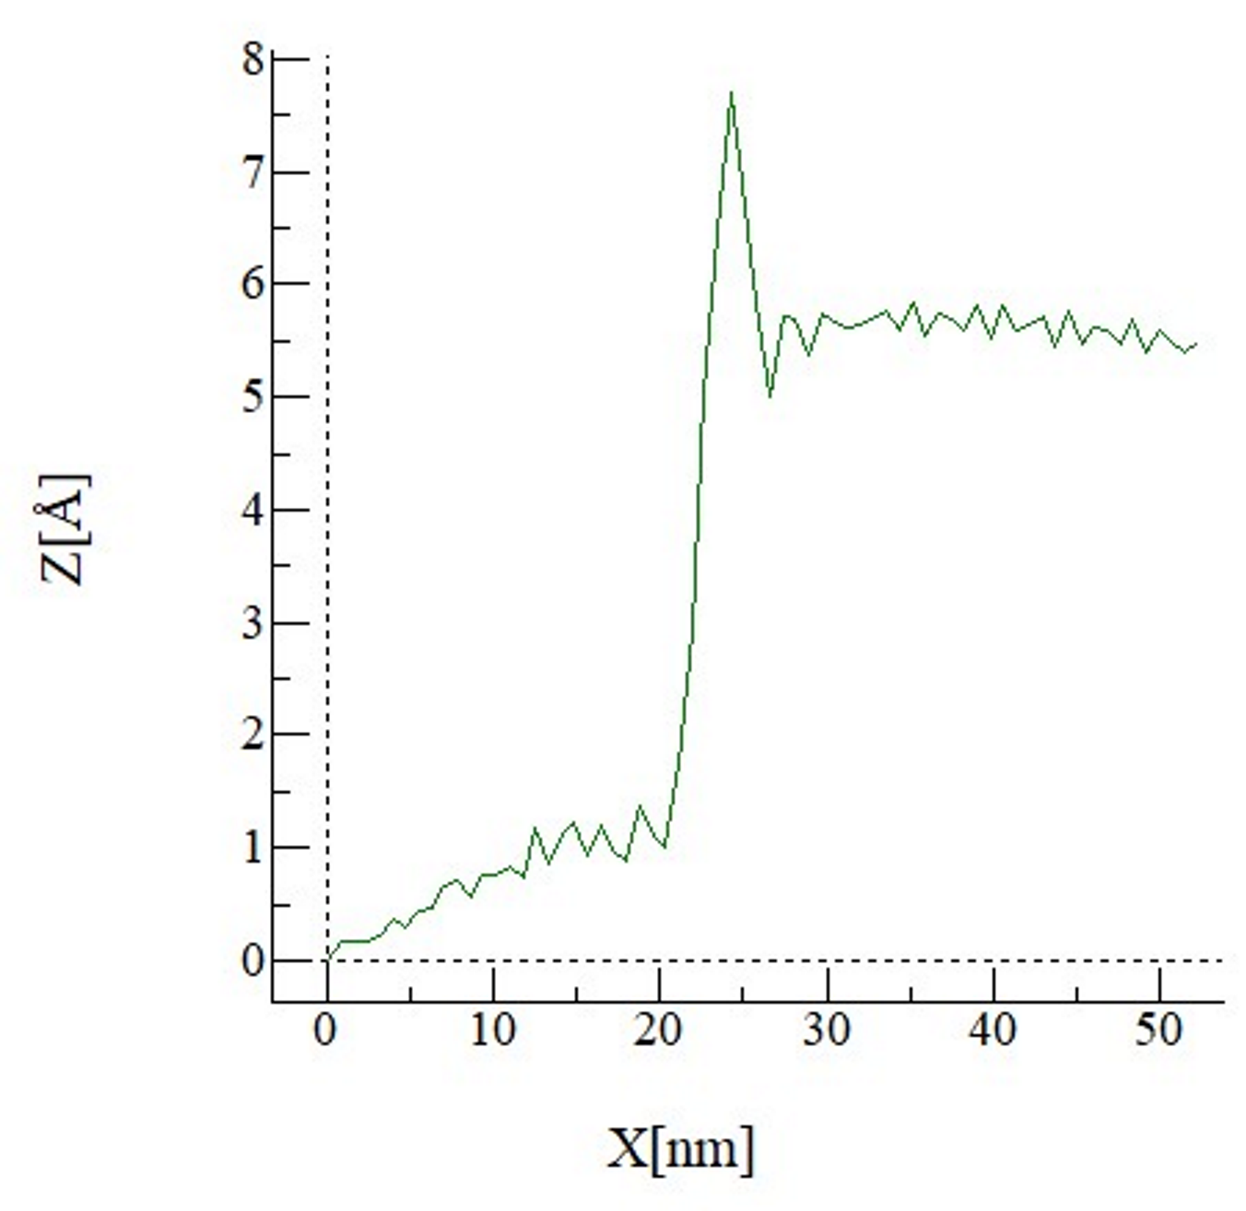
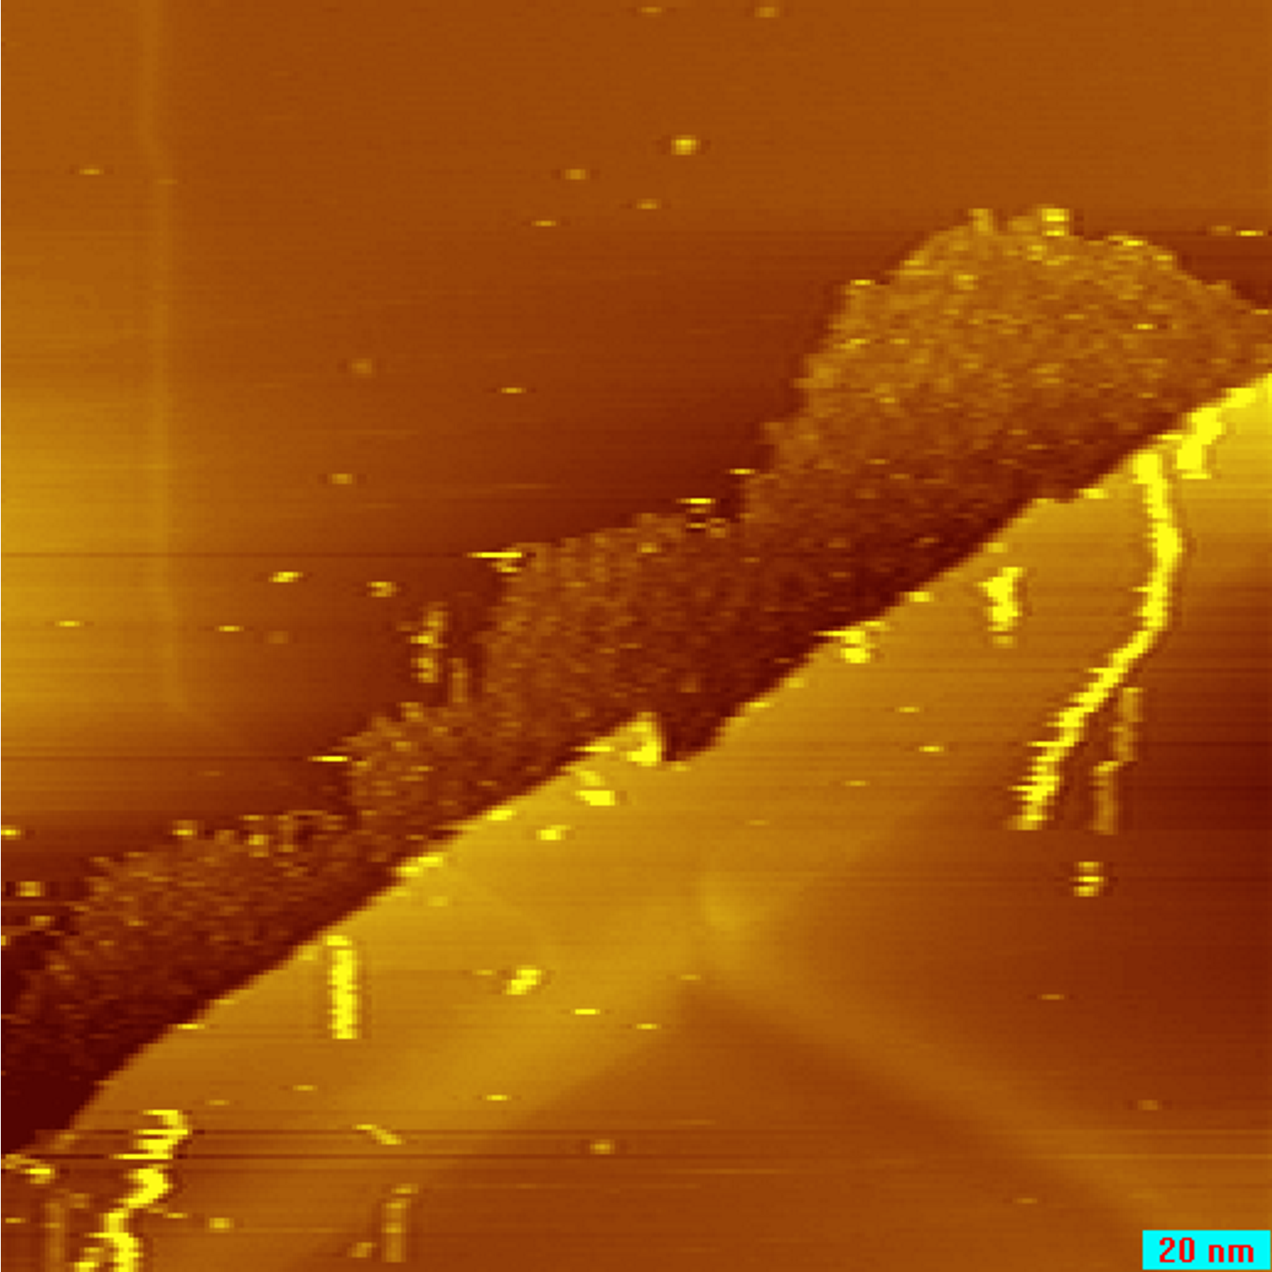
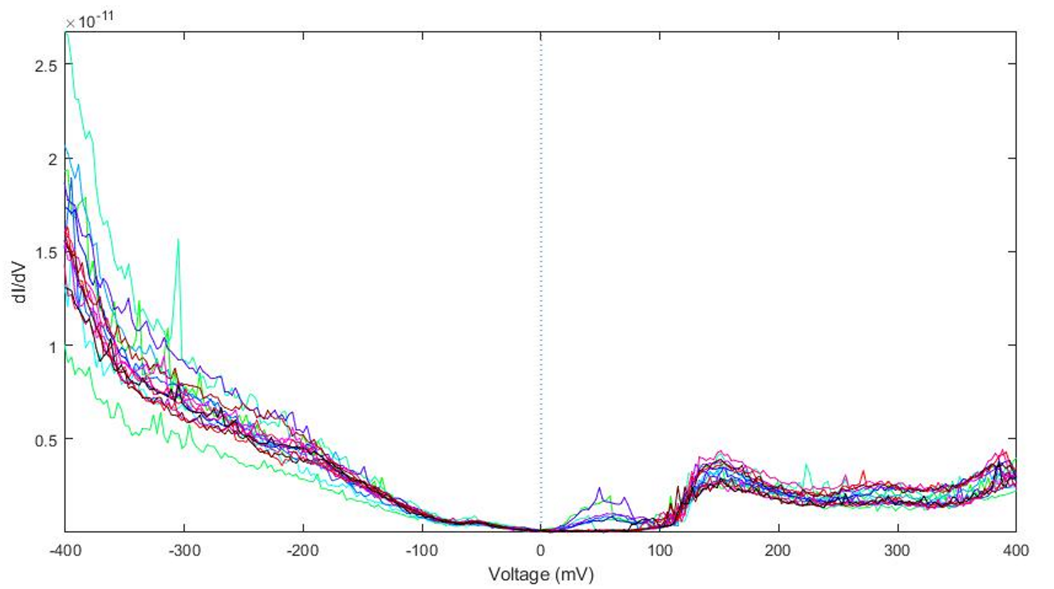
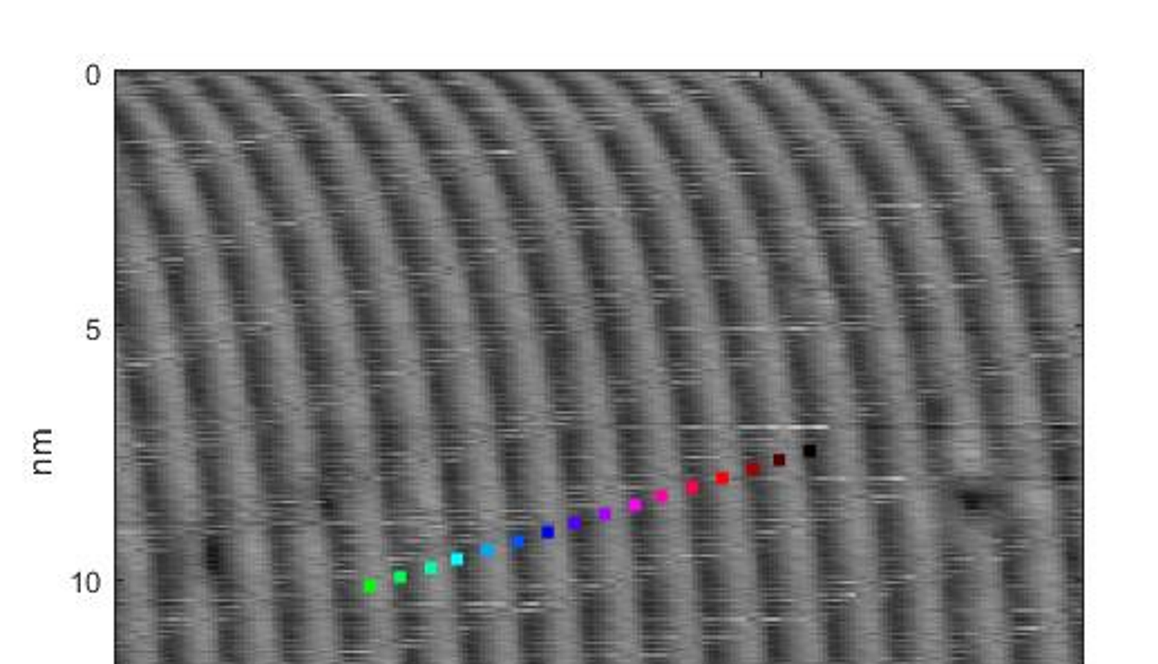
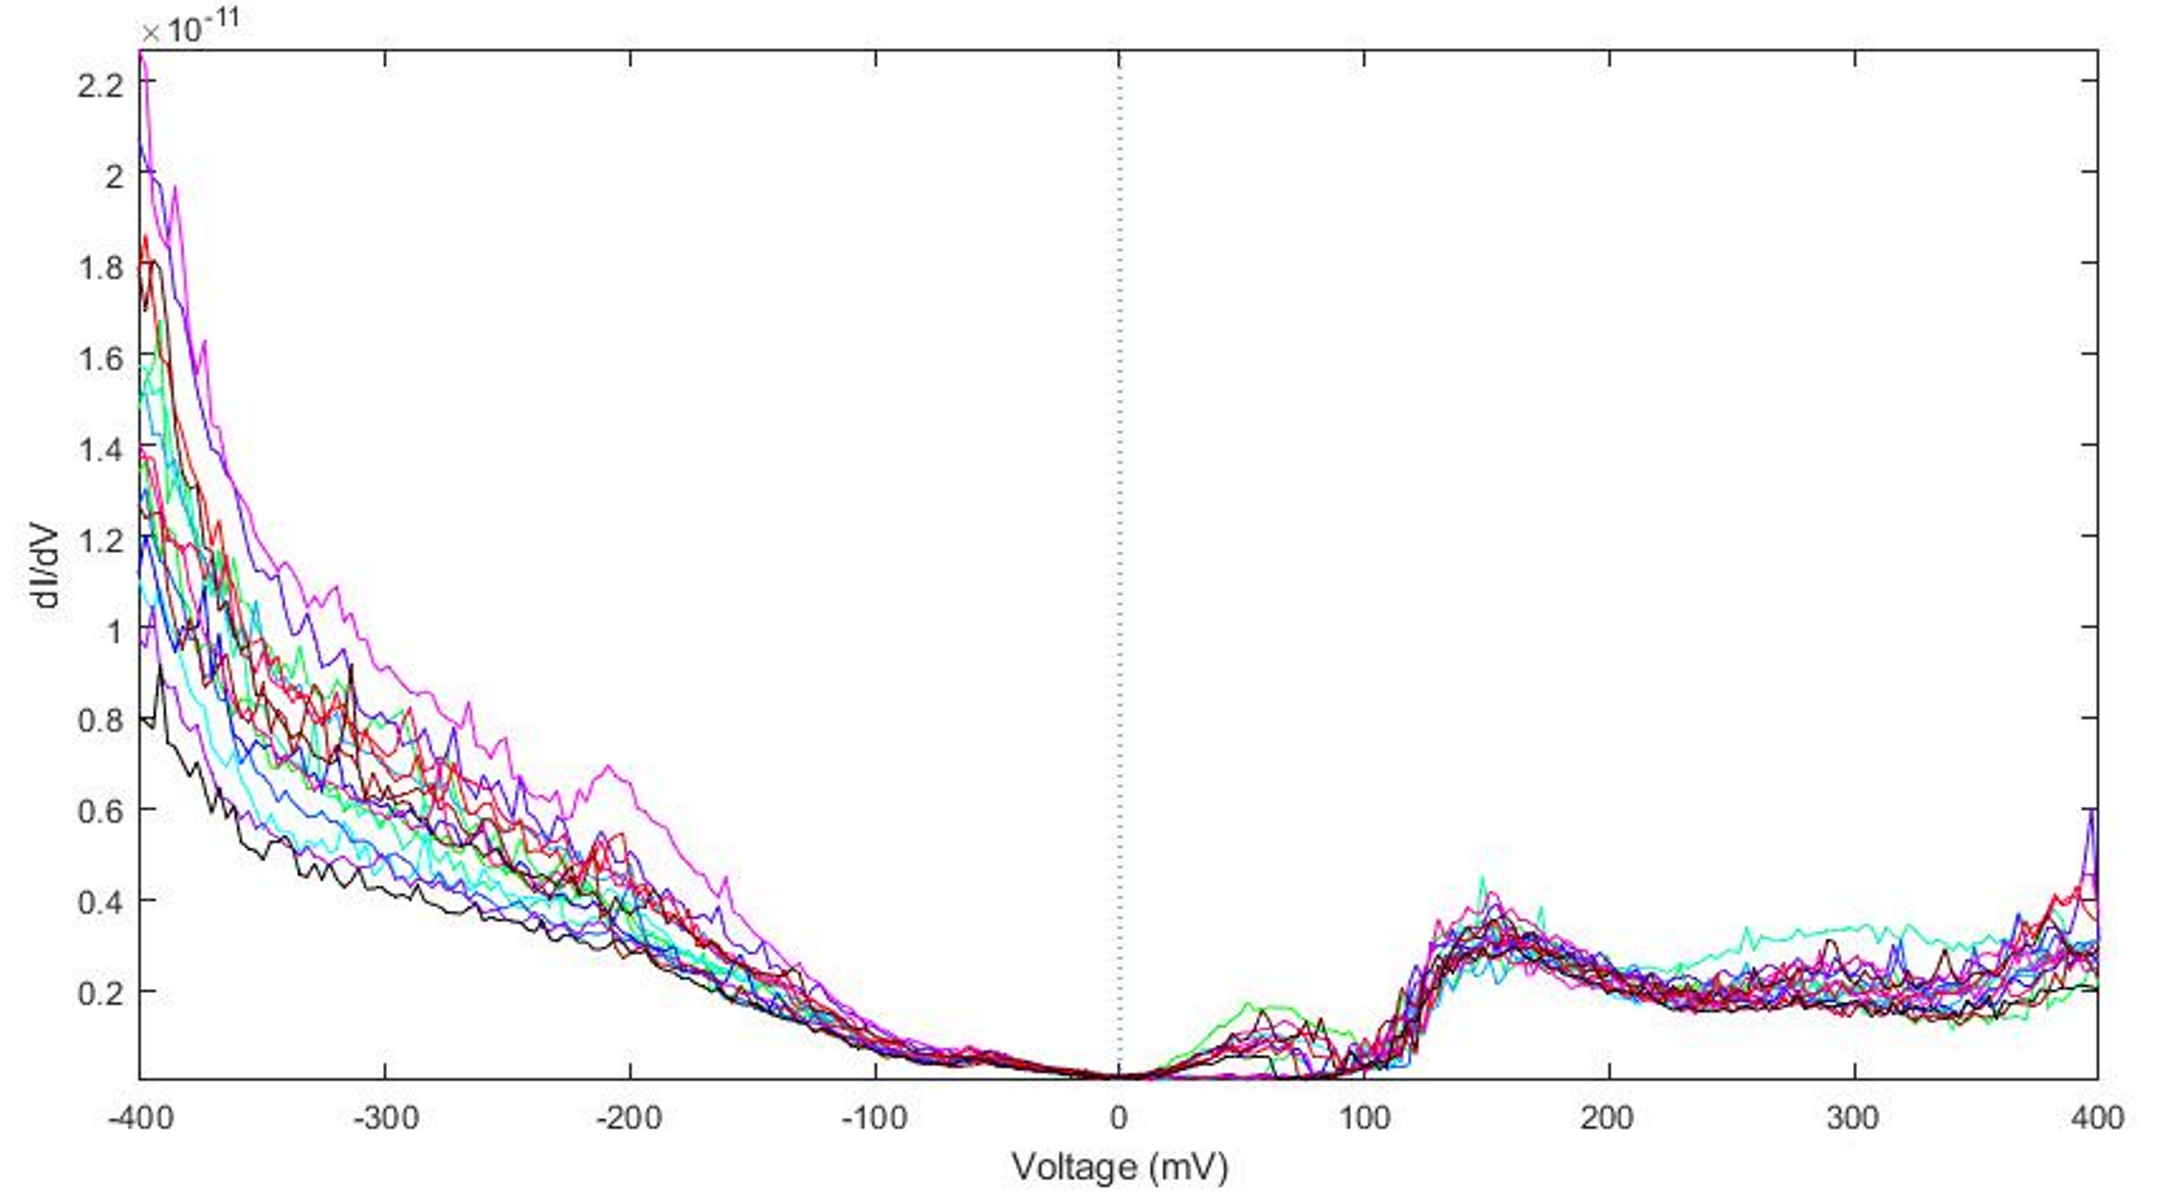
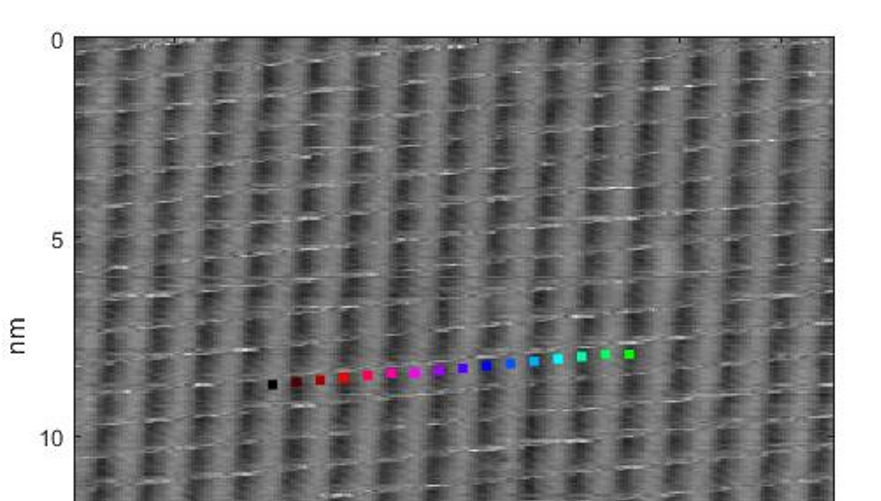
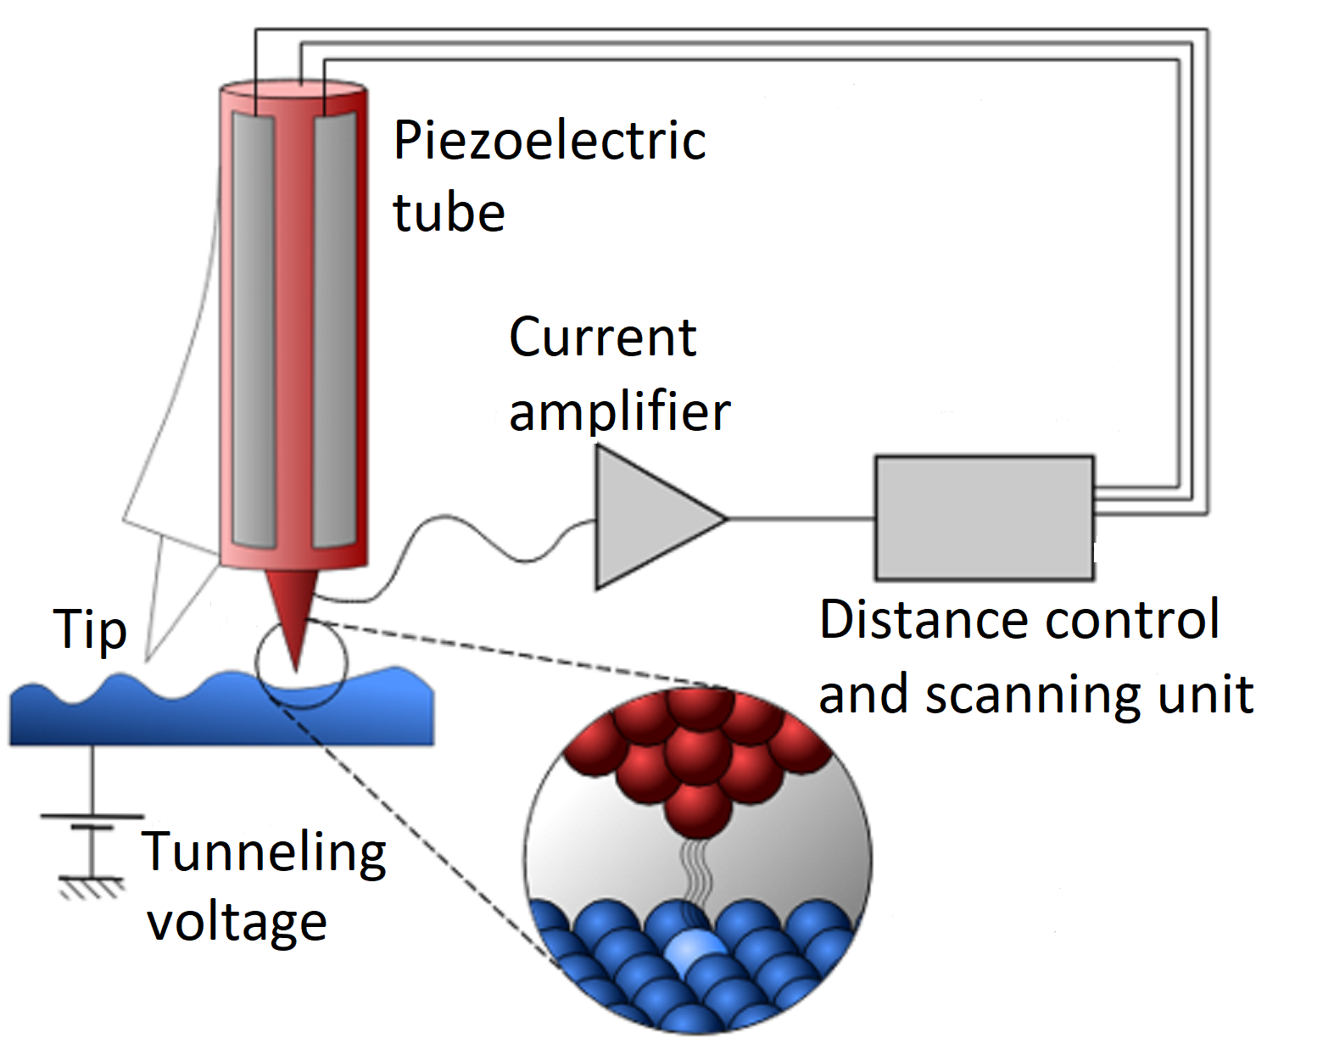
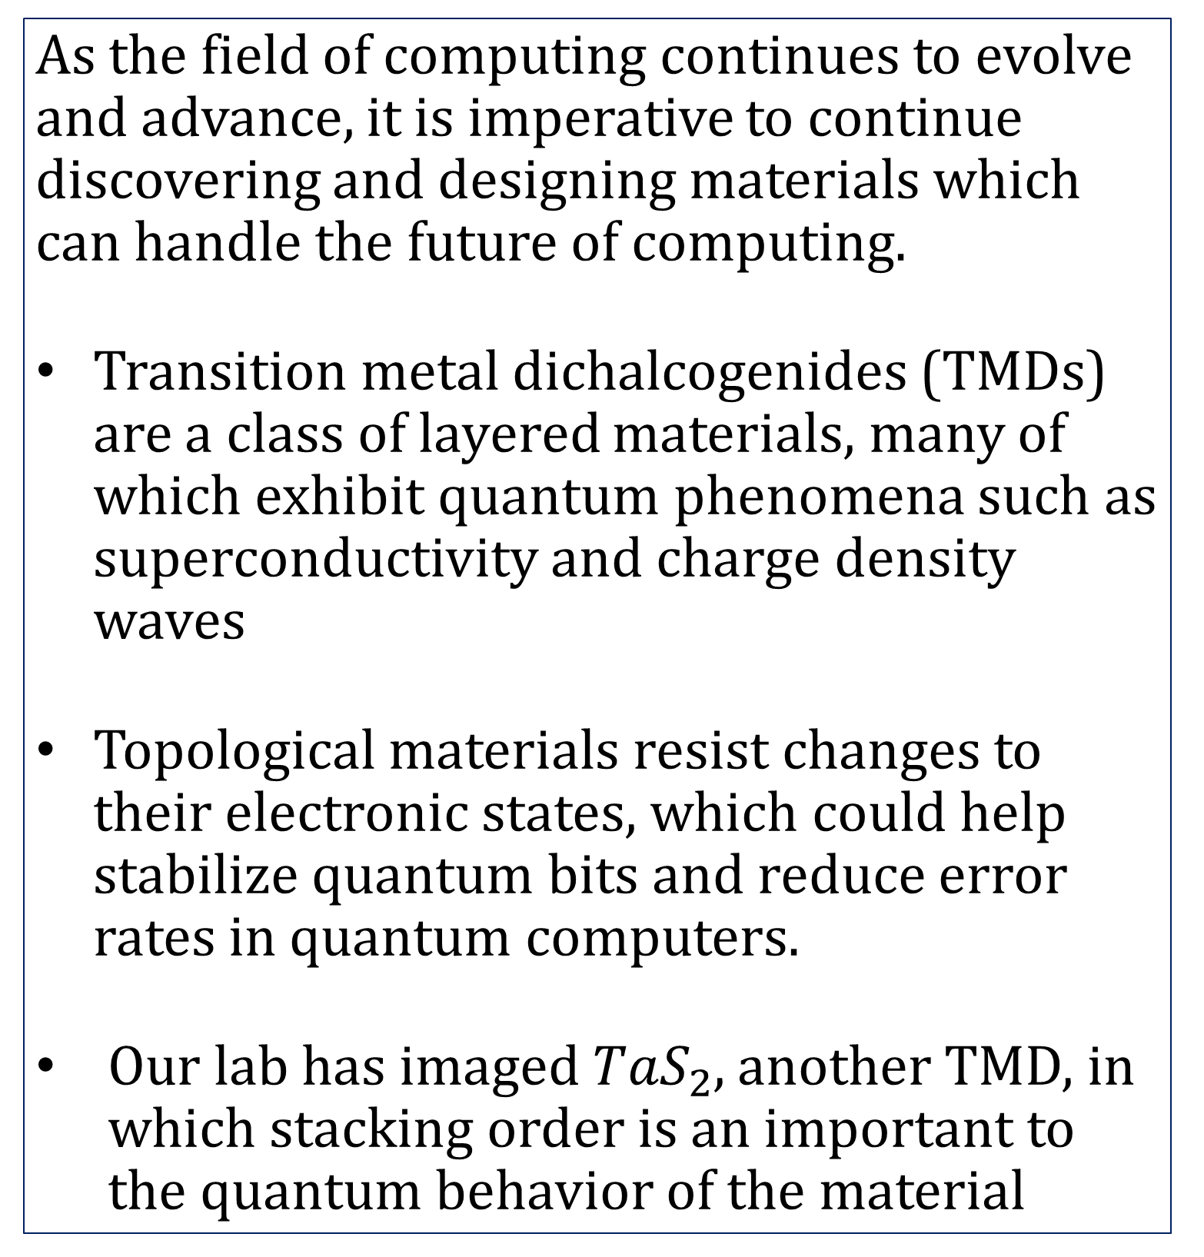

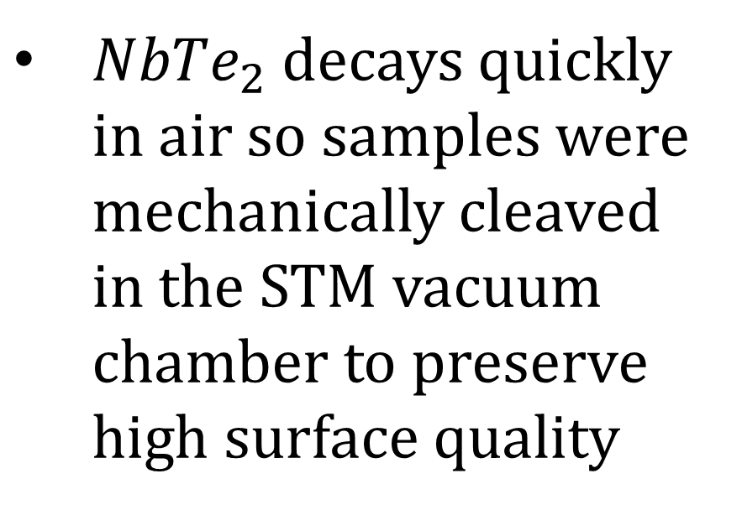
Investigating Layer Dependence of ${NbTe}_{2}$ Using
Scanning Probe Microscopy
Gavin Smith, Shawna Hollen, Ben Cambell
Department of Physics and Astronomy, University of New Hampshire, Durham, NH
Place your Project Logo Here
Introduction
STM Image and Height Profile of Step Edge
Methods
As the field of computing continues to evolve and advance, it is imperative to continue discovering and designing materials which can handle the future of computing.
Transition metal dichalcogenides (TMDs) are a class of layered materials, many of which exhibit quantum phenomena such as superconductivity and charge density waves
Topological materials resist changes to their electronic states, which could help stabilize quantum bits and reduce error rates in quantum computers.
Our lab has imaged ${TaS}_{2}$, another TMD, in which stacking order is an important to the quantum behavior of the material
To answer our research question, we first scanned large areas of our sample to find a step edge
We imaged at low temperature (10K) to minimize thermal drift allowing us to more easily image a specific feature over time
Once at the step, we took high resolution STM scans, finding a tip bias of 200-300mV produced the best results
Following imaging, we conducted point and line dI/dV spectroscopy both on and off the step edge, looking for differences between the spectra, which could indicate new electronic states
Figure 2: STM image of a step edge in NbTe2 with a height profile across (blue line). The step height is between 5-6 Angstrom which agrees with the literature. We also see that there is contamination along the step
Spectroscopy on Both Sides of the Step
(a)
b
Figure 3: (a) STM image of part of the step edge in figure 2. Boxes labeled b and c indicate locations of the smaller STM images taken off the step (b) and on the step (c). At each of those locations, we took dI/dV line spectra, depicted by the colored dots. Those line spectra (d,e) span from -400mV to +400mV, and include 16 points which lay at different points on the charge density wave.
Conclusions
We saw no distinct features from the line spectra that only appear on one side of the step
  Point spectra we took at 4 other locations, 3 on the step and 1 off the step, all agree with the line spectra taken on both sides
Step edge was too contaminated to take spectra directly across it
Research Question
Since Niobium Ditelluride NbTe₂ is a TMD and has been identified as a possible topological material, does it exhibit quantum properties which are affected by the layer stacking order?
c
(d)
Background
(b)
Scanning tunneling microscopes (STM) use the quantum mechanical phenomena of electron tunneling. When we position a sharp tip very close (<1nm) to a surface and apply a bias we can induce a tunneling current.
Next Steps
Write code to visualize point by point spectroscopy data that we took to see if it agrees with our initial observations
Cleave a new crystal of NbTe2 in vacuum and see if we can find a cleaner step-edge
Take dI/dV spectroscopy of wider voltage ranges, and on at least 1 other step edge to better understand our results
(e)
${NbTe}_{2}$ decays quickly in air so samples were mechanically cleaved in the STM vacuum chamber to preserve high surface quality
(c)
References
Figure 1: STM diagram [1]
[1] "File:Scanning Tunneling Microscope schematic.svg" by Michael Schmid and Grzegorz Pietrzak is licensed under CC BY-SA 2.0.

