Slide 1
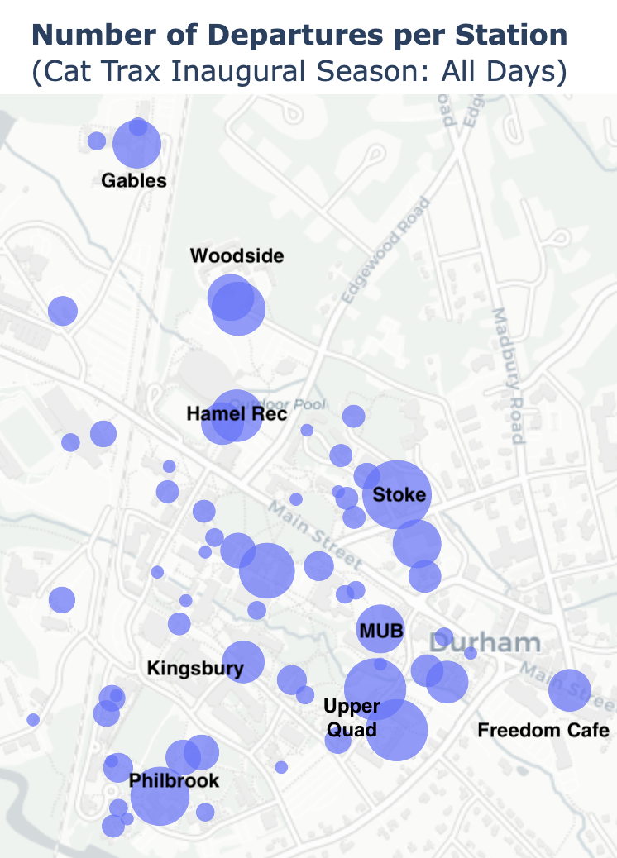
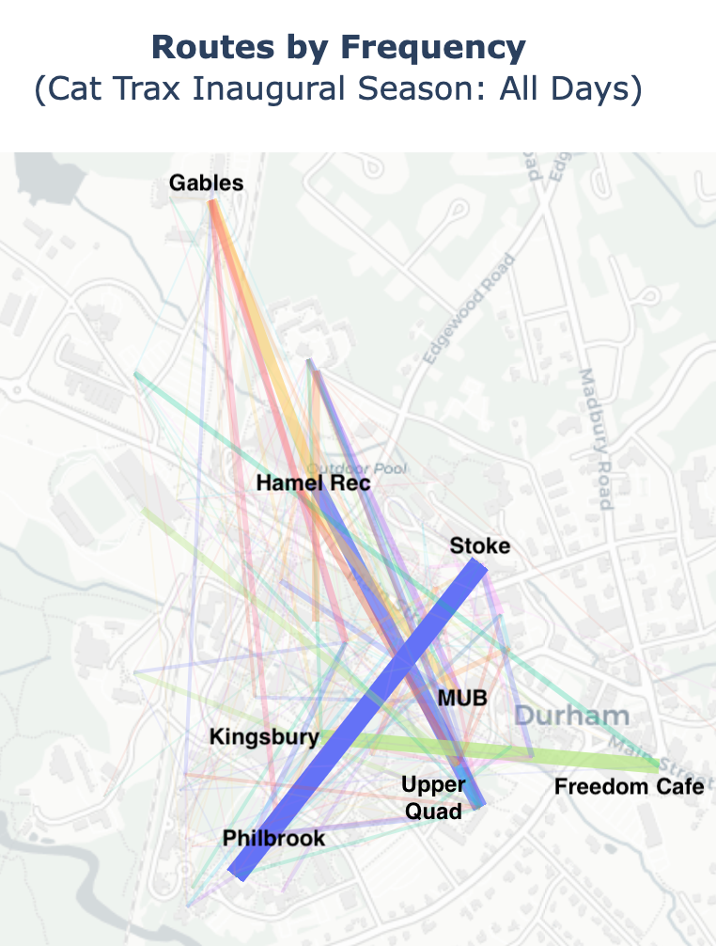
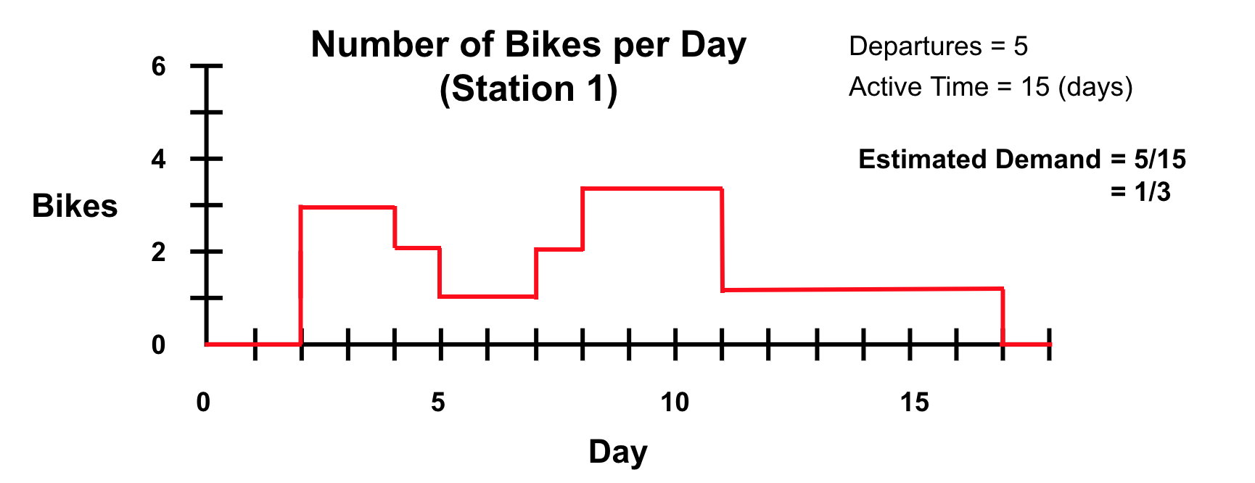
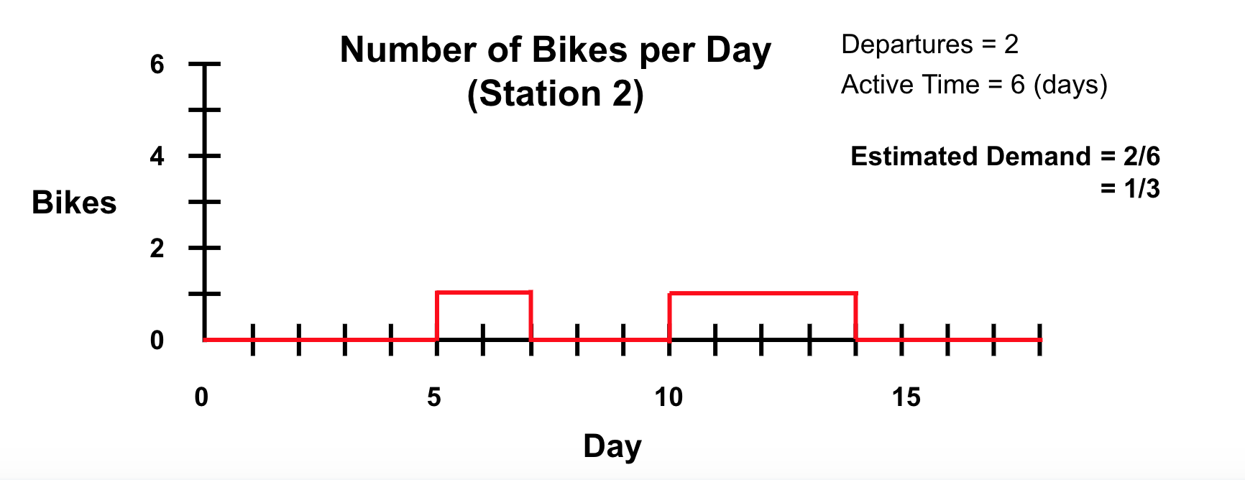
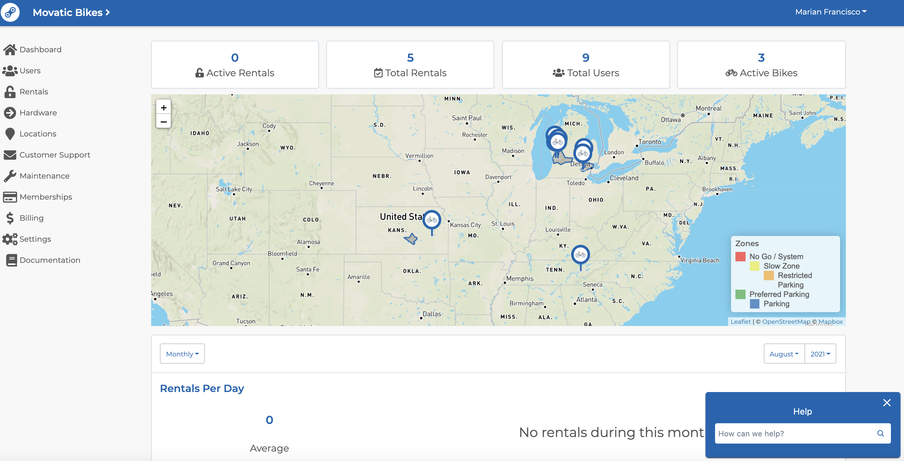
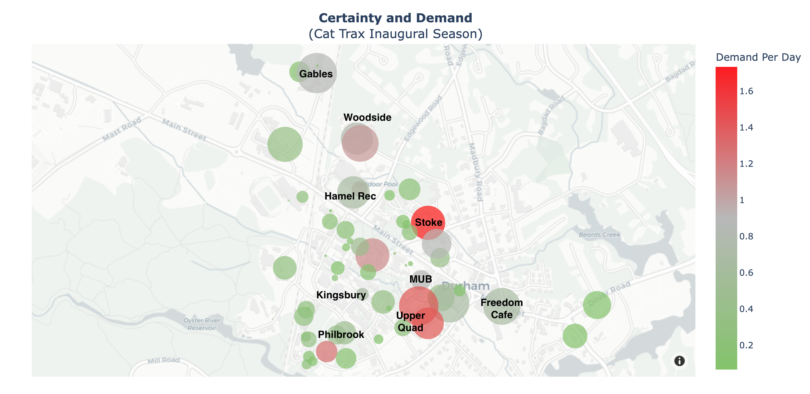
Real-Time Optimization of UNH Bike Share System
Carson Loughridge
Advisors: Dean Sullivan, Jeffrey Lapak
University of New Hampshire Innovation Scholars 2023
Introduction
Exploratory Data Analysis
Distribution Algorithm
Bike availability is a key concern in bike share systems. Our project aims to provide the Sustainability Institute's Cat Trax Bike Share system with an effective algorithm for redistributing bikes. After defining a metric for demand, we propose a simple heuristic approach for addressing demand at bike stations. Bike rebalancing is a popular field of research. Modern studies, however, focus heavily on large scale systems and redistribution costs.
In contrast, our project provides a practical, concise, and intuitive method for bike redistribution at UNH. Working with Jennifer Andrews, a Sustainability Project Director, software will be officially implemented within the month. We hope to demonstrate the potential of data science applied to sustainability at UNH.
At the request of the Cat Trax 's team, we developed data visualization for general insight on bike usage. All data visualizations are originally digital and interactive (hovering over specific data provides additional information).
Cat Trax administrators are prompted for two values:
Number of bikes to redistribute.
Floating-point value for "riskiness".
A higher riskiness value favors stations with less certainty.
Fig 1 (Left). Departures by station. Bubble size correlates to the number of departures.
Next, a "score" for each station is calculated with the formula below:
Bikes are then distributed proportionally to station scores. A secondary hidden parameter determines how often the heuristic explores zero certainty stations, where no demand estimates can be made (since no departures have occurred).
C = Certainty
D = Estimated Demand
R = Riskiness
Station Score = ( CD + (1 - C) * RD )
Fig 2 (Right). Routes by frequency. Line thickness correlates to route frequency.
Simulation Results
Data Collection
Table 1: Number of Successful Trips
Nine simulations were run using weekly redistributions with
various riskiness values and durations. Demand was modelled with uniform random
variables evaluated in hourly
segments, where expected
departures per hour were
calculated from Cat Trax's inaugural season data. The "Original Method" consisted of placing 5 bikes at the MUB and equally distributing the rest.
Measuring Demand
 | R = 0.5 | R = 1 | R = 1.5
5 Weeks | 505, 548 | 596, 572 | 587, 482
10 Weeks | 1073, 1119 | 1178, 921 | 1217, 1032
15 Weeks | 1873, 1587 | 1804, 1408 | 1816, 1427
The Cat Trax Bike Share system is hosted through a third-party company: Movatic.
We define “demand” at a station as the average number of people per day who wish to check out a bike. Departures are a good indicator of demand. However, if no bikes are available at a station, demand cannot be measured through departures. Thus, we distinguish between states of a bike station. A station is “active” when it has one or more bikes. A station is “inactive” when it has no bikes.
Historical Data
Heuristic Method (Red)
Original Method (Blue)
Our proposed heuristic method out-performed the status quo for configurations bolded and underlined in Table 1. The heuristic method initially distributes all bikes evenly. The original method, however, contains a priori knowledge of demand. Thus, tuning the heuristic with data from previous seasons may significantly improve results.
Trip Data Features
Bike trip data is downloaded from Movatic and parsed into a Pandas DataFrame in Python.
| Start Station | Start Time |
| End Station | End Time | Bike ID |
Fig 3 (Left).
Fig 4 (Right).
Movatic Admin
Python3
Future Work: Sustainability X Data Science
To estimate demand at a station, total number of departures is divided by total time active. However, this discounts time in which a station is inactive (refer to Fig. 3 and 4, where two different stations have identical estimated demand). Thus, we introduce “uncertainty”. Uncertainty is defined as the percentage of time a bike station was inactive. Below, we visualize demand and uncertainty by station for Cat Trax's inaugural season.
Many possible improvements to this heuristic method exist. Weighting recent data more heavily, utilizing data from previous bike share seasons, modeling demand more realistically during simulated testing, and incorporating arrival data into the heuristic are all promising areas to work on.
We hope this project provides a sneak-peek into the potential of pairing sustainability with data science at UNH. Data science brings an entirely new toolbox to sustainability problems, and computer science students are hungry for resume-building projects. We wish to establish a strong, long-lasting relationship between the Sustainability Institute and the Computer Science Department. Future plans are currently being discussed.
**Open Mobility Foundation prevents real-time trip route data for user anonymity. Thus, we combine historic bike trips with real time station data. **
Real-Time Data
Available bikes at each station queried through Movatic's General Bikeshare Feed Specification API
Fig 5. Demand and Uncertainty by Station. Bubble size correlates to uncertainty. Color correlates to estimated demand.
Acknowledgements
References
Authorization errors debugged with:
A big thanks to Jennifer Andrews, Kyle Ouellette, Nathan Chasse, Mason McDonald, Nathan Maybach, and Prof. Dean Sullivan. Thank you, Prof. Shawna Hollen, for running Innovation Scholars. Thank you to UNH, the UNH IOL, and the Sustainability Institute for providing such a wonderful opportunity .
Chemla, Daniel, et al. “Bike Sharing Systems: Solving the Static Rebalancing Problem.” Discrete Optimization, vol. 10, no. 2, May 2013, pp. 120–146, https://doi.org/10.1016/j.disopt.2012.11.005. Accessed 24 Oct. 2019.
Chiariotti, Federico, et al. “A Dynamic Approach to Rebalancing Bike-Sharing Systems.” Sensors, vol. 18, no. 2, 8 Feb. 2018, p. 512, https://doi.org/10.3390/s18020512.
Ghosh, Supriyo, et al. “Dynamic Repositioning to Reduce Lost Demand in Bike Sharing Systems.” Journal of Artificial Intelligence Research, vol. 58, 27 Feb. 2017, pp. 387–430, https://doi.org/10.1613/jair.5308. Accessed 19 Feb. 2021.
Figure 7. The server design that allows communication between the frontend and the backend.

