Slide 1
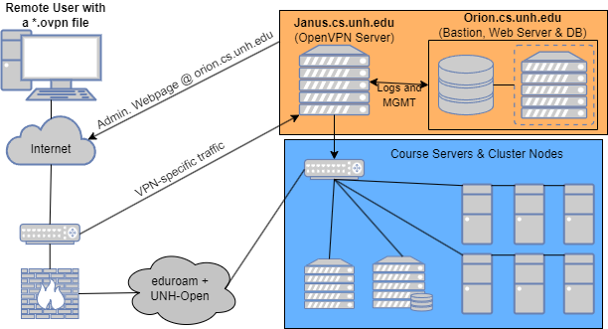
Orion Enterprise VPN Ryan Skelly, Mike Stack, Luke Allison, Connor LaRocque CS Department, University of New Hampshire, Durham, NH 03824
Place your Project Logo Here
Introduction
Design and Implementation
Results
The current computing infrastructure at UNH poses various challenges for the CS/IT community. They are required to physically be on campus to access computing resources and lack a method for protecting sensitive network traffic to and from campus. These limitations hinder their ability to learn and research efficiently. Orion VPN provides a solution to these issues: with its secure access to computing resources in the CS department, students and professors can work from anywhere and protect their sensitive information, enabling them to discover and explore without limitations.
The VPN consists of two different machines. The first is Orion, the virtual bastion host, which is the only point of entry to Janus, and hosts the Web server, and database. The second is Janus, a physical PC which hosts the VPN server. The hosting of our management interface has been done with an Apache2 web server(Httpd) and leverages a custom Python script for creating and managing configurations. A Systemd daemon has also been setup to log VPN utilization into the database. OpenVPN has been configured to set up a routing-based split tunnel over UDPv4 and has been hardened with the use of packet filtering via iptables. VPN connection specifics are logged into journalctl and a MariaDB server for easy retrieval by CS administrators through CLI, or the web.
Our team conducted a Beta test on the 132.177.4.0/24 and 132.177.5.0/24 internal subnets, as shown by the architecture diagram. This was done to confirm operational success and not compromise any actual internal subnets (as 132.177.0.0/20 are routable). The config generating script has been proven to work, and successfully logs connection specifics to the MariaDB server. Password Support has been enabled through the use of a PAM.d plugin offered by OpenVPN. Additional Routes have also been instantiated to provide further access.
Architecture Diagram
Conclusions
Description
The product is in service and functioning as designed allowing access to CS resources without the need to open services to the Internet. Account configurations are created via Python and scripting tools allowing secure delivery to the CS community. Tracking and monitoring of the system is working via the management system. Version Control and product management has been setup for both the VPN and the web interface. Client configurations are securely delivered to their CS accounts on agate.cs.unh.edu. The entire project is delivered via the CS Gitlab Server.
Orion VPN is a virtual network system designed to provide users a secure and encrypted tunnel to campus from anywhere in the world. It has two parts, the VPN itself, along with a web-facing management interface. Orion was built on top of the de facto open-source VPN solution, OpenVPN, which has been granularly tuned to integrate seamlessly with existing university-owned resources. The management interface serves as a system that administrators can use to view and control client connections, and a guide to provide students and faculty with documentation in case things go awry.
Web Management Interface
Future Work
Future work will entail improving upon the automated security & audit scanning(IDS) functionality of the VPN, and test performance speeds of bulk concurrent connections. Other miscellaneous work could include developing the system "Software Bill of Materials" (SBOM), implementing MFA/Push Notifications for administration accounts, two factor authentication and enabling IPv6.
Requirements
Functional Requirements:
Direct VPN connection to CS network
Automated lifecycle - add, track and remove VPN accounts
Fast/Reliable Tunnels
Location Independence
Non-Functional Requirements:
Pertinent Documentation
Easy to use and reliable
Security Requirements:
Password Support
Improved security to CS resources
Client Logging
Administration reporting and VPN creation alerts
Acknowledgements
We would like to thank our sponsor Scott Kitterman for the inspiration for this project as well as the continued support. A special thank you to the Computer Science and Information Technology departments for providing hardware, and to the beta users that helped us develop and refine our implementation.

