Slide 1
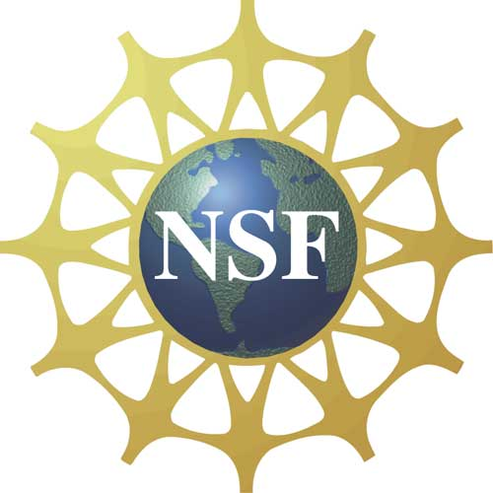


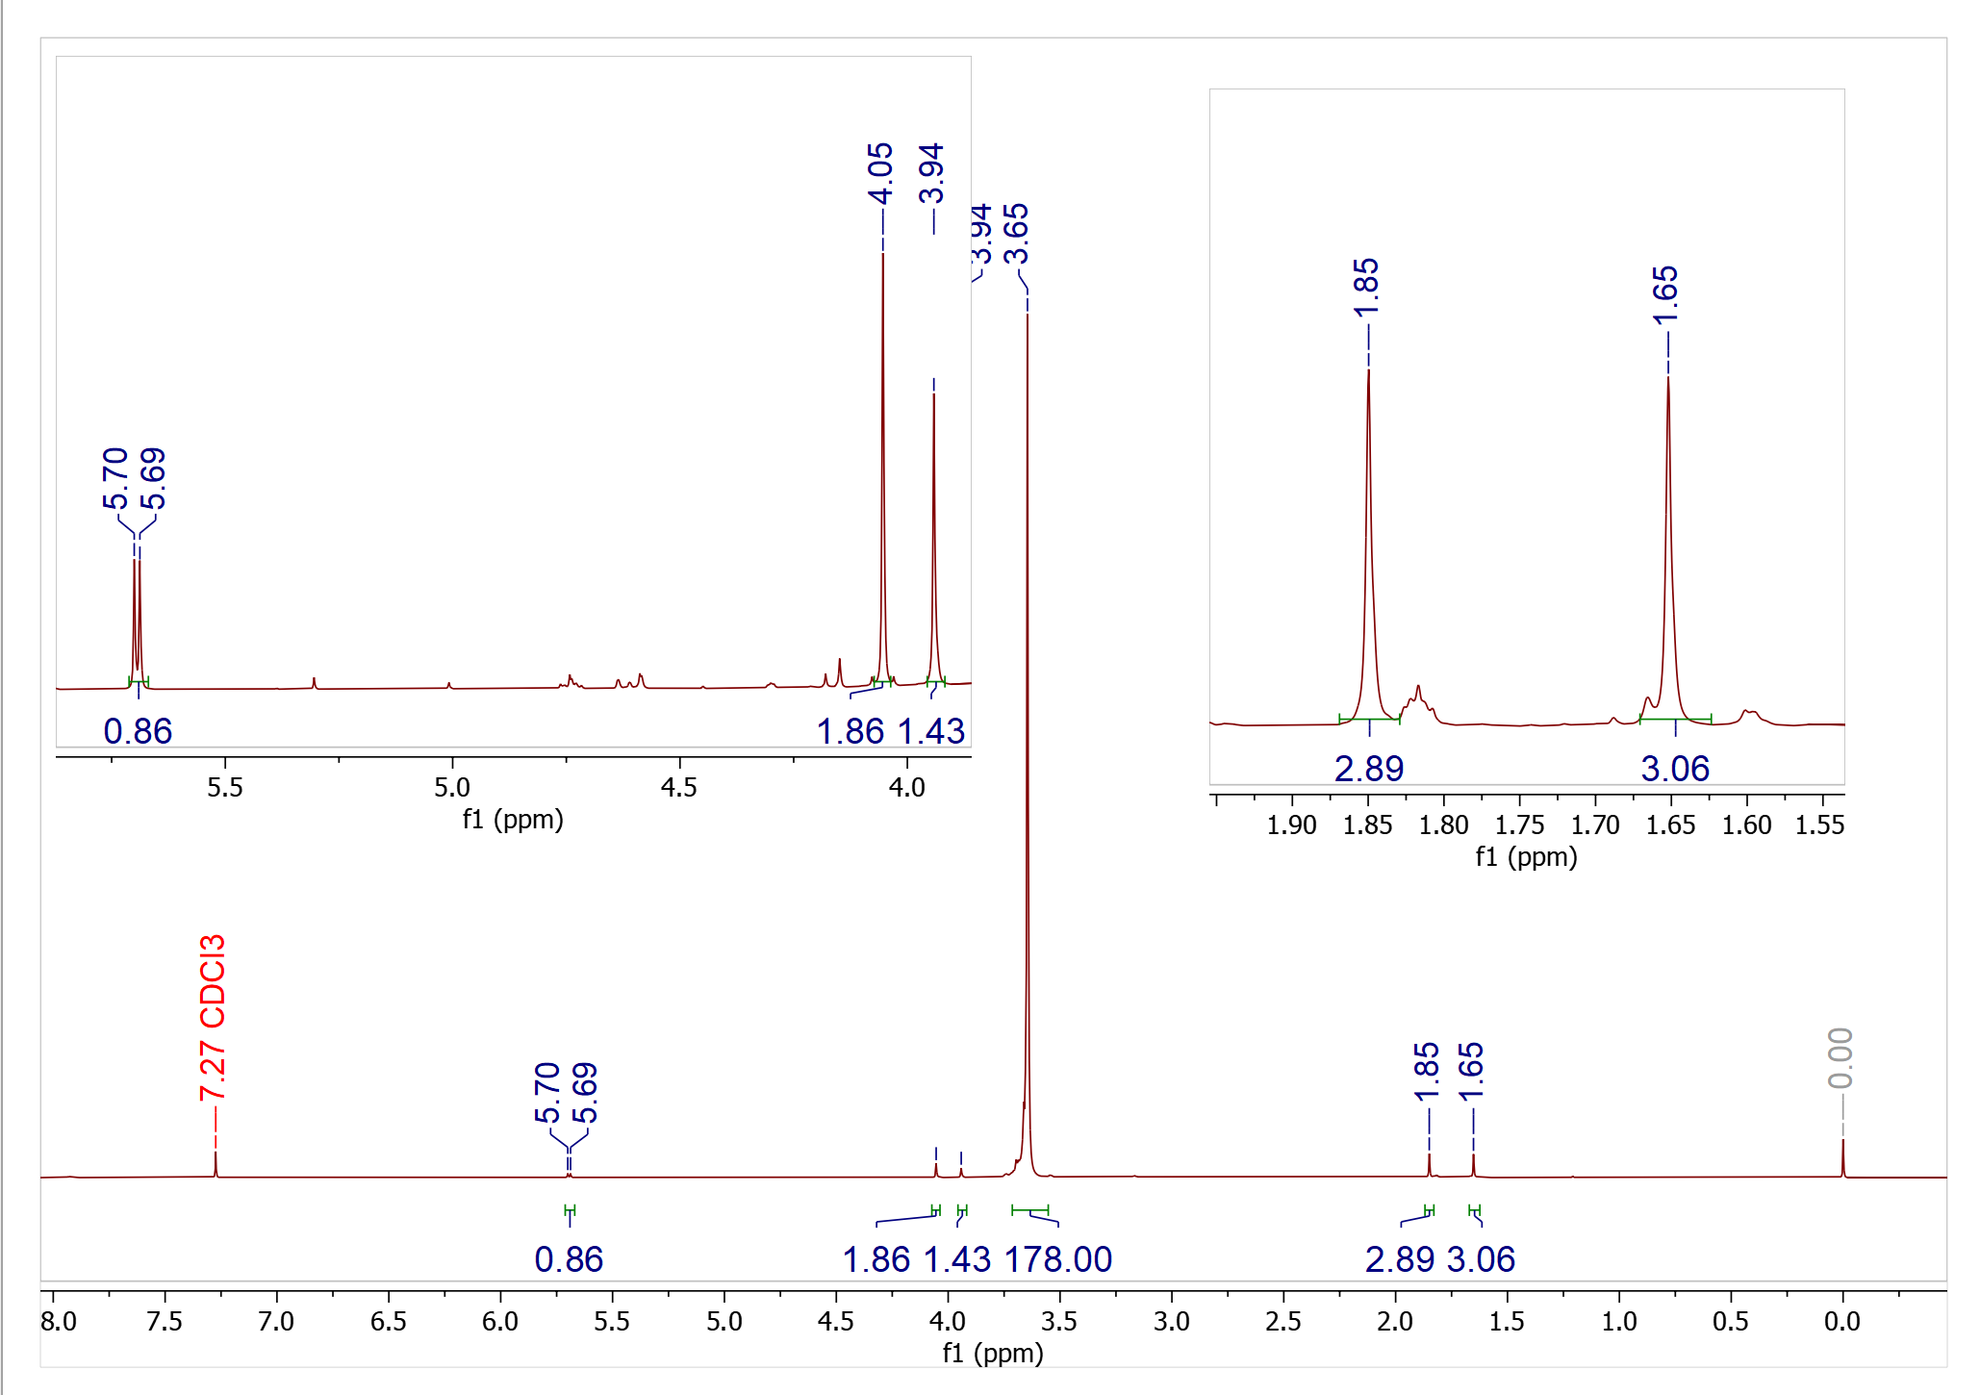
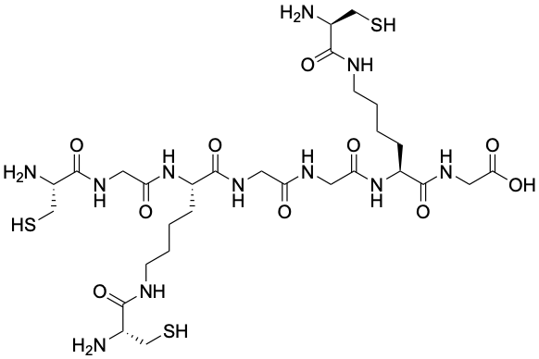
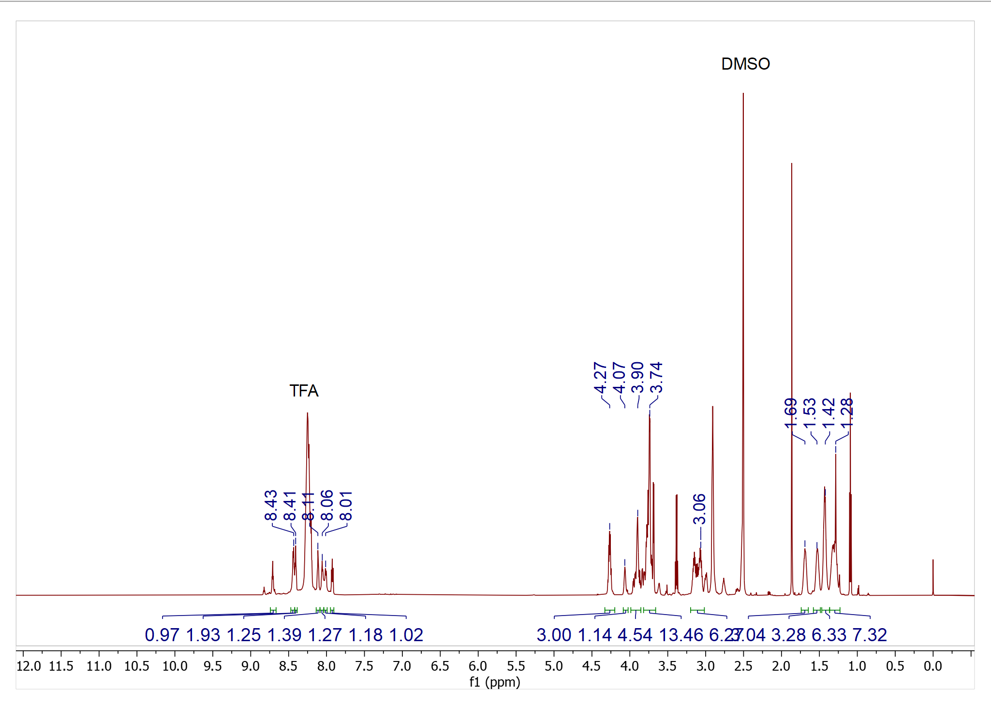
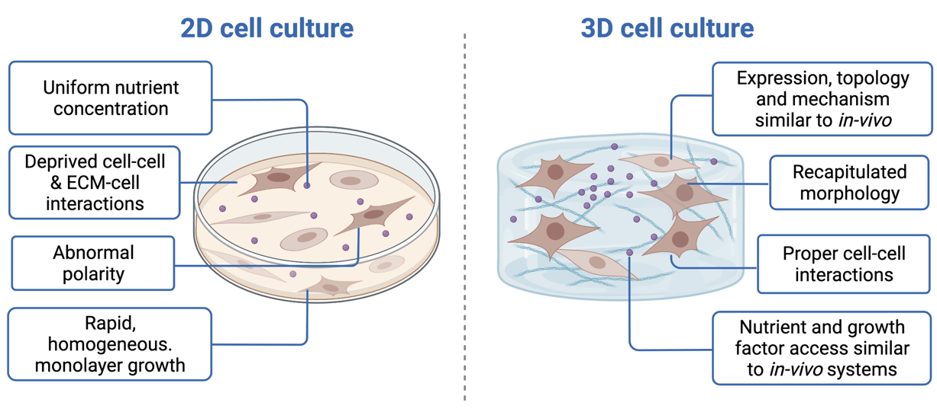
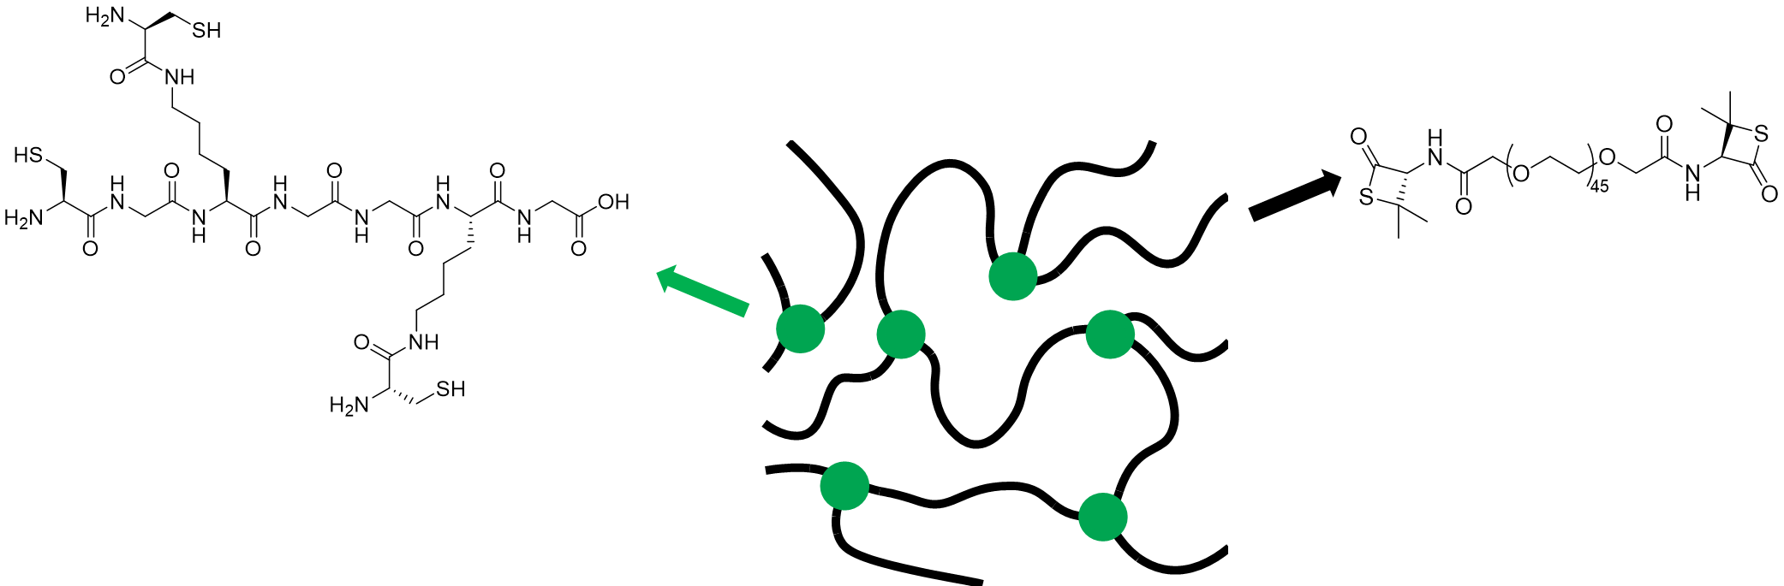
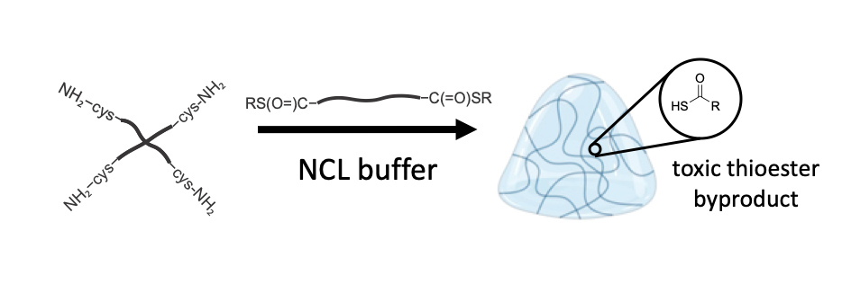
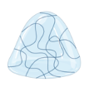
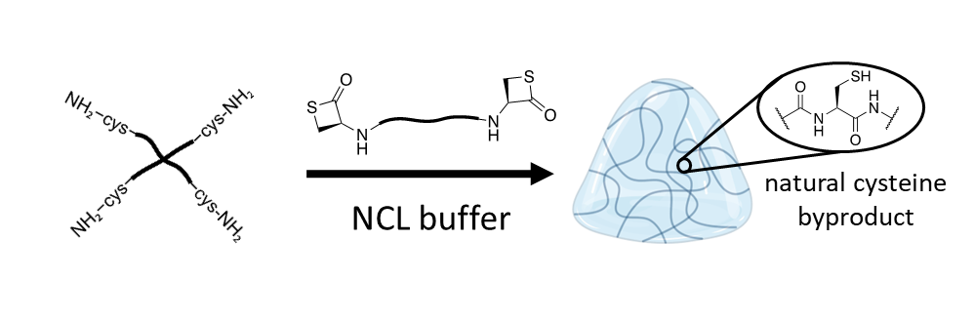
Development of 3D cell cultures through noncytotoxic native chemical ligation
Kelsey MacCallum, Samuel Ashooh, Matthew Currier, Nathan Oldenhuis
kelsey.maccallum@unh.edu
Introduction
Experimental
Results
The extracellular matrix (ECM) is a complex and dynamic network composed of growth factors and protein scaffolding that influences a variety of cellular functions. When studying cells and their processes in synthetic conditions, it is important that the environment can properly emulate the synergistic relationship between cell and ECM.
To truly emulate cell-ECM interactions found in vivo, synthetic environments must expose cells to attachment motifs in three dimensions while also providing variation in nutrients, stiffness and mechanosensing (all with the ability to be manipulated by the cell itself). Over the last several decades, there has been a growing interest in developing in vitro investigation strategies that can bridge the gap between 2-dimensional (2D) cultures and animal models. Three-dimensional (3D) models have become popular in recent years as a replacement for conventional monolayer cell cultures due to their ability to more accurately recapitulate conditions found in vivo. In a variety of applications, including drug delivery and stem cell research, use of 3D models has already proven to provide more physiologically relevant information and better prognostic data for in vivo tests¹.
With the discovery and resulting popularity in 3D cell culture research over the last two decades, techniques to produce crosslinked hydrogel from rapid, efficient and facile methods have been adopted for cell encapsulation. While some groups have established success creating 3D scaffolds crosslinked through native chemical ligation (NCL)^{2,3}, here we propose a novel variation of the technique as a nontoxic means of cell encapsulation through a β-thiolactone-fuctionalized polymeric backbone. In doing so, we hope to establish an innocuous and facile method to 3D cell scaffold platforms that can be tuned and manipulated to vary aspects such as hydrogel formation kinetics.
Scheme 1: (K(C)) Peptide Synthesis:
Tri-NCL Capable Crosslinker: CGRGDS Adhesion Ligand:
Scheme 2: Penicillamine Beta-Thiolactone
Scheme 3: PEG 2k Penicillamine-Beta-Thiolactone
Scheme 3: Conditions for Hydrogel Formation
Figure 2: ¹H NMR of PEG 2k Penicillamine-Beta-Thiolactone
Figure 3: ¹H NMR of Tri-NCL Capable Crosslinker
Figure 1: General overview of 2D vs 3D cell cultures. Recent innovations in hydrogel technologies have afforded access to recapitulate conditions similar to environments present within in-vivo tissues, though true ECM analogs remain elusive.
Future Work
Rheology testing of hydrogel material properties and gelation kinetics
Cytotoxicity studies
Synthesis of MMP degradable crosslinker for use in enzymatically degradable hydrogel formation
Cell culture in hydrogel – quantification of cell growth with confocal microscopy
Current
System
Literature Cited
(1) Edmondson R, Broglie JJ, Adcock AF, Yang L. Three-dimensional cell culture systems and their applications in drug discovery and cell-based biosensors. Assay Drug Dev Technol. 2014 May;12(4):207-18. doi: 10.1089/adt.2014.573. PMID: 24831787; PMCID: PMC4026212.
(2) Hu, B.-H.; Su, J.; Messersmith, P. B. Hydrogels Cross-Linked by Native Chemical Ligation. Biomacromolecules 2009, 10 (8), 2194–2200. https://doi.org/10.1021/bm900366e
.
(3) Chen, K.-T.; Ieritano, C.; Seimbille, Y. Early-Stage Incorporation Strategy for Regioselective Labeling of Peptides Using the 2-Cyanobenzothiazole/1,2-Aminothiol Bioorthogonal Click Reaction. ChemistryOpen 2018, 7 (3), 256–261. https://doi.org/10.1002/open.201700191.
(4) Agouridas, V.; El Mahdi, O.; Diemer, V.; Cargoët, M.; Monbaliu, J.-C. M.; Melnyk, O. Native Chemical Ligation and Extended Methods: Mechanisms, Catalysis, Scope, and Limitations. Chemical Reviews 2019, 119 (12), 7328–7443. https://doi.org/10.1021/acs.chemrev.8b00712.
This research is supported by a National Science Foundation EPSCoR award (#1757371)
Proposed
System

