Slide 1
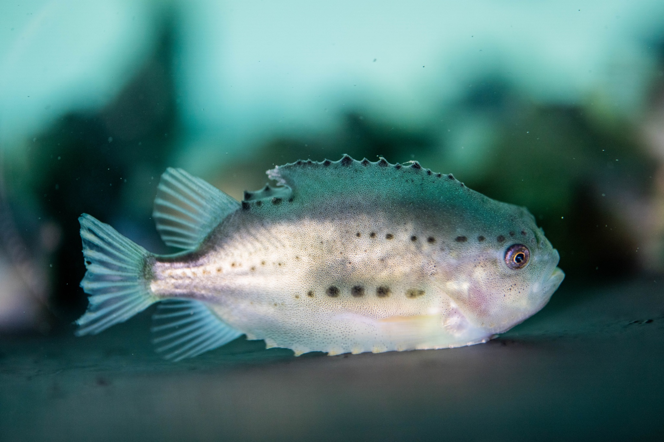
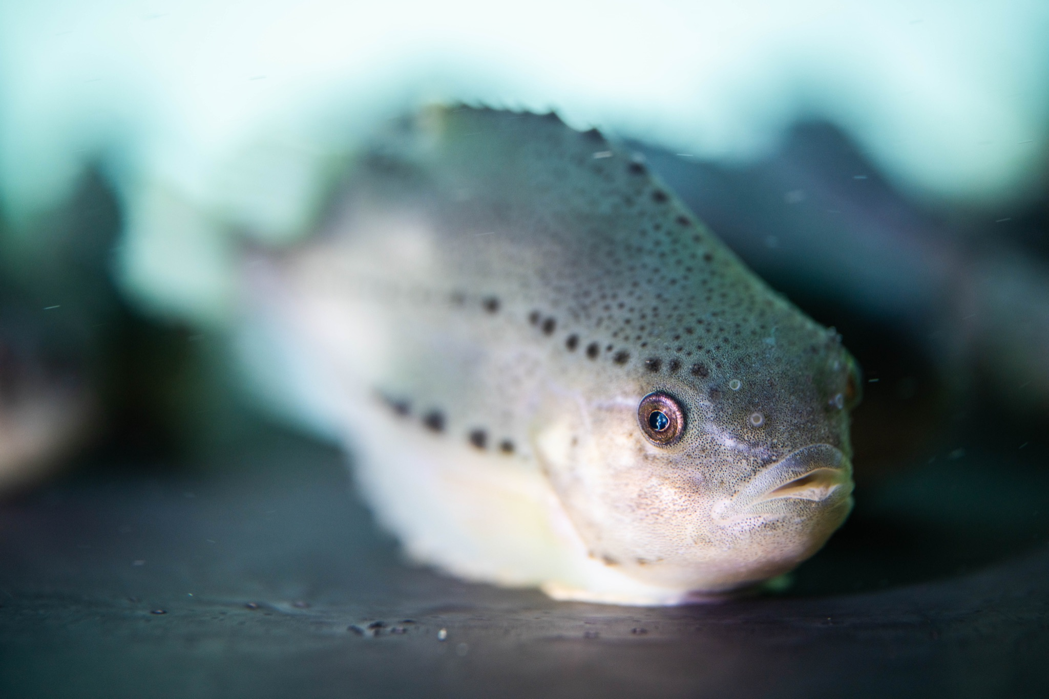
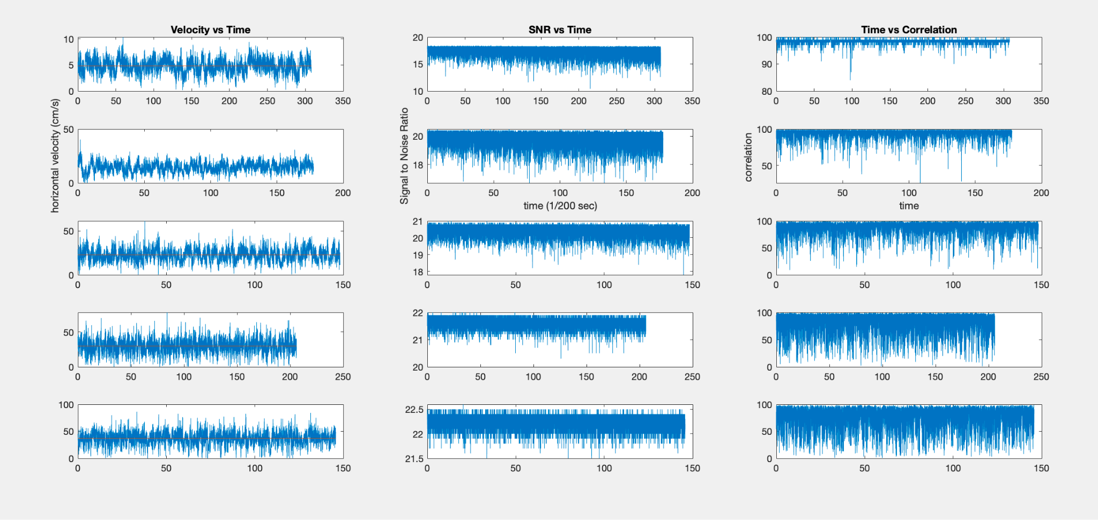
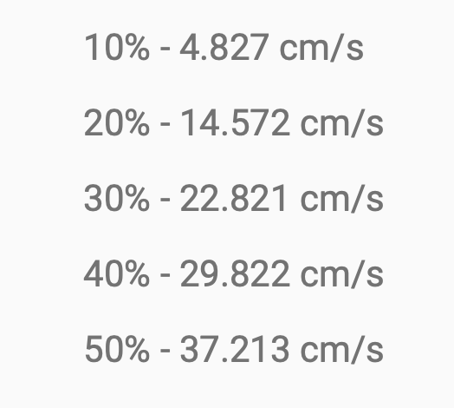
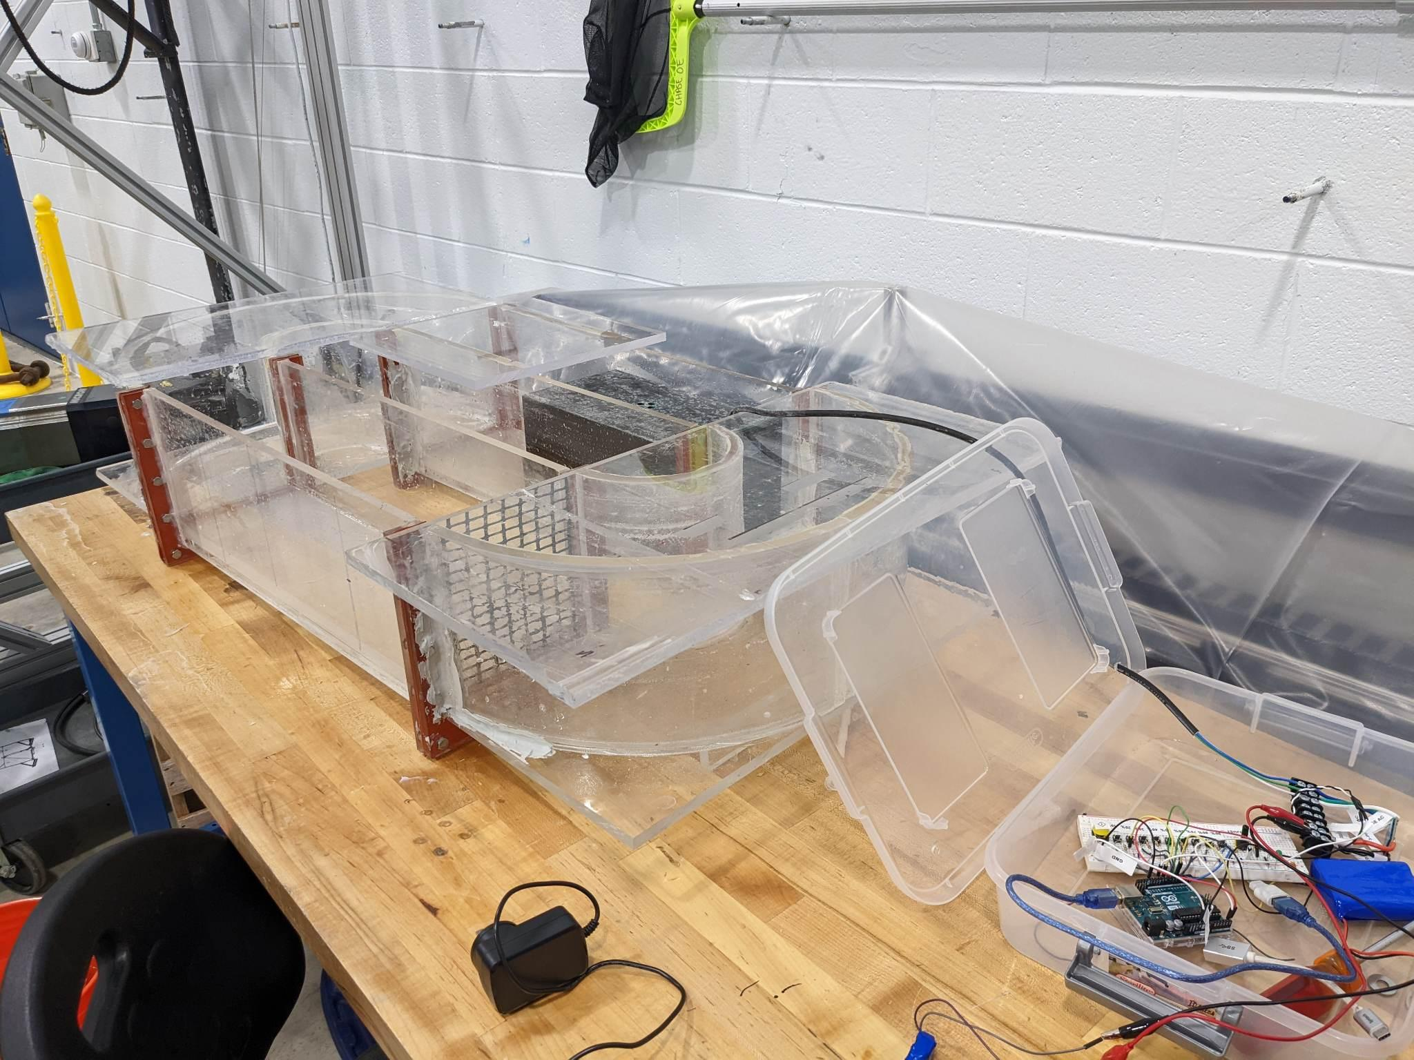
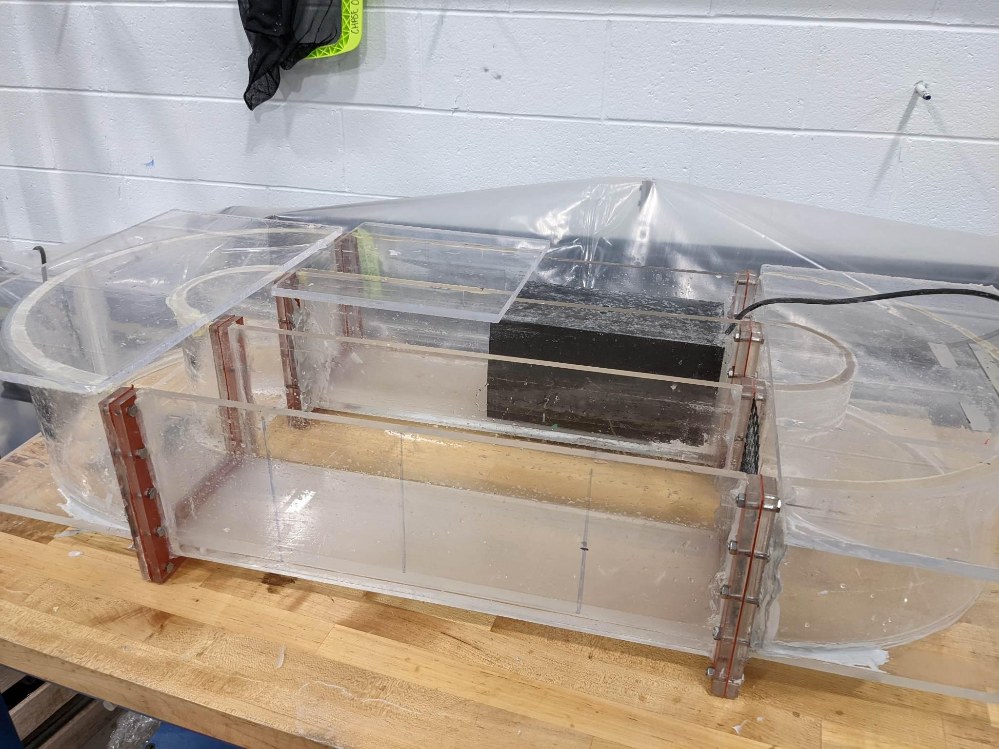
Modifying a Variable Speed Flow Chamber
to Test Lumpfish Sucker Strength Eli Silovich, Matthew Furletti Department of Ocean Engineering, University of New Hampshire, Durham, NH 03824
Introduction
Lumpfish Raised at the UNH Marine Reasearch Complex
Results
Lumpfish are a small pelagic fish found in the North Atlantic and the adjacent locations of the Arctic Ocean. Juvenile Lumpfish are a sustainable way to minimize the risk of sea lice infestations within salmon and steelhead trout farms. Lumpfish have a natural method of resisting strong currents by the use of a suction disc on their ventral side to adhere to objects to prevent being swept away. It is unknown if the Lumpfish suction strength can resist the varied water velocities they might experience at the farms. In 2021 a project was started to design a way to test the suction strength of Lumpfish. The first group built a flume to test the suction strength of juvenile Lumpfish under varied water velocities. The goal of the flume is to achieve water velocities between 4 and 60 cm/s with steady flow. At higher speeds, the flow produced by the thruster is turbulent and unsteady. Our task is to analyze the current flow of the flume and figure out a method of getting the flow in the testing section steady.
Juvenile Lumpfish
Juvenile Lumpfish
Further testing will be necessary to get a better grasp on the flow speeds that the flume can produce. The recorded data will also need to be analyzed for turbidity. The initial results show that the flume can reach one of the target speeds of 4cm/s. More testing with the new lid will need to be done to test the highest speeds that the thruster can produce.
Tim Brigg’s Feb 22
Tim Brogg’s Feb 22
Methodology
Data
Conclusions
Our goal within the course of this project was to identify and remove sources of turbidity from the flume. In doing so, the following step were taken to accomplish this target;
To measure the turbulence of the flume’s flow, a Nortek Vectrino was used to collect data for later analysis in Matlab.
A lid to the chamber was added to assist in reducing the vectical flow of the water, and thus reducing the turbidity
Flow veins were added into the bends of the chamber. This modification will help reduce any cross track flow from forming as the flow enters the testing chamber.
Recorded Flow Data
Average Velocities
From the data collected, it is still too early to say that the flow of the flume is steady and non turbulent. Moving forward with the continuation of modifying the flume to achieve the desired flow speeds and steady flow, a few things will be tried. A new flow duct will be designed with a smaller half angle, and different setups for the flow vanes at the bend will be made.
Graphs of Velocity, Signal to Noise Ratio, and Correleation
Time Averaged Velocities Measured with Vectrino Plus
Data
sTAMD Simulations
Acknowledgements
Photos of the Flume
Data collected by the Vectrino was directly saved as a .vna file and was imported into Matlab. Within Matlab, the collected data for operations of the fan from 10 percent to 50 percent total power was examined. We had plotted and reviewed the velocity, signal to noise ratio, and correlation for each power that we had recorded the data for. When collecting the data, we had built a mount on top the chamber such that the Vectrino was held steady.
Project Advisors:
Dr. Elizabeth Fairchild (DBS), Dr. Tracy Mandel (ME/OE), Dr. Martin Wosnik (OE/ME), Shelby Perry (MS/DBS)
Additional acknowledgements:
The 2021-2022 Lumpfish flow chamber research group
References
Ageeva, T. N., Lorentzen, G., Nilsen, H. A., & Lian, K. (2021). Lumpfish (cyclopterus lumpus) used as cleaner fish: Characterization and suitability for human consumption. Applied Food Research, 1(2), 100008. https://doi.org/10.1016/j.afres.2021.100008
Jonsson, P. R., van Duren, L. A., Amielh, M., Asmus, R., Aspden, R. J., Daunys, D., Friedrichs, M., Friend, P. L., Olivier, F., Pope, N., Precht, E., Sauriau, P.-G., & Schaaff, E. (2006). Making water flow: A comparison of the hydrodynamic characteristics of 12 different benthic biological flumes. Aquatic Ecology, 40(4), 409–438. https://doi.org/10.1007/s10452-006-9049-z
Flume with Flow Duct Inserted
F lume with Flow Duct and Arduino Wiring

