Slide 1
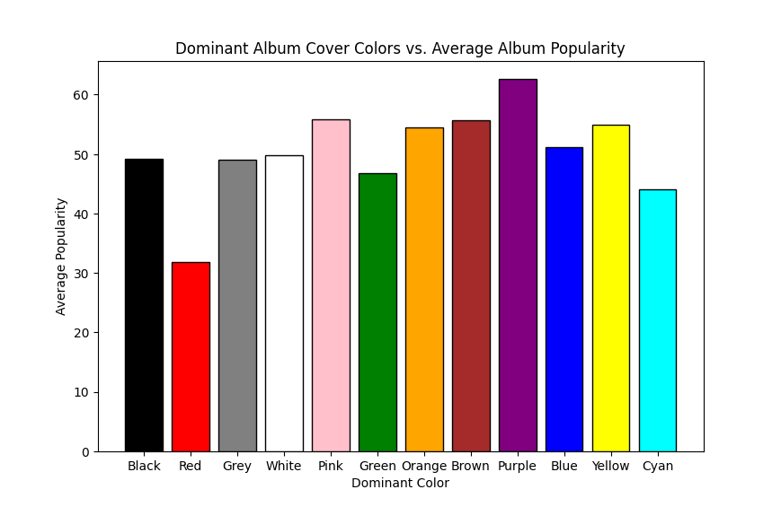
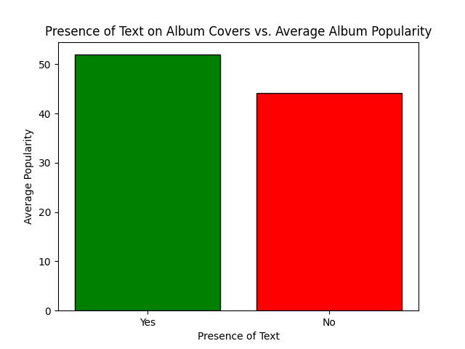
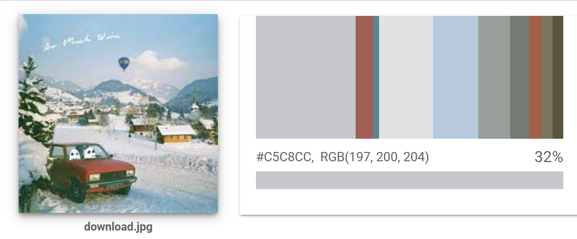
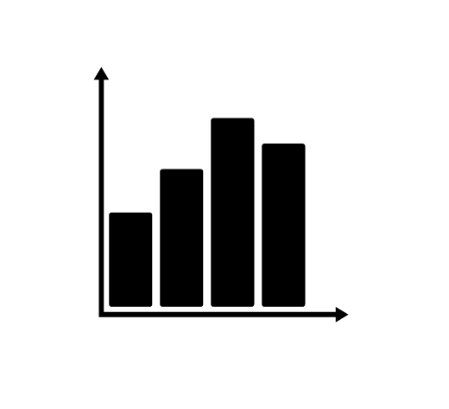
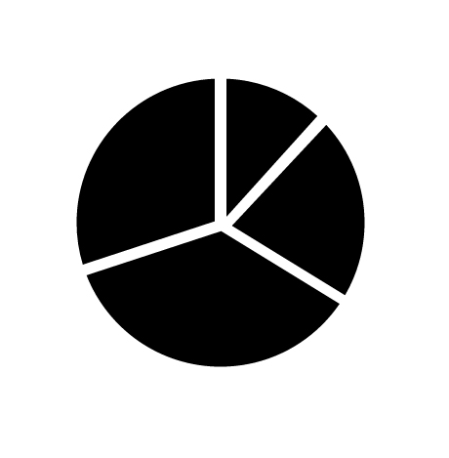
Album Cover Analysis Alexander White and Elisabeth Drakatos Innovation Scholars, University of New Hampshire, Durham, NH 03824
Introduction
Process
Results
With the difficulty lesser-known music artists have in gaining notoriety and the high saturation of the music space, it is important to optimize every aspect of this marketing process. It can be very difficult for music artists to reach new audiences with their music, making it hard to rise in popularity. This discourages aspiring music artists from entering this field, because it is so volatile. To solve this, we analyzed various album cover components to determine if certain components may be correlated with an album's popularity. Specifically, album cover color and the presence of text on the album cover.
The results for the data regarding dominant color in album covers yielded a mean average popularity of 50.47, and a standard deviation of 7.67. The color with the lowest average popularity value was red. Album covers with a dominant color of red had an average popularity value of 31.83. The color with the highest average popularity was purple, which had an average popularity of 62.6. The other colors were much closer to the mean of the data.
The results for the data regarding presence of text in album covers yielded a standard deviation of 5.487. There was also a slight difference in average popularity from the data we analyzed, where album covers with the presence of text had an average of 51.93, while those without text had an average popularity of 44.17.
Methods
Charts
Conclusions
We developed a Python application that fetches album information from the Spotify API for each track in a pre-defined indie playlist. This data included a URL to the album cover.
Our application then downloaded this URL and sent it to the AWS Rekognition API. The dominant color and presence of text is then returned by the Rekognition API for analysis alongside the album popularity.
Our application then analyzes this data using the popularity for each album. The application then generates the graphs for this data. These graphs were strictly bar graphs since (aside from popularity values) the entirety of the data was categorical.
Based on the results of this data, it seems that album covers with a dominant color of red are much less popular on average than other colors. It also showed that album covers with a dominant color of purple are more popular on average, although not significantly higher than every other color. Based on the second graph, it can also be seen that the album covers containing text are more popular on average than those without text.
It is important to note that these conclusions aren't applicable to all album covers, since much more data will have to be analyzed before a reliable broad generalization can be made. However, based on this data that was analyzed, album covers that contain text and have a dominant color of purple are the most popular for Indie albums.
Chart #1 Sub-Title Here
Chart #2 Sub-Title Here
Chart #1 Caption Here
Chart #2 Caption Here
sTAMD Simulations
Next Steps
Visuals
Graph #1 Sub-Title Here
Graph #2 Sub-Title Here
Analyze a larger data set, and possibly some more variables
Conduct further research to identify a causation rather than just a correlation
Depending on the results of the research, make the information well-known so artists can optimize their viewership
Data
Variables Analyzed:
Dominant colors in album covers
The presence of text in album covers
470 Indie album covers were analyzed for these two variables. When finding dominant colors, generalizations were made to group different shades of the same color under one universal color name. For example, light green and dark green were combined into the color group "green". Indie album covers were specifically analyzed for data to avoid confounding variables like artist popularity.
Acknowledgements
Special thanks to:
Cohort Leader Kyle Oulette and Dean Sullivan
TA's Nathan and Mason
The UNH InterOperability Lab
Graph #1 Caption Here
Graph #2 Caption Here

