Slide 1
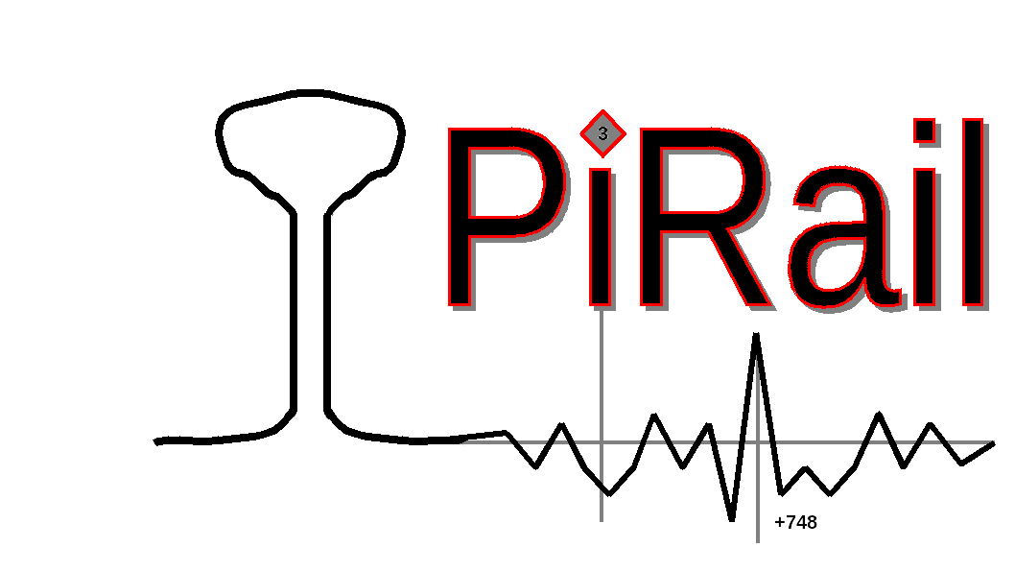
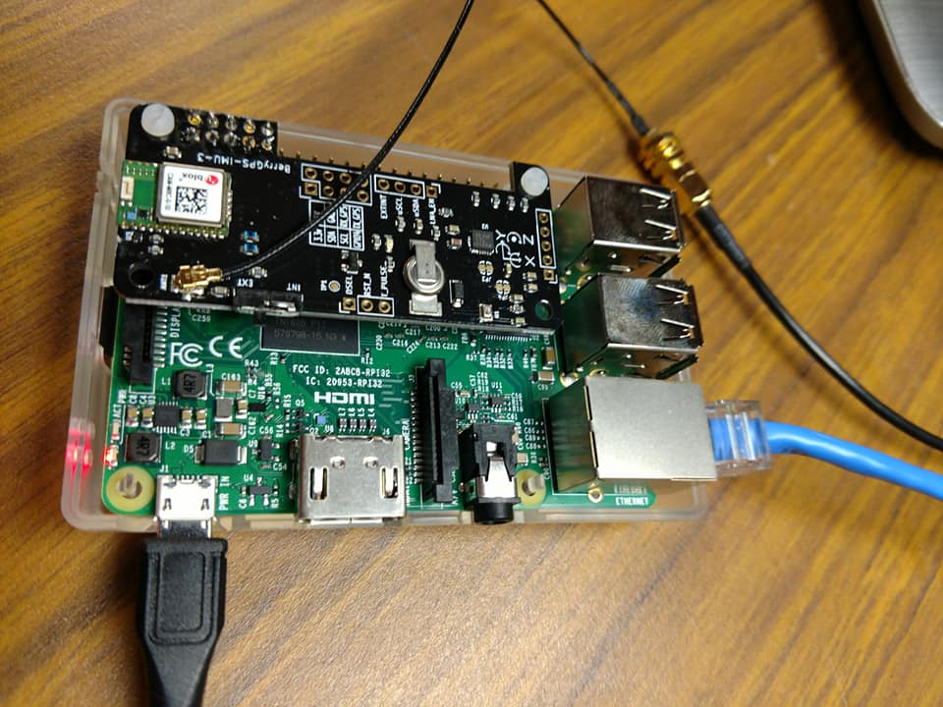
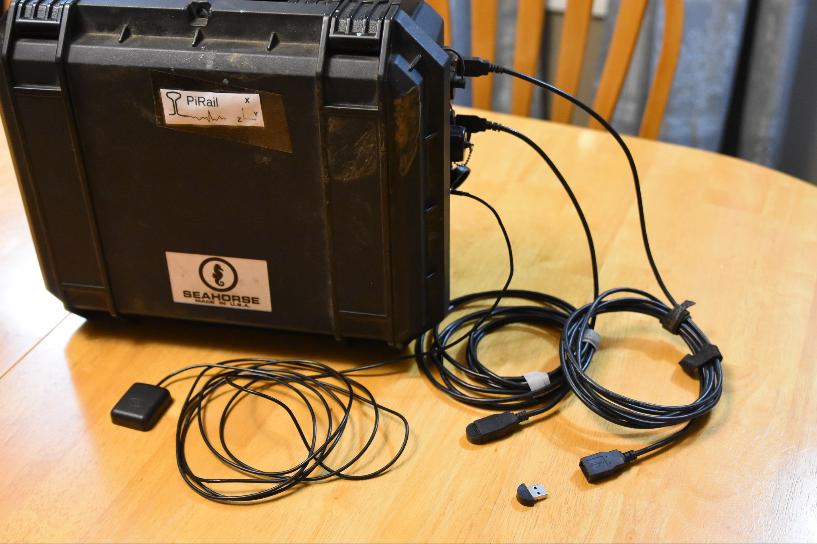
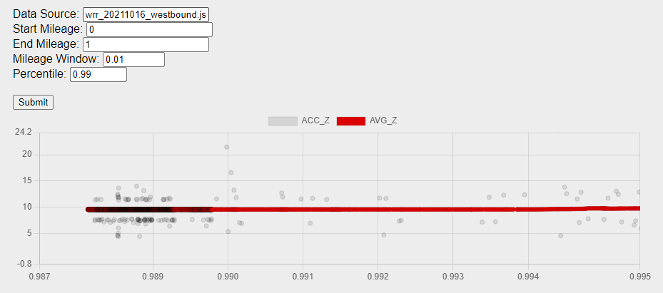
PiRail Team Members: Matthew Cusack, Luke Knedeisen, Josh Knauer Project Sponsor: Jonathan Miner Computer Science Department, University of New Hampshire
Introduction
*Last Year’s Work* / Physical Technology
Results
Railroads face the challenge of inspecting and maintaining miles of track, historically involving time-consuming manual inspection. With the advent of technology, railroads are turning to data collection and analysis to improve efficiency. Improving the track inspection process will result in lower input costs for rail companies, and safer tracks for staff, passengers, and cargo. Vibration data and acoustic data are collected while riding along the tracks, and the combination of the two datasets can in theory be used to diagnose track imperfections.
The overall goals of PiRail are to perform data collection with low-cost components, and to promote youth research into the technology and data analytics used by the railroad industry. This year's UNH Team focused on graphing the acoustic data and hypothesizing the relationship between acoustic and vibration data.
PiRail 2022’s Work
Our project aims to answer the question of whether graphing the two data sets side by side can be helpful in identifying where railroad tracks have been damaged. From the data we've graphed so far, there does not seem to be a direct correlation between the two data sets.
To test our audio graph generation, we visually compared the shape of the graph when plotted with our methods, to when plotted with existing tools and programs. More precise testing is not necessary at this time, as accuracy matters more in the context of this data than precision.
Data Collection Technology
Put together by our project sponsor, a Raspberry Pi is utilized along with a GPS sensor and microphone. The hardware is mounted inside a weather proof box, and collects data while attached to a rail vehicle.
The PiRail 2022 team’s vibration data graph. The PiRail 2023 Team worked to improve the existing web interface and backend processing.
Methodology/Requirements
Charts
Conclusions
PiRail hardware, mounted on a rail vehicle, uses an Inertial Measurement Unit (IMU) and microphones to collect the vibration and acoustic data. All data is geo-tagged and time coded. IMU data is saved as JSON records, and audio data saved as WAV files.
Requirements:
Users specify start and end times from the overall data file, and only data within those bounds will be visualized.
Users are able to input audio and vibration data for concurrent visualization via a file upload function within the web page.
Users are able to interact with the graph by zooming in on areas of the graph that might be of interest to them.
Graph of Combined Audio Data and Vibration Data
It took longer to get up to speed than expected because the project lacked documentation on the existing graphing process
The web interface was changed to graph data by time, instead of mileage, enabling the display of both datasets on a common x-axis
The correlations between datasets is not as clear as the team hypothesized. There is more research to be done in this field
Going forward, the project may continue with the machine learning aspect that began to be developed by last year's team, continue enhancing the way data is processed to reduce generation time, or seek to include further sets of data that have been recorded such as LIDAR data.
While there wasn't an obvious correlation between the audio and vibration data sets, future PiRail teams could have a heavier focus on analyzing the data in order to find less obvious correlations and patterns that could lead to easy detection of damaged rail tracks.
Design/Implementation
This graph displays combined audio and vibration data in 60s increments. We were hoping to see more correlation between the spikes in values of the two datasets.
The audio and vibration data are graphed using the open-source Chart.js library. After the data is submitted to the webserver, the user can use the web interface to choose the data set(s) that they would like to visualize.
Before generation, the number of data points is thinned out to allow Chart.js to display the graph in a more reasonable amount of time. This is done by sorting the data through an algorithm that takes out data points within a certain number of standard deviations as well as limiting events per second. The user is also able to interact with the data by zooming in and out on the graph to view varying levels of detail.
Basic Architecture
Acknowledgements
Special thanks to last year’s PiRail team for the great work, our sponsor Jonathan Miner for the guidance and assistance throughout the year, and to Professor Benedetto for being our group advisor.

