Slide 1

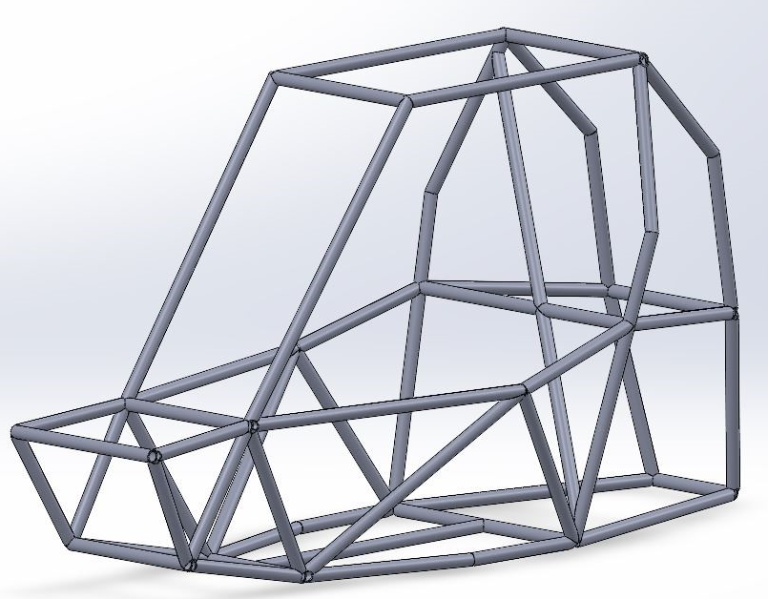
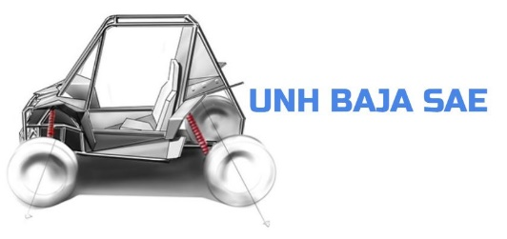
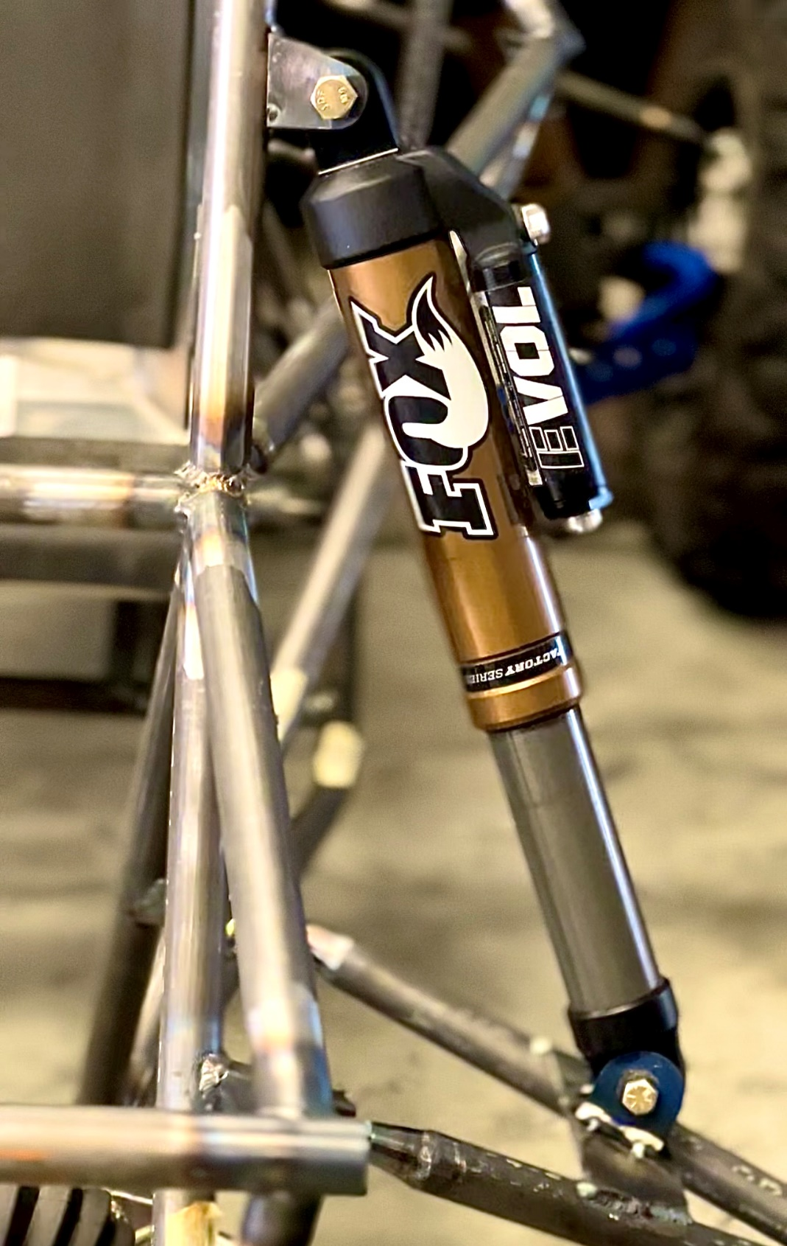
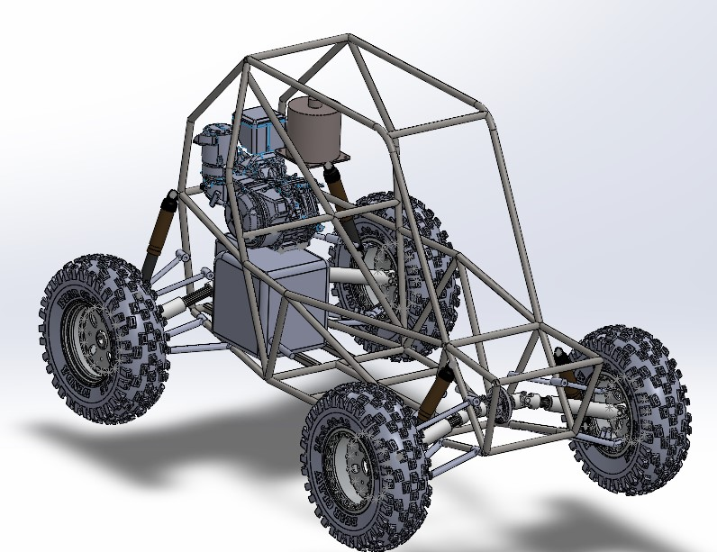
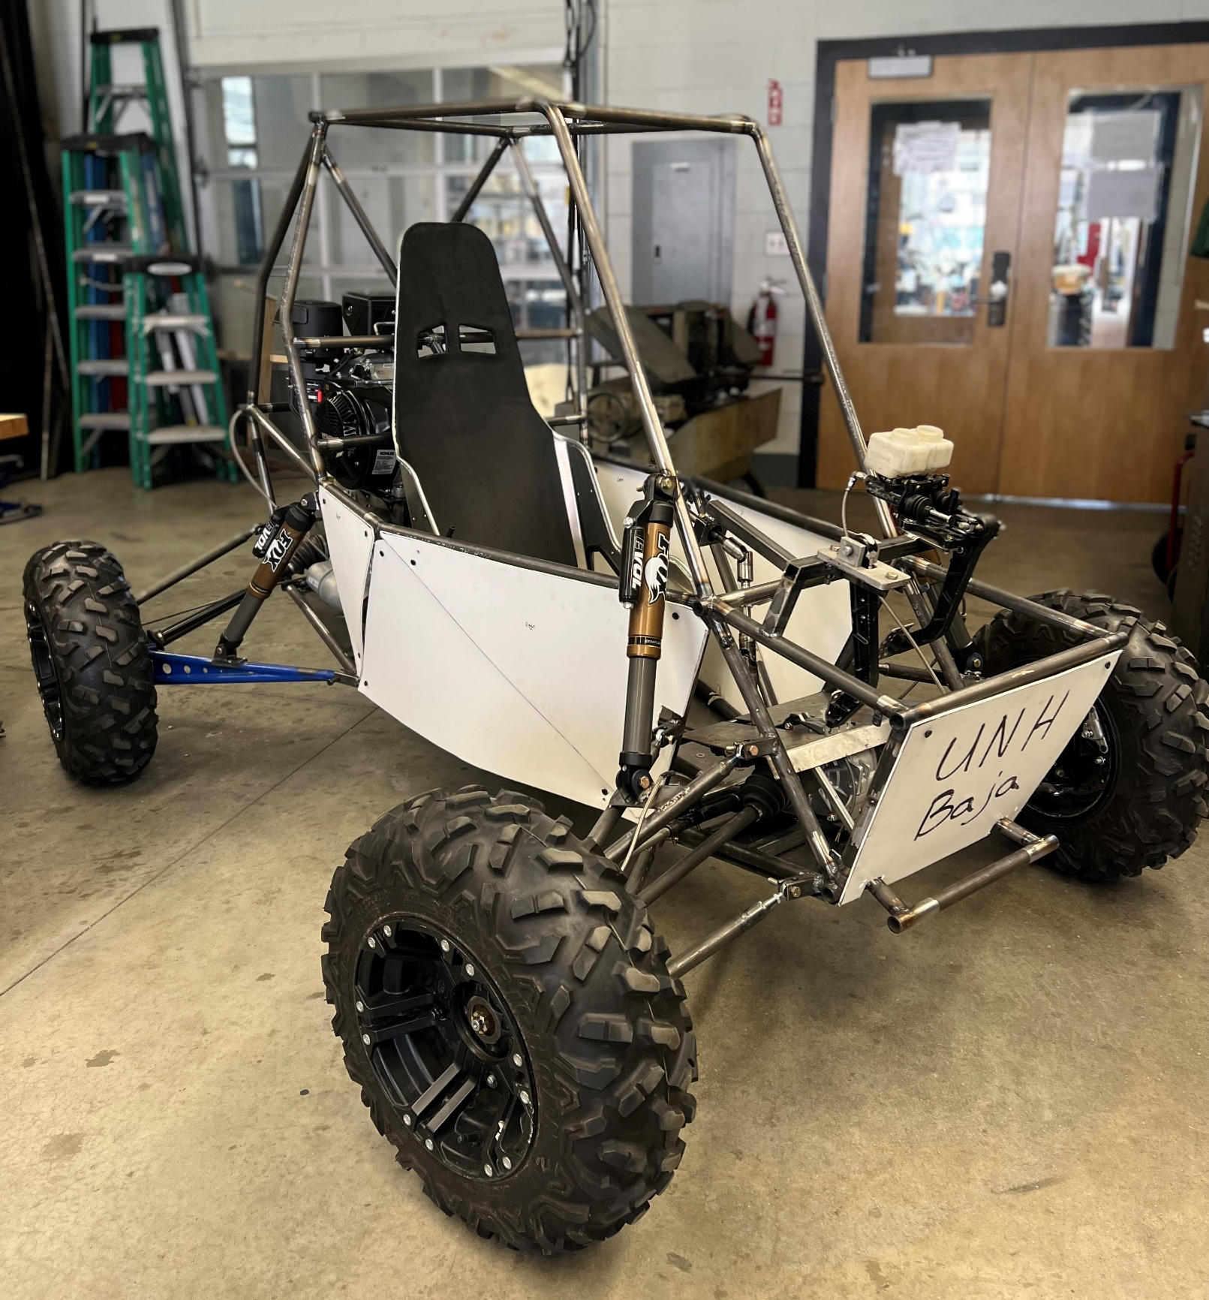
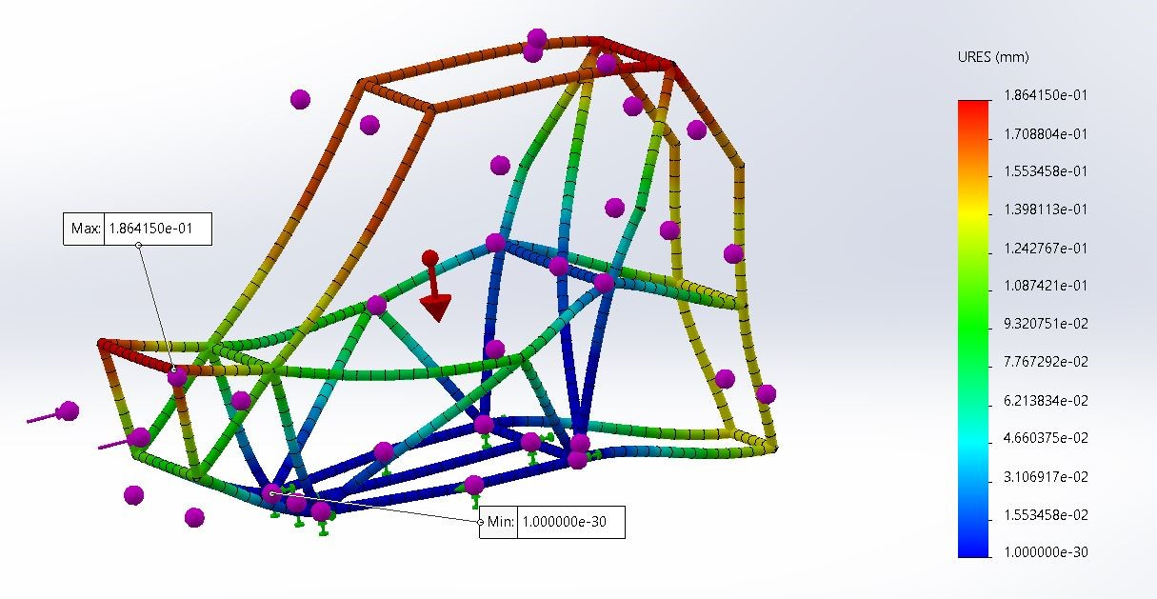
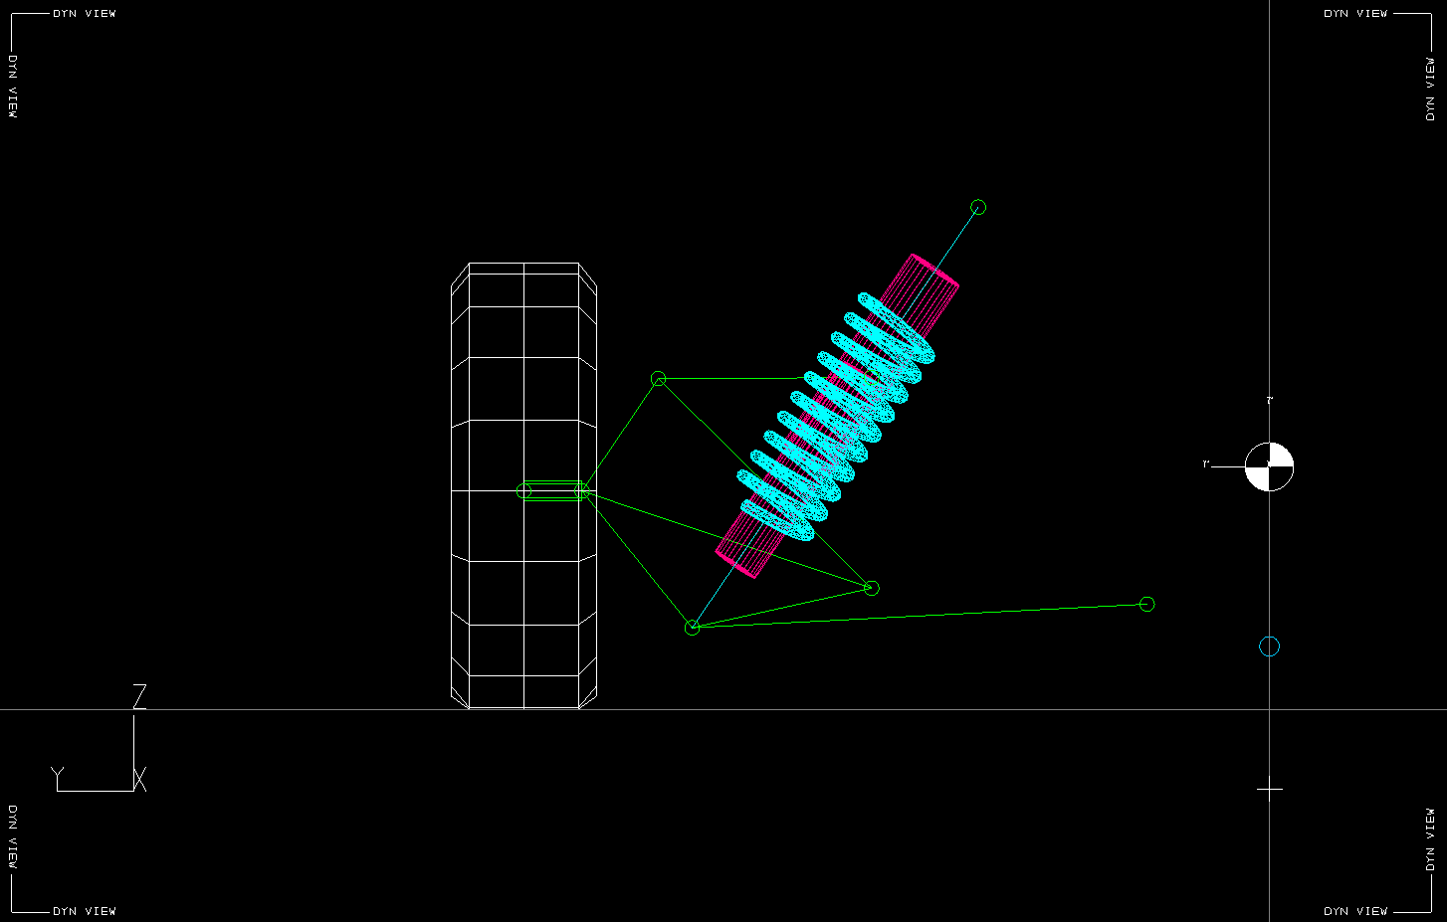

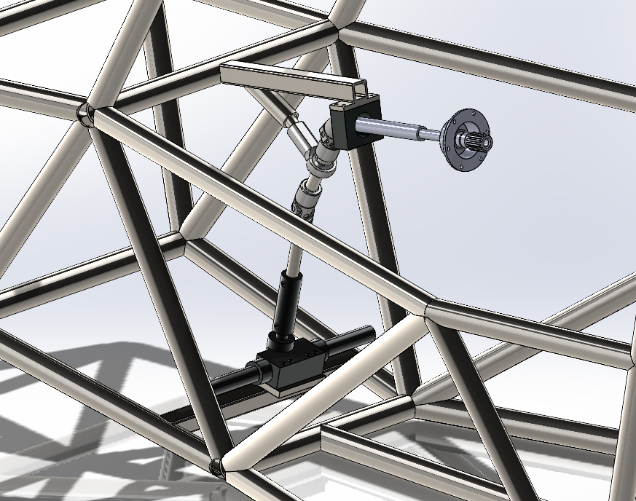

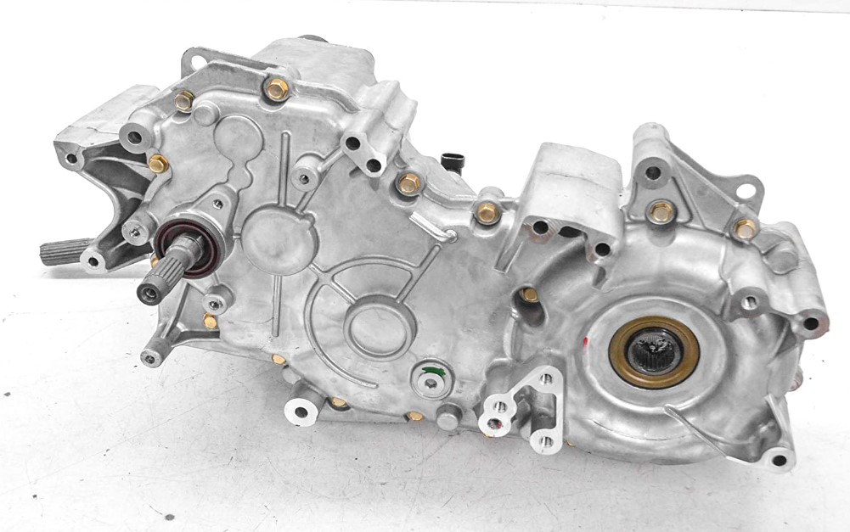
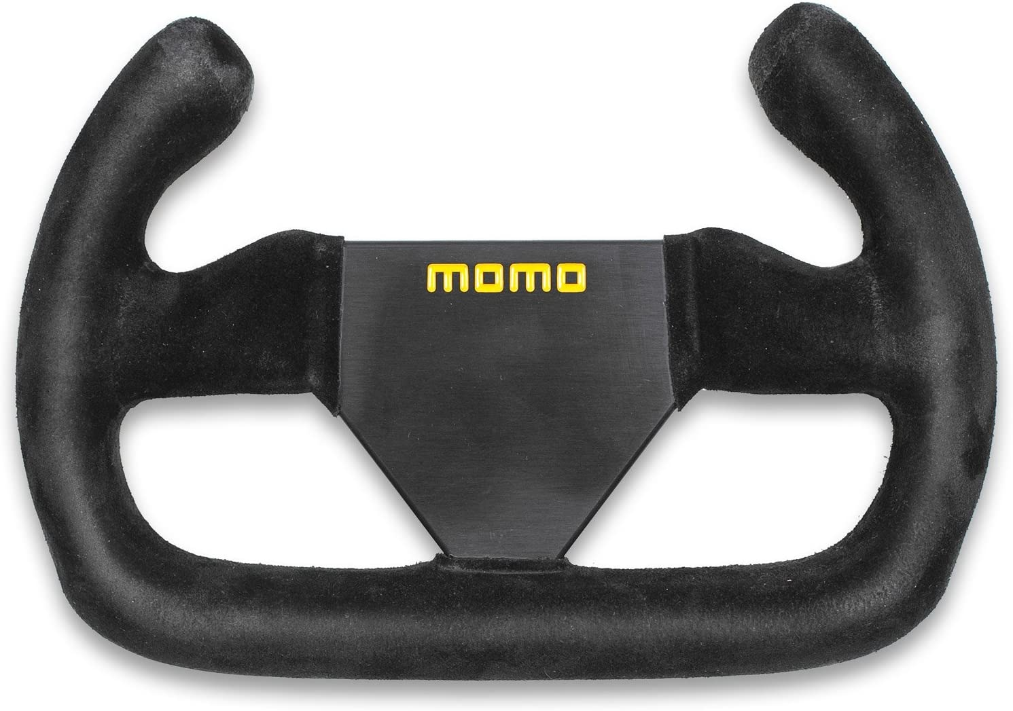
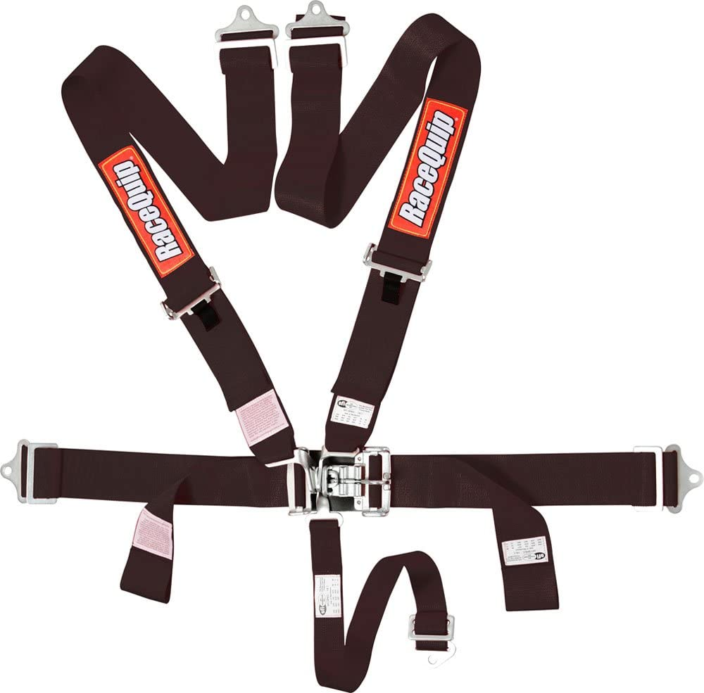




UNH Baja SAE 2022 – 2023
Team Members: Jacob Deem, Jack Gray, Alex Fragomeni, Wade Mitchell, Matt Scaringella, Graham Ten Haken
Mini Baja
Frame
College of Engineering and Physical Sciences
Department of Mechanical Engineering
Suspension
Design Goals:
Maintain a weight less than 110 lbs.
Allow for a 4,000 N impact without critical deformation
Maximize comfort and safety for driver
Meet all 2023 Baja SAE competition rules
Purpose:
Reduce impact from obstacles
Ensure safety and comfort for the driver
Geometry:
Designed to keep vehicle control over various obstacles
Built to aid the steering and acceleration
Modeling:
Lotus Shark suspension software
SolidWorks 3D modeling
Manufacturing:
Fox Float EVOL shocks
Water-jetted and TIG welded mounts fixed to frame and
a-arms
Manufacturing:
TIG welded tubular AISI 1020 steel
Less than 0.2 mm deformation from 4,000 N front impact
Optimal powertrain, suspension and controls mounting points
Fits 75”, 250 lb. driver comfortably
Powertrain
Competition
Controls
Engine:
Kohler CH440 14 HP 429 CC
Average RPM:
Top speed:
Must NOT modify engine in any way
Pedals:
Willwood aluminum racing pedal with tandem reservoir
Safety Harness:
To ensure the safety of the driver, Racequip’s 5-point Racing Harness is utilized
Oshkosh, Wisconsin
May 4 – 7
100 teams worldwide
Five dynamic sub-competitions
Business presentation
Cost evaluation
BOM
130+ page rule book
Transmission:
2016 Polaris 450 PRNDL transfer case
PRNDL gears
CVT motor to transmission connection
Paired with hardened steel CV axles
Steering:
Features precise steering controls, with a 15:1 steering box providing accurate and responsive handling
Brakes:
Polaris ATV brake calipers, lines and pads to ensure responsive capabilities
Other Sponsors:
Todd Gross
May-Win Thein
Tom Ten Haken
Doris Eberlein
Marcus Owens
UNH CEPS Dean’s Office
Sponsors

