Slide 1
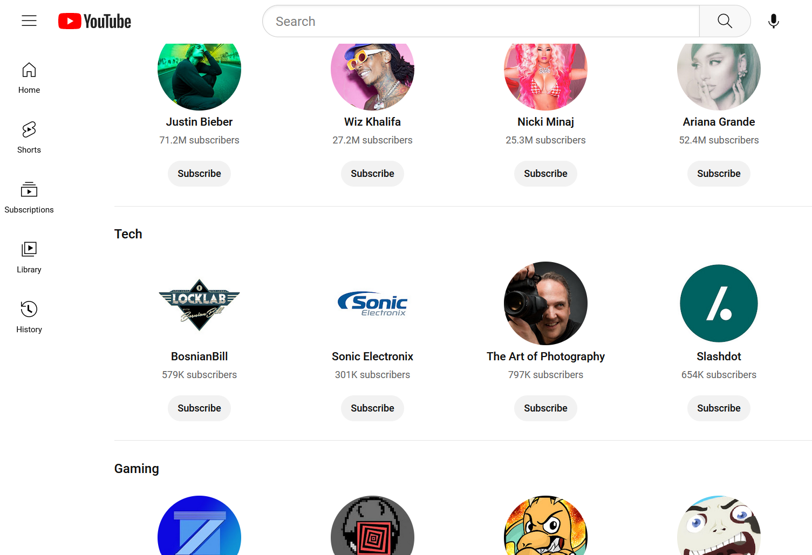
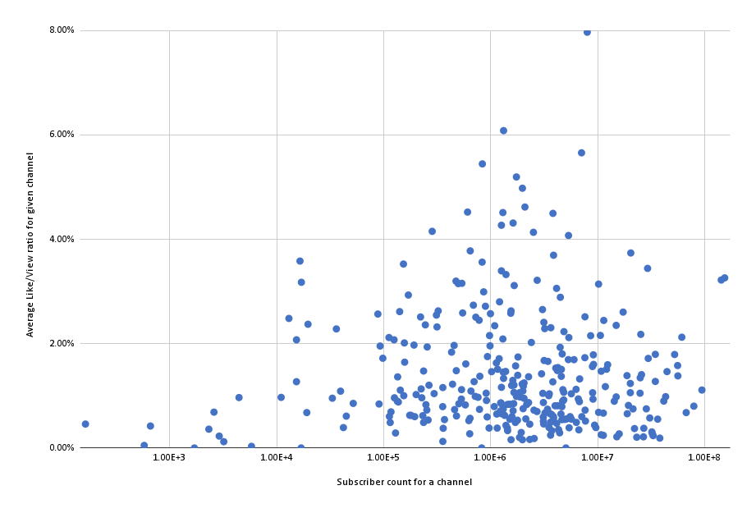
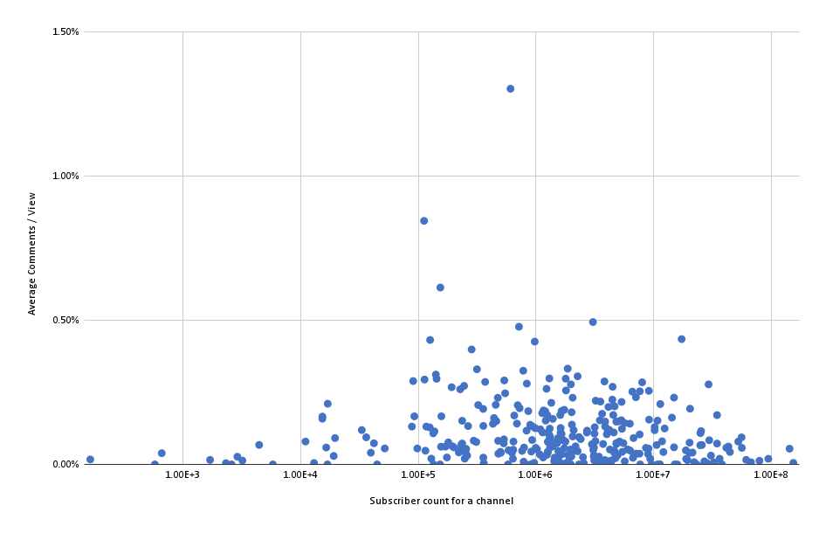
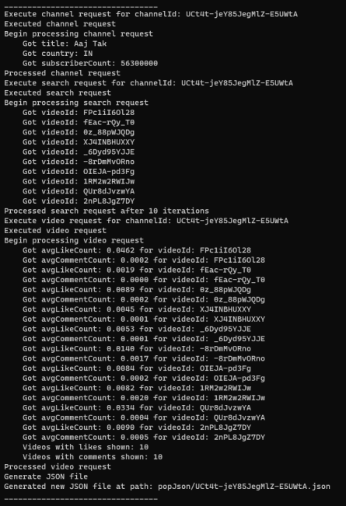
How Subscriber Count Impacts Interactions on YouTube Torsten Diesel (any pronouns), Ali Osman (he/him) College of Engineering and Physical Sciences, University of New Hampshire, Durham, NH 03824
Introduction
Images
Results
YouTube has become one of the most popular online platforms for video sharing, with over 2 billion monthly active users. As a result, it has become a valuable tool for content creators to gain visibility, build their brand, and earn revenue. Some of the key metrics for measuring success on YouTube is the quantity of views a video receives, the quantity of “likes” a video gets, and the creators’ subscriber count. But how does subscriber count influence the number of likes a given video receives? In this project, we are investigating how the average like-to-view ratio and average comment-to-view ratio for a channel are impacted by total​ subscriber count.
YouTube – Browse Channels Page
YouTube Researcher Program
Our data does not indicate a direct correlation between subscriber count and how much engagement a video gets, be it likes or comments. What we do see, however, is that users tend to comment on videos somewhere between 1/4th to 1/8th of the time that they tend to like videos.
In order to access the Data API, we had to apply for the YouTube Researcher Program.
Methodology
Scatter Plots
Conclusions
First, we applied for access to YouTube’s Data API, which allows us to collect YouTube data in the public domain. This required us to send our research proposal and methodology to YouTube’s Researcher Program. Next, we wrote a Python program using this Data API to randomly select more than 300 channels on YouTube. (Details on how we picked which channels we used below.) Then we used the Data API to calculate the average like-to-view ratio and the average comment-to-view ratio for a given creator's top ten most viewed videos, picking up their total subscriber count along the way. Using Google Sheets, we were finally able to create the scatterplots (right) to analyze the data we had collected.
How Subscriber Count Influences Average Like per view
How Subscriber Count Influences Average comments per view
We found that for a given channel, regardless of its subscriber count, there is no correlation between that and the average like-to-view and comment-to-view ratios.
Understand also that this ratio could be skewed based on datapoints not created by humans, but by bots. Larger channels are known to have scam bots impersonating the creator, which our study does not account for. We are running under the assumption, however, that the effect of this is minimal.
How we picked what channels to use
sTAMD Simulations
Acknowledgements
Application Programming Interfaces
Generated a random date
Used the YouTube Data API to find 50 most recent videos uploaded on that date
Grabbed the channel ID from each video
Only added useable channel IDs to our list
Videos must be viewable – not paid YouTube Movies
If video already appears elsewhere in our list of channels, we reject it
Channel must have more than 100 subscribers
Otherwise, we add it to a list of channel ID’s
From each channel, we pull their top 10 most-viewed videos, and use the sum of those videos’ views, likes, and comments for our data
Example of a successful API Request
What’s an API?
APIs, or Application Programming Interfaces, allow two different applications to talk to one another. In this case, it allowed YouTube to talk to the Python program we wrote, in other cases it might allow your phone to talk to Siri or Google. APIs are used for a variety of different purposes and use-cases, ours was only one such example.
Kyle Ouellette
Dean Sullivan
JSON File output of API Request
References
{
“channelId”: “UCX6OQ3DkcsbYNE6H8uQQuVA”,
“title”: “MrBeast”,
“videoIDs”: "se50viFJ0AQ,YlvcFJOE-OE, 0e3GPea1Tyg,zxYjTTXc-J8,S_CUEOBZ0P4, r7zJ8srwwjk,9bqk6ZUsKyA,GLoeAJUcz38, yXWw0_UfSFg,fMfipiV_17o",
“country”: “US”,
“avgLikeCount”: 0.03218778863633846,
“avgCommentCount”: 0.0005454054032955014,
“subscriberCount”: “143000000”
}
https://developers.google.com/youtube/v3/docs

