Slide 1


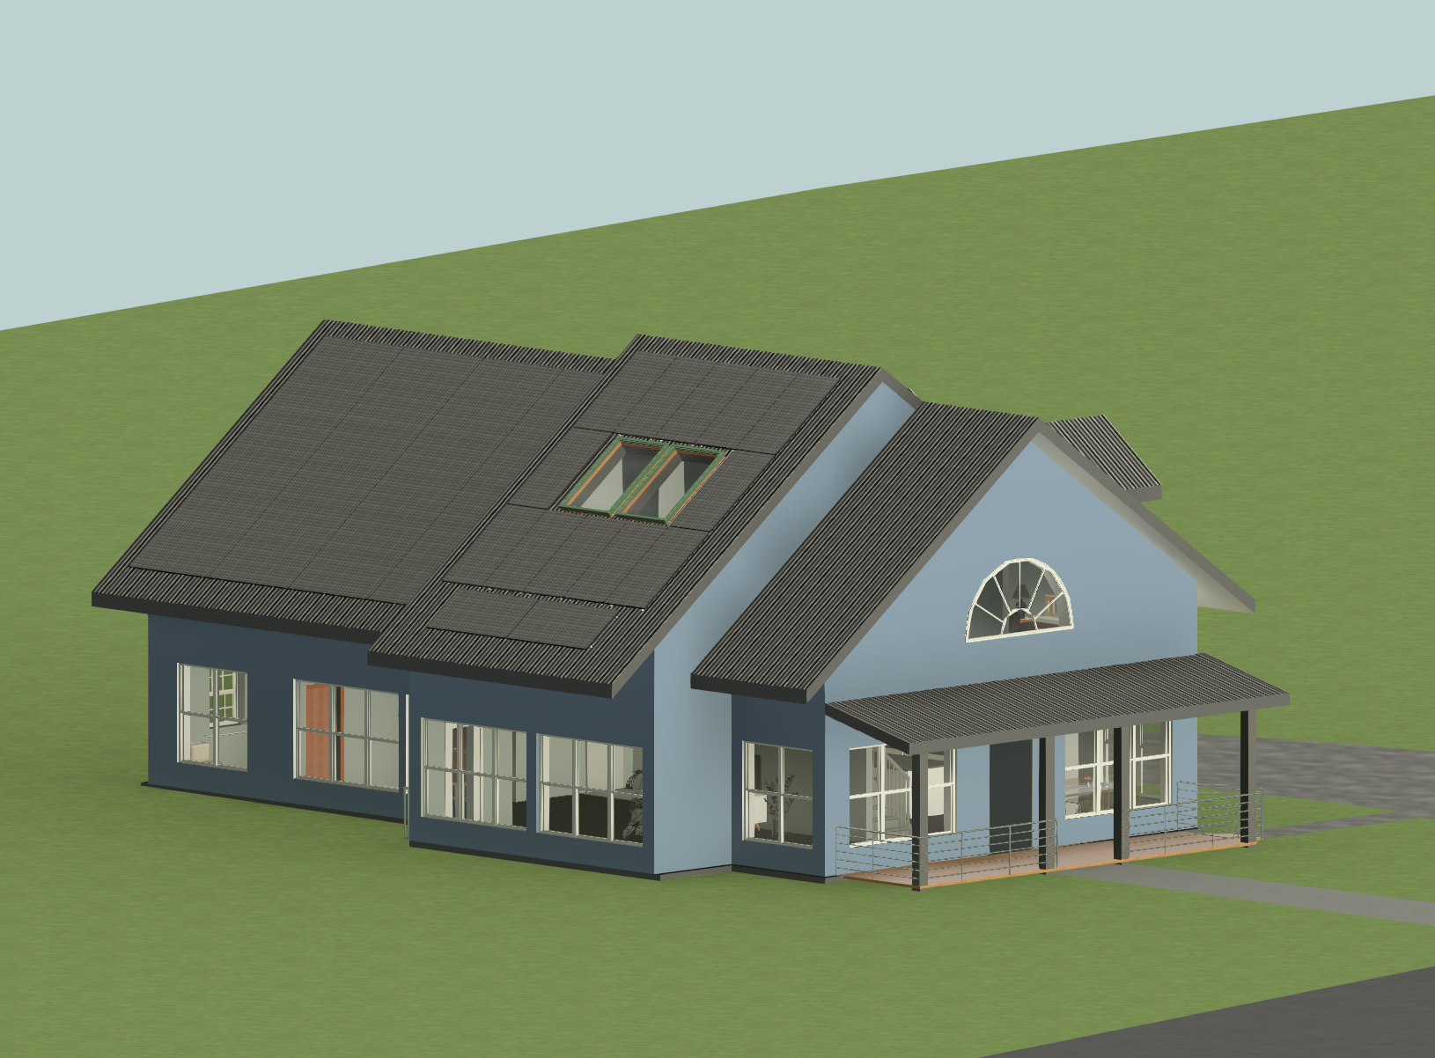
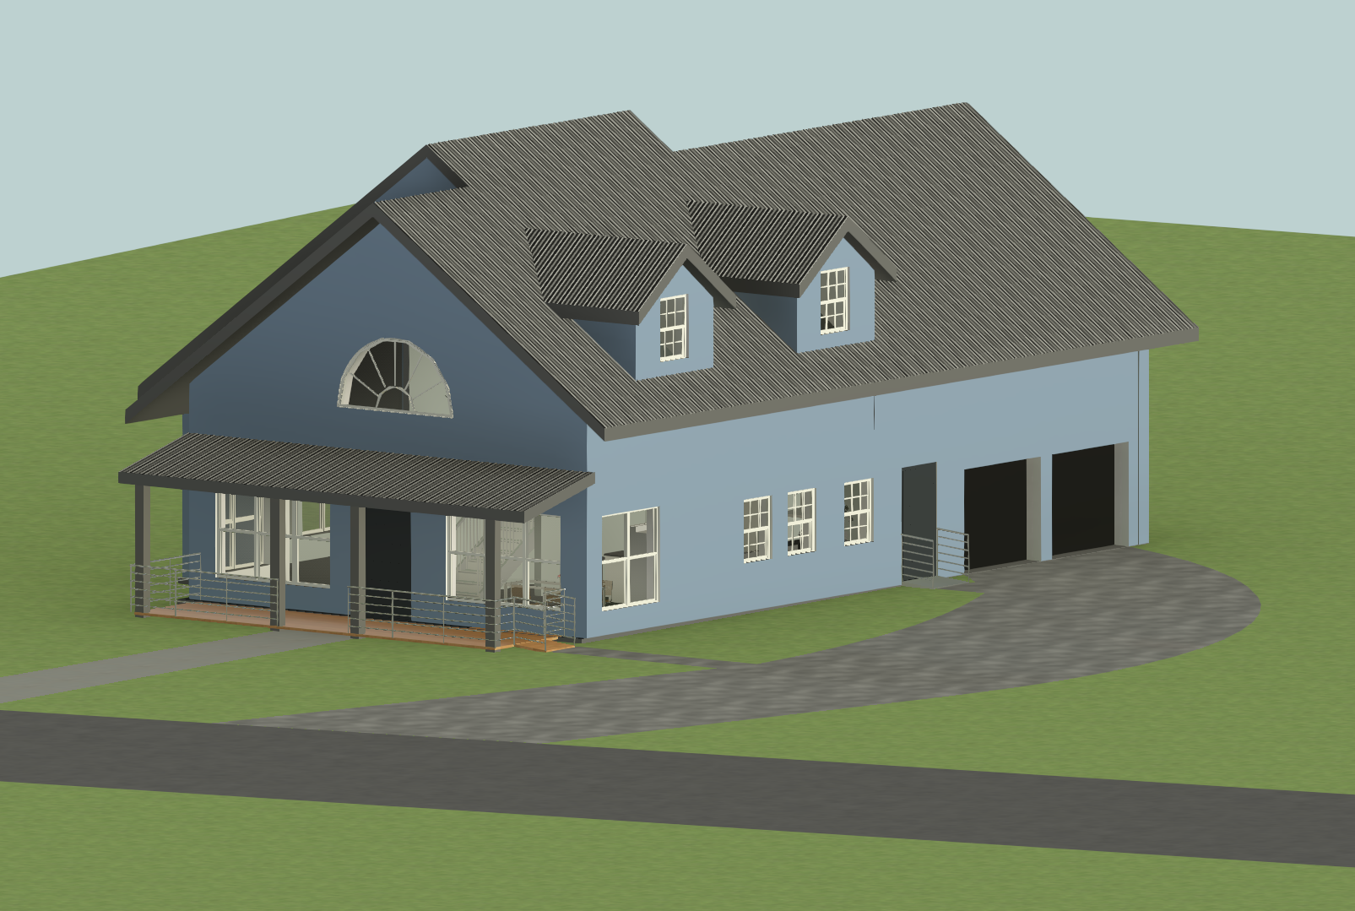
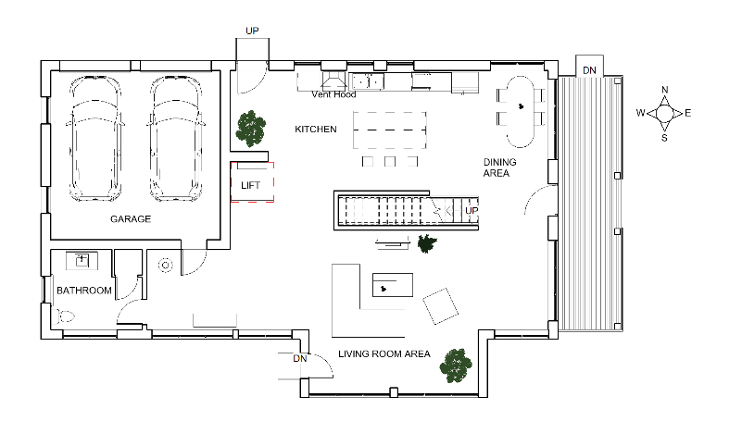
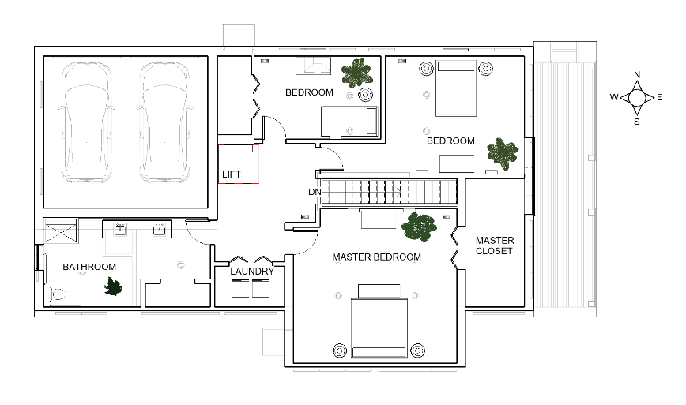
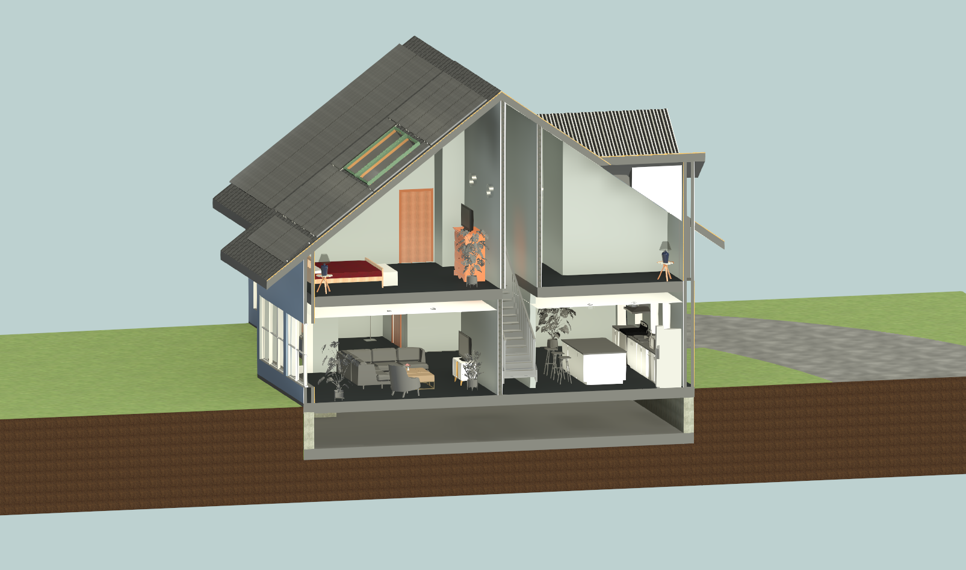
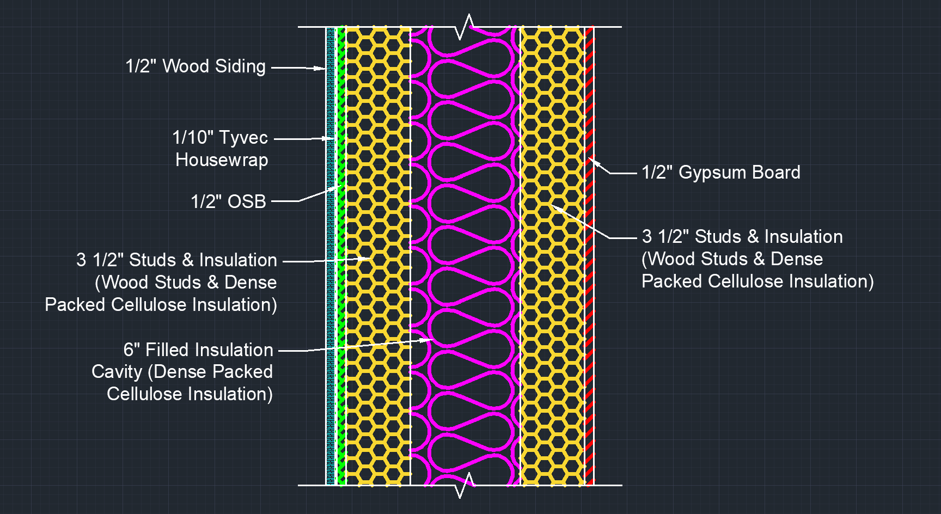
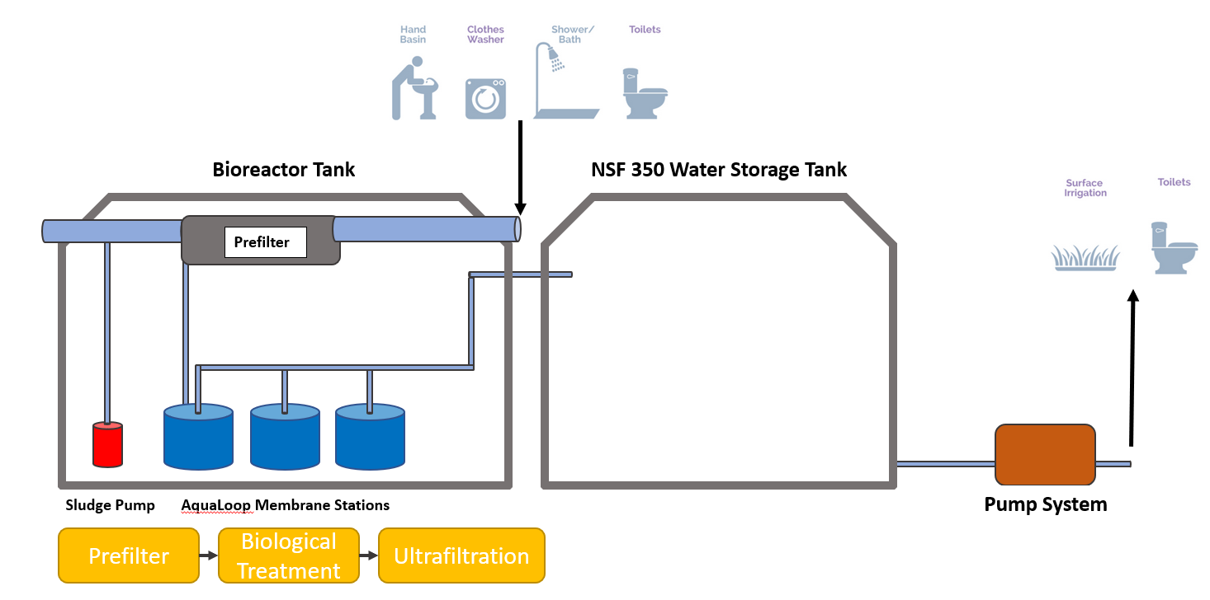
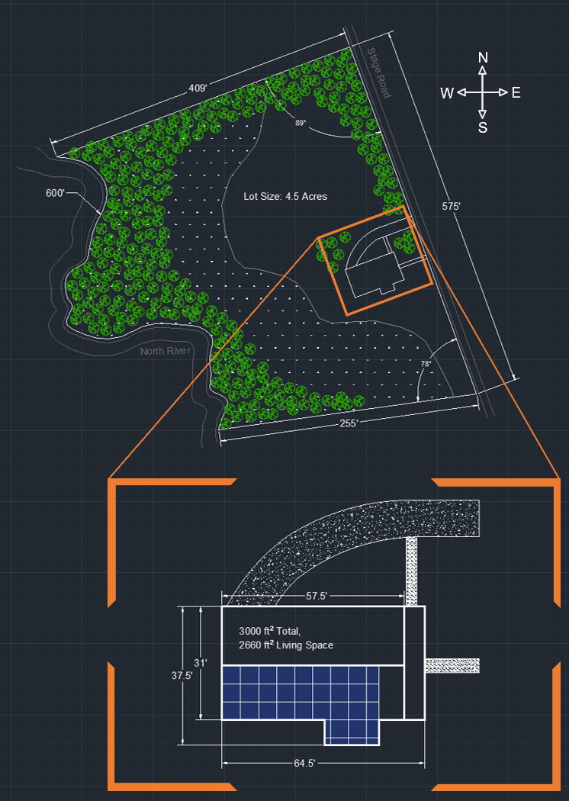
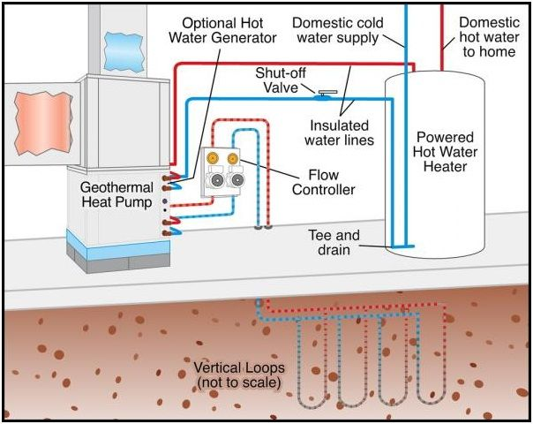
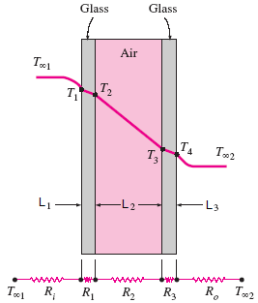
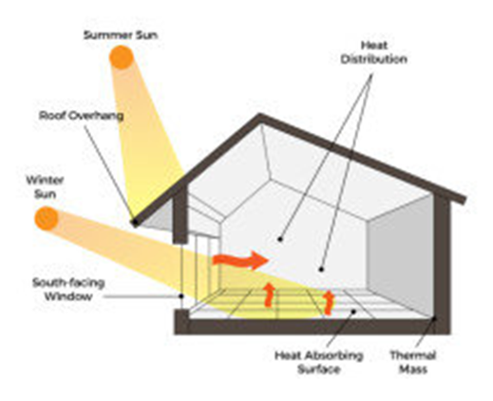
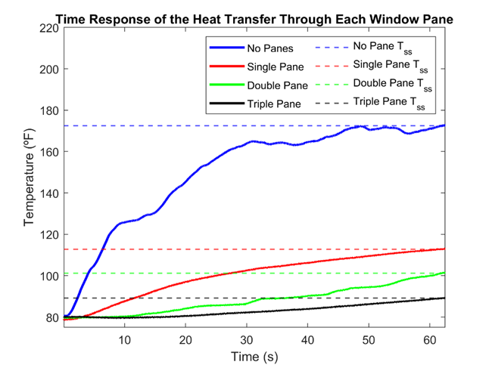
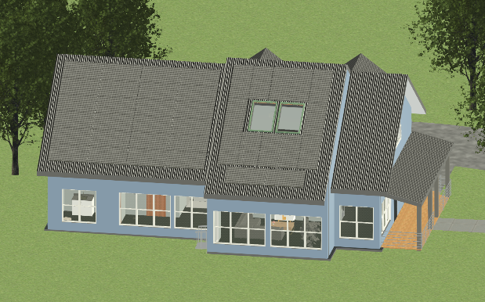
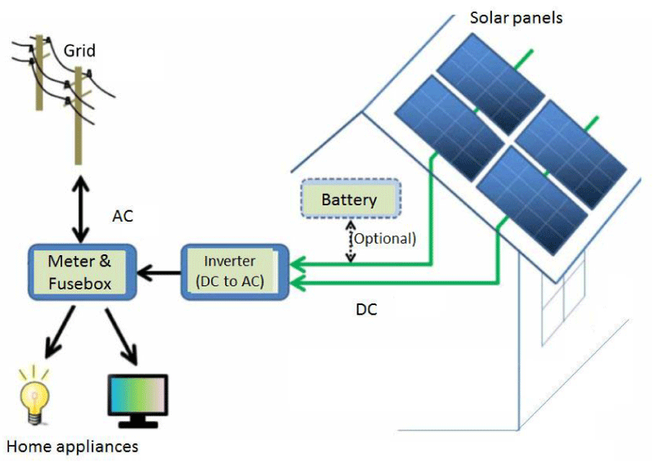
U.S. Department of Energy Solar Decathlon
Introduction
University of New Hampshire Departments of Mechanical, Civil, & Environmental Engineering
Matthew Colucci, Caleigh D'Angelo, Jesse Hight, Jessica Jin, Jordan LeClair, Matthew Mouser, Amina Nefic, Brooke Shepard
Integrated Performance
HERS Rating
Without Solar: 33
With Solar: -22
Engineering
Systems design
and material
selection adhere
to regional climate
and building codes
Integrated performance of all home systems are optimized to maximize self-sustainability and reduce financial obligation to better fit local community trends
Automated Thermal Shutters
Integration of insulated rolling window shutters that can be lowered at night to help add an additional thermal barrier from outside elements, due to lower thermal resistance of double pane windows
Solar Decathlon Design Challenge
Annual collegiate competition consisting of 10 contests and sponsored by the U.S. Department of Energy, where teams from around the world are challenged to design high-performance, low-carbon buildings powered by renewables
About Us
The team has sustainability at the forefront of the design, incorporating innovative technologies and materials to create a home that’s not only eco-friendly, but also comfortable and modern. We are passionate about reducing the environmental impact of the building and are proud to showcase this home as an example of what’s possible with sustainable design
Design goals
Net Zero Energy: generate as much as is consumed
Location Determination: proximity to UNH
Maximizing House Design: window to wall ratio
Energy Efficiency: of photovoltaic and geothermal
USAGE ↓
Heating/Cooling
Architecture
Engineering
Market Analysis
Durability & Resilience
Embodied Environmental Impact
Integrated Performance
Occupant Experience
Comfort & Environmental Quality
Energy Performance
Presentation
EFFICENCY ↑
NEED ↓
Thermal Envelope
Electricity Generation
AFFORDABILITY ↑
SELF SUFFICIENCY ↑
First Floor
Second Floor
A Peek Inside
Embodied Environmental Impact
Architecture & Building Envelope
Water Use
Use of water from the North River for irrigation purposes
Greywater system and rain catchment system to reuse water
Reduction of Carbon Emissions
Use of carbon neutral timber products
Systems within house designed to be low-carbon emitting with long service lives
House is to be built on a pre-cleared lot thus minimizing carbon emissions and disturbance to environment
System components chosen such that waste generation is kept to a minimum at the end of their service lives
Double Stud Walls
14.6 in. thick
exterior walls
13 in. of
insulation
Establishes the
basis of the
thermal
envelope
Green Materials
Dense packed
cellulose, carbon neutral lumber, metal roofing
ADA Compliance
Ramps at all entryways with 32 in. doorways throughout the home and a Savaria Lift System
Double Pane Windows
Use of double pane windows
allow for passive solar use
Triple pane windows increases
thermal resistance inhibiting
efficient usage of passive solar
Passive Solar
Utilizes the sun’s solar energy to
heat the home during the winter
3.5 ft. roof overhangs function seasonally as shading from the excess solar energy in the summer
Net Heat Gain of 37,900 BTU/Day
Wall Cross-Section
Mechanical Systems
Site Location
176 Stage Rd, Nottingham, NH
Climate Zone 5b
600 ft of River Access, 4.5 Acres
15-30 Minutes to Schools, Downtown Amenities, Emergency Centers, & Grocery Stores
Heating & Cooling
5-ton, Ground Source, Geothermal Heat Pump with Desuperheater
Forced Air Ducted HVAC System
Make Up Air Units
Geothermal Piping
Greywater System
Closed Loop, Vertically Oriented
~ 2500 Feet of Underground Piping
Energy Performance
Photovoltaic
System: 38 panels, 450 W rated capacity, 17.1 kW system size with a 20% panel efficiency
Annual Generation: 26,200 kWh
Payback period: ∼ 10.5 years
Seasonal Consumption vs. Generation
Battery/Inverter
Battery: SBR128 Sungrow
Inverter: SH4.ORS Nominal Capacity: 12.8 kWh
Acknowledgements
Project Advisor Felix DeVito
United States Department of Energy Solar Decathlon
Summer Sun
Heat Distribution
References
Roof Overhang
[1] (ICC), I. C. C. (n.d.). 2021 International Energy Conservation Code (IECC): ICC Digital Codes. 2021 INTERNATIONAL ENERGY CONSERVATION CODE (IECC) | ICC DIGITAL CODES. Retrieved February 10, 2023, from https://codes.iccsafe.org/content/IECC2021P1/chapter-4-re-residential-energy-efficiency
[2] National Renewable Energy Laboratory (NREL) home page | NREL. Solar Radiation Data Manual for Flat-Plate and Concentrating Collectors. (n.d.). Retrieved April 11, 2023, from https://www.nrel.gov/docs/legosti/old/5607.pdf
[3] Svarc, J. (2023, February 22). Sungrow inverter and Battery Review. CLEAN ENERGY REVIEWS. Retrieved April 11, 2023, from https://www.cleanenergyreviews.info/blog/sungrow-solar-inverters-review
[4] Zoning ordinance regulations - Nottingham. Town of Nottingham New Hampshire. (2021, June 8). Retrieved April 11, 2023, from https://www.nottingham-nh.gov/sites/g/files/vyhlif3611/f/uploads/2021_nottingham_zo ning_ordinance_accepted_20210608.pdf
Winter Sun
South Facing Window
Heat Absorbing Surface
Thermal Mass
The panels will over produce in the Spring and Summer and underproduce in both the Fall and Winter at which point the owners will buy back from the grid

