Slide 1
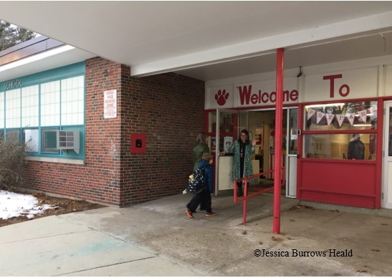
Through the Door: A Case Study of Kindergarten Transition in One Elementary School Jessica Burrows Heald Department of Education, University of New Hampshire
Introduction
Results
Discussion
Nearly 4 million children “walk through the door” and enter kindergarten each year in the U.S. (U.S. Department of Education, 2015), yet this major life transition is not well understood, despite being a topic of research for several decades. Guided by a sociocultural theoretical framework, this study examined the perspectives of both school staff and families using a mixed-methods case study design to gain a deeper understanding of the transition process in one elementary school in a Northeast city with a population of over 30,000 residents.
The key finding was that families and children were expected to fit into school and be ready for school through the transition process.
Families
All children experienced some type of issue/challenge
Families also experienced challenges/adjustment
Some children and families needed more individualized support
Families wanted more information
Some families leveraged cultural/social capital for more individualized supports
Teachers
Viewed transition as time-limited and activity-based
Children/families expected to accommodate to school rather than a mutually reciprocal partnership
Academic skills valued-> tracking, deficiency paradigm were evident
Lack of power/agency felt by teachers regarding transition
New Hampshire Kindergarten Readiness Indicators (2012) defines school readiness (and transition) as a shared collaboration among families, schools, and communities. More effort from schools is needed to take part in this collaboration and open the door for families to be more involved in transition, which will require change at multiple levels, including training/professional development for pre/inservice teachers and school/district administrators, structural changes in kindergarten curriculum, and policy. A key implication is that school districts and schools need to expand the experiences and activities they offer to all families related to transition through a multi-dimensional approach to transition, which will level the playing field when it comes to cultural capital giving some families advantages during the transition process as a variety of supports would be open to all families. Re-thinking transition by treating families as active partners is necessary to better support children and families during this important life transition.
Methods
Qualitative methods (document analysis, observations, and interviews) were primarily used with a quantitative component embedded within, the Family Experiences & Involvement in Transition survey (McIntyre, et al., 2007). Survey participants included 16 self-selected families from three kindergarten classrooms. Interview participants included the school principal, three kindergarten teachers (ranging from 10 to 20 years of kindergarten teaching experience), and four families (all mothers experiencing kindergarten transition for the first time). Data was collected as follows: ongoing document analysis (kindergarten registration materials, district/school family handbooks, materials from formal transition event, teacher class letters); observation and field notes for two transition events prior to school entry (August); family surveys administered in fall (September – early November); family interviews conducted in fall (late October-late November); family survey results reported to teachers in February; and administrator/teacher interviews completed in March.
References
Contacts
McIntyre, L.L., Eckert, T.L, Fiese, B.H., DiGennaro, F.D., & Wildenger, L.K. (2007). Transition
to kindergarten: family experiences and involvement. Early Childhood Education
Journal, 35(1), 83-88. http://doi.org/10.1007/s10643-007-0175-6.
New Hampshire Department of Education. (2012). New Hampshire kindergarten readiness
indicators (Version 2.3, February 2014).
https://www.dhhs.nh.gov/dcyf/headstart/documents/nh-kindergarten-readiness.pdf
U.S. Department of Education (2015). A matter of equity: Preschool in America. Retrieved from
https://www2.ed.gov/documents/early-learning/matter-equity-preschool-america.pdf
For more information contact: Jessica Burrows Heald
jaburrows@gmail.com

Slide 2
This poster template provided courtesy of
UNH ESRC Poster Printing Services
Trust us to make your poster look GREAT!
Website: http://posters.unh.edu
Poster Guide: http://goo.gl/1E7TJY
DELETE THIS SLIDE BEFORE PRINTING

