Slide 1
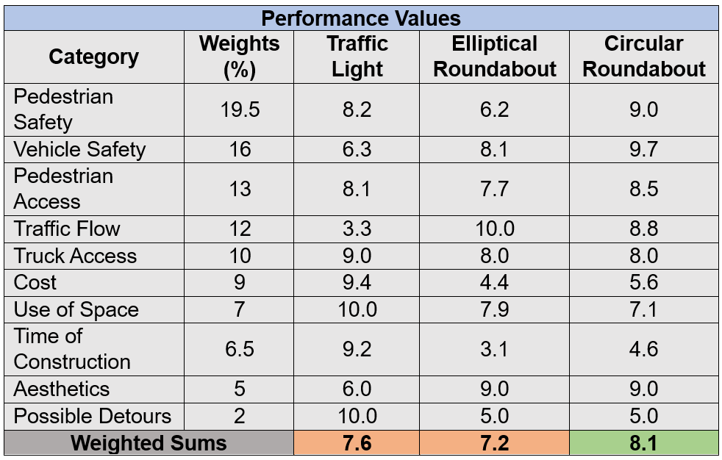
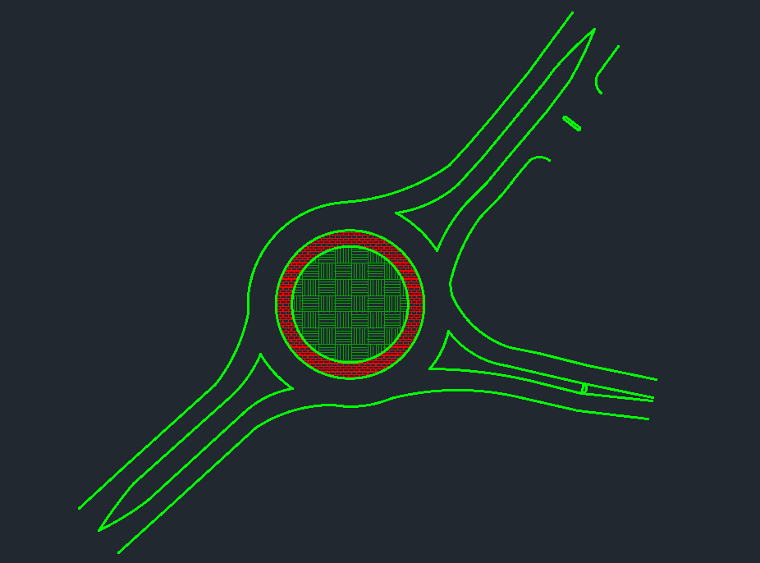
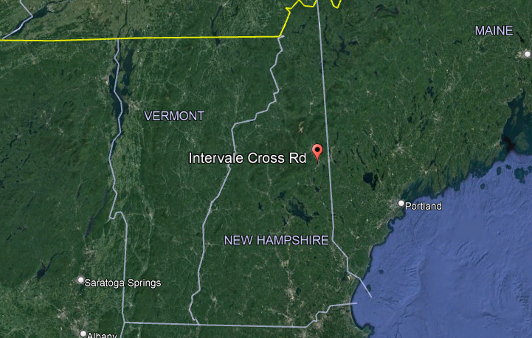
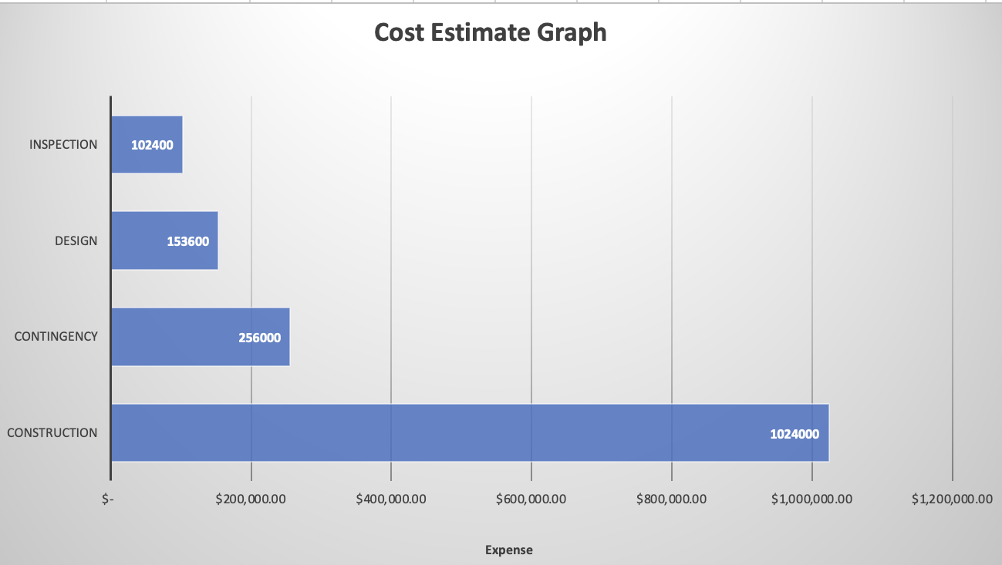
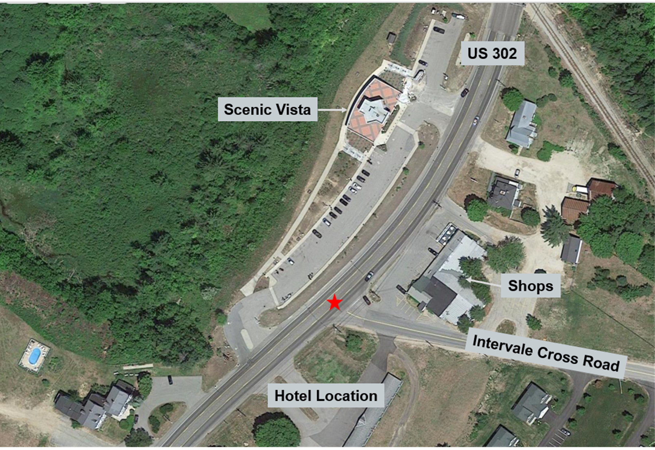
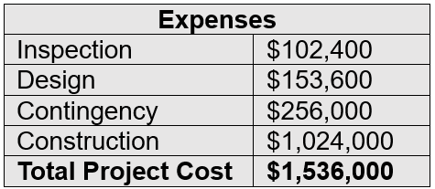
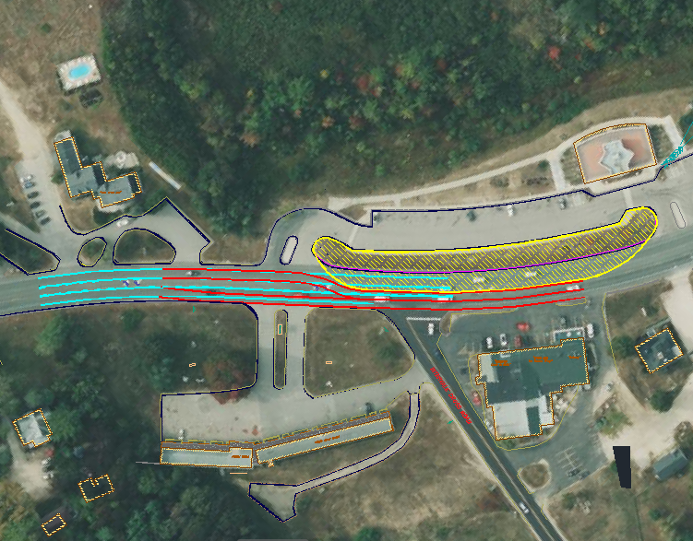
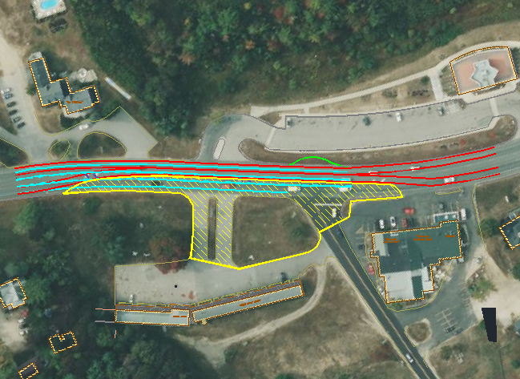
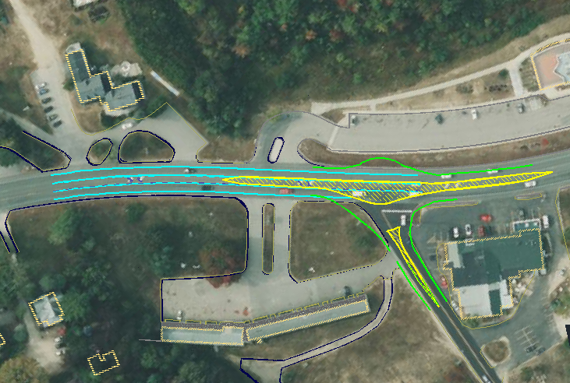
Transportation Planning US Rt 302 at Intervale Cross Road George Smith (PM), Meghan Abbey, Michael Mercer, Jake Morrier, Tim Spencer Department of Civil and Environmental Engineering, University of New Hampshire, Durham, NH 03824
Introduction
Alternative Design Ideas
Decision Matrix
Overview:
The primary goal of the project was to design a safer and more accessible intersection for both vehicle traffic and pedestrians crossing Route 302, without hindering the current flow of traffic or causing backups and/or crashes.
Scope:
The fall semester was dedicated to analyzing the current traffic flow, researching potential design alternatives, developing alternative designs, and developing the construction process.
The spring semester was dedicated to creating a decision matrix to choose the preferred alternative, performing a swept analysis to ensure all vehicles have access, and calculating a cost estimate for the preferred alternative.
Traffic Signal
Elliptical Roundabout
Circular Roundabout
A traffic light increases pedestrian safety by forcing traffic to come to a complete stop. However, this could slow the flow of traffic along Rt 302.
The flatter arc sections acting parallel to US Route 302 would promote faster flowing traffic and greatly facilitate truck access.
Single lane roundabouts increase all safety factors by reducing vehicle speed and the number of lanes pedestrians must cross.
The decision matrix chart exhibits how the preferred alternative design was selected. Through group collaboration, each category was given a weight as a percentage, and a performance value based on a 1-10 scale. The weights and performance values were then multiplied together to get the weighted performance values, which were then summed together. The largest weighted sum was selected as the preferred alternative.
Preferred Alternative
Location
Final Roundabout Design
Final Design Roundabout Specs
For the final design selection, a roundabout with an inner diameter of 110ft was chosen. This was determined to be the best option since it maximizes vehicle traffic while maintaining the smallest impact on the surrounding area. The roundabout was minimized using vehicle path analysis methods. To accommodate large semi-trucks, the truck apron needed to be larger than typical truck aprons. There are two crosswalks to allow pedestrian access to the hotel, scenic vista, and commercial plaza.
Dimensions:
110ft inner diameter
18ft inner lane widths
30ft truck apron radius
14ft central circle width
12ft wide approach lanes
25ft crosswalk minimum setback
Cost Estimate
The estimated construction was calculated at $32/ft. Adding 25%, 15%, and 10% for contingency, design, and inspection respectively, gave the total projected cost.
Construction Phases
Phase 1
Phase 2
Phase 3
Scenic Vista
Scenic Vista
Scenic Vista
Acknowledgements
Project Sponsor: Jordan Pike, PE
HEB Engineers, Inc.
Project Advisor: Dr. Jo Sias
University of New Hampshire
References
Key: The blue lines represent the original lane configurations, the red lines show the flow of traffic during construction, the yellow lines represent the barrier line and construction zone, and the green lines show completed construction.
NCHRP Roundabouts: An informational guide.
Manual on Uniform Traffic Control Devices: For Streets and Highways.

