Slide 1

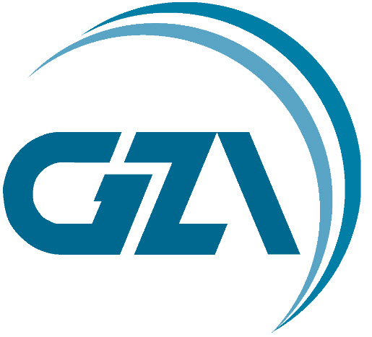
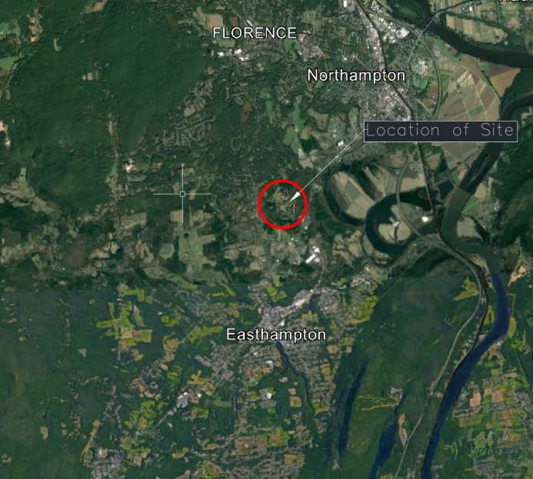
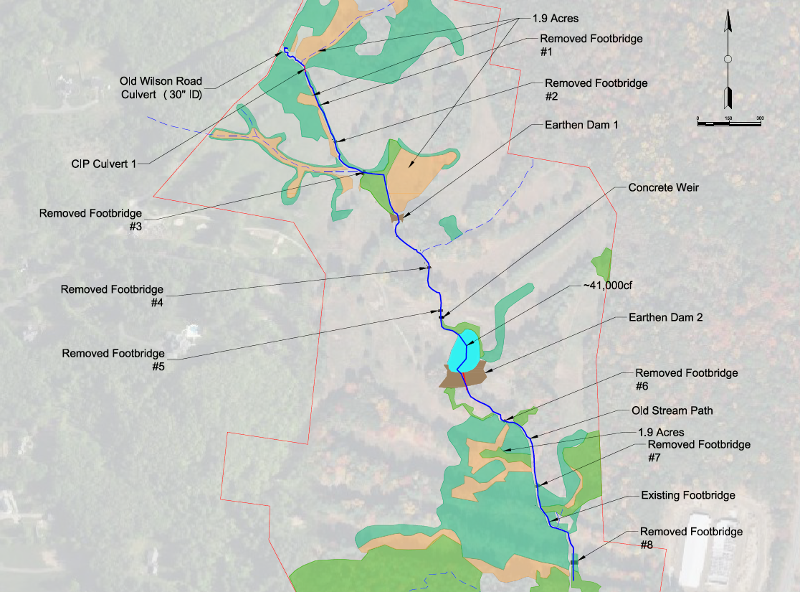
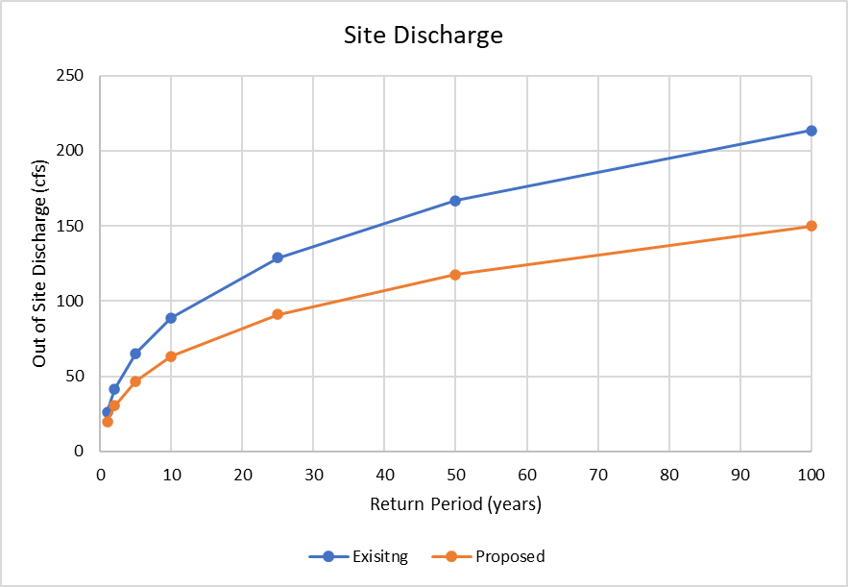
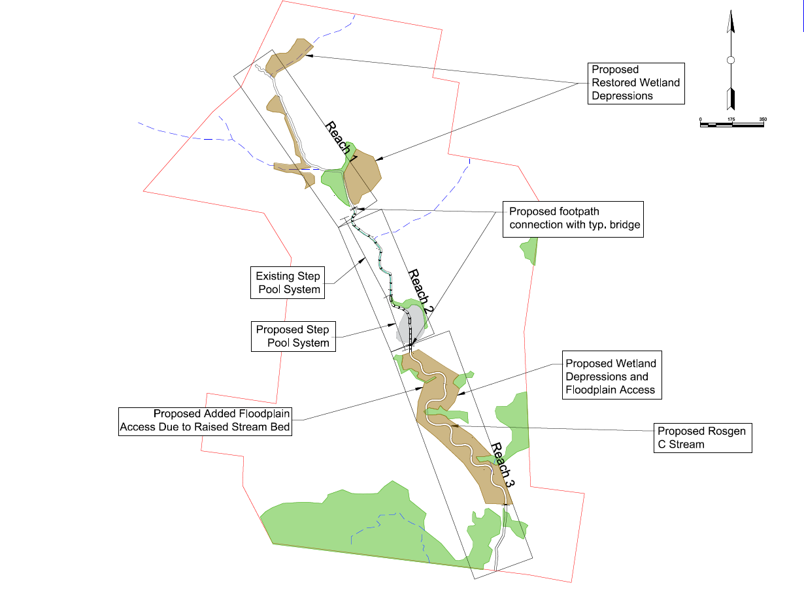
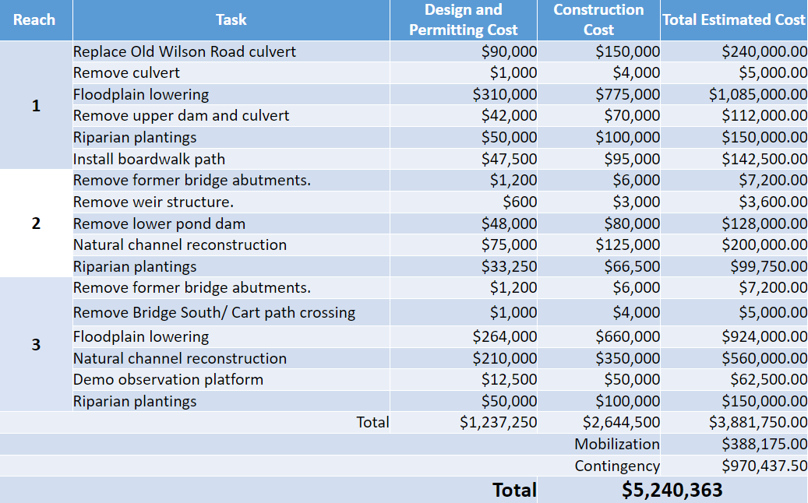
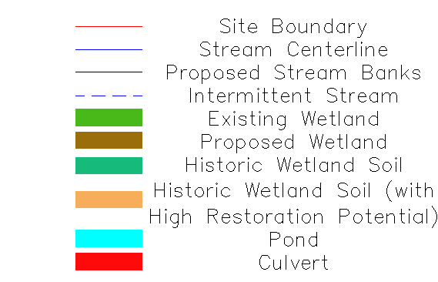
Nashawannuck Brook Restoration
Joshua Dow, Sunjay Sood, Jacob Stephens
Civil/Environmental Engineering, University of New Hampshire, Durham, NH 03824
Introduction
Existing Conditions and Locus Map
HydroCAD
Pine Grove, a private golf course, is a 105-acre site that houses a 0.64-mile stretch of the Nashawannuck Brook The brook was artificially straightened, with a handful of structures added in and around the stream. The natural drainage was altered, as well as having most of the natural vegetation being removed for the development of the golf course. A 50% conceptual design was created for the town of Northampton, MA.
Location of site
Stakeholder Wants and Needs
Hydrological Restoration
Habitat Restoration
Carbon Sequestration
Wetland Restoration
Flood Protection
Removal of Infrastructure
Locus Map
Existing Conditions
Proposed Conditions
Cost Estimate Table
Existing Conditions Parameters
Length of Stream: 0.64 miles
Drainage Area: 0.48 miles²
Old Wilson Rd Culvert: 30 inches (undersized)
Infrastructure
2 Dams
1 Concrete weir
14 Footbridges
Length of Channelized Stream: 0.23 miles
Estimated Pond Volume: 41,000 ft³
2 Year Peak Flood: 22.4 ft³/s
10 Year Peak Flood: 50.3 ft³/s
Design Improvements
Benefits
Total added flood storage: 102,000 ft³
Total added Wetlands: 143,218 ft²
Replaced Old Wilson Road Culvert: 14 ft open bottom box culvert
Typical Footbridge span: 15 ft
The proposed stream design will improve on flood protection by having increased storage potential, compared to the current conditions of the site. The ecological improvement to the stream will help revitalize the area and help bolster the current ecosystem while being a catalyst for the expansion of the wooded areas into the golf turf.
Legend
Reach 1 will have wetland depressions to act as supporting flood storage
Reach 2 will have the pond removed and replaced with a step pool stream channel. In addition, the banks will be restabilized from current erosion
Reach 3 will have the channelized bank armor removed and moved to create a C stream channel. The stream will regain access to floodplains with addition of wetland depression.
Acknowledgements
Academic Advisor: Julie Paprocki PhD, UNH
Project Sponsor: Haley Puntin, GZA
City of Northampton, MA
Rosalie Starvish PE, Project Manager GZA-Springfield
Tighe & Bond

