Slide 1
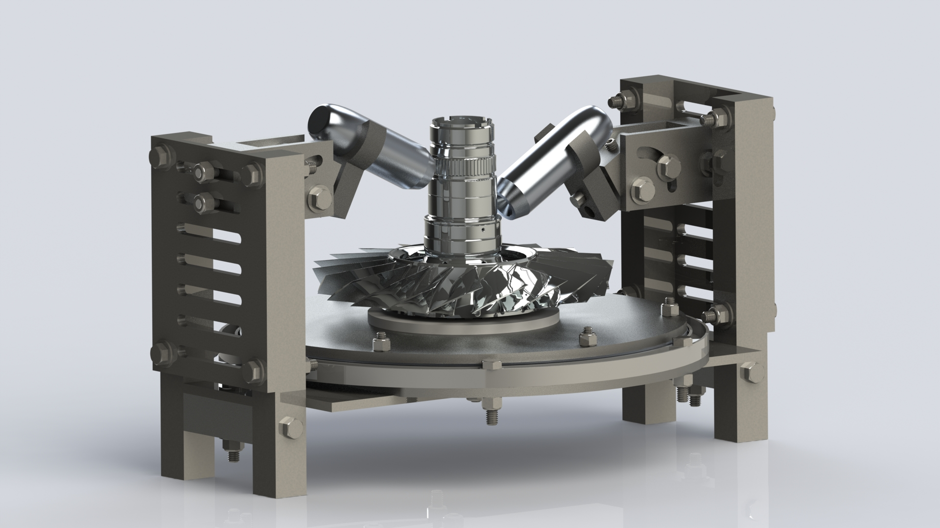
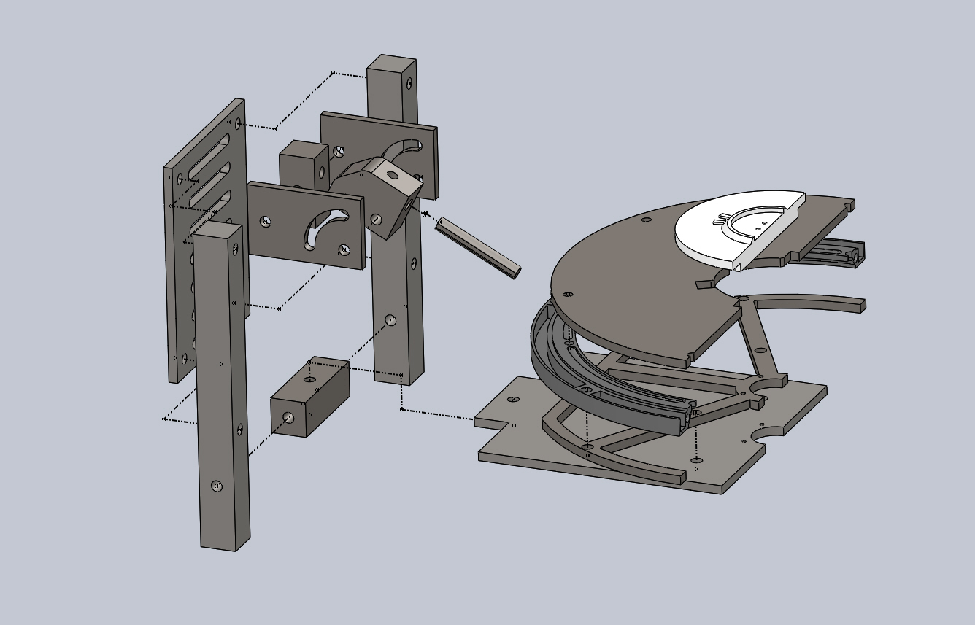
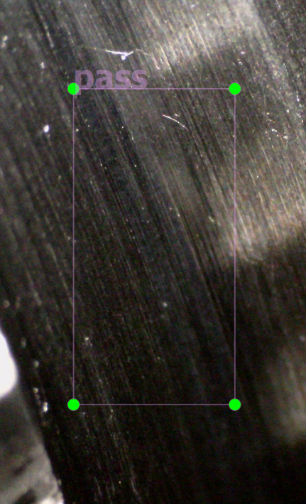
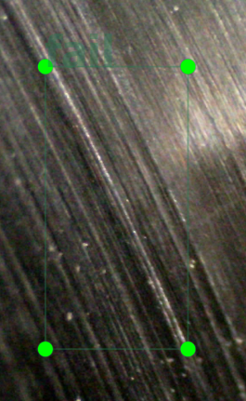
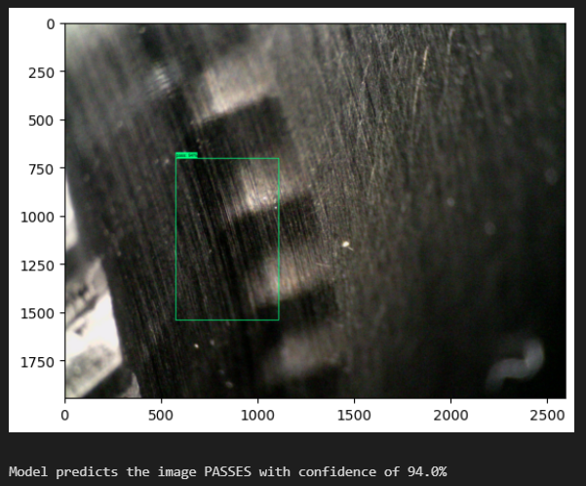
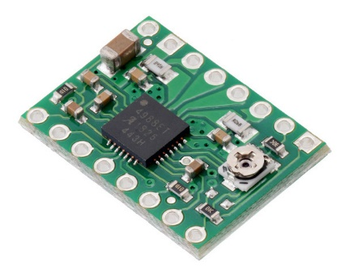
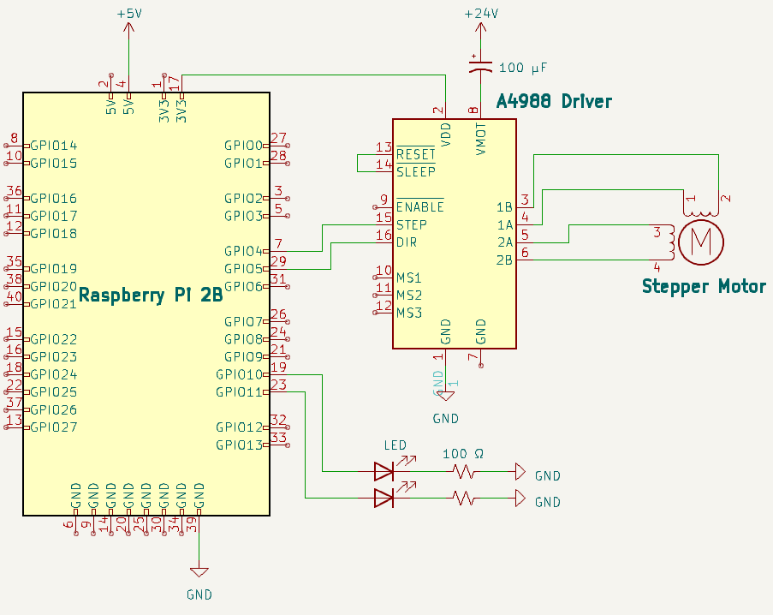
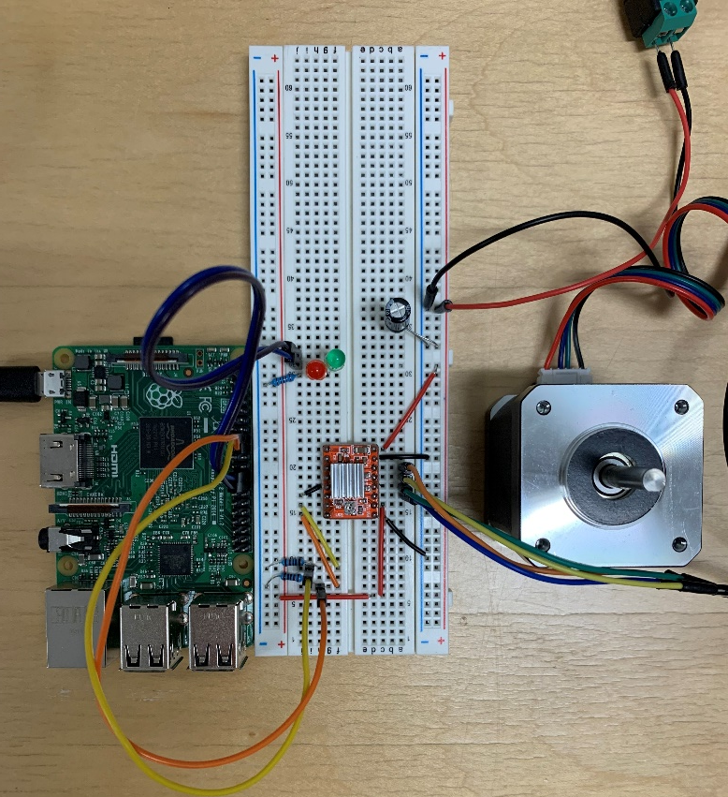
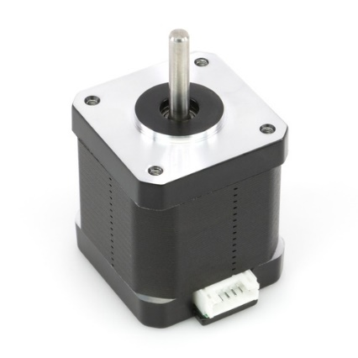
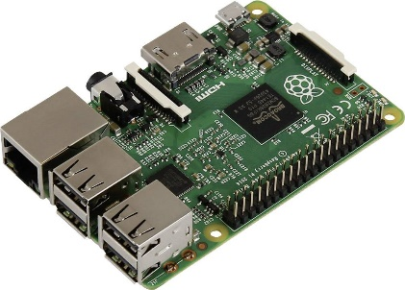
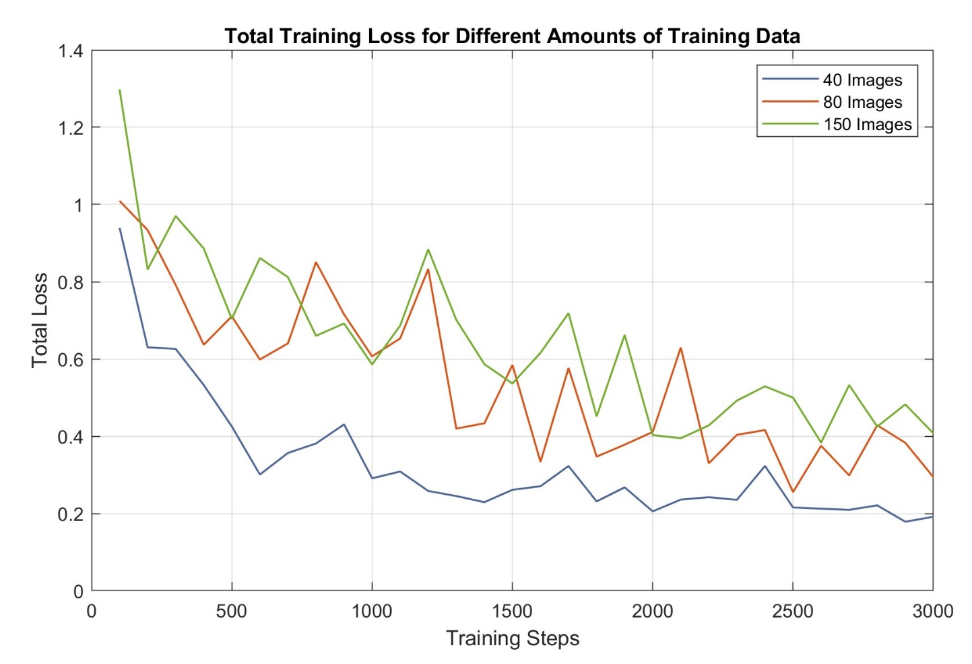
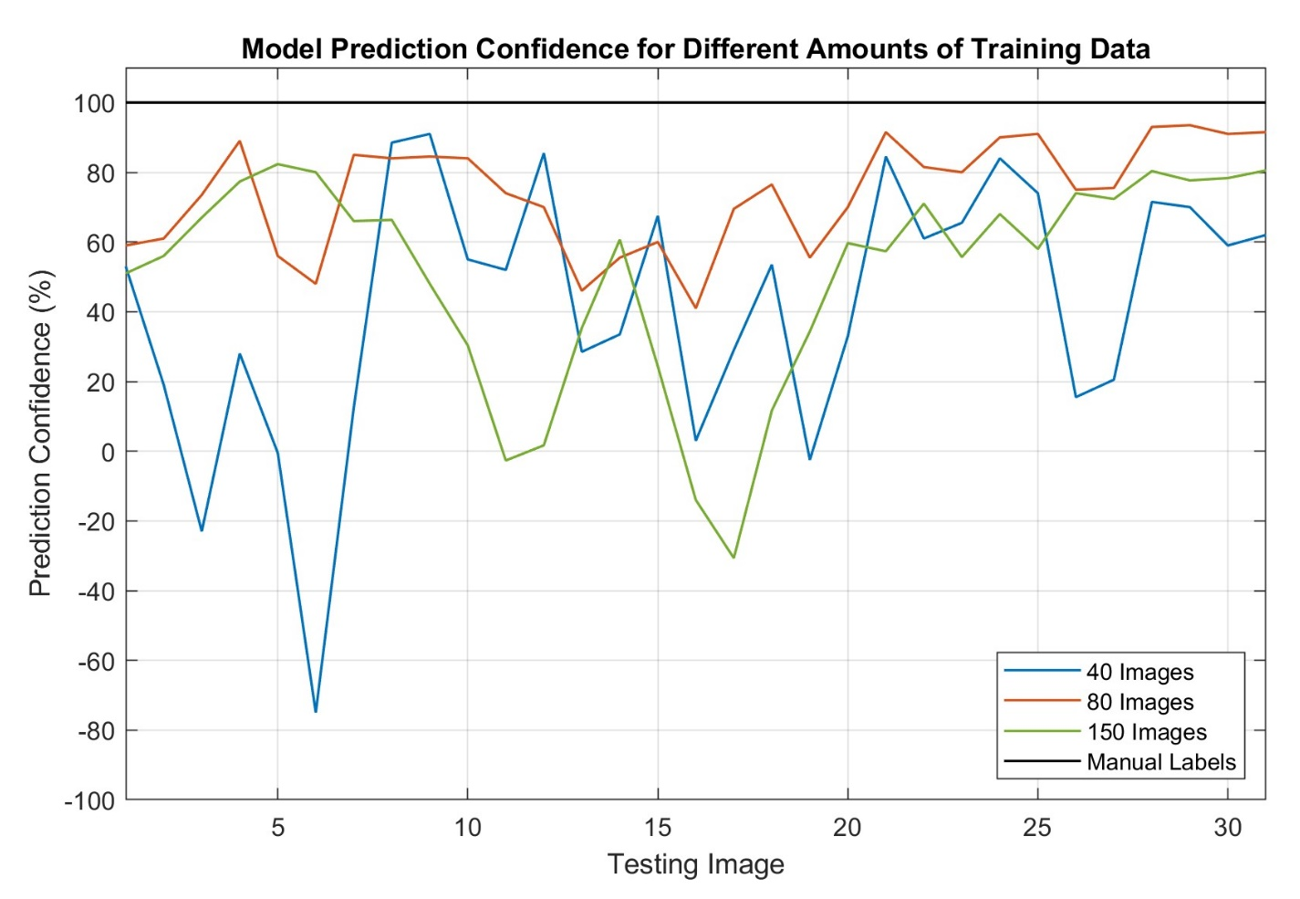
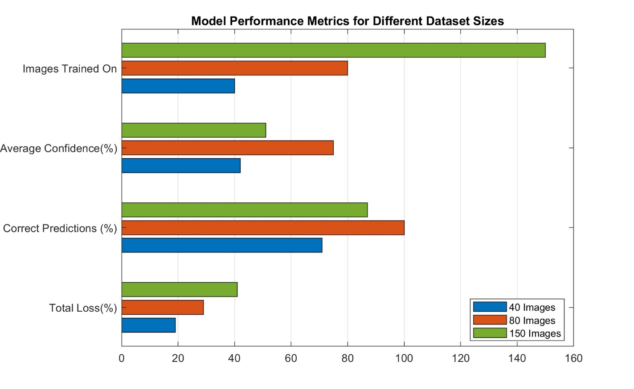
Automating Defect Detection with Machine Learning Shane Toma, Jason Provencher, Estuardo Pinto Department of Mechanical Engineering, University of New Hampshire, Durham, NH 03824
Introduction
Mechanical Design & Description
Introduction: General Electric (GE) Aviation manufactures bladed disks (blisks) for a variety of turbine engines. To ensure parts are of acceptable quality, each part undergoes several inspection stages. Currently, the visual inspection stage is done manually, and human error can result in missed defects. When parts with defects are not recognized until later inspection stages, additional reworking is required, wasting time and money.
Project Statement: Build a system which can automatically scan common defect areas on the blisk and determine if the part is defective. We aim to increase manufacturing efficiency by reducing part reworking after visual inspection stage.
How: Automate visual inspection stage with digital microscope and machine learning to reduce missed defects.
Major System Components
Turntable: Blisk sits upon turntable so that it can be rotated 360 degrees
NEMA 17 Stepper Motor and A4988 driver: Motor shaft connects to the turntable to allow the blisk rotation to be precisely controlled
Dino-Lite Digital Microscope: Captures images of blisk defect areas
Microscope Stand: Positions the microscope in the correct position to view the desired area
Raspberry Pi 2B: Wirelessly connected to computer/machine learning algorithm to allow for motor control
Machine Learning Algorithm: Processes microscope images and determines if defect is present
Design Constraints
Cameras must be mounted in a fixed position, needed to be movable for tuning but rigid
This led to the use of ladder rungs and a lock nut pivot system, allowing variable depth from blisk
Stepper motor fixes to a 3D printed blisk holder, that way they can be easily replaced after wear and can be modified to fit multiple different blisks
Large diameter bearing used to keep fixtures away from the blisk to ease to process of switching out blisks before and after defect checking
SolidWorks simulations confirmed the total deflection to be 0.004mm and vibrate at a resonant frequency of 415Hz
Photo rendering of full assembly loaded with blisk
Exploded section view of assembly
Machine Learning Process & Description
Electrical Components
Model Training
Model Testing
Pre-Trained Model
Supervised training using pre-trained model on COCO dataset
Model has already been trained on wide array of data, then is fed new data for specific use case
Large amounts of blisk images are manually labelled as pass or fail
Model trains on manually labelled data and learns patterns in each category
Circuit Diagram, Physical Setup & Major Components
Manually labelled pass and fail
System Flow Chart
Machine Learning Results
Current Progress
Models were trained on three datasets:
Dataset 1: 40 images
Dataset 2: 80 images
Dataset 3: 150 images
All models are then tested on the same 31 images that the model has not previously seen
Step: One iteration of the algorithm through a batch of training data.
Total Loss: Quantifies model performance by measuring the difference between the predicted output and correct output over all the training data
Parts for final assembly are being milled and water jetted
Additional model testing to improve performance
All electronic components are set up
Final draft of main code to connect all system components
Next Steps
Process Overview: Running the script on the main computer, the microscope is accessed and an image is taken. The image is then given to the ML model, which determines pass or fail.
Image Pass: If no defect is found, the Raspberry Pi is accessed remotely, and increments the motor one step
Image Fail: If a defect is found, the location of the motor is saved, and the operator is notified
Negative % denotes incorrect prediction
Assemble Final Design
Final Data Collection at GE Facility
Final Testing and Optimization
Dataset 3 introduced too much variation in the images, resulting in lower model performance than Dataset 2
Acknowledgements
Image repeatability is key for high accuracy, rigid microscope mount will allow for consistent data
Thank you to our faculty advisor Dr. John Roth for design guidance and to John Graham and George Archer from GE Aviation for sponsoring this project.

