Slide 1


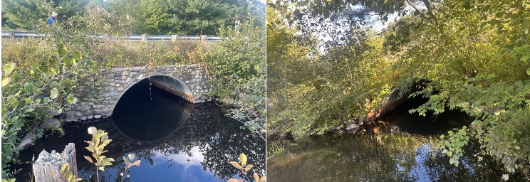
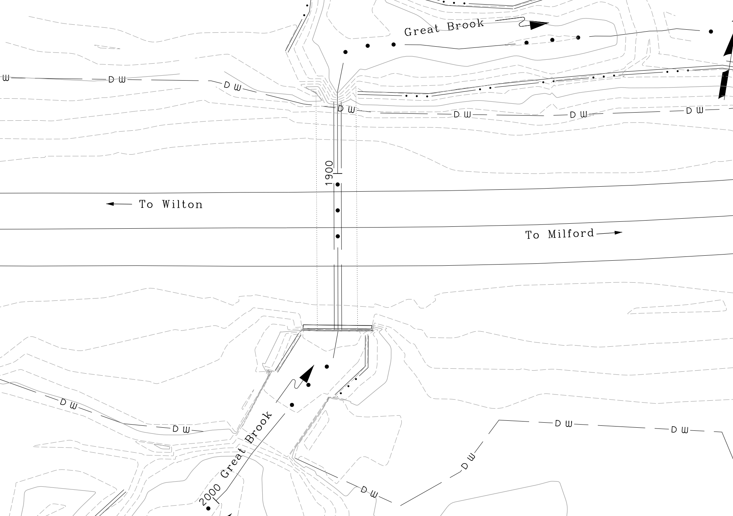
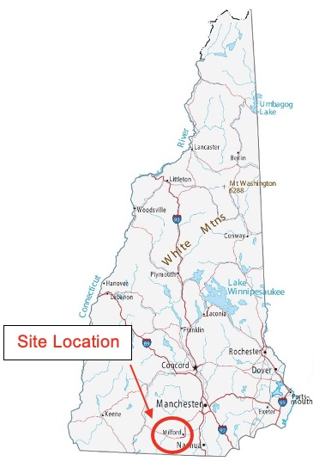
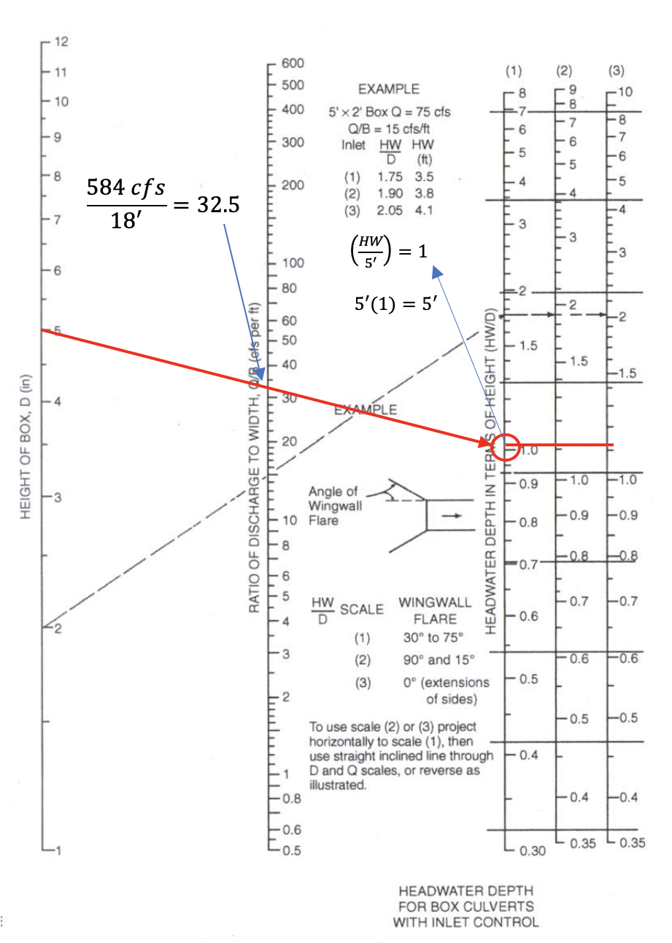
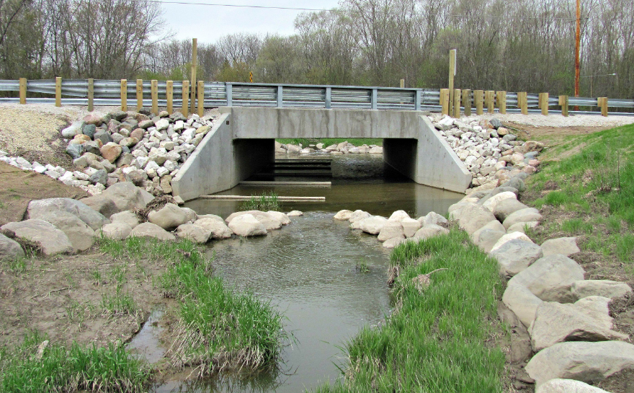
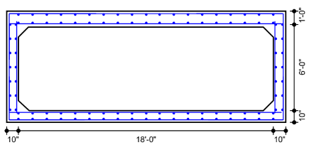
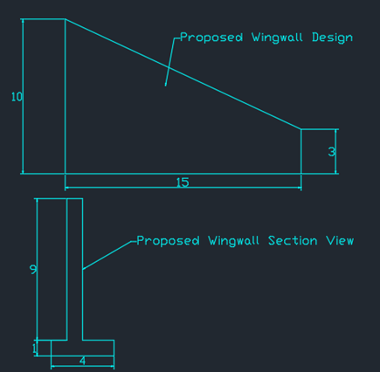
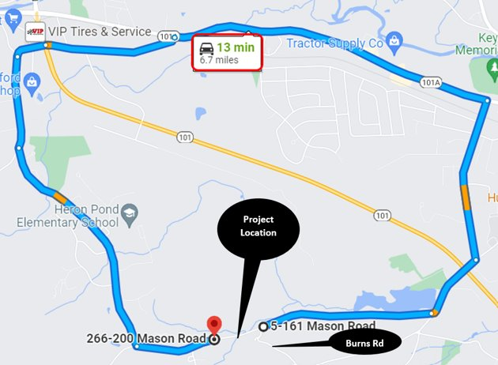
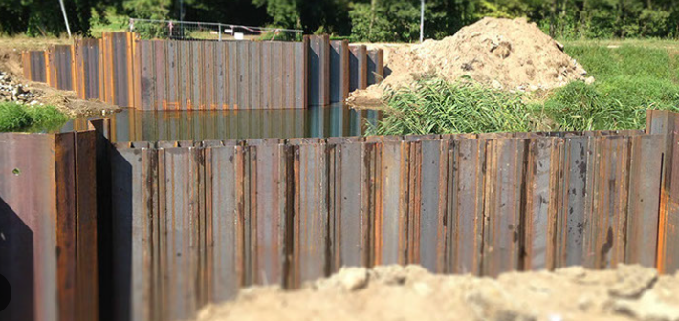
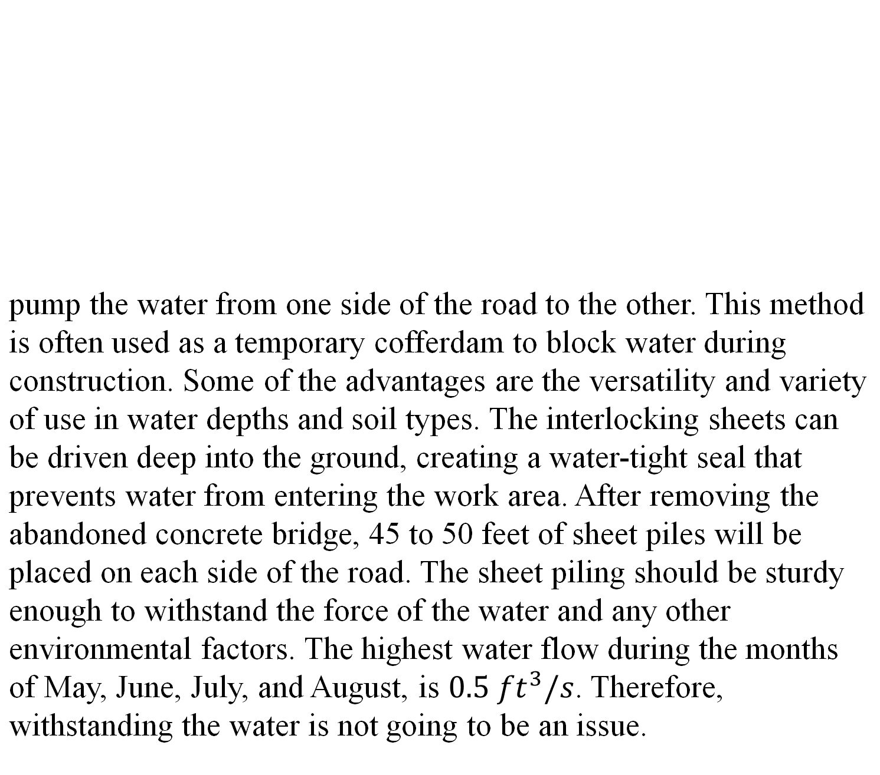
Bridge Replacement – Mason Road over Great Brook – Milford, NH
Cameron Sweet (Project Manager), Charles Wetherbee, Douglas Reitmeyer, Moise Reveil, Seth Reed
Civil and Environmental Engineering, University of New Hampshire, Durham, NH 03824
Place your Project Logo Here
Introduction
Existing Conditions
Geotechnical Properties
In Milford NH, where Mason Road crosses Great Brook lies existing bridge number 089/106, built in 1982. The existing structure spans 11 feet supporting a 22-foot-wide roadway. This local road carries an estimated traffic flow of 3,500 vehicles per day and is designed for HL-93 loading. In 2018 the bridge was red-listed and given a 59.6% sufficiency rating. Issues include an insufficient hydraulic opening as well as structural deterioration. On site also lies an abandoned bridge just upstream adjacent to Mason Road that was left in place during construction of the 1982 bridge. This abandoned bridge is a concrete slab roughly 3 feet thick, posing its own set of problems. GM2 Associates brought the project to UNH’s Project Planning and Design course. The goal of the project has been to determine and design the process of saving or replacing the bridge to provide the Town of Milford a safe and effective roadway.
Mason Road
  Utility poles
  Underground watermain
  Guardrails on both lanes
Hydraulic Opening
  Inlet elevation 270’
  Outlet elevation 269.5’
On October 30, 2020, GM2 Associates, Inc conducted a geotechnical investigation which consisted of two drive and wash borings down to refusal on either side of Bridge No. 089/106. The borings were drilled to refusal at depths of 56 and 54 feet below existing grade. Standard Penetration Tests and soil sampling were performed at varying depths. Soil observed during the investigation comprised of fill overlying alluvium deposits. The fill was classified as a poorly graded sand with silt and gravel (SP-SM) and the alluvium was classified as either a silty sand (SM) or a poorly graded sand (SP) depending on the depth. N-Values obtained during testing ranged from approximately 7 to 40, with an average value of around 18.
Existing Inlet and Outlet
Structure
  Corrugated pipe arch spanning 11 feet
  Carrying 2 lane roadway
Problems
  Red-listed due to deterioration of the pipe
  Insufficient hydraulic opening
Abandoned Bridge
  Roughly 3-foot-thick concrete slab on footings in the brook
  Restricts water in high flow conditions
  Hotspot for beaver activity
Description | Approximate Depth to Bottom of Stratum (feet) | Material Encountered | Consistency / Relative Density
Fill | 10 to 10.5 | Poorly Graded Sand, with gravel and silt, brown (A-1, A-3) | Loose to Dense
Alluvium | 44 to 53 | Silty Sand trace gravel with Poorly Graded Sand trace silt, red-brown to grey brown. (A-2-4, A-3) | Loose to Medium Dense
Glacial Till | 54 to 56 | Silty Sand trace gravel, gray. (A-2-4) | Very Dense
State Level Locus Map
Topographic plan view
Hydraulic Analysis
Bridge Structure
Pavement Design
The code requires that the hydraulic opening of bridge 089 must be designed for a 50-year flood event. The 50-year flood flow for Great Brook is 584 cubic feet per second coming from the 3.11 square mile watershed that is associated with the water crossing.
Given the geometric constraints of the site as well as the 50-year flood flow of 584 cubic feet per second, the hydraulic opening was calculated using the Federal Highway Administrations’ (FHWA) Hydraulic Design of Highway Culverts nomograph. It was determined that the opening should be 18 feet wide and 6 feet tall including 1 foot of freeboard to allow debris to pass without blockage. The dimensions were designed including wingwalls angled between 30 and 75 degrees measured with reference to the direction of the flow.
Precast Box Culvert
Precast Section Drawing
The estimated traffic flow for Mason Road was 3,500 vehicles per day with approximately 4% truck traffic. The data was utilized to convert the traffic count to Equivalent 18-kip Wheel Loads (N18), which was determine to be 1.8 million ESALs over a 25-year design life.
The structural number is an index value derived from the analysis of traffic, roadbed soil conditions and environmental impact. The structural number is equated to layer thickness and layer coefficients to determine the appropriate pavement section. The structural number obtained from the AASHTO nomograph and equation was 2.6.
An appropriate pavement section was then designed that met both the structural and the gradation requirements necessary for this job. The section can be seen below.
Precast sections from Michie Corporation to be delivered on site
A total of five – 6-foot sections will make up a 30-foot length
Precast sections to be set at an elevation to allow for two feet of structural base for roadway
Outer precast sections will include points of connection for guardrails and wingwalls
Pavement Section
Pavement Layer | Thickness (in)
Bituminous Concrete Top Course | 1.5
Bituminous Concrete Binder Course | 3.5
Crushed Gravel Base Course | 8
Gravel Sub-Base Course | 12
Total Thickness 25 | Total Thickness 25
The figure above depicts a concrete box culvert containing
similar characteristics to the proposed Mason Road bridge
FHWA Hydraulic Design of Highway Culverts nomograph
Scour and Wingwalls
Traffic and Water Control
Acknowledgements
When a bridge construction project is underway, it can cause significant disruptions to the normal flow of traffic, resulting in congestion, delays, and potential safety hazards. Workers on
The group would like to extend a special thank you to our project sponsor Brandon Loiselle from GM2 Associates Inc. along with our UNH faculty advisor Dr. Raymond Cook for their time and expert advice that has helped guide us through this design project.
the construction site may need to close lanes or reduce speed limits, creating bottlenecks that can cause backups and frustration for drivers. That is why in this project, detouring traffic around the construction site can help alleviate these issues with a 7-mile, 13 minute detour for approximately one month of road closure. Some of the detour’s benefits are improving the safety for both construction workers and motorists, increasing the speed of construction, and cost savings. Detouring traffic can reduce the overall project timeline and labor costs, as well as reduce the need for temporary traffic signals or flaggers.
pump the water from one side of the road to the other. This method is often used as a temporary cofferdam to block water during construction. Some of the advantages are the versatility and variety of use in water depths and soil types. The interlocking sheets can be driven deep into the ground, creating a water-tight seal that prevents water from entering the work area. After removing the abandoned concrete bridge, 45 to 50 feet of sheet piles will be placed on each side of the road. The sheet piling should be sturdy enough to withstand the force of the water and any other environmental factors. The highest water flow during the months of May, June, July, and August, is $0.5 {ft}^{3}/s$. Therefore, withstanding the water is not going to be an issue.
Four wing walls will connect to each corner of the box culvert. They are used to retain backfill on the embankments along the stream, providing stability to the structure and preventing it from erosion. The wing walls were designed to match the existing slope of the embankments and angled to help channel the water into the culvert.
Sheet piling is a construction technique that involves driving interlocking steel or concrete sheets into the ground to create a water-tight barrier. A water pump system will be used to continuously
References
“Building Bridges Leaving Legacies .” Acrow Building Bridges. Leaving Legacies., https://acrow.com/.
“Hanover-Norwich 42278 Ledyard Bridge over Connecticut River Public ...” Ledyard Bridge Over Connecticut River, New Hampshire Department of Transportation, 14 Apr. 2021, https://www.nh.gov/dot/projects/hanovernorwich42278/documents/42278-pre-04142021.pdf.
Snyder, Dan. “Steel Press-Brake Formed Tub Girder System Selected for 2021 AASHTO Innovation Initiative Focus Technology.” Short Span Steel Bridges, 22 Dec. 2020, https://www.shortspansteelbridges.org/aii-pbtg/.
“Stream Stats.” StreamStats, USGS, 24 Mar. 2016, https://streamstats.usgs.gov/ss/.
Waheed, Amjad. “Load Ratings By Manual Calculations.” Ohio Department of Transportation, https://www.dot.state.oh.us/Divisions/Engineering/Structures/BridgeManagementSection/StructureRatingSuperload/Load%20Rating%20byhand%20Presentations%20and%20Spreadsheets/Load_Rating_Training_Session_3_Slab.PDF.
“Weighted Average Unit Prices.” New Hampshire Department of Transportation, NHDOT, 17 Feb. 2022, https://www.nh.gov/dot/org/projectdevelopment/highwaydesign/documents/WeightedAveragesImperial.pdf.
Wingwall Design
Headwater and tailwater slabs will be in place on the streambed between
the wingwalls. Riprap will be strategically placed on the leading edge of
headwater slab and the trailing edge of the tailwater slab to protect
against local scour. Riprap size should be 12”-16” based on and average
flow velocity of 6 feet per second.

