Slide 1
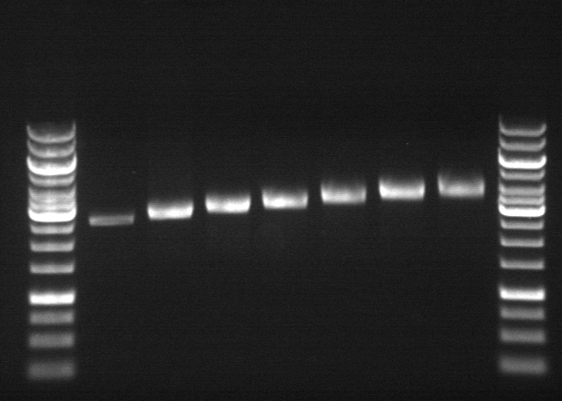
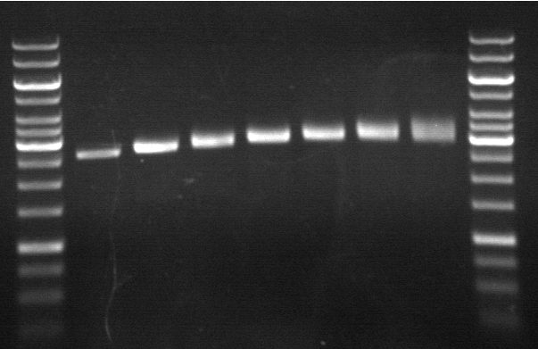
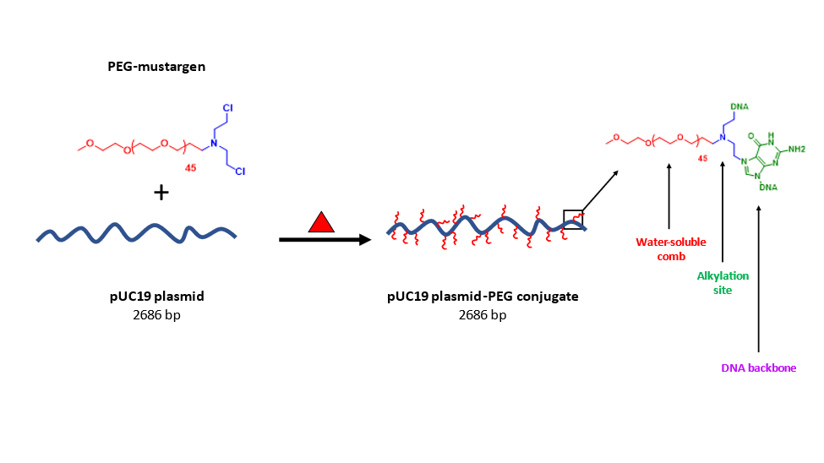


Novel Plasmid DNA Macrocyclic Bottlebrush Polymer
Owen Durant,¹ Nicholas Pierini,² Nate Oldenhuis²
²Department of Chemistry, University of New Hampshire, Durham, NH
Introduction
Synthesis
Gel Electrophoresis
Motivation. Advances have been made toward generating bottlebrush polymers with unique topologies and assemblies, but synthetic methods and dispersity limitations remain. In this work, biologically derived linear pUC19 plasmid DNA (pDNA) serves as a backbone for synthetically made poly(ethylene glycol) methyl ether mustargen (mPEG-CEA) to alkylate under biologically relevant conditions. By varying the molecular weight mPEG-CEA and the concentration relative to the pDNA, a variety of macrocyclic bottlebrush polymers can be generated with this method. Visualization of the formed bottlebrushes was achieved through the combination of atomic force microscopy (AFM) and agarose gel electrophoresis. This method serves as a facile route to achieve PEGylated DNA materials which can significantly improve DNA’s ability to be used as a material in the future.
Modified PEG side chains
Preliminary Results. Using agarose gel analysis, the pDNA displayed differences in size by changing the molecular weight of PEG-mustargen (M_{w} 2000 vs 750). The highest Pegylated pUC19 PEG-mustargen₂₀₀₀ appeared at ~4500 bp while PEG-mustargen₇₅₀ showed at ~3500 bp
A
lpUC19
10 eq.
20 eq.
30 eq.
40 eq.
50 eq.
60 eq.
B
lpUC19
10 eq.
20 eq.
30 eq.
40 eq.
50 eq.
60 eq.
Figure B. Reaction scheme for synthesis of mPEG-mesylate. All structures were confirmed using ¹H NMR. n = 750, 2000, 20000
Figure C. Reaction scheme for synthesis of mPEG-diethanolamine. All structures were confirmed using ¹H NMR. n = 750, 2000, 20000
Figure F. 2.5% agarose gel showing increasing molar equivalence of mPEG-mustargen relative to pDNA (10-60 equivalence) A) mPEG₂₀₀₀ B) mPEG₇₅₀
Conclusions & Future Work
Figure D. Reaction scheme for synthesis of mPEG-bis-chloroethylamine. All structures were confirmed using ¹H NMR. n = 750, 2000, 20000
Conclusion
We have demonstrated the synthesis pDNA bottlebrush polymers via modified polyethylene glycol monomethyl side chains. Agarose gel analysis allowed for easy characterization of the pDNA bottlebrush polymers. These results provide a facile route for a grafting-to approach for PEGylation of pUC19 plasmid DNA.
Future Work
Future work includes getting AFM images of the plasmid-PEG conjugates and a restriction digest study to confirm chemical modification and overall structure.
Figure A. Reaction scheme for synthesis of pDNA bottlebrush polymer and structure of side chains of the bottlebrush polymer
References
Rationale Design of pDNA Bottlebrush. Mustargen compounds are well known compounds capable of alkylating DNA allowing for straightforward grafting-to handles¹. PEG is a well established, FDA approved polymer with known compatibility for conjugation to DNA and other biomolecules in part due to properties such as high-water solubility². The chosen linearized plasmid, pUC19 was derived from a high plasmid yielding fed-batch fermentation process developed by the Oldenhuis lab. This allows for a polymer backbone of a known size which can be characterized using well established techniques like agarose gels and AFM.
Sauter, B.; Gillingham, D. DNA Damaging Agents in Chemical Biology and Cancer. CHIMIA 2020, 74 (9), 693.
Alconcel, S. N. S.; Baas, A. S.; Maynard, H. D. FDA-Approved Poly(Ethylene Glycol)-Protein Conjugate Drugs. Polymer Chemistry 2011, 2 (7), 1442–1448. https://doi.org/10.1039/c1py00034a.
Acknowledgements
Acknowledgements – This research was supported with funding from the National Science Foundation’s Research Experience for Teachers in Engineering Grant (ENG-1132648).
This research is supported by a National Science Foundation EPSCoR award (#1757371).
Various molecular weight mPEG modified with mustargen end group
Figure E. Proposed mechanism for alkylation of DNA with via intramolecular cyclization (aziridinium formation) of the mustargen followed by nucleophilic attack by the N7 position of guanodine
lpUC19 plasmid
2686bp

