Slide 1


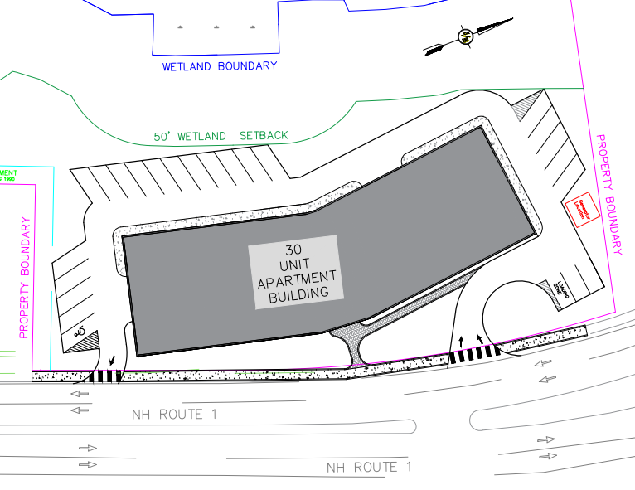
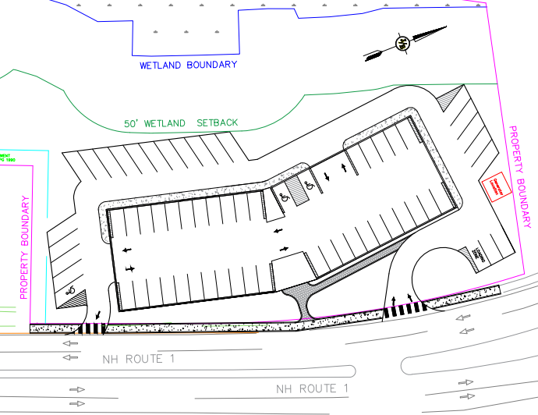
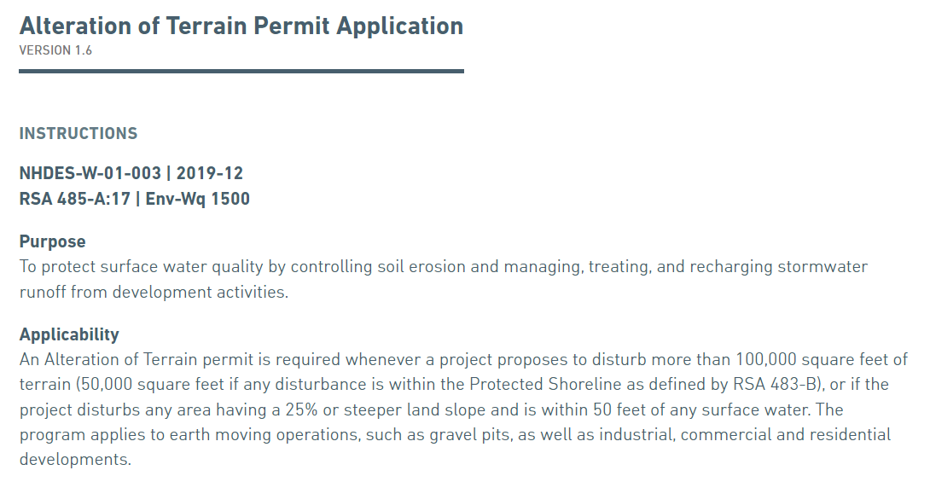
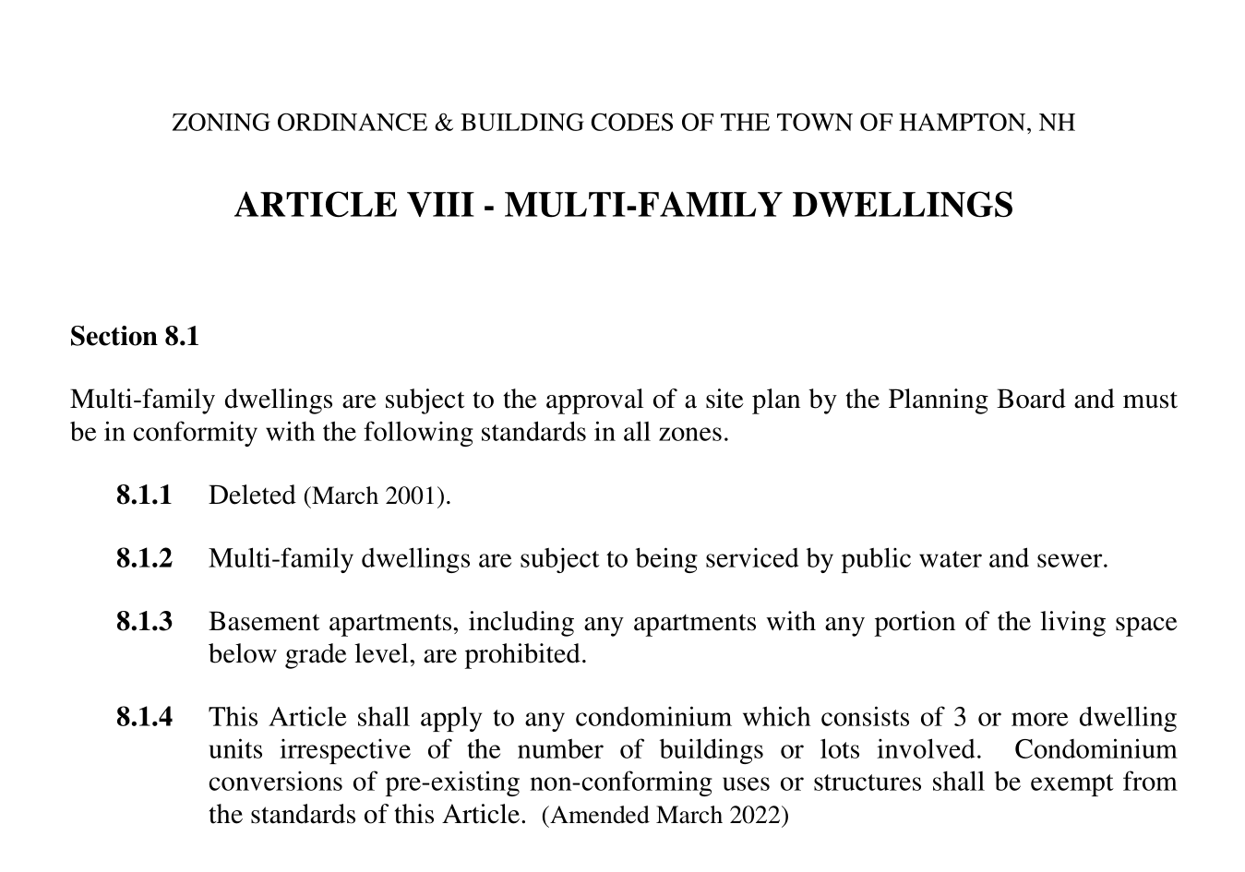
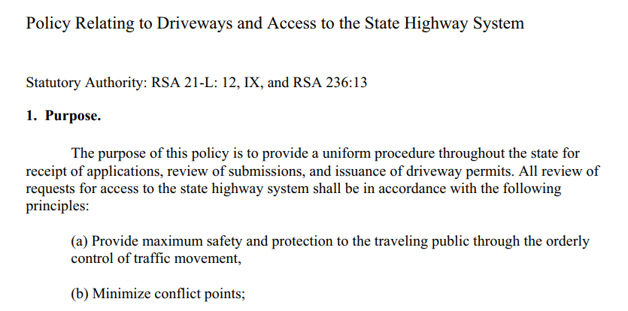
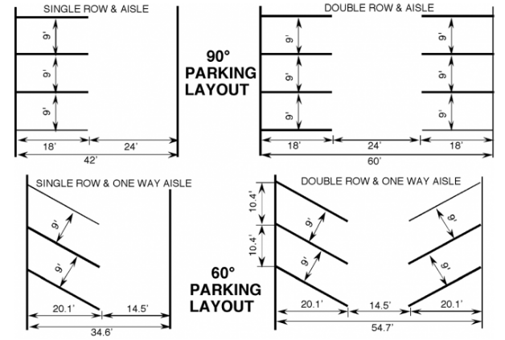
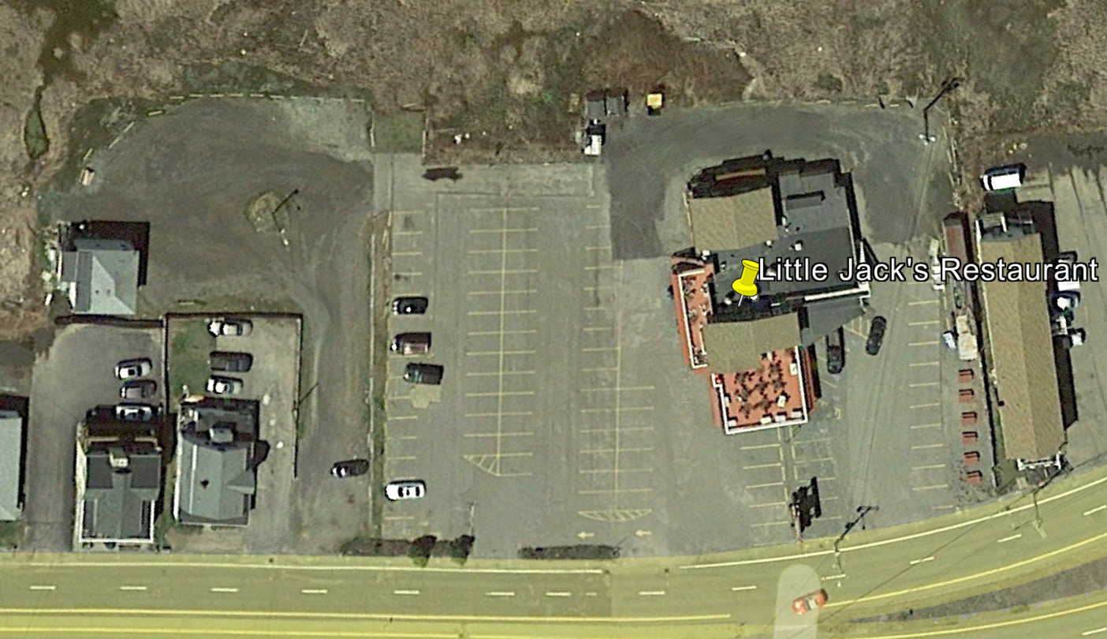
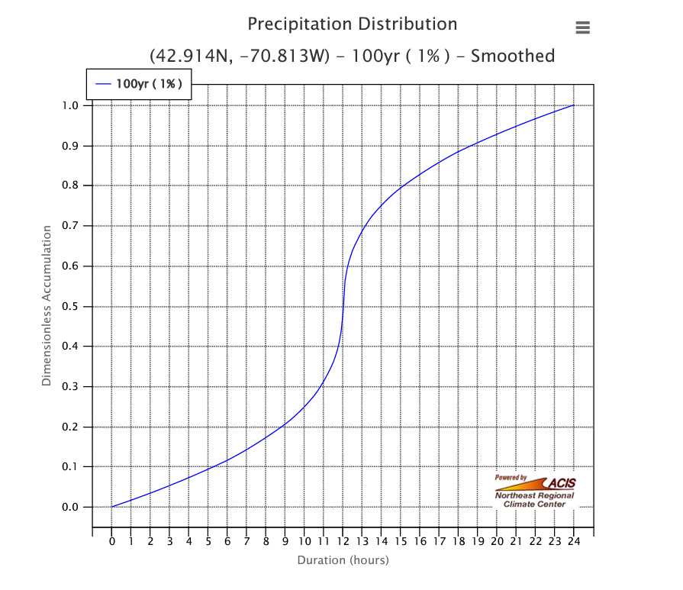
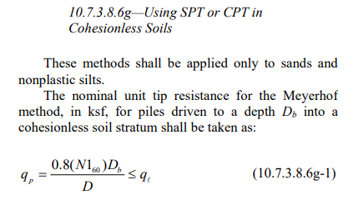
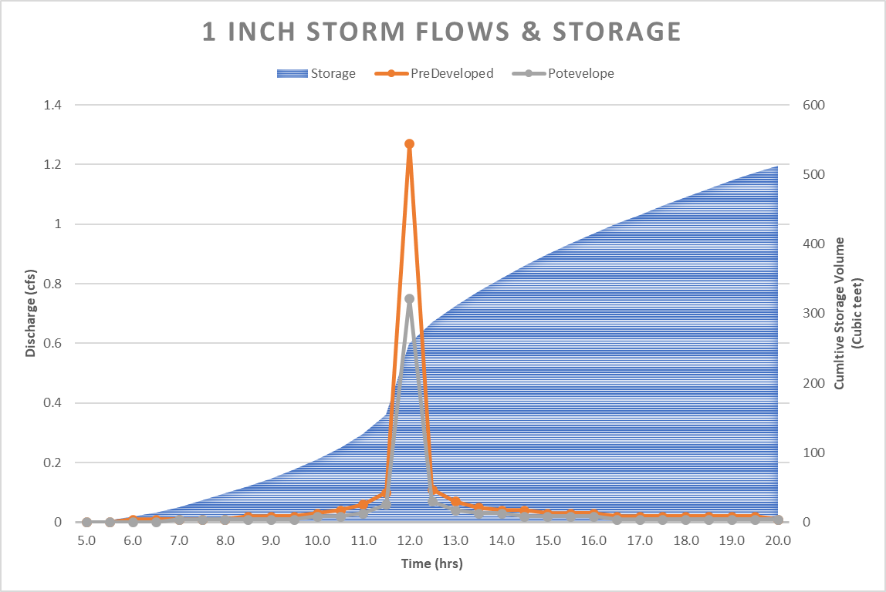
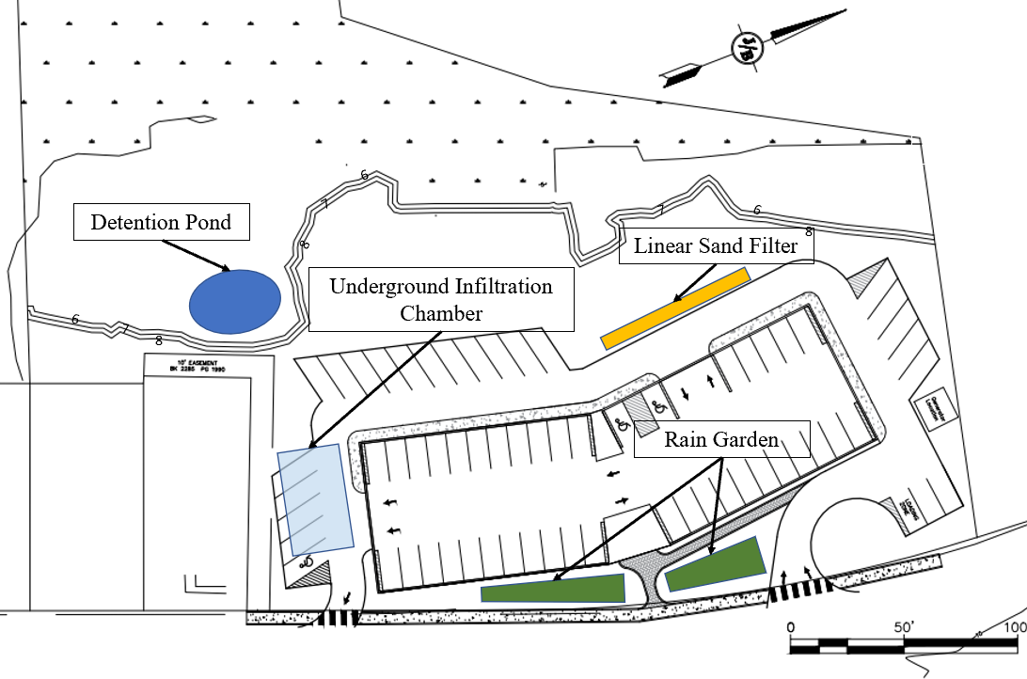
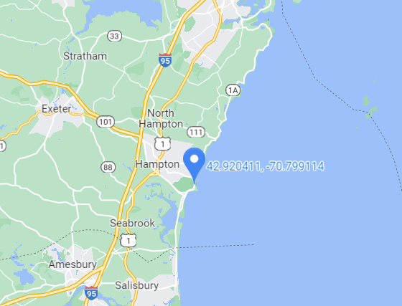
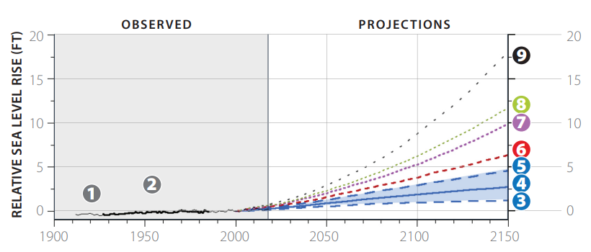
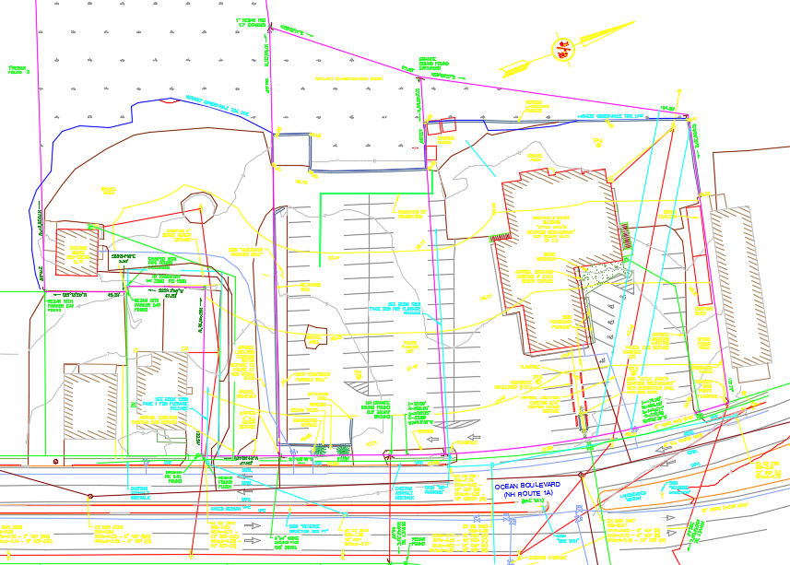
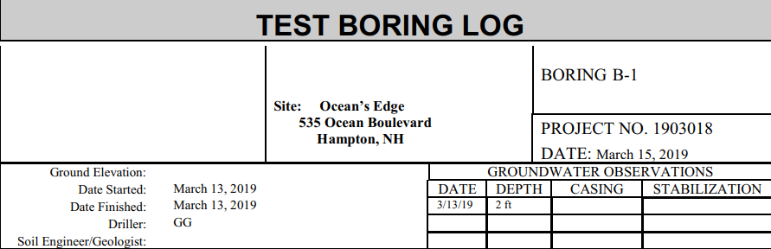

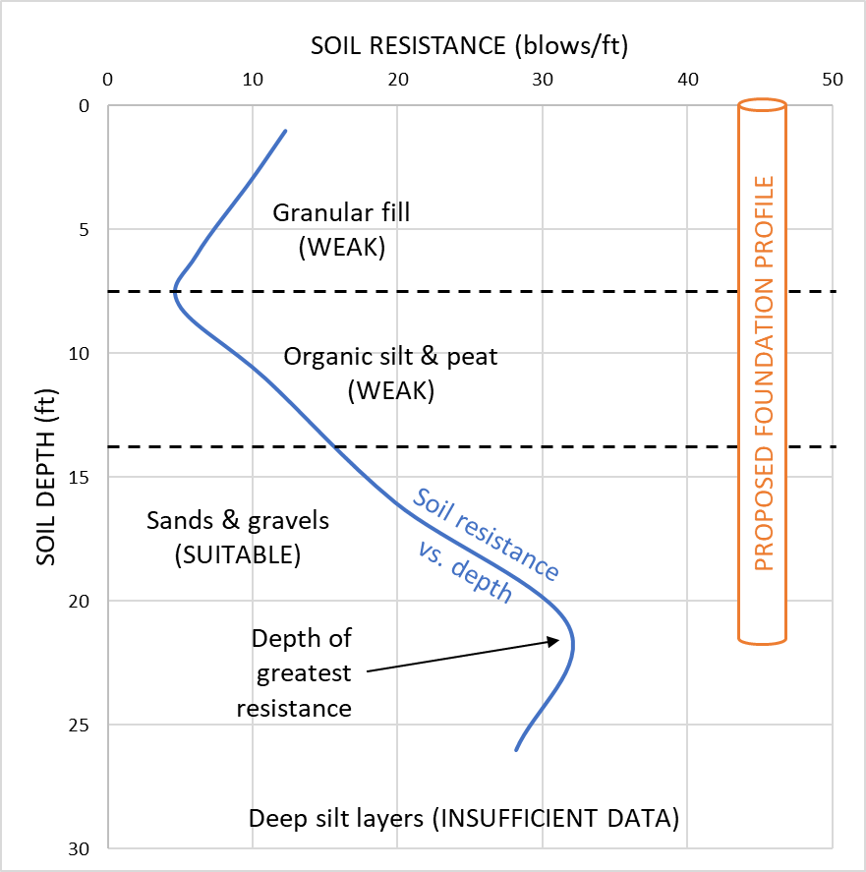
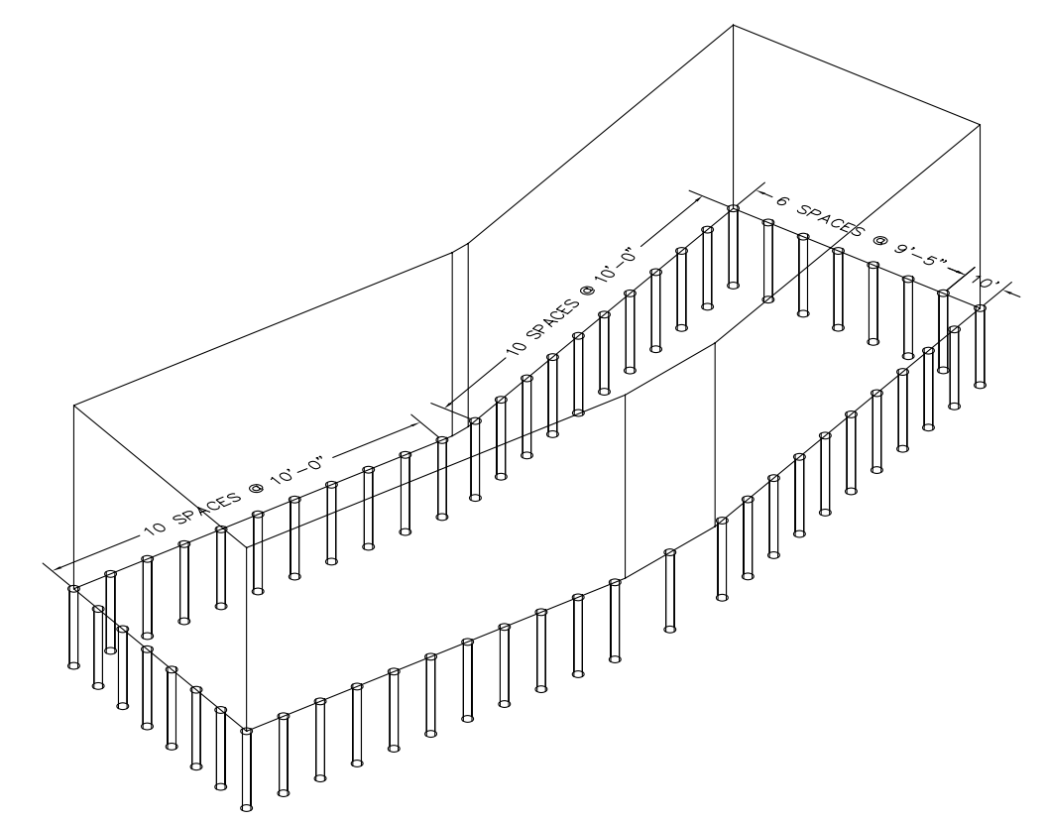





Former Little Jack’s Restaurant Redevelopment
Lauren McNaughton, Justin Coralli, Mark Adler, Nicholas Mason, and Owais Khalid
Civil and Environmental Engineering, University of New Hampshire, Durham, NH 03824
Introduction
Site Design
Research Summary
The former location of Little Jack’s Seafood Restaurant has been assigned to be demolished. The objective of this project is to design a 5-story residential condominium building with 30 units in its place.
The site sits on 4.4 acres of land at 537 Ocean Blvd, Hampton, NH, and abuts a protected tidal marsh. Additionally, the entire property is within a 100-year flood zone and is known to flood during storm surge events.
The fill and organic soil layers immediately underneath the site are highly saturated and compressible, making them unfit for shallow foundations. Roadway limitations also exist, with the existing driveway and sidewalk network needing to be repurposed for residential use.
Site Layout
First Floor Layout
NHDES Shoreland Protection and Alteration of Terrain Requirements
Town of Hampton Building and Architectural Codes
Site Maps
Little Jack’s Restaurant, 2018
Stormwater Infrastructure
NHDOT Driveway Regulations
Town of Hampton Parking Lot Design Standards
Stormwater Study
Stormwater Locations
AASHTO SPT-Based Foundation Development Methods
Cornell Northeast Regional Climate Center Extreme Precipitation Data
UNH Coastal Flood Risk Summary
537 Ocean Blvd, Hampton, NH
Foundation Design
Provided Existing Conditions
Provided Geotechnical Report
Scope
Geotechnical Study
Foundation Scheme
Principal town, state, and federal regulations and guidelines were consulted in the redevelopment of Little Jack’s. These informed:
Floor dimensioning ∙ Driveway layout ∙ Roadway & shoreland setbacks
Erosion control ∙ Runoff treatment ∙ Stormwater model development
Subsurface analyses ∙ Foundation development ∙ Flood risk mitigation
Condominium design and site layout
Stormwater management design
Soil analysis and foundation design
Acknowledgements
Report
We would like to extend our sincere gratitude to all those who volunteered their time to help make our project the best it could be. We specifically want to thank:
Coastal hazards analysis
Our Advisors:
Our Sponsors:
Our References:
Prof. Kenneth Flesher
Philippe Kalmogo, PhD
Paige Libbey, PE
Ian MacKinnon, PE
Jennifer Jacobs, PhD
Thomas Ballestero, PhD
Fei Han, PhD
Town and state permitting summary

