Slide 1

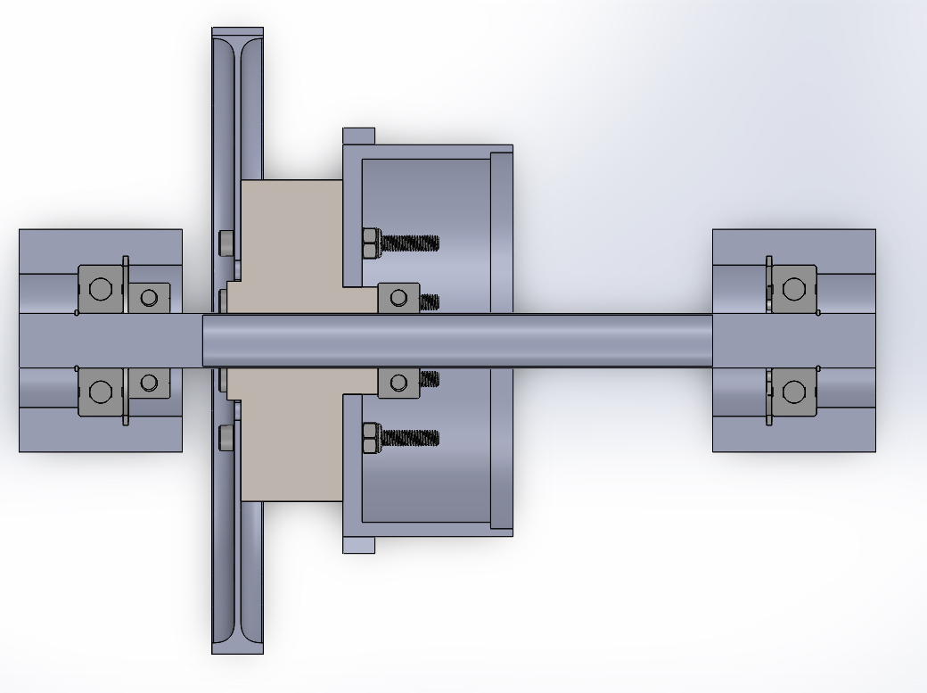
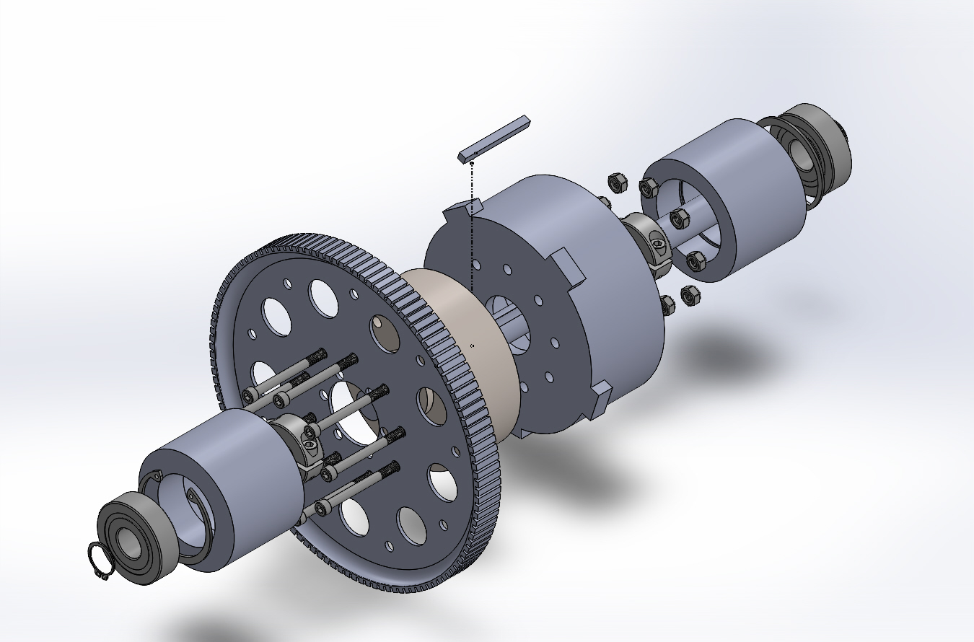
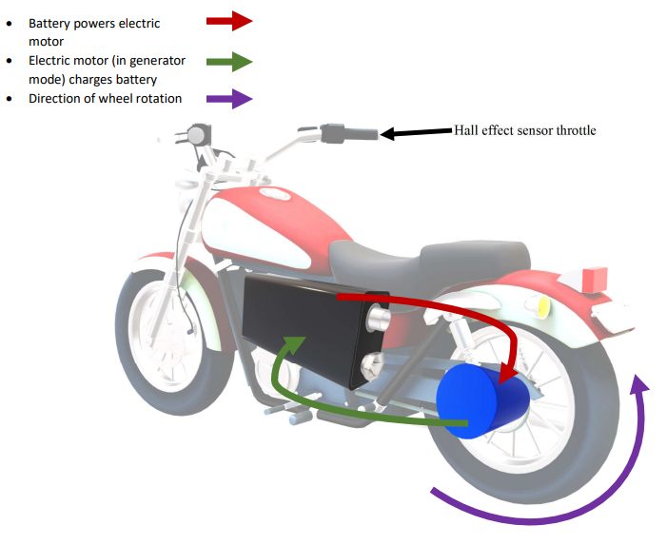
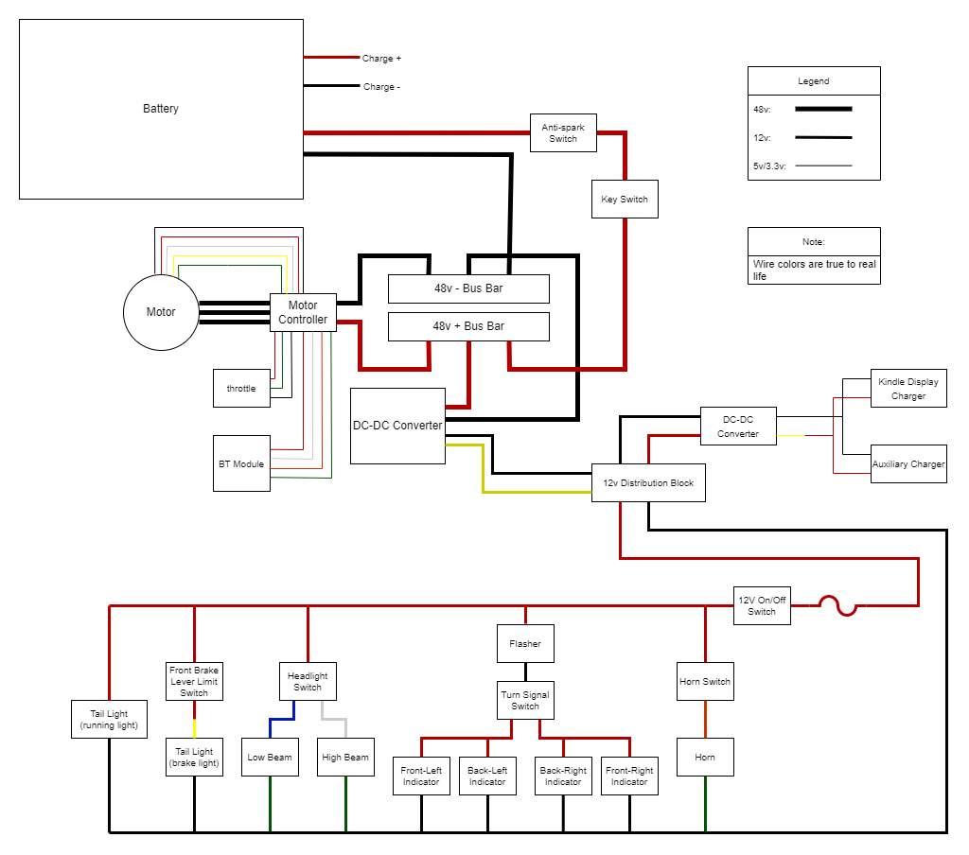
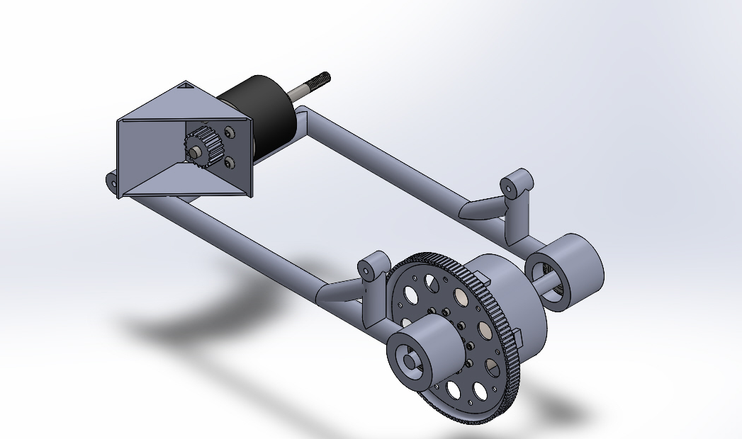
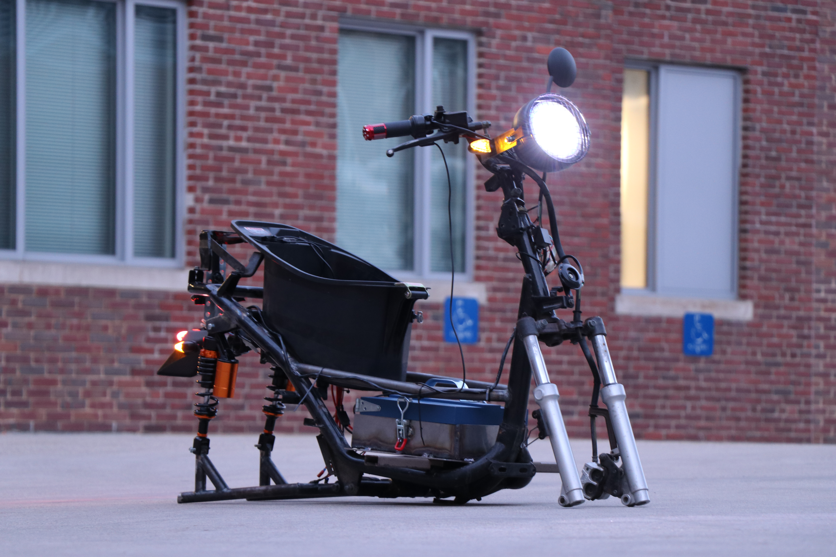
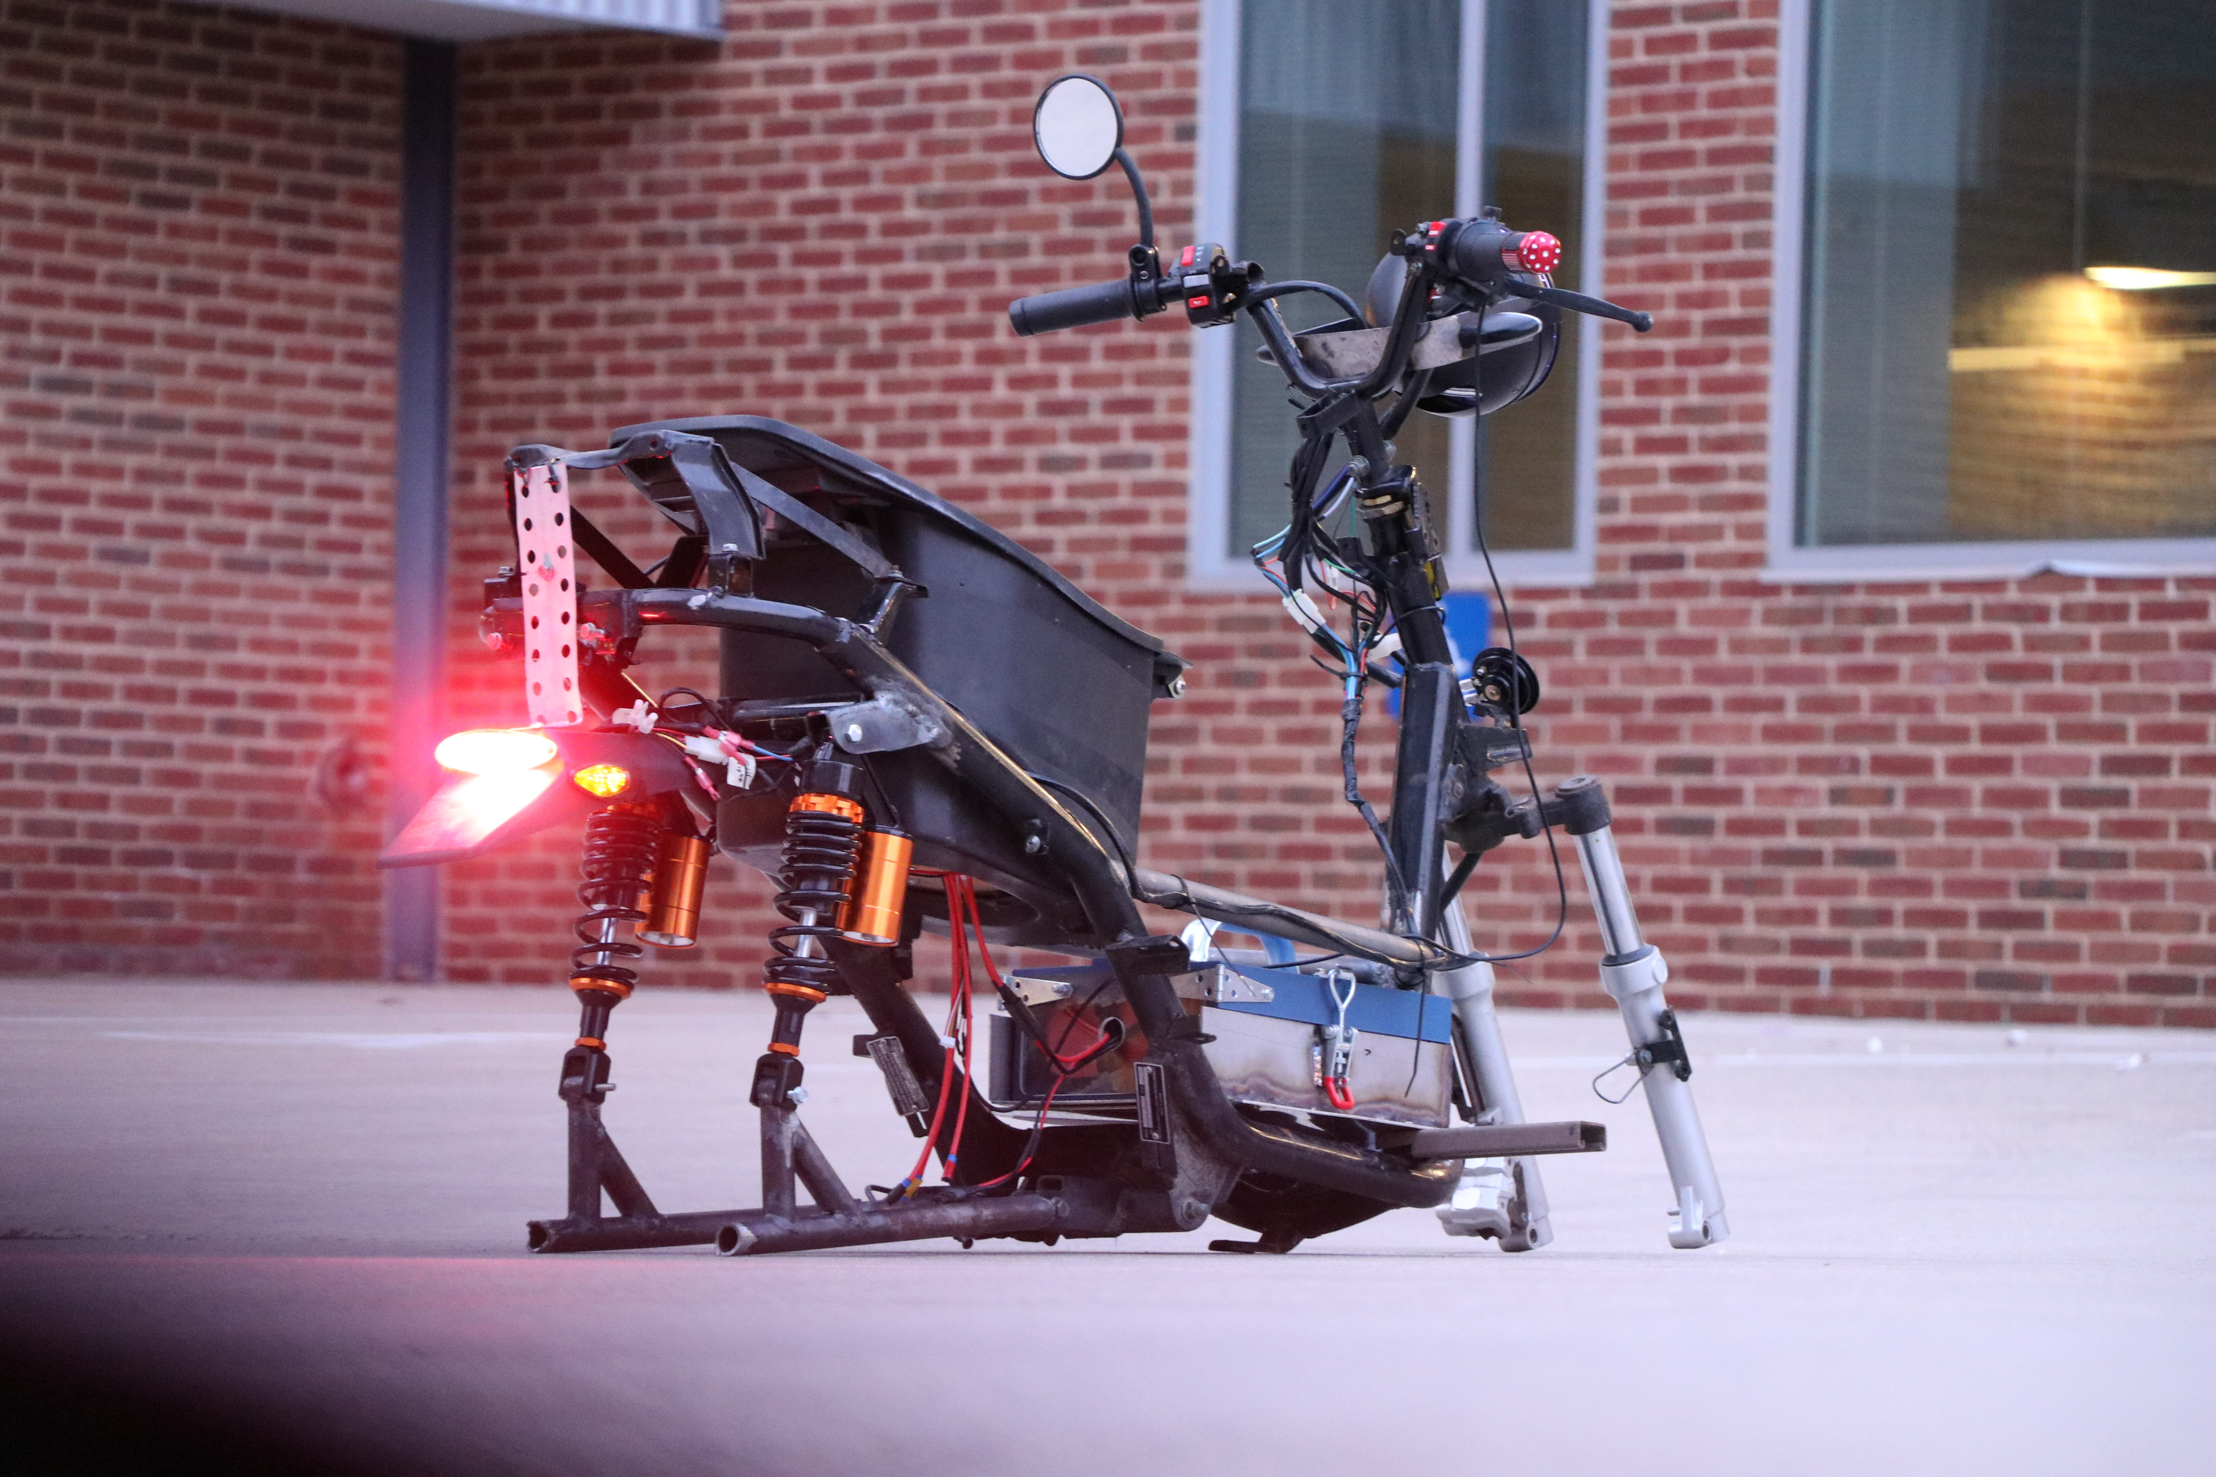
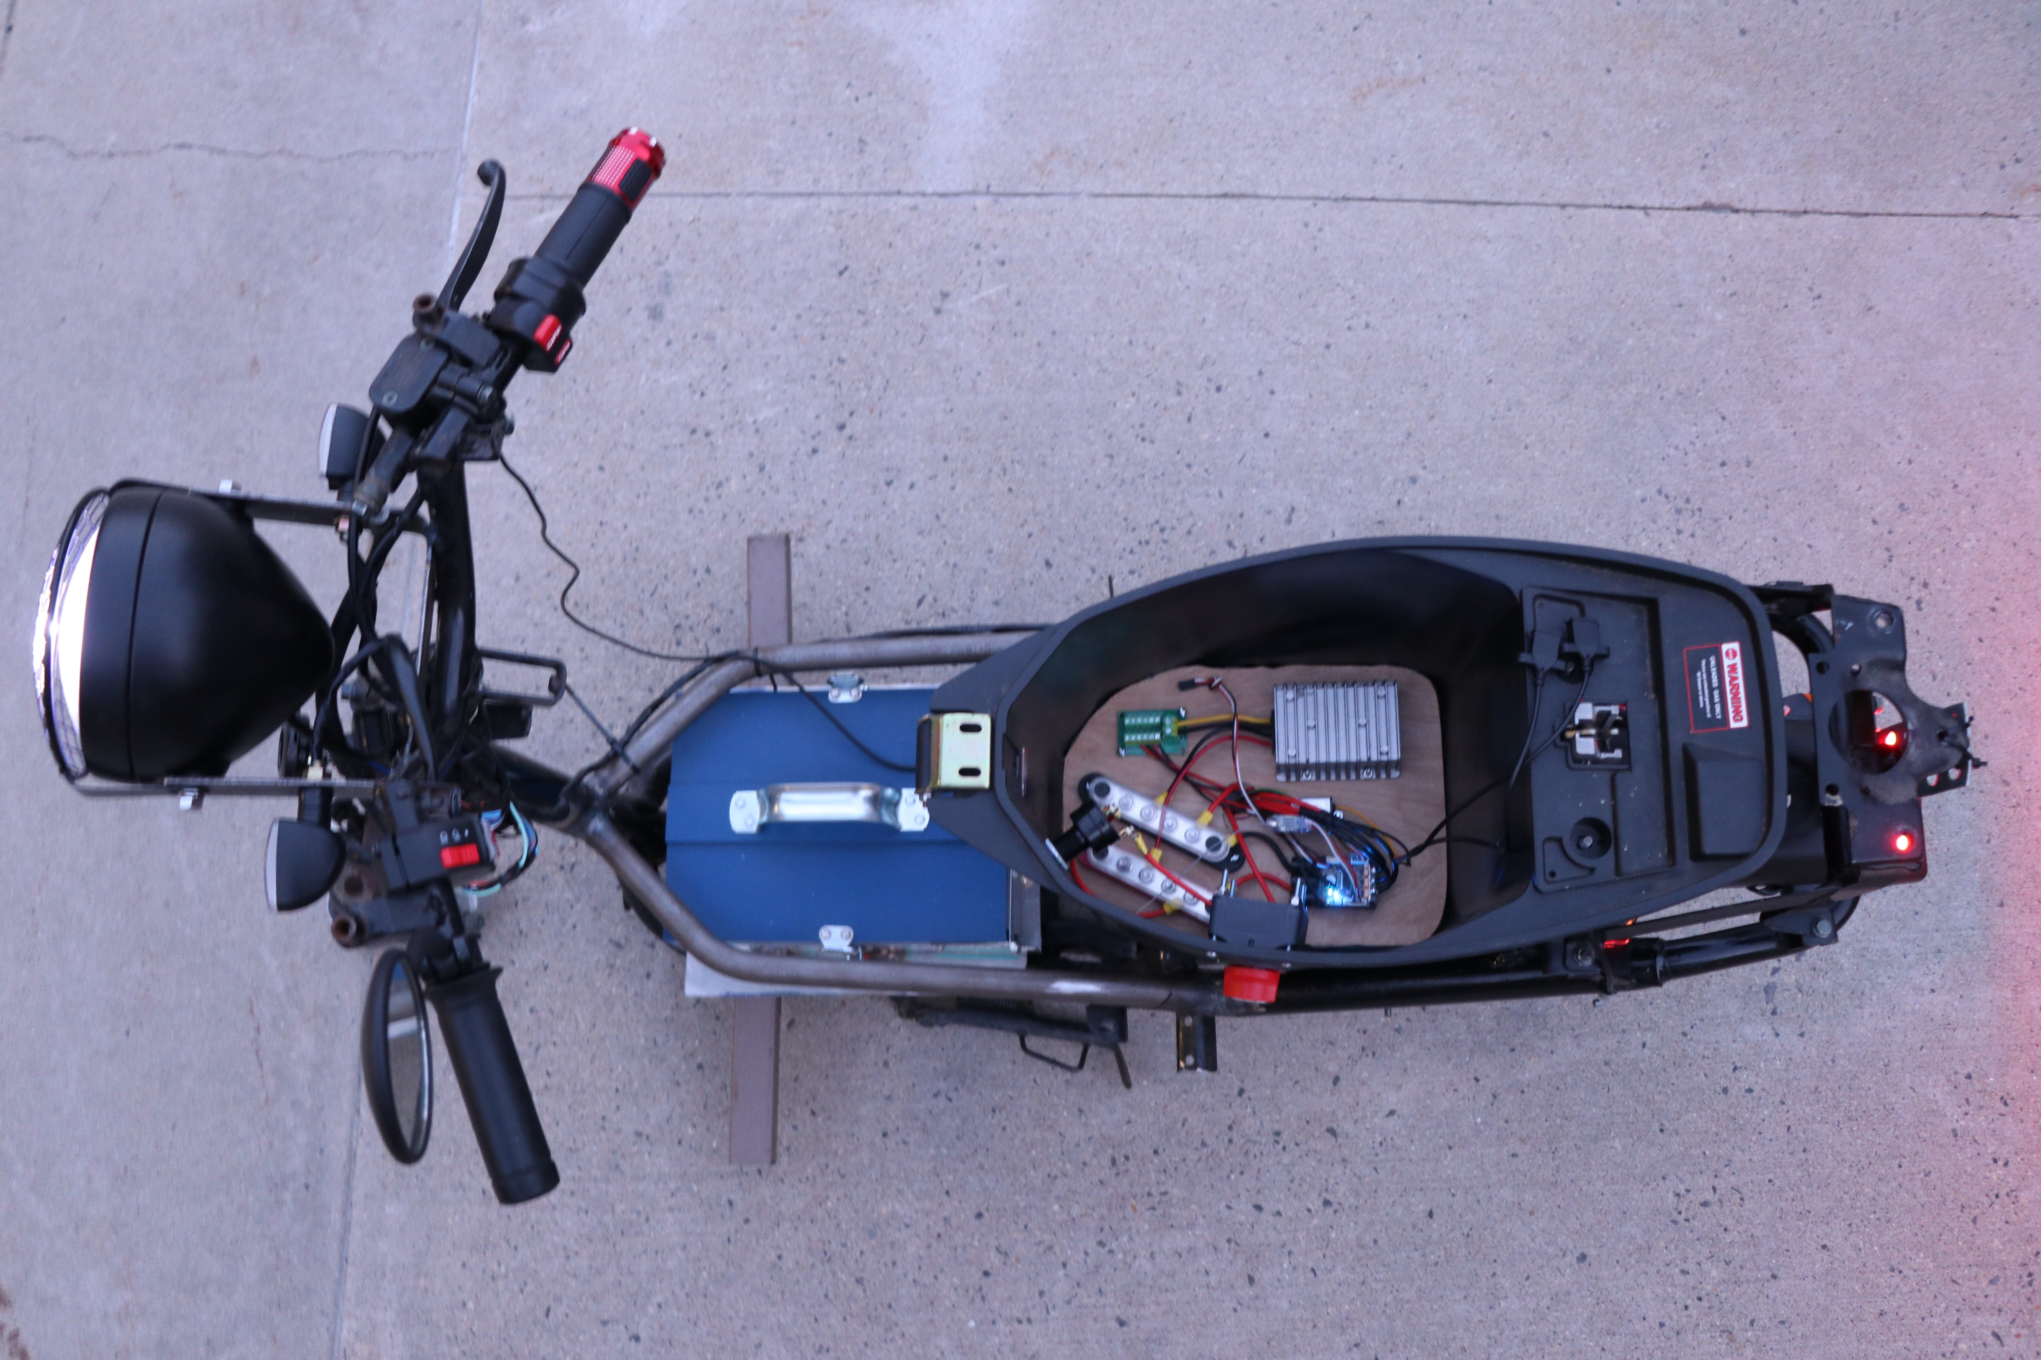
Electric Moped Conversion
Electric Vehicle Organization
Logan White, Adam Elsner, Nick Snyder, Dylan Callahan, Owen Tolve
Department of Mechanical Engineering, University of New Hampshire
Project Overview
Vehicle Statistics
Drivetrain & Propulsion
Goal: Convert an internal combustion engine moped into a battery electric vehicle to provide a sustainable form of transportation for students at UNH.
  Redesign the rear axle and propulsion system
  Design an electronic system to support a touch-screen tablet that integrates real-time data with the device.
  Design a wiring harness that independently controls the vehicle’s lighting, motor speed controller, and battery management system (BMS).
Battery Electric Moped
48V 30Ah Battery (1.4kWh)
6kW Motor
Top Speed (30mph Limit Disabled): 47 mph
Range: Approximately 50 miles
Regenerative Braking System
Above image shows a section view and an exploded view of the moped’s redesigned drivetrain
  Axle spins using bearings and uses a keyway cut to force the tire to rotate with the axle
  Retaining rings and shaft collars keep the parts stationary
Electronics & Wiring
When the voltage signal from the updated throttle position is less than the previously recorded voltage read from the throttle, the speed controller activates the regenerative braking system by reversing the direction of the motor. During regenerative braking, the motor acts as a generator, producing a voltage that is opposite in polarity to the voltage of the battery, effectively charging the battery. While the voltage produced by the motor during regenerative braking may still be positive, it will be lower than the battery voltage. The direction of current flow during regenerative braking is opposite to the direction of current flow during normal motor operation.
Development Photos
The above image shows the propulsion system (minus the belt)
  Uses welds to attach the motor mount and drivetrain to the swing arm
References
Contacts
.
Club Advisor: Ivo Nedyalkov
Safety Approval: Noah MacAdam
Machining: Scott Campbell
Logan.White@unh.edu
Adam.Elsner@unh.edu
Nick.Snyder@unh.edu
Dylan.Callahan@unh.edu
Owen.Tolve@unh.edu

