Slide 1

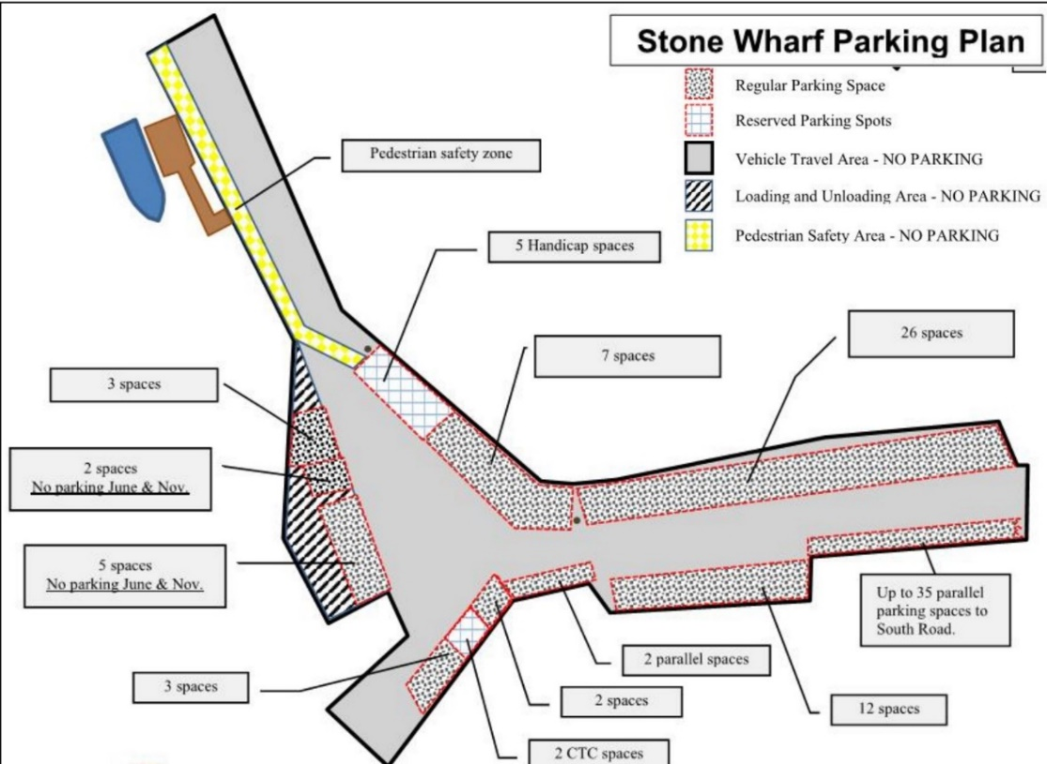
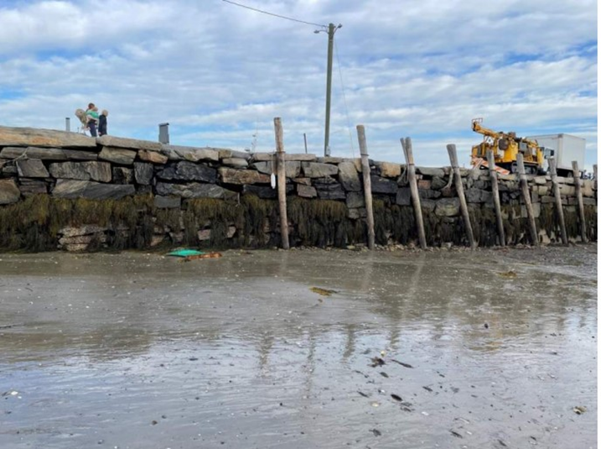
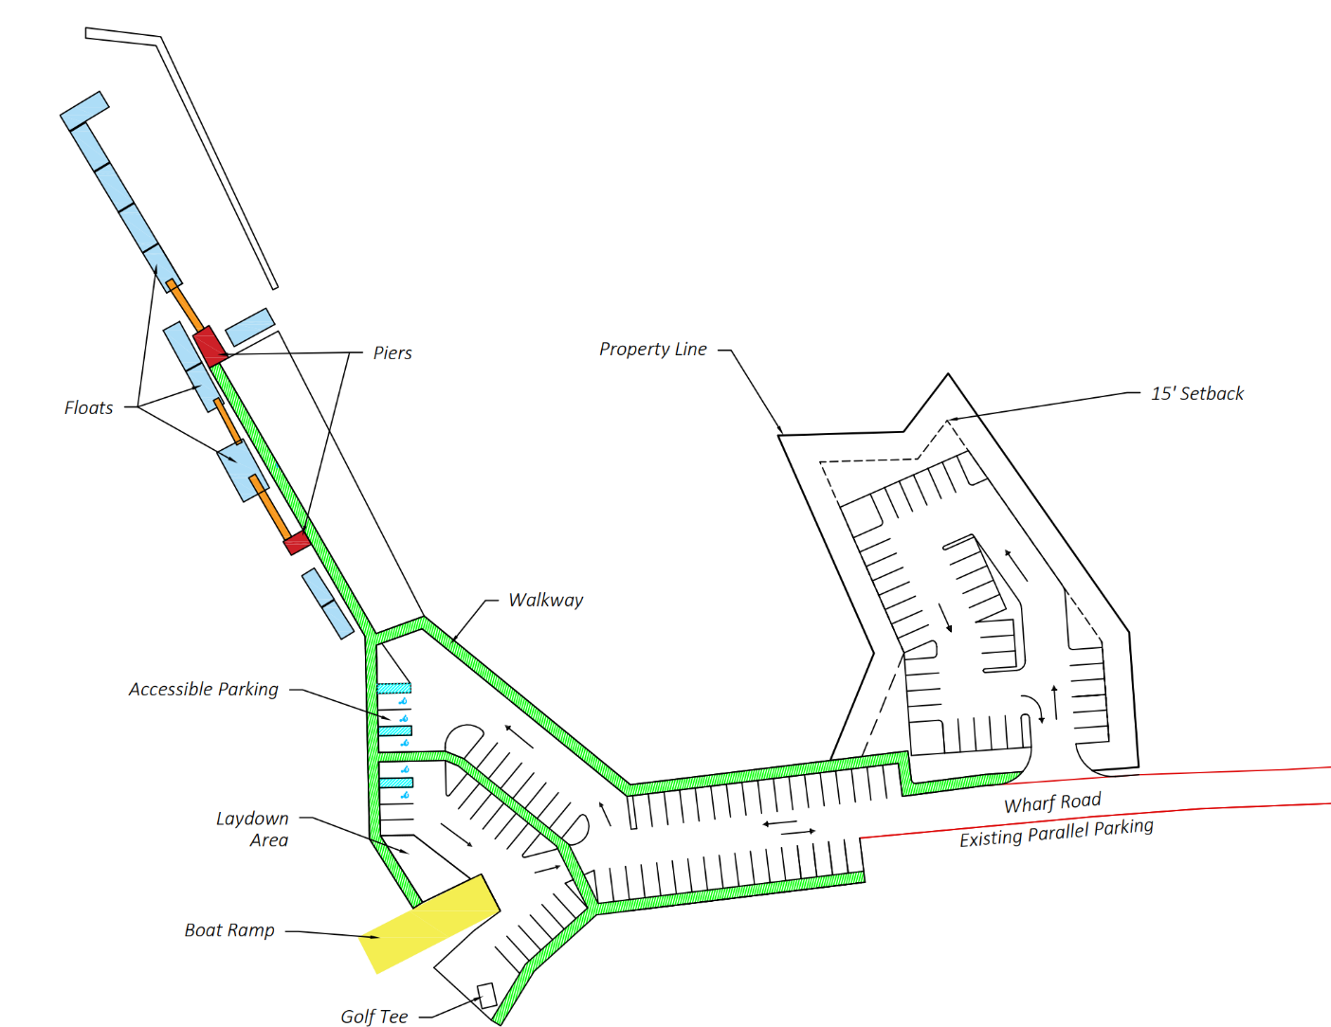
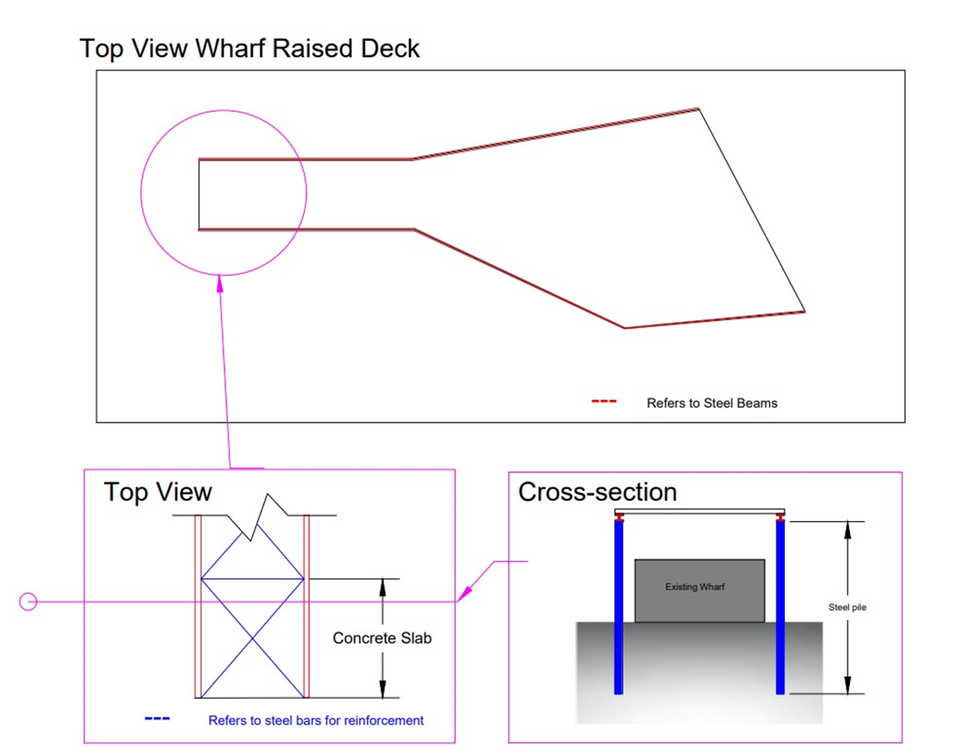
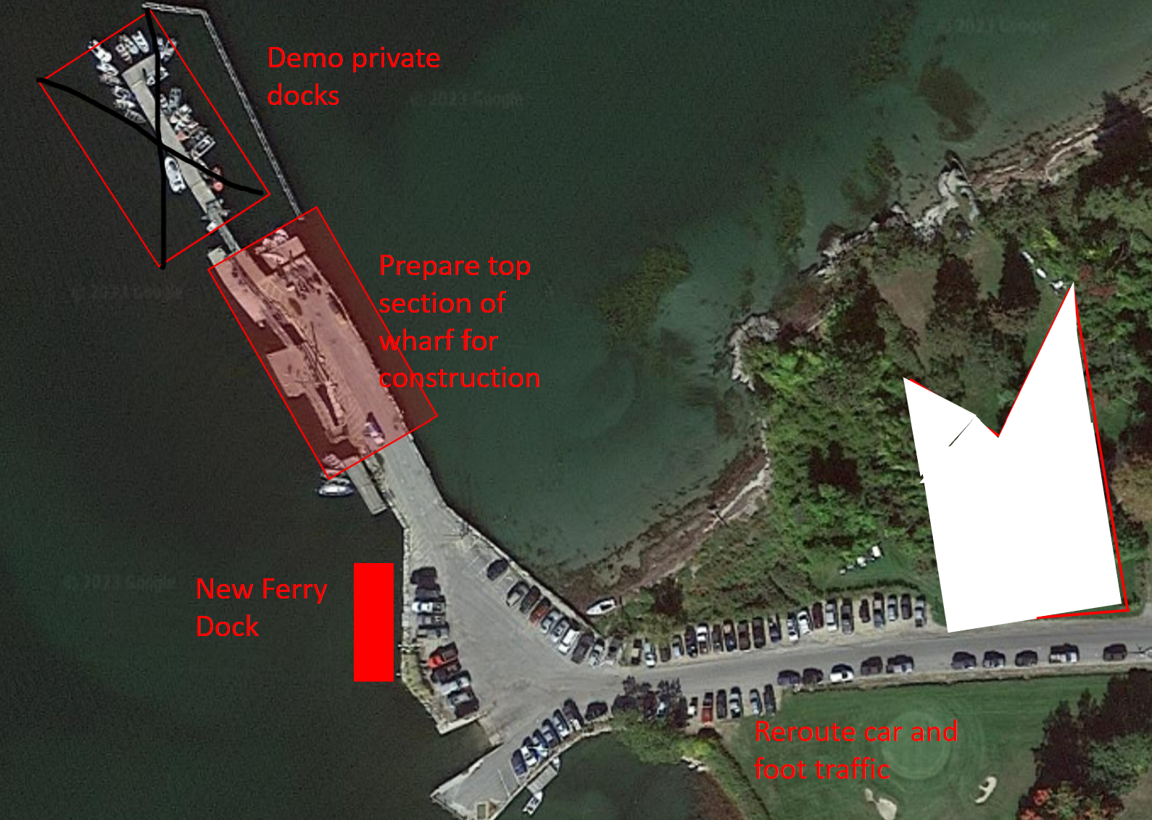
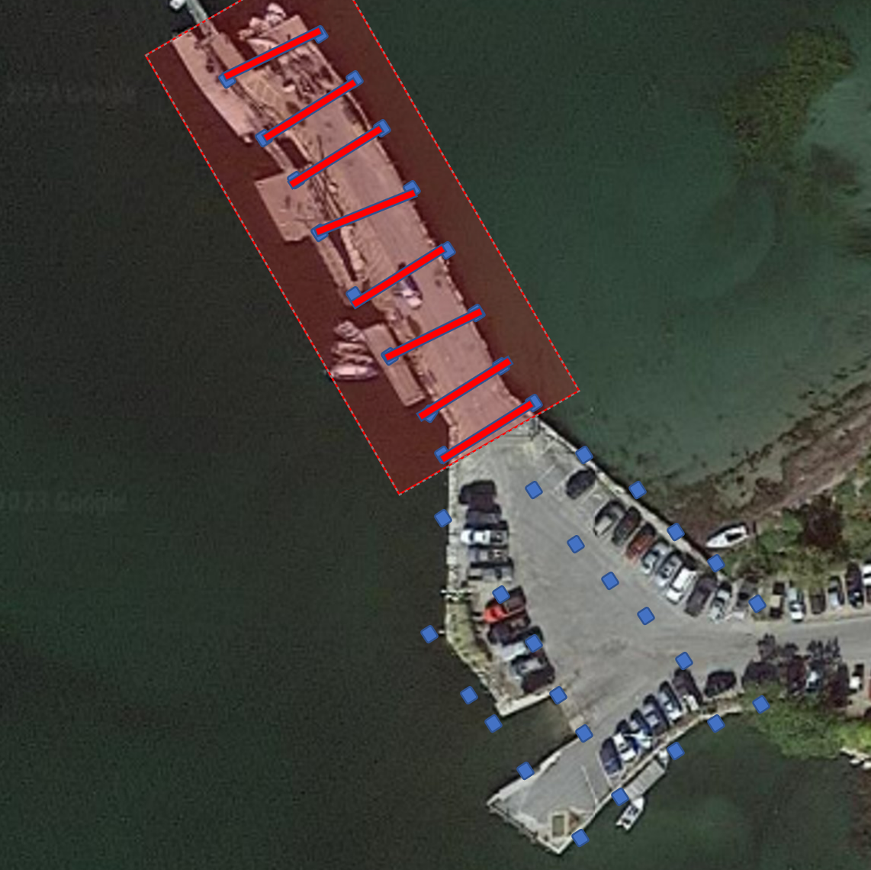
Chebeague Island Stone Wharf
Heidi Booher, Miranda Pierre, Nate Trueworthy, Sebastian Jones
Civil and Environmental Engineering, University of New Hampshire, Durham, NH 03824
Introduction
Existing Conditions
Site Update
Fifteen minutes of the coast of Yarmouth, Maine, Chebeague Island is home to about 330 year-round residents. For 130 years, the Chebeague Island Stone Wharf has been used as the only public access point between the island and the mainland. However, with the growing population, the wharf is unable to meet the daily demands of the town's residents and visitors. This project has been developed to create site improvements associated with pedestrian safety, continuous traffic flow, and structural stability.
Proposed designs need to support pedestrian access, recreational/commercial boaters, fishermen, ferry access, parking, and barge traffic access. The structure must also be raised to account for sea level rise and storm wave overtopping. Construction phasing has been planned out as well, as the wharf must remain open during construction.
Site Existing Conditions
Structural Existing Conditions
The site design criteria for this project are to redesign the parking on the wharf to create continuous traffic flow. The current traffic flow is considered a public safety hazard, due to the one-way flow and lack of designated vehicles and pedestrian zones. To address this, Team 2 investigated new parking locations off the wharf and designed continuous flowing vehicle and pedestrian traffic patterns on the wharf. The team's final site design develops a parking lot upland of the wharf. This design improves pedestrian safety by building-out a pedestrian walkway and improves traffic flow by eliminating the existing parallel parking as well as creating a clear flow for traffic.
Figure #1 Current Layout of Vehicle and Pedestrian Traffic
Figure #2 Current Structural Conditions
Construction Phasing
Structural Updates
Construction must begin in late summer when traffic is slowing down and go through the winter when traffic on the wharf is at its lowest. The first task that needs to be completed is the development of the parking lot on the golf course land (shown as white shading in figure 5), as it will be used as a staging area for the rest of the construction process. The “pavement” used to finish the surface needs to be permeable to allow for storm water drainage, a requirement for the permitting that will be obtained. This means that a gravel top will be used.
The next step is to build a temporary ferry dock at the location shown in Figure 5. Once the temporary ferry dock is ready to be used, the old one will be demolished and removed, and pedestrians will be rerouted to the new dock. Additionally, the private docks must be torn down (figure 5), to make room for construction on the main wharf. After the Wharf has been risen, new ones flush with the new height will be constructed.
Structural improvements will begin with the piles being driven (piles are depicted as blue squares in Figure 6). The wharf will be split down the middle, horizontally, and the south side will remain open for public use, while the north is under construction. Once the north side is complete it will be opened while the piles on the south side are driven in.
For this project precast concrete decks will be used to systematically piece together the top deck. Before the deck can be placed, precast beams of must be placed across each pile horizontally. Once horizontal beams are in place, the cast in place deck will be placed on top as shown in Figure 6 as red rectangles. Once the piles are completed, the structure has been risen and the surface is finished, a permanent ferry launch will be constructed at the original position. This will require the closing of the boat launch to be used for a staging area. This closer will have to be coordinated with the 5-7 winter fishing boat owners who use the launch during this time frame.
Once the structural construction is completed, the final step will be to bring the road and boat launch up to the new wharf elevation. This will be done by adding in aggrege fill, and then repaving and painting new lines for smooth vehicle transitions. With the wharf and the path to it completed, construction of the new private boat docks will take place. They will be in the same location as they were prior, at the top of the wharf.
Structural Update Design
The main advantage of this design is its ability to be constructed on top of the existing structure. The cross-section in Figure 4 shows how this is possible. The fact that the piles must be driven outside the existing structure allows for a significantly increased design width, which grants more space for the traffic flow alternatives detailed above. Due to the relatively shallow bedrock on the Stone Wharf site, (the bedrock reaches a maximum of 33 feet) this design is very stable, allowing it to comfortably sit at the maximum design elevation of 15.3 feet. Thus, this design is a long-term solution, which allows the town to not have to worry about raising the wharf again in the foreseeable future.
Some of the drawbacks to this design is the fact that the steel beams and rods would need to be either a corrosion resistant alloy, coated, or both. It is recommended that both options be used as salt water is quite corrosive to standard steel. This design does require a relatively high volume of concrete, however the reliability of concrete, especially in a marine environment, outweighs the cost.
Figure #3 Site Update
Results & Conclusions
Raising the wharf elevation to 15.3ft above sea level gives the community peace of mind in terms of overtopping and flooding. This elevation is a permanent solution that would not require raising the wharf again in the next 100 years. The increased wharf surface area, and new satellite parking allows for more cars to visit the wharf with a smooth flow of traffic. Both these issues were paramount to the community and these solutions should provide notable and satisfying results.
The most important part of the construction phasing was timing. The wharf is the only public access point for the island and is utilized daily. Closing the wharf for construction is not an option. Building around the existing wharf while keeping it functional proved to be most difficult as we had to work around the needs and safety of the community through the course of construction.
Figure #4 Structural Updates
Phasing Maps
Acknowledgements
This project was supported and advised by Jason Gallant from Wright-Pierce as well as Dr. Fei Han and Anthony Putin from the University of New Hampshire.
References
Gallant, Jason. Wright-Pierce, Portsmouth, NH, 2022, Stone Wharf Assessment.
Collins Engineering. Stone Wharf Master Plan. 2017.
“Standards Details 2020.” MaineDOT, https://www.maine.gov/mdot/.
Figure #5 Construction Plan Pre-Wharf Rise
Figure #6 Beams and Piles Layout

