Slide 1
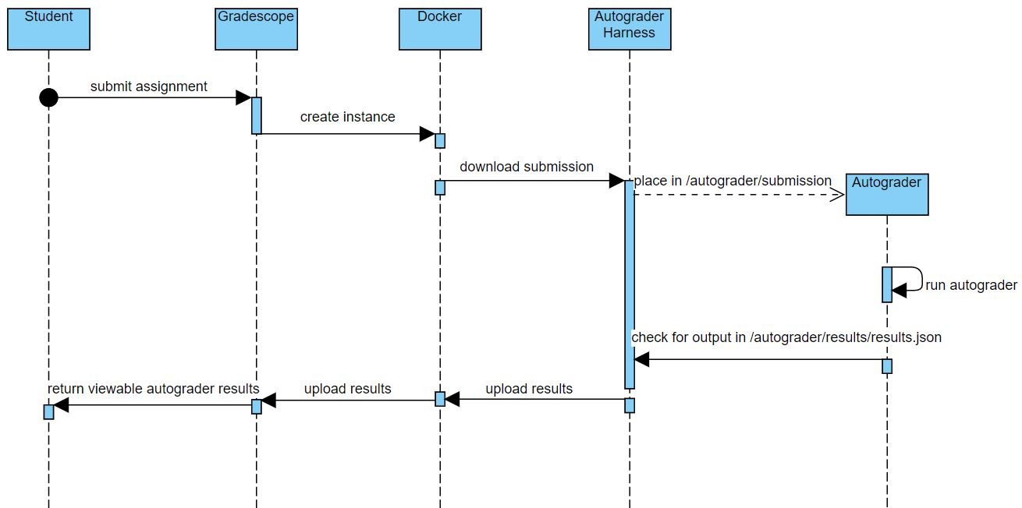
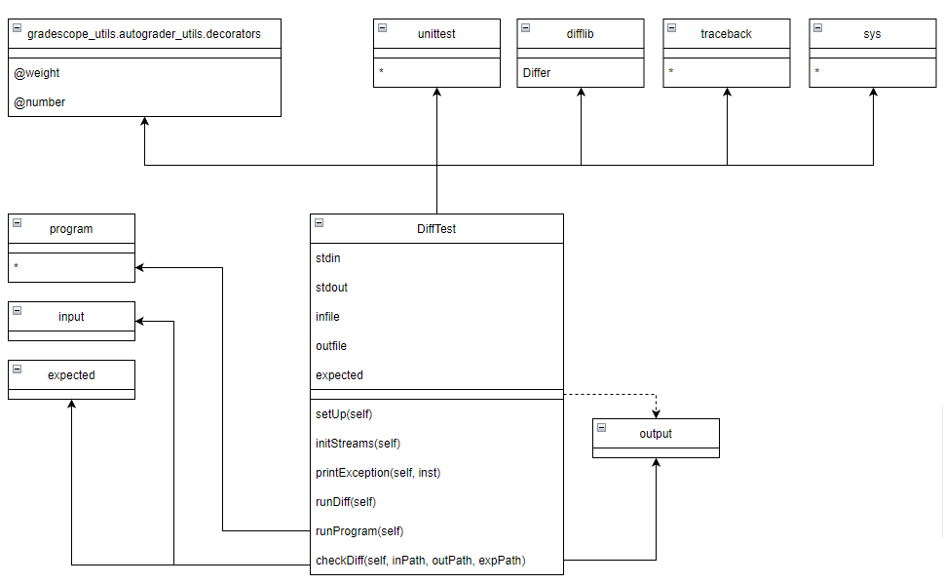
Code Library Construction Creating the building blocks of an autograder Lazaros Tsaros, Riley Mularien, Chris Tjahjadi Department of Computer Science, University of New Hampshire
Introduction
Design
Testing
The inordinate amount of time needed to grade student work is a longstanding issue that has plagued computer science and information technology education for decades. The solution to this is an “autograder” - an aptly named program that runs a battery of tests on any program run through it.
Gradescope is an online service that has tools to help expedite the grading process of written exams, assignments, and submitted code. This project aims to serve as a foundation for writing portable and modular autograders, allowing instructors freedom with assignment grading, as well as providing students with immediate, actionable feedback.
Utilizing Gradescope as a hosting site, any professor or TA can write a program that will run students’ work through a battery of tests and return their grades within a very short amount of time.
Having a strong understanding of Gradescope’s student submission process was crucial to grading system development. Here are a few diagrams that illustrate the process:
The project itself is considered complete when the team has a working code library. This has proved to have its challenges, notably because the previous autograding system, Mimir, is only available to access for a limited time meaning that past test cases and scripts must be stored elsewhere for future teams to reference.
The code library provides a basis of functionality which will be used to write more specific test cases for assessing student assignments. Since many of the assignments in these CS courses have some core similarities regarding expected input and output of the program, the work can be sufficiently abstracted and therefore can be referenced across multiple autograders.
Results & Future Work
Requirements
When a student submits their assignment to the autograder via Gradescope, an instance of a Docker image is created; it is used every time a student submits an assignment.The autograder runs, puts any output into a JSON, and uploads it for the student to view on the Gradescope UI. Docker allows the autograder to run in a lightweight, virtualized environment.
Currently, the basic autograder structure supports easy addition of test cases and a simple comparison tool. Only assignments coded in Python are supported, but other relevant languages such as Java and C are planned to be supported as well.
Using CS415 as a working set, a majority of assignments consisted of input and output testing. As such, most test cases in the autograders would use the tool that compares how the student’s program and the professor’s program produce output with a given input.
In the future, there will be more functionality to support more specific test cases besides input and output testing, to cover the scope of cases found in the intro-level CS courses.
This project seeks to fulfill the following requirements:
Facilitate automatic grading of programming assignments
Provide students useful output for debugging & feedback
Expedite the test case writing process
Practicality & Usage
Professors and TA’s
Those who are tasked with building, testing, and maintaining autograders for classes get the most value out of this project. Autograders are meant to save time and effort, but the creation process can be tedious. The code library we created seeks to remedy this by removing the repetivity of the process.
Students
The immediate and verbose feedback provided by our library is a big help for students. Giving them the opportunity to precisely identify issues and prevent submission of faulty code that would provide no useful feedback will greatly accelerate their learning.
Acknowledgements
.
Sponsors
Professor Matthew Magnusson
Advisors
Craig Smith
The diagram above displays the rough structure of the code base. Currently, the code runs the user’s program against the input and expected output of the test case by running a comparison tool.

