Slide 1
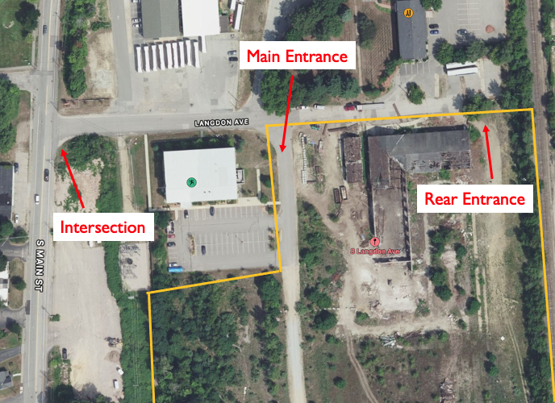
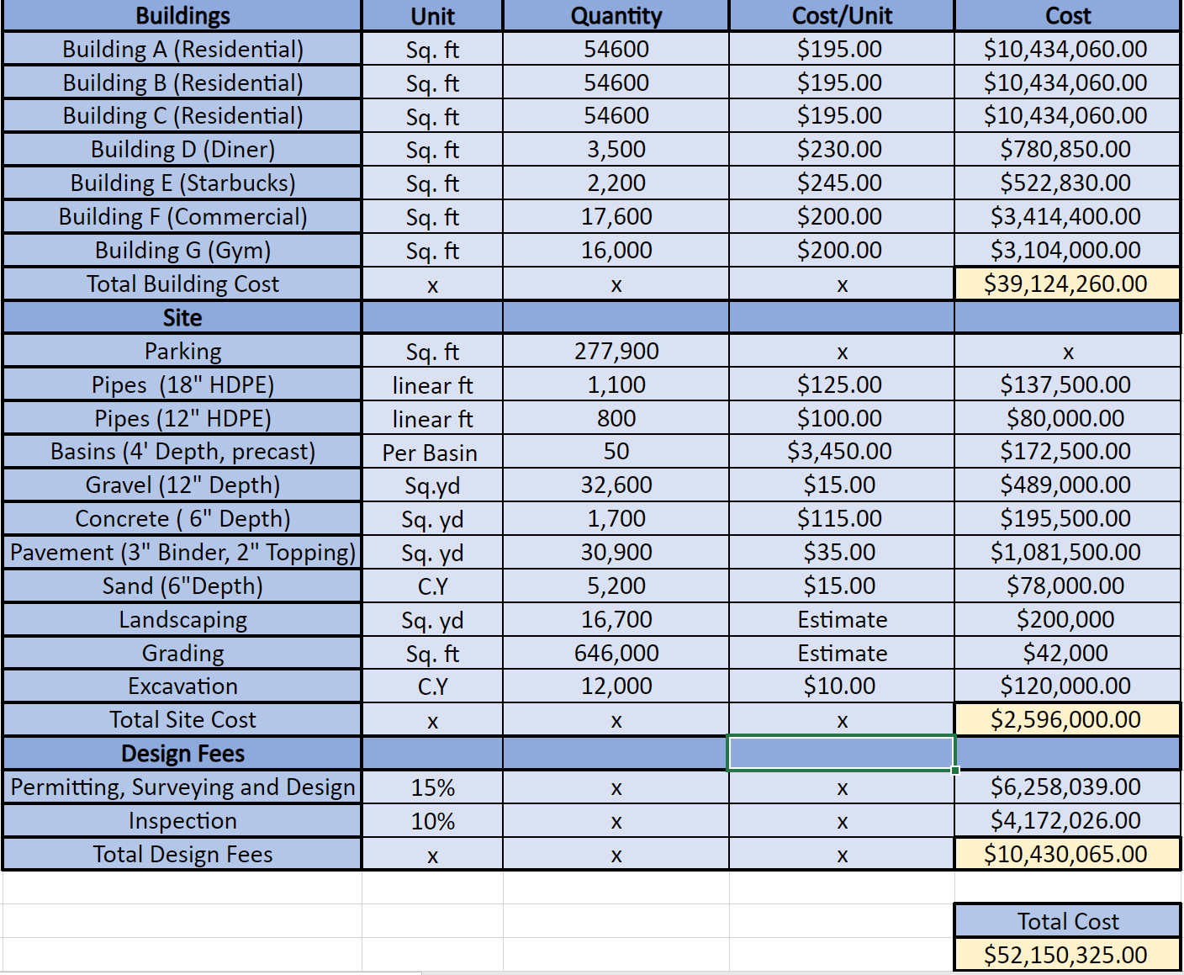
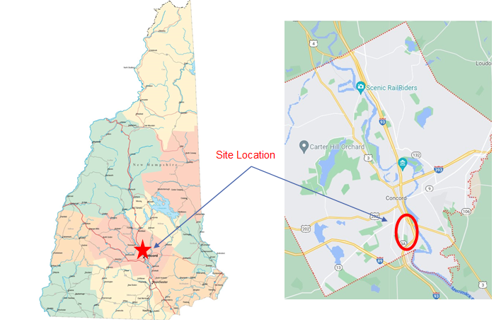
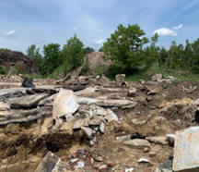
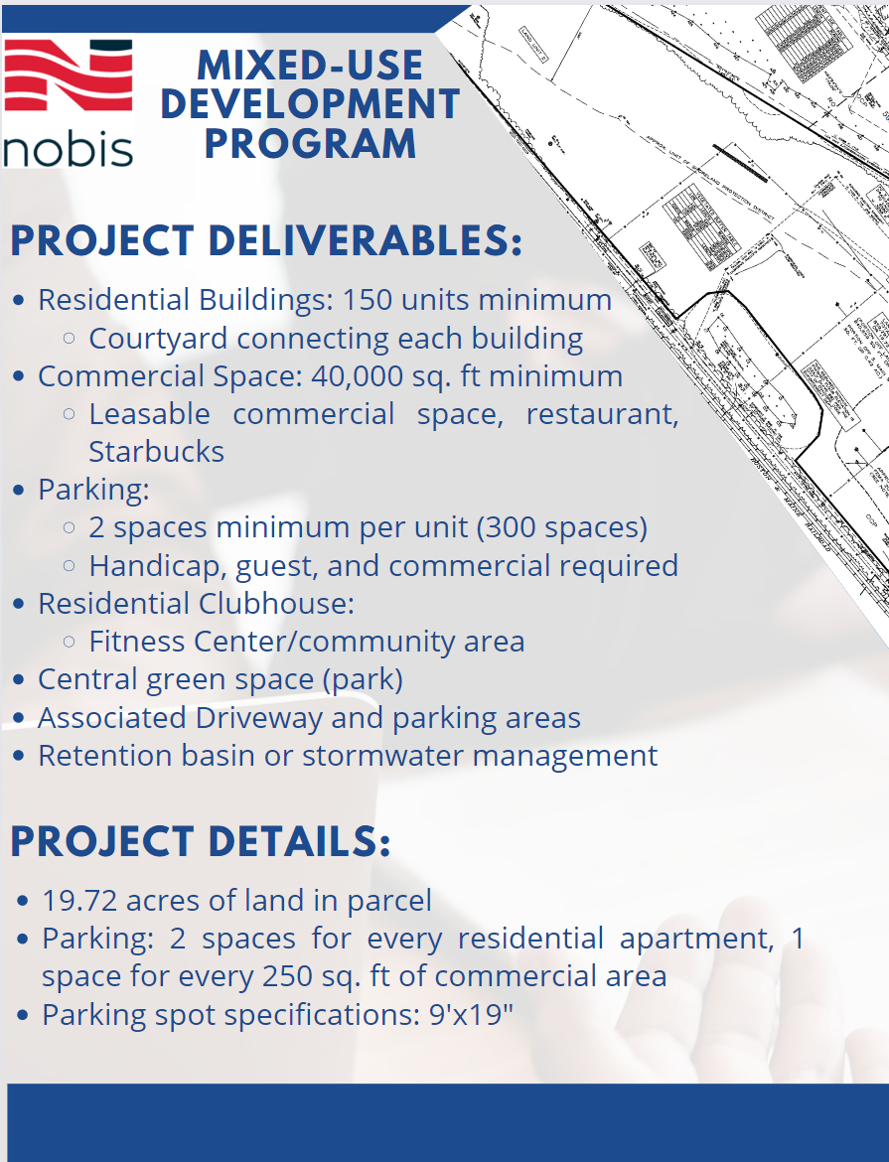
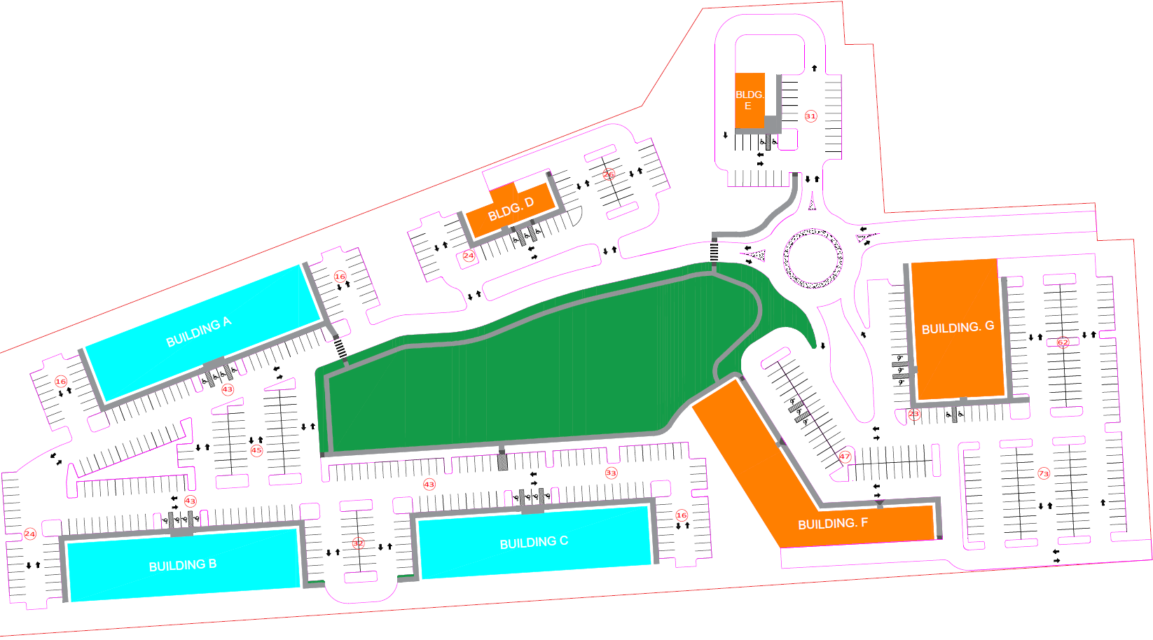
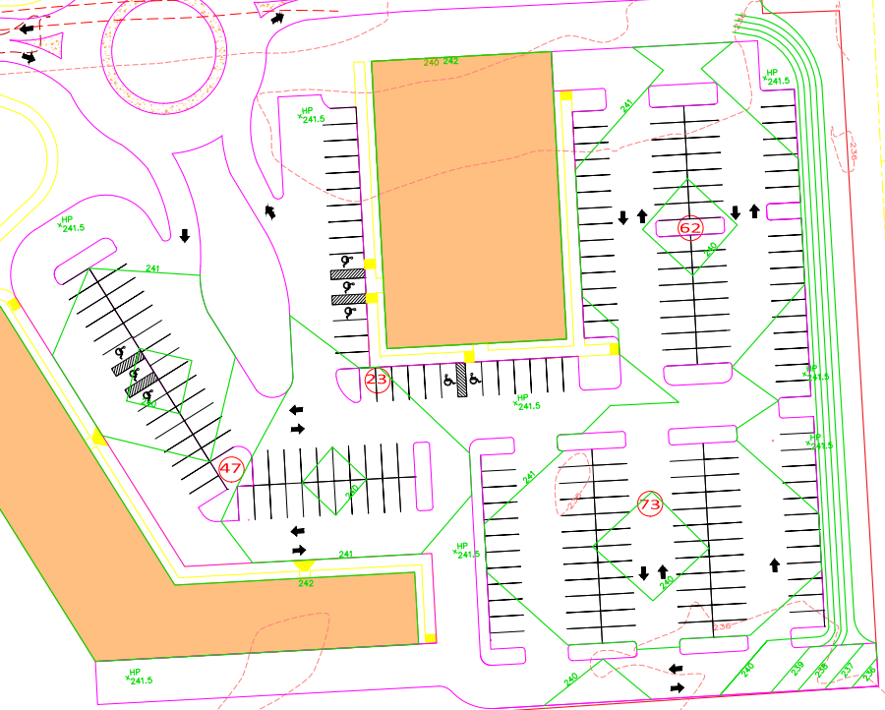
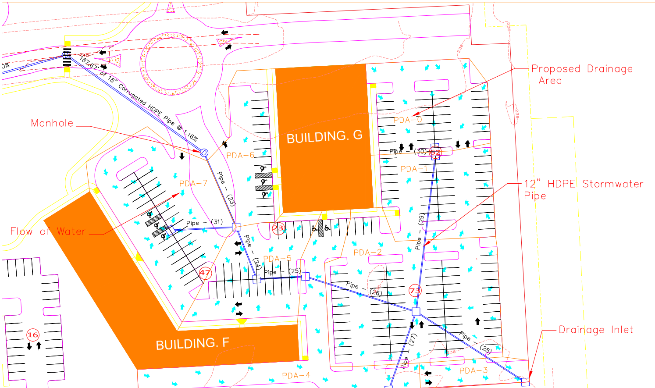
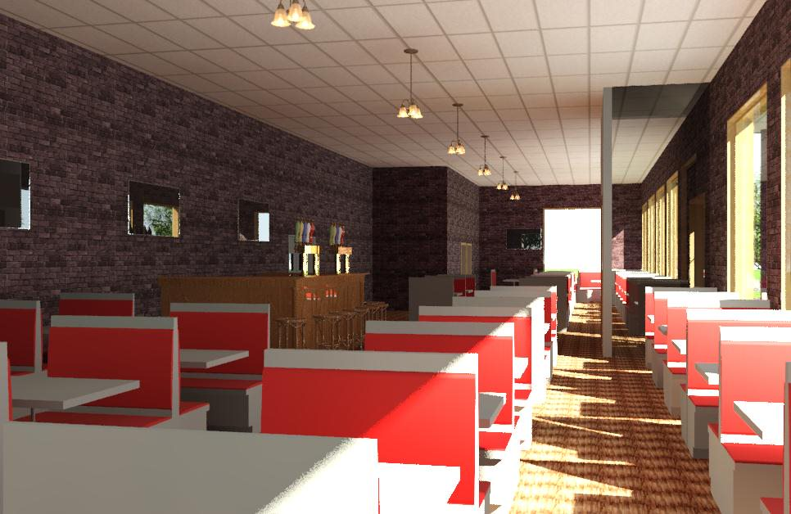
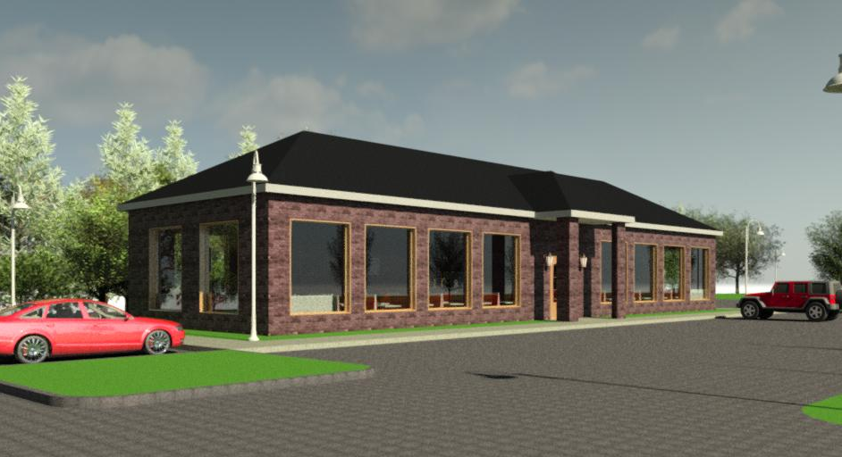
Mixed-Use Development – Concord, NH Christopher Trovato(PM), Nolan McGovern, Ben Hodsdon, Zach Scarpola, Anthony Cogliano College of Engineering and Physical Sciences, University of New Hampshire, Durham, NH 03824
Introduction
Location/Existing Conditions
Cost Estimate
Overview
Redevelopment of a 34-acre old railyard located on Langdon Avenue in Concord New Hampshire
Scope of work includes schedule, program, parking, grading, drainage, modelling, and due diligence
Proposed design is a multi-use development featuring three residential apartments, diner, gym, commercial offices, recreational area, and a drive-through Starbucks
Progression
Fall semester consisted of researching Concord regulations, creating preliminary design report, designing rough draft site plans, and sorting out all logistics.
Spring semester was dedicated towards finalizing the site plan, parking layout, grading, drainage, calculating the cost estimate, and creating 3D architectural building renderings.
Project Program
Final Proposed Site and Parking
Grading and Drainage
Diner
Starbucks with Drive Through
Residential Building A
Gym
Park/Green Space
Residential Building B
Residential Building C
Commercial Office Space
Diner Renderings
Acknowledgements
Project Sponsors:
Andrew. Bullock, Nobis Group, Concord NH
Morgan Dunson, Nobis Group, Concord NH
Project Advisor:
Anthony Puntin, PE

