Slide 1
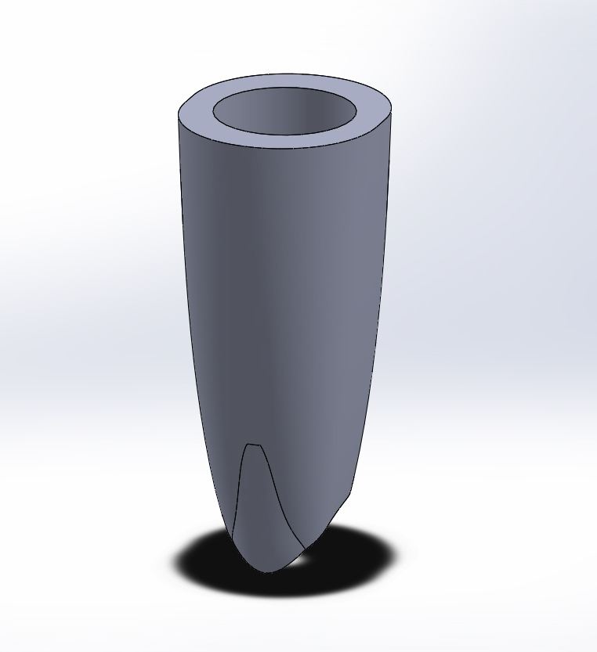
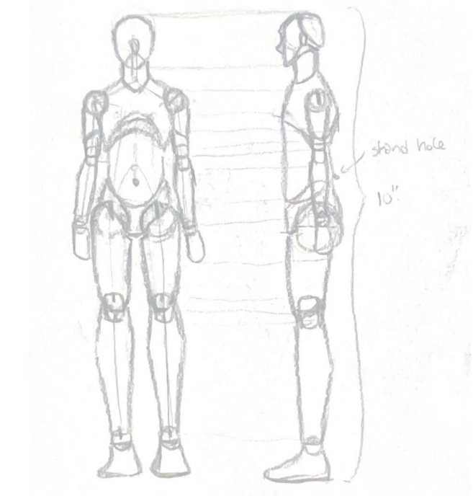
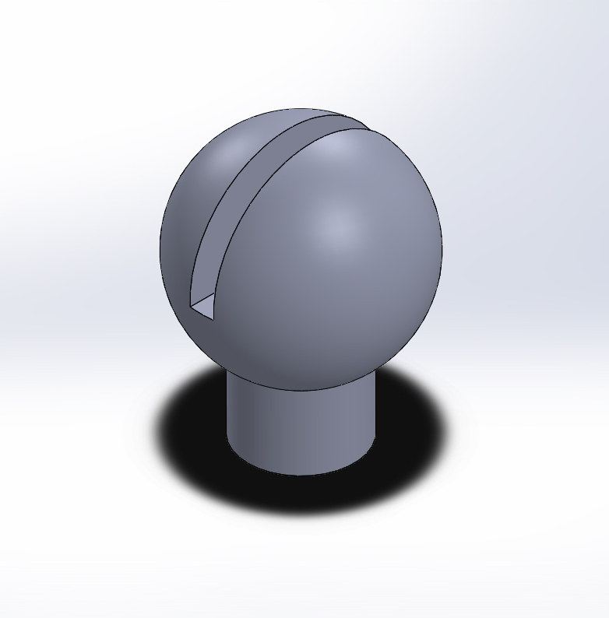
ARTICULATING FIGURE Observing the Movement of the Human Body Kaleigh Wilson Department of Mechanical Engineering, University of New Hampshire
Introduction
Results
Discussion
Articulating figures can serve many uses across different fields of work. Some uses include:
Robotic development
Prosthetic limbs and implants
Model of how the human body moves/poses – reference for artists and animators
Designing the flexible sections of the body (i.e., the leg) can help provide insight on the mobility of different parts of the body. These insights can be implemented in new prosthetic development.
Considering and manufacturing the human body does bring valuable information. Some worthy notes include:
How joints operate and how they can be replicated in different ways
Different positions require different configurations in order to be possible in an inorganic medium (if the leg is made from harder materials such as plastic, how will the mobility be captured?)
Studying and designing different ways for limbs to be made can also provide other options to the disabled, who might want the extra mobility in a limb that can bend just as much as an organic limb.
Methods
Figure 2: Upper Leg
Figure 3: Hip
To plan out articulation, a draft was drawn to ensure proportions were kept in mind while designing the leg.
Reflection
Although the goal was to reconstruct the whole body, the leg did come with valuable skills and experiences. Some include:
Practice design skills on paper – conceptualizing the idea and creating a visual
Hone CAD skills on SolidWorks – attempting to create an organic figure on a program designed to create geometric parts
Understand the process of 3D printing – learning a new printer and minimizing potential machine errors
Taking the initial idea and bringing it into the real world
Figure 5: Knee
Figure 4: Lower Leg
Figure 1: Figure schematic
The parts were built in SolidWorks and 3D printed. To create the articulation, a rubber band is passed through all the pieces, tight enough to keep all the parts together and allow the leg to bend at the knee and ankle. The components are also able to swivel, allowing for more poses.
.
Contacts
For more information contact: Kaleigh.Wilson@unh.edu
Figure 6: Foot
Figure 7: Ankle

