Slide 1

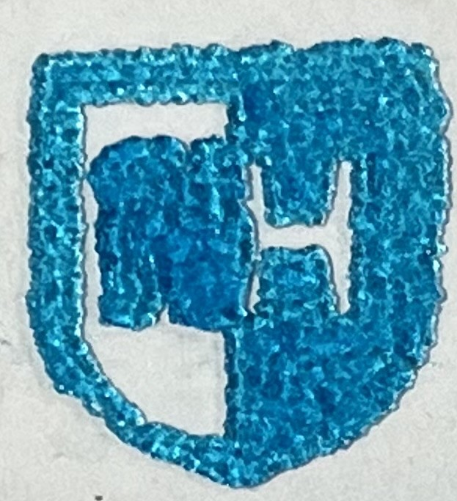
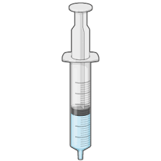
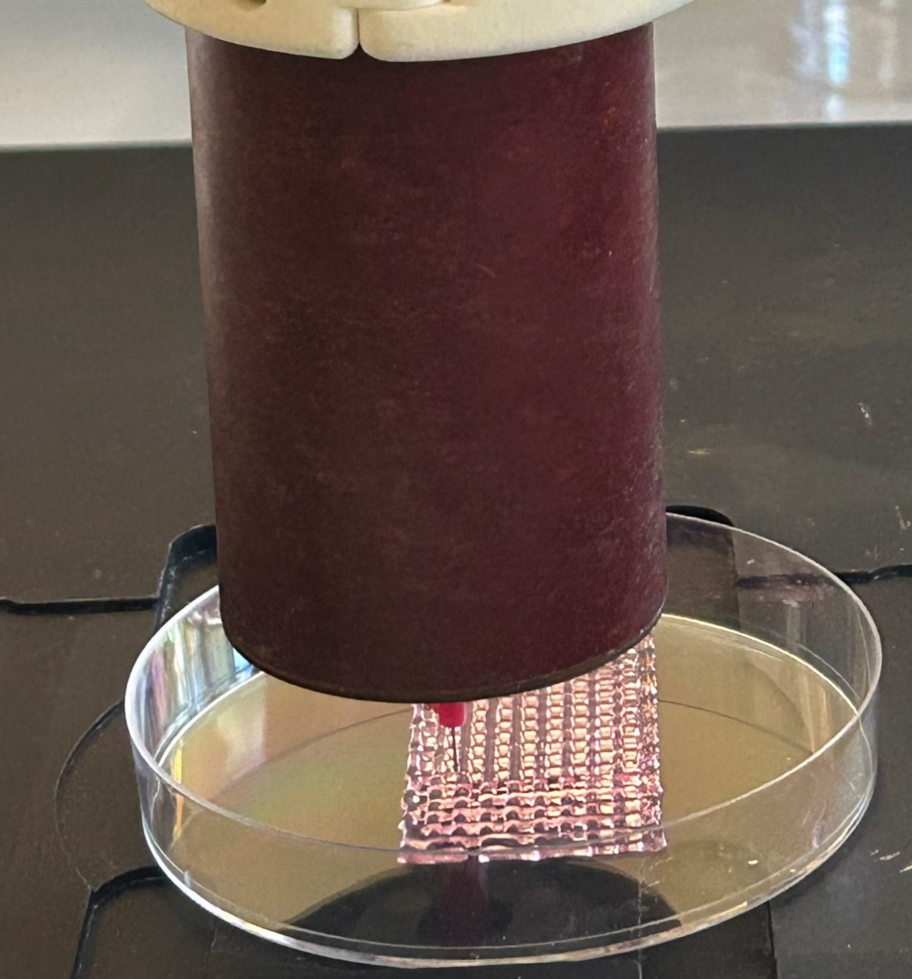
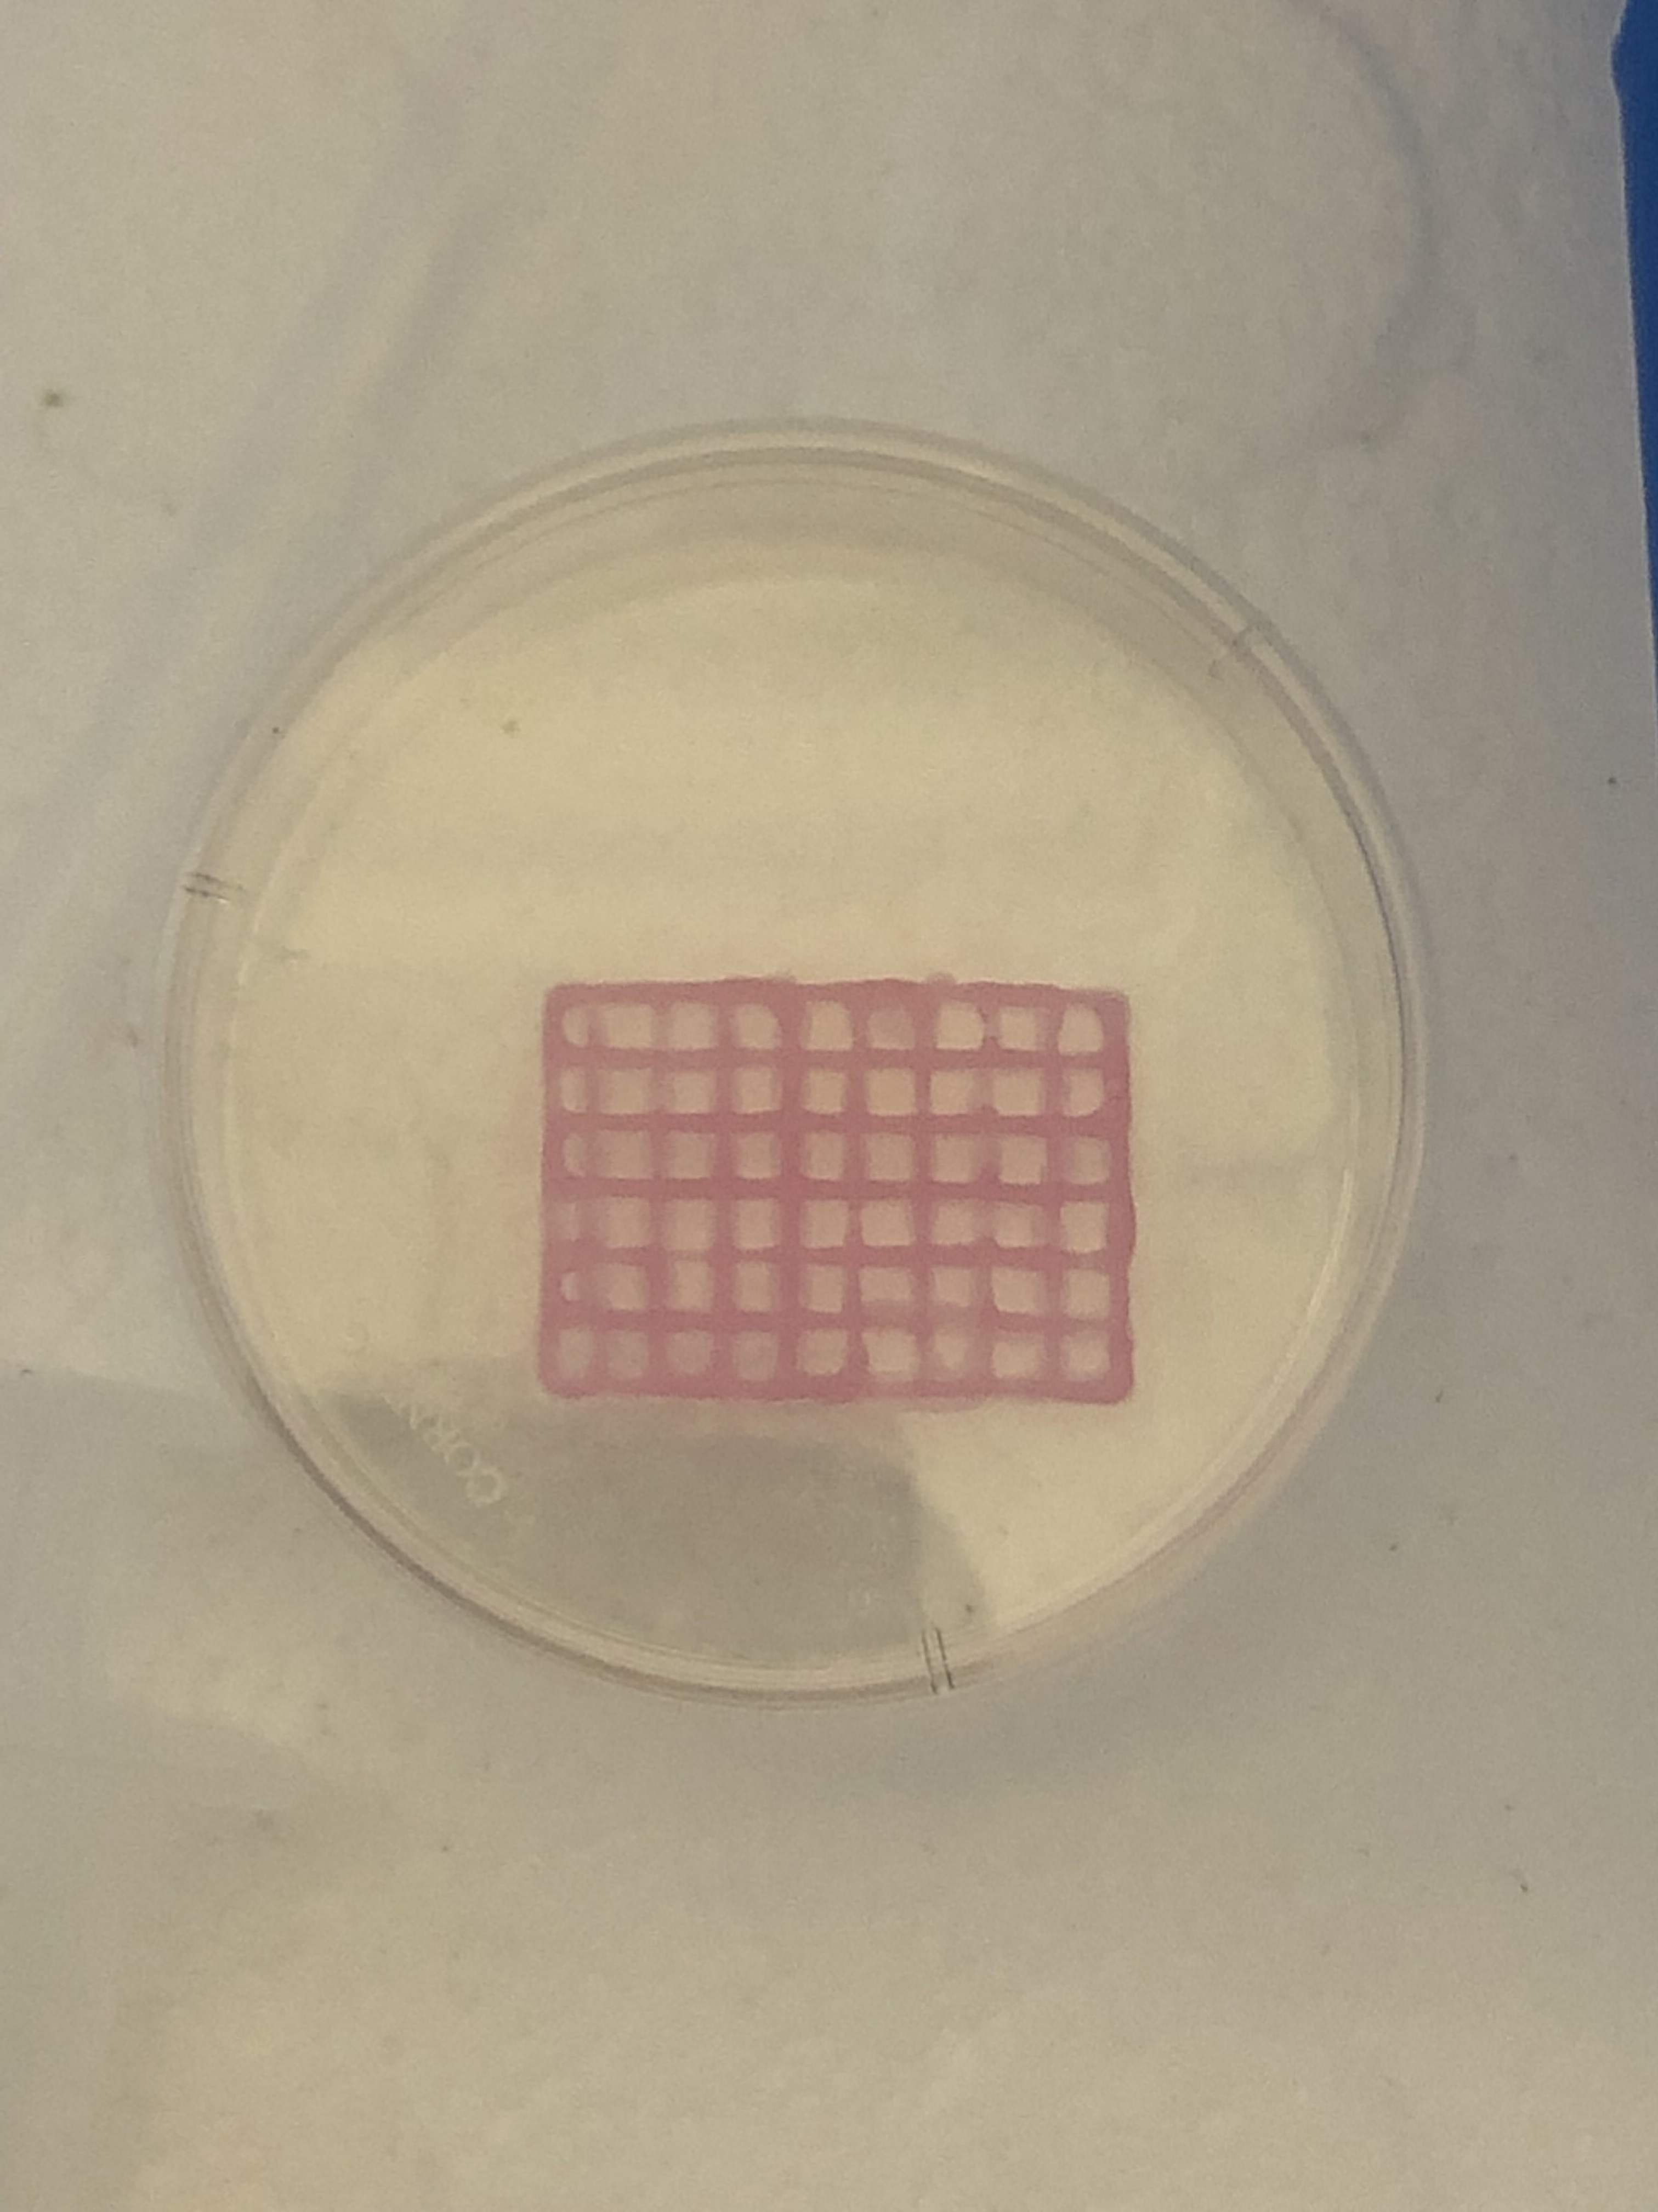
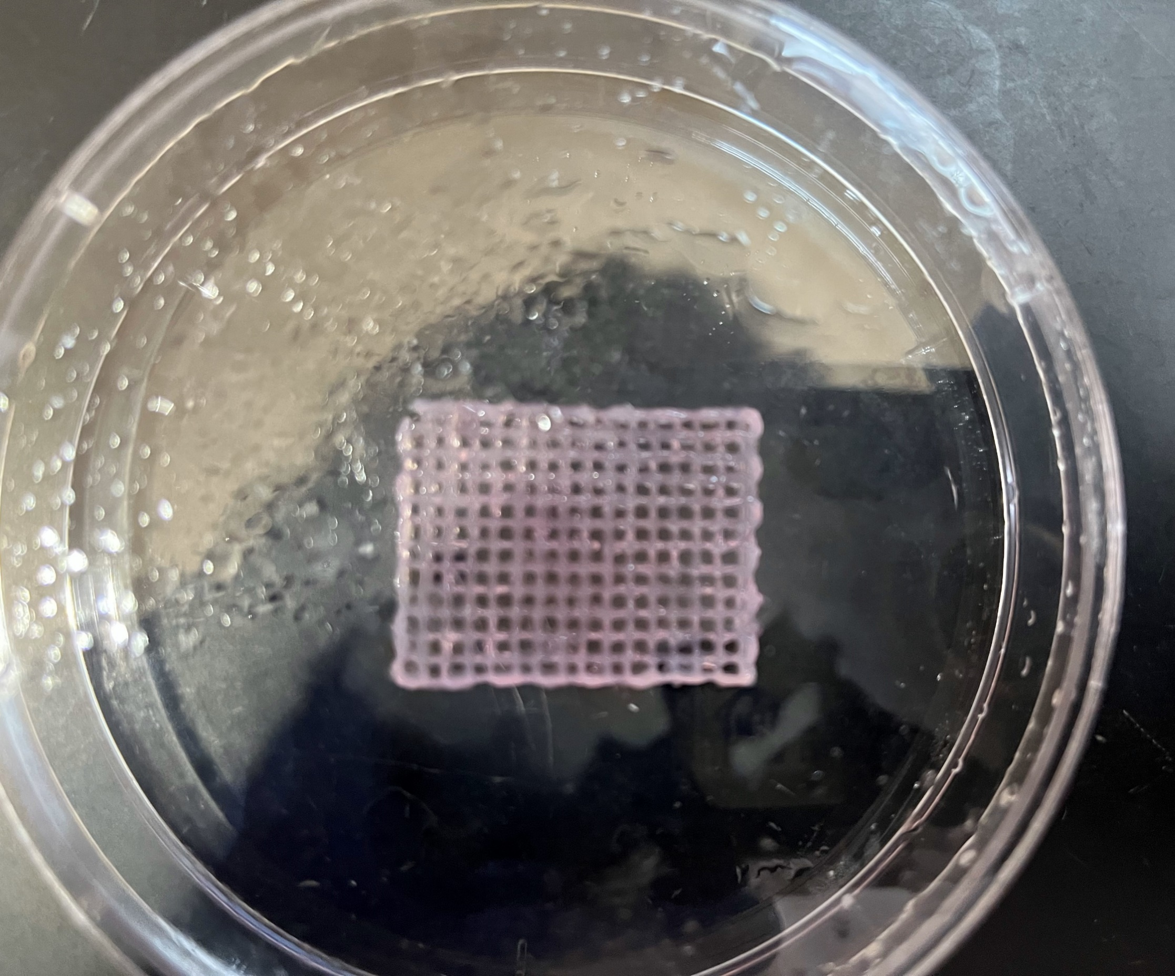
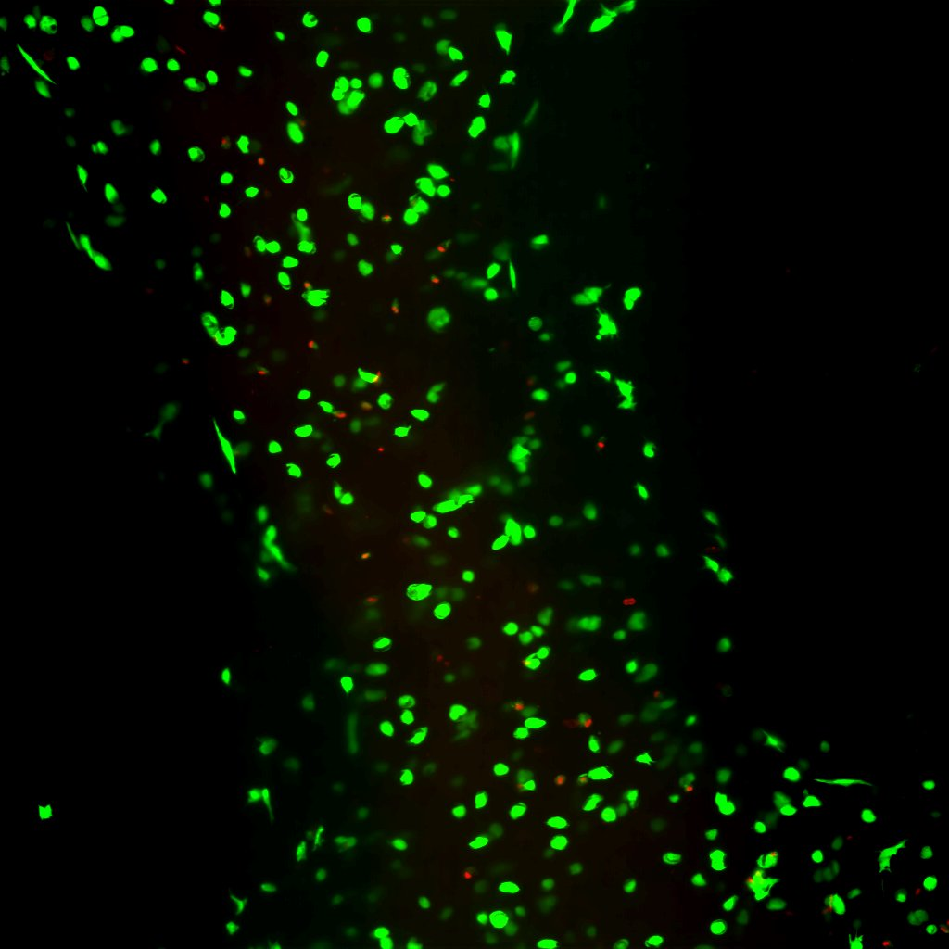
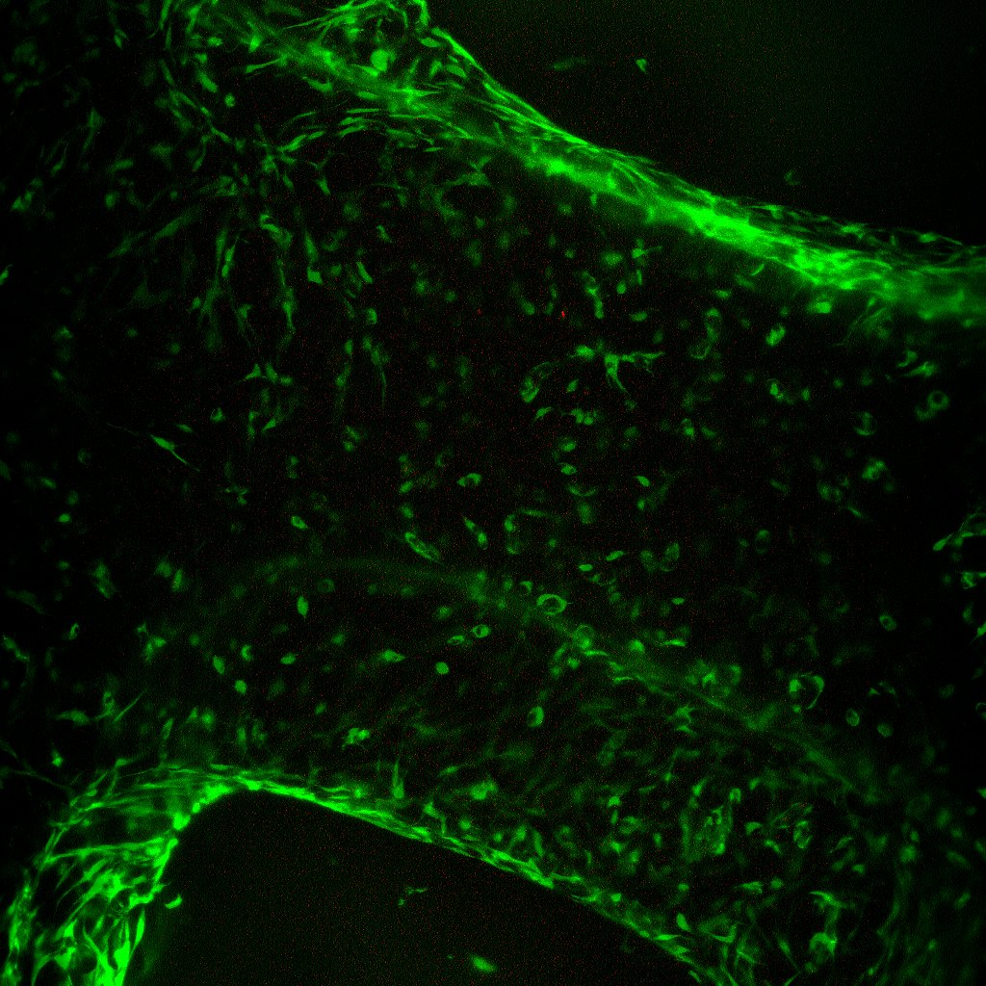
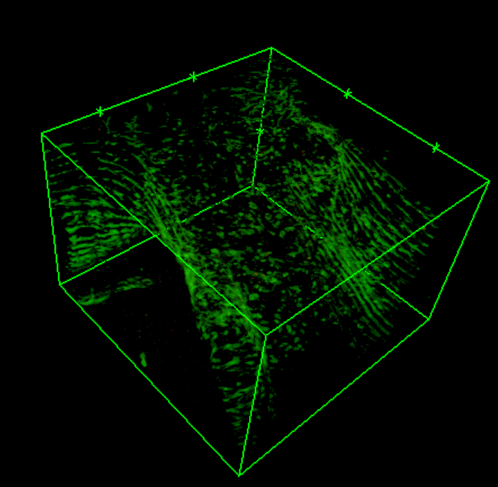




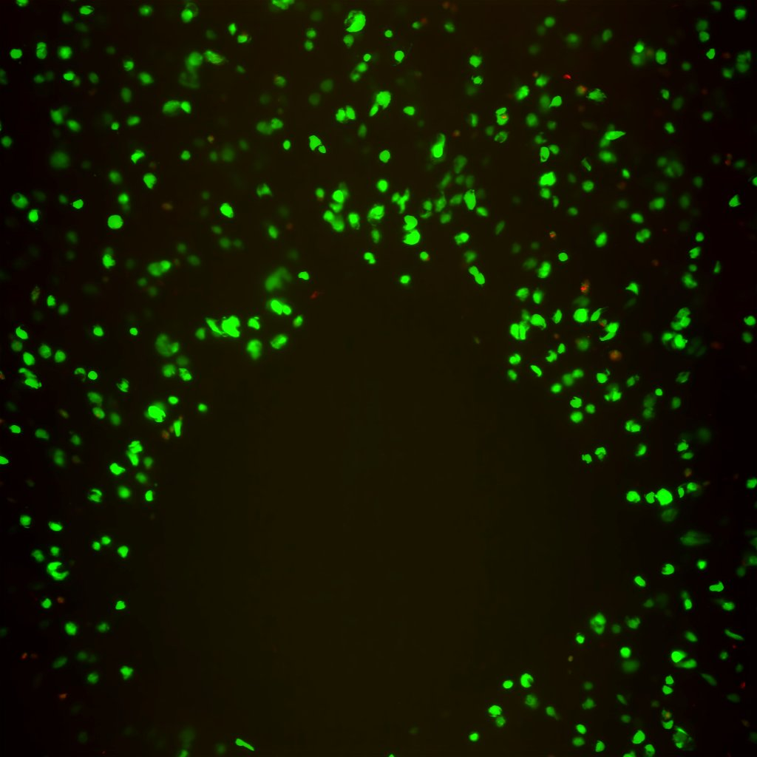
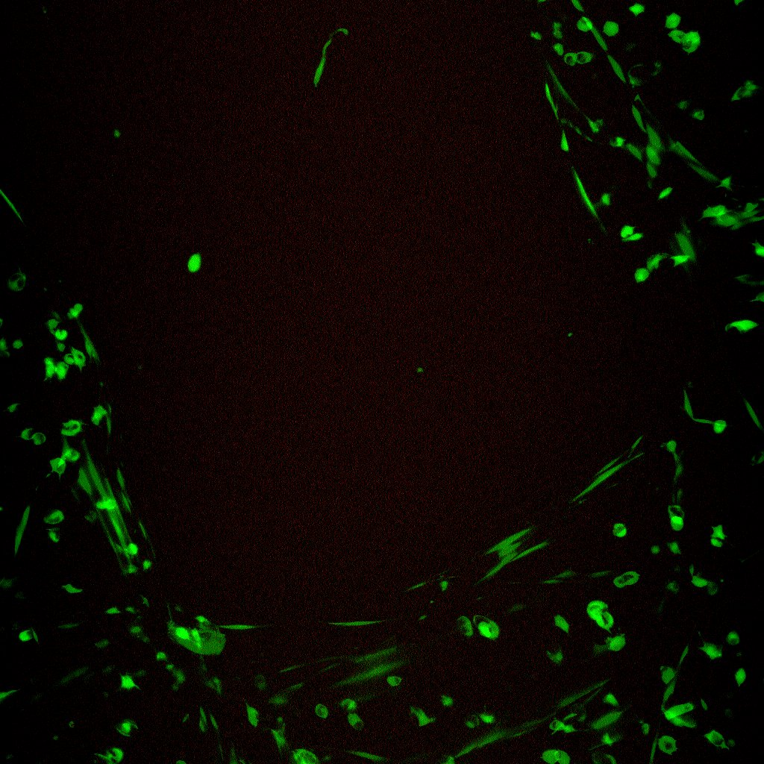
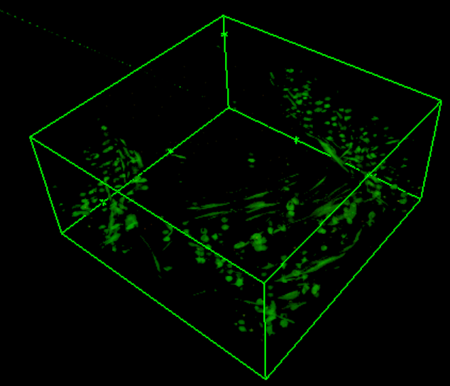
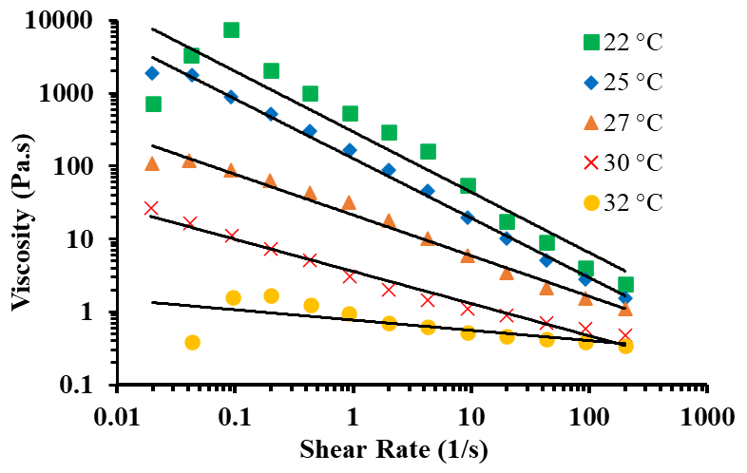
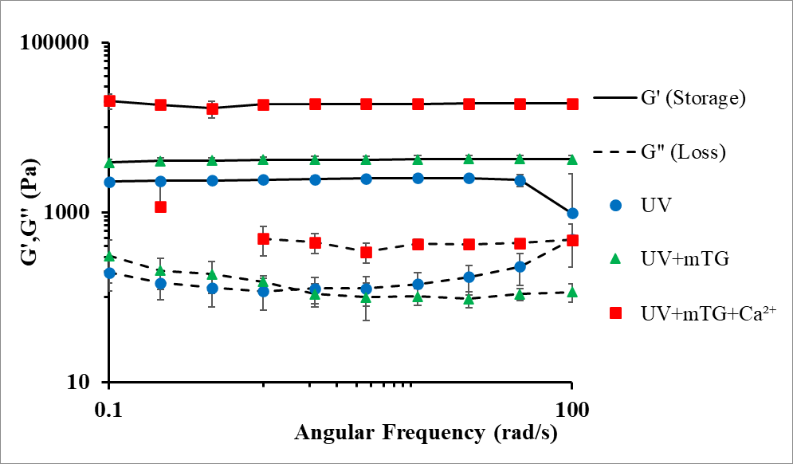
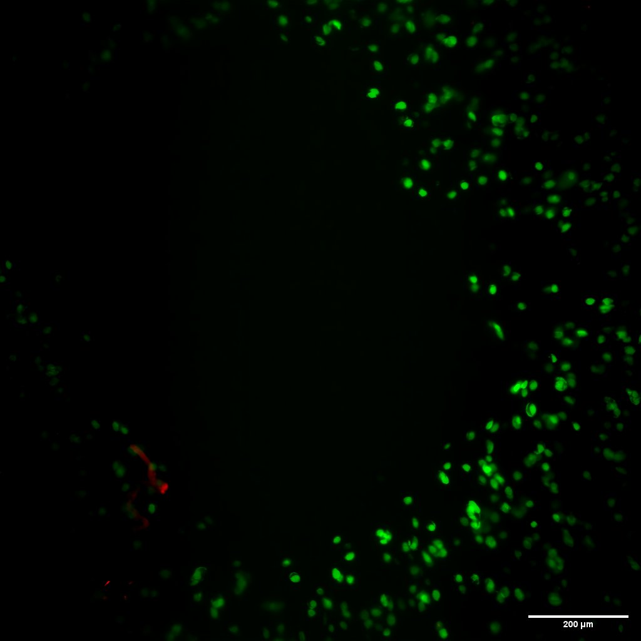
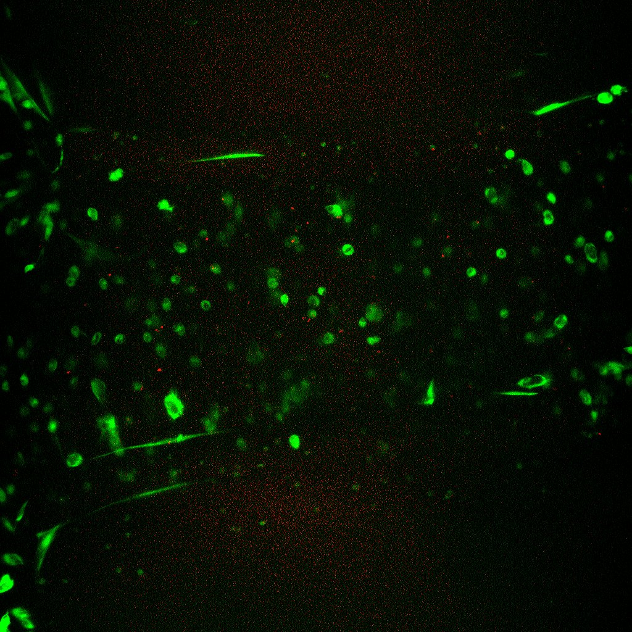
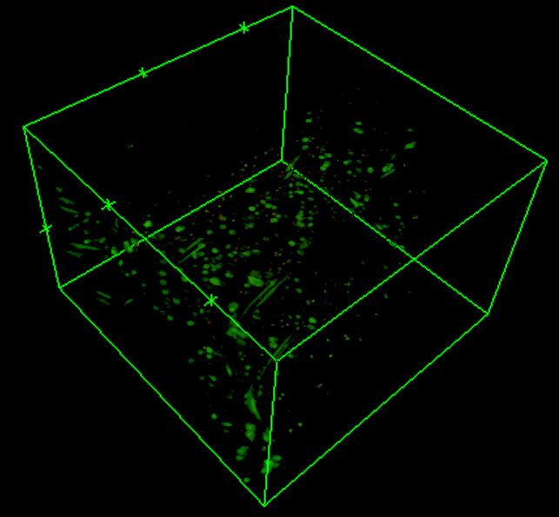
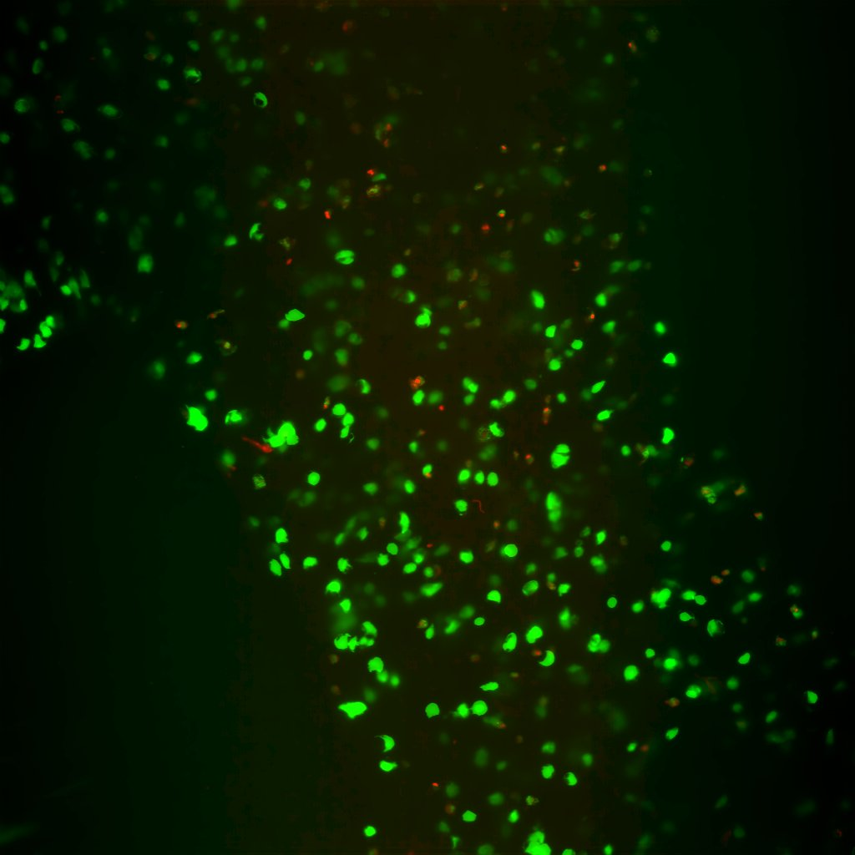
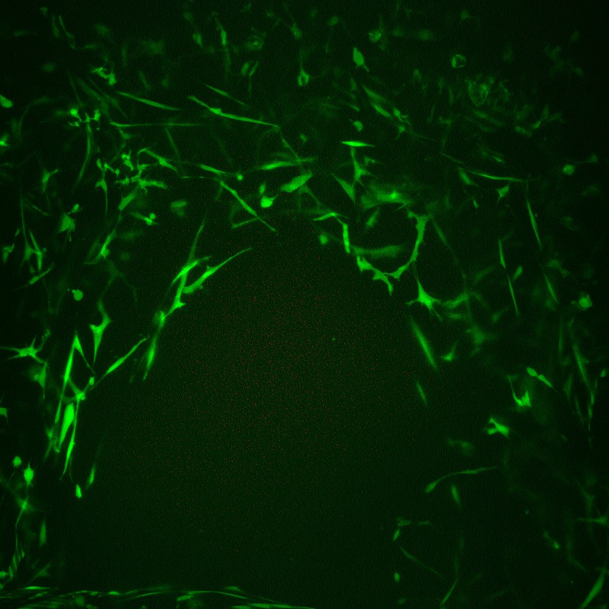
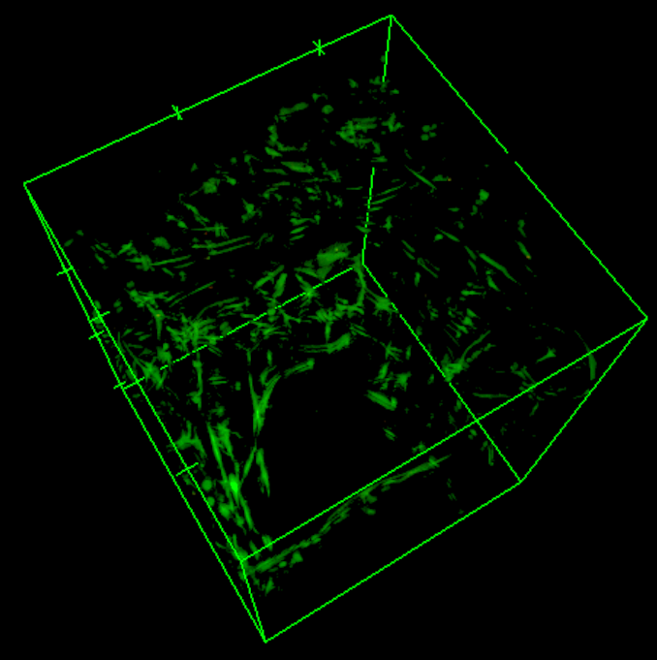
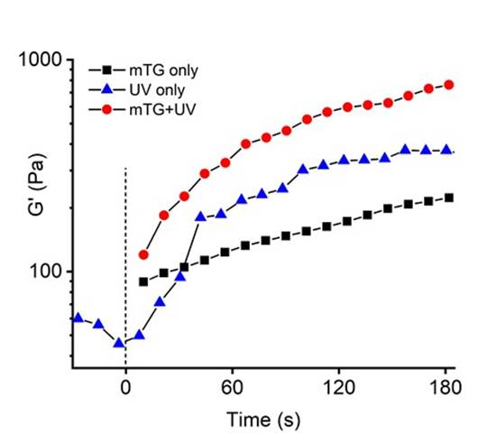
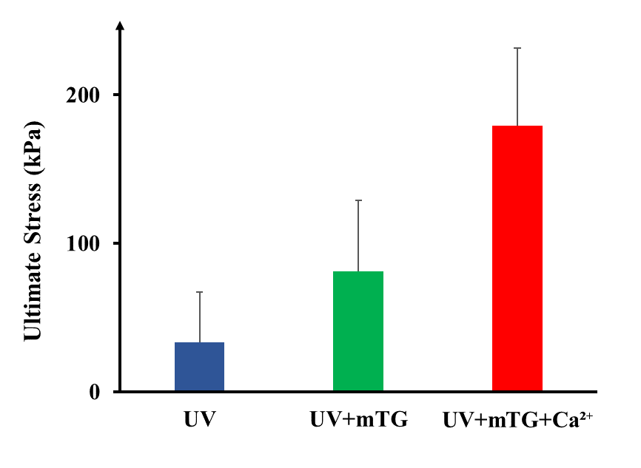
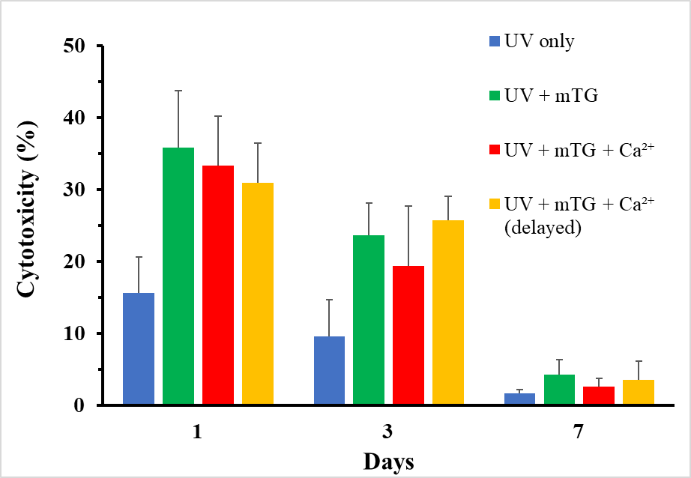
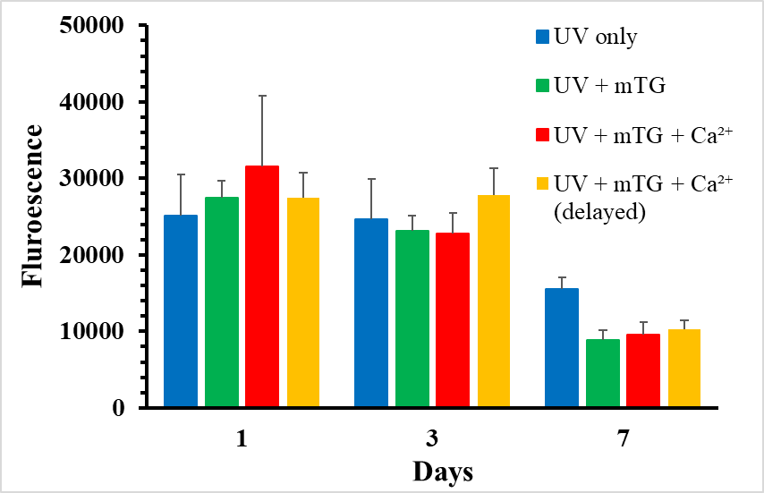
Novel 3D Printing Process for Improved Mechanical Properties of Tissue Engineering Scaffolds Jackie Desrosiers, Kyung-Jae Jeong*
Department of Chemical Engineering, University of New Hampshire, Durham, NH 03824
*Corresponding Author KyungJae.Jeong@unh.edu
Introduction
Schematic
Live/Dead Confocal Imaging
A 3D printed bio-ink provide​s a complex structure with precise placement of cells and ECM, in a layer-by-layer process
Potential Applications
Modeling for disease and tissue development
Methods to repair, regenerate, or replace damaged tissue
Challenges
Biocompatibility of the bio-ink and crosslinking methods
Mechanical stability of the crosslinked hydrogel
Goals
To print a biocompatible ink with improved mechanical properties (stiffness and strength)
For the bio-ink to show noticeable advantages over current methods and solutions
Day 1
Day 7
Day 7 – 3D Projection
Prepare bio-ink and cell mixture
Print 3D Scaffold
Crosslink via UV light
Crosslink via mTG and Ca²⁺ bath
UV Only
GelMA crosslinked via UV radiation
Alginate crosslinked via Ca²⁺
Gelatin crosslinked via mTG
UV + mTG
Methods
Physical Characterization of Bio-Ink
Crosslinking Methods
Photo-polymerization (GelMA)
Ionic crosslinking (Alginate with Ca²⁺⁾
Enzymatic crosslinking (Gelatin and mTG)
Preparation of Bio-ink
Sterile solution of Irgacure (0.5% w/v), Gelatin (5% w/v), and GelMA (5% w/v)
Autoclaved alginate (1% w/v) added and dissolved at 37 ℃
Rheological Testing
TA Instrument AR 550
Viscosity measured as a function of shear rate
Stiffness measured as a function of time and angular frequency
Cell Culture
HDF cultured at 37 ℃ and 5% CO2
DMEM media supplemented with 1% penicillin/streptomycin and 10% bovine serum
HDF concentration of 5 x 10⁶ cells/mL mixed in bioink
3D Bioprinting
BioAssemblyBot 400 & TSIM modeling software
Bioink printed at 27 ℃, 10-15 psi, and 5 mm/s
Analysis
Live/Dead Confocal Imaging
AlamarBlue Assay
LDH Assay
a)
c)
UV + mTG + Ca²⁺
b)
d)
a) Viscosity measurement of bio-ink solution at varying temperatures
b) Storage modulus of hydrogel as it crosslinks overtime
c) Bio-ink stiffness measurement of different crosslinking methods
d) Bio-ink strength measurement of different crosslinking methods
UV + mTG + Ca²⁺ (delayed)
Research Summary
Biocompatibility of 3D Printed Structure
Bio-ink proved to be a shear-thinning fluid
Addition of both mTG and calcium crosslinking greatly increased the hydrogel stiffness
Live/Dead assay showed biocompatibility of the bio-ink and 3D bioprinting method
Over 7 days, HDF cells spread and proliferated with minimal cell death
Delayed crosslinking of calcium showed slightly better cell proliferation than immediate calcium crosslinking
Acknowledgements
This research was sponsored by the U.S. National Science Foundation and was accomplished under the Grant No. OIA-1757371. Thank you to Mrinal Ganash for all his help and Maria Skidmore and Patrick Earley for their previous work.
LDH Assay Results, measuring cytotoxicity through cell plasma membrane damage within the sample
AlamarBlue Assay Results, measuring cell proliferation over time

