Slide 1
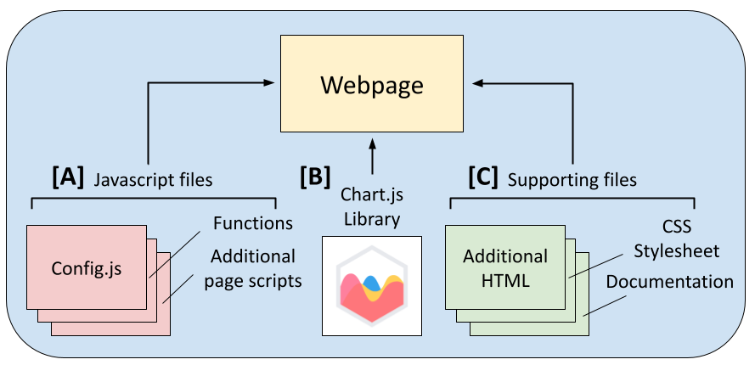
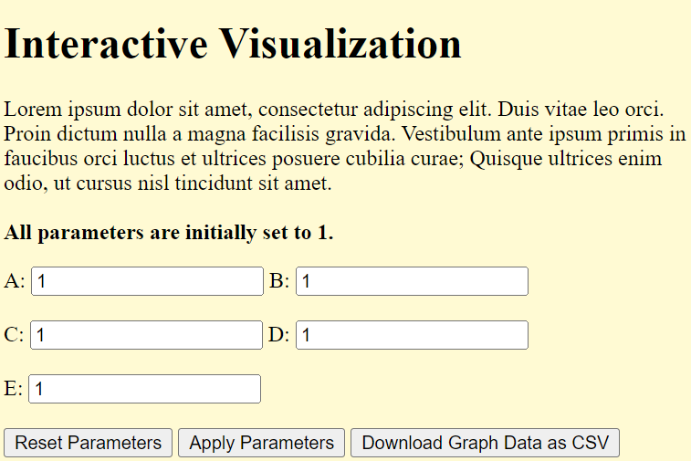
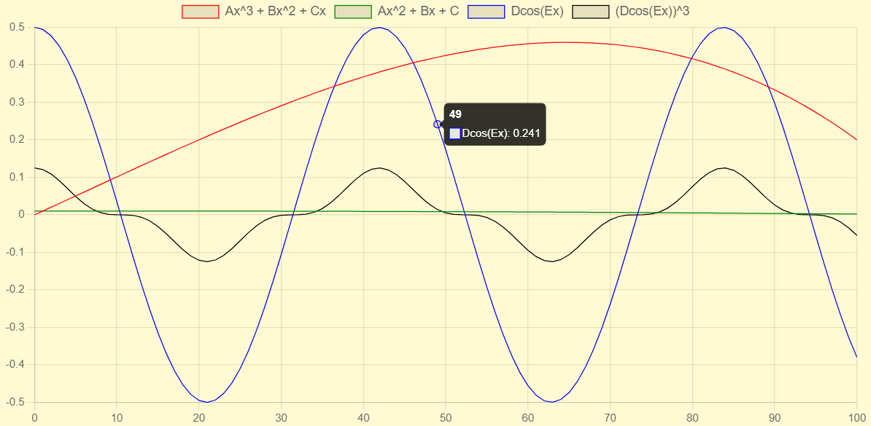
Interactive Scientific Visualization in HTML Jimmy Fitzgibbons, Jason MacMillan, Beau Ramsey, Mitchell Cormier Project Sponsor: Jamie Pringle | Project Advisor: Matthew Plumlee Department of Computer Science, University of New Hampshire, Durham, NH 03824
Introduction
Architecture and Design
Testing
Current scientific graphics are limited by their static nature and their inability to represent multiple datasets. These drawbacks both hinder the ability of readers to apply the scientific models depicted and make it difficult for authors to effectively convey their research.
Interactive Scientific Visualization in HTML serves as a robust and reliable solution to these limitations. Our application has the capability to improve academic viewers’ understanding of complex models and will allow researchers to provide a new level of depth to their figures through interactive graphics and custom datasets.
Our architecture consists of three main system components: the JavaScript files, Chart.js, and the Supporting files.
The JavaScript files [A] provide functionality to the page - these include the graph configuration, the function declarations, the data generation, and the Download CSV feature.
Chart.js [B] is an open-source local library that is used to generate an interactive graphic from the specifications included in the JavaScript files.
The Supporting files [C] include additional HTML files, the CSS stylesheet, and user documentation.
Alongside unit/performance testing, we consider the following test cases:
Input Coverage: Fuzzing testing will ensure proper input validation across all input cases.
Browser/Device Compatible: Support includes all modern browsers on mobile & desktop.
Usability Testing: A group of researchers will be asked to integrate predetermined equations into the application and provide design feedback.
Comprehension Testing: A group of students will be asked to interface with the application and provide feedback about how it aided model comprehension.
All computations for the application are done on the client side, with no outside dependencies or dynamically loaded libraries.
A researcher seeking to integrate equations into the application must edit the JavaScript files and the main HTML file. The specific changes that are necessary for this task are outlined in the User Documentation.
Application Requirements
User Interface
Conclusions
Application design must be fully client-side, with no outside dependencies
Must be compatible with all modern browsers
Must have interactive features that enhance user comprehension of complex scientific models
Must support any closed form, real-valued equation expressed with standard algebraic and trigonometric functions
Researchers must be able to integrate new equations seamlessly
The application’s UI consists of two main sections, as seen below. The parameter input section (Fig. 1) allows users to modify the dataset used to generate the graph. Users may also download a CSV representation of the graph data. The interactive graphic (Fig. 2) provides a way for users to interact with the depicted model in a more comprehensive way.
Interactive Scientific Visualization in HTML provides functionality that helps researchers and academic viewers overcome the limitations of current scientific graphics. Researchers can provide more depth to their figures by integrating their own equations into the application, while academic viewers can improve their comprehension of models through custom datasets and interactive graphics. Extensive testing ensures that our application adequately meets these criteria, along with requirements relating to robustness and reliability.
Fig. 1: Parameter Input Section
Fig. 2: Interactive Graphic

