Slide 1


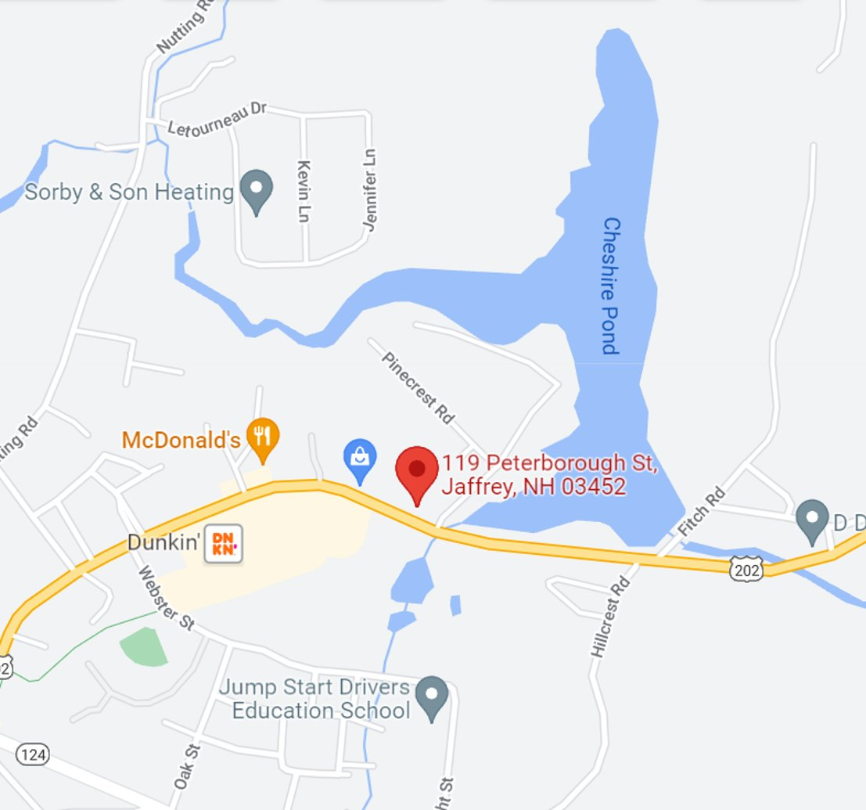
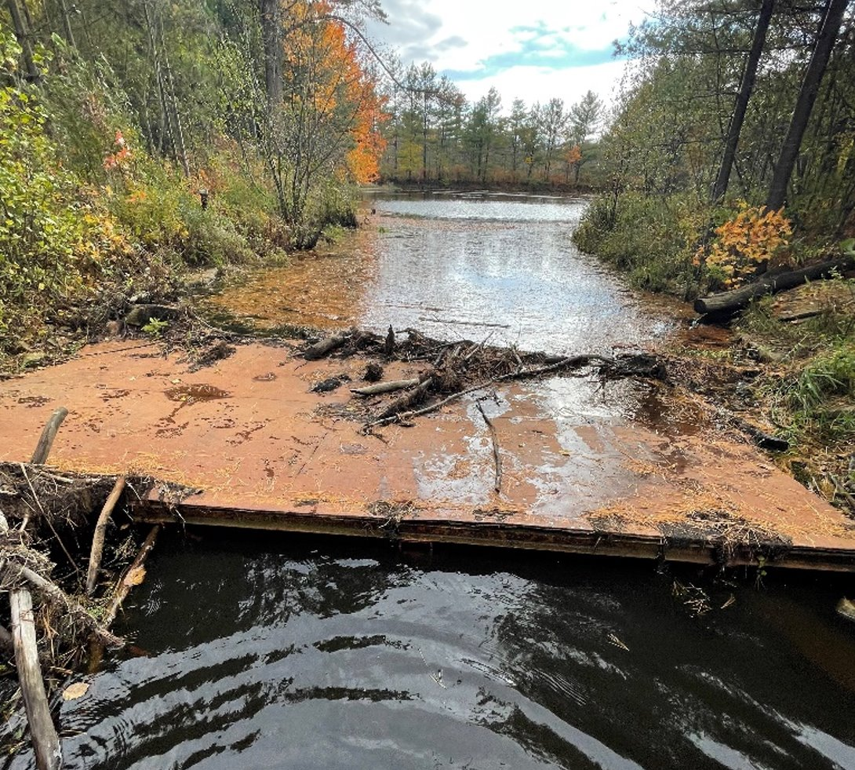
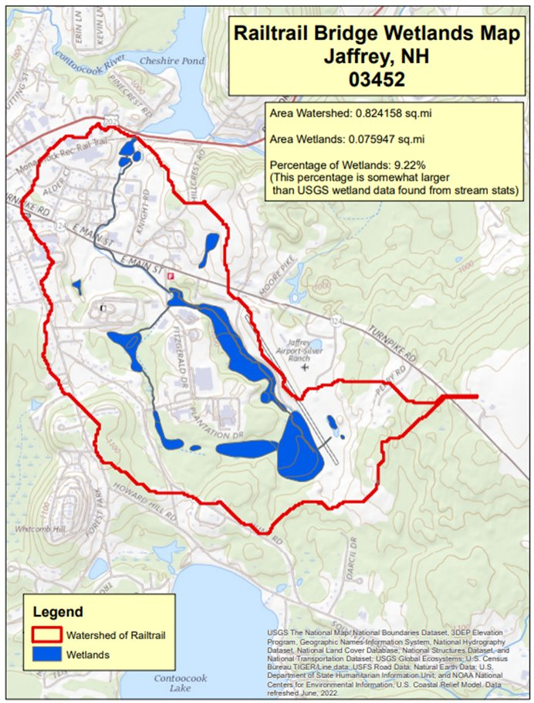
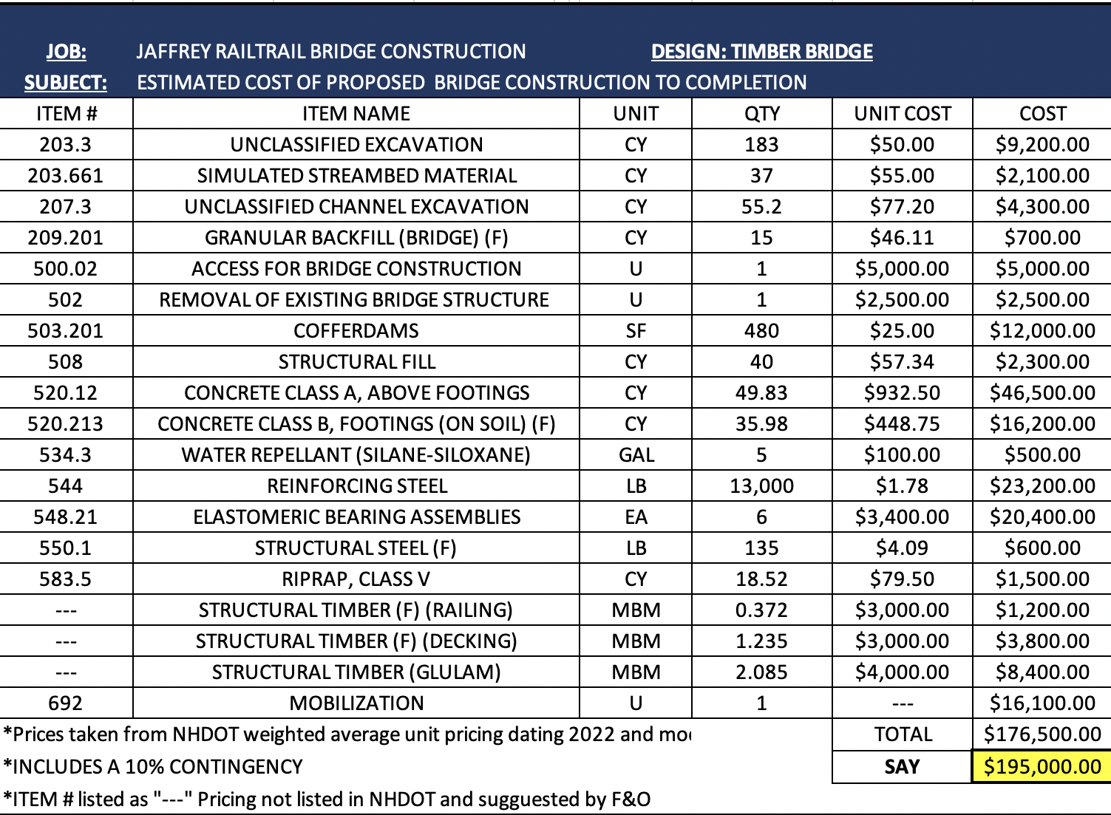
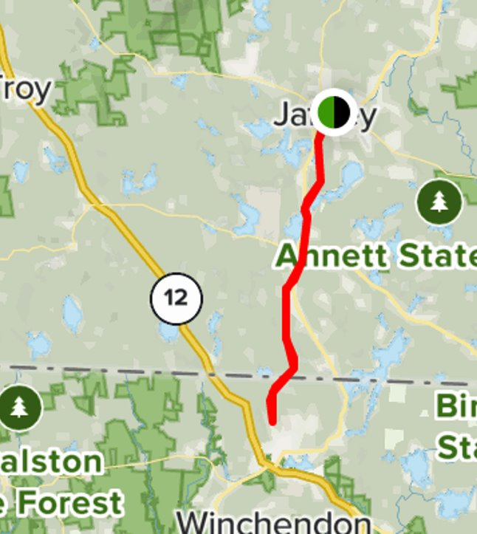
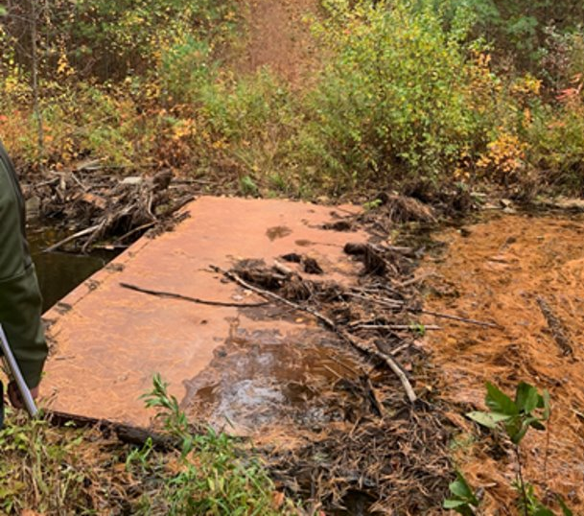
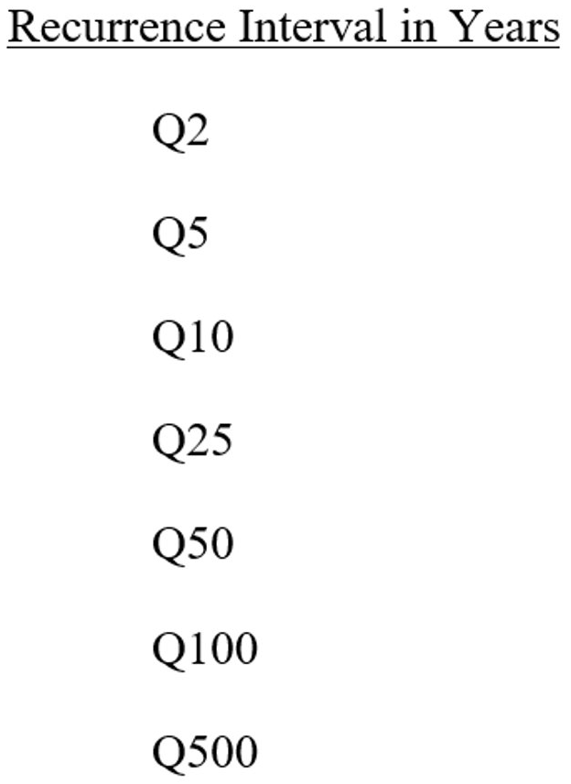
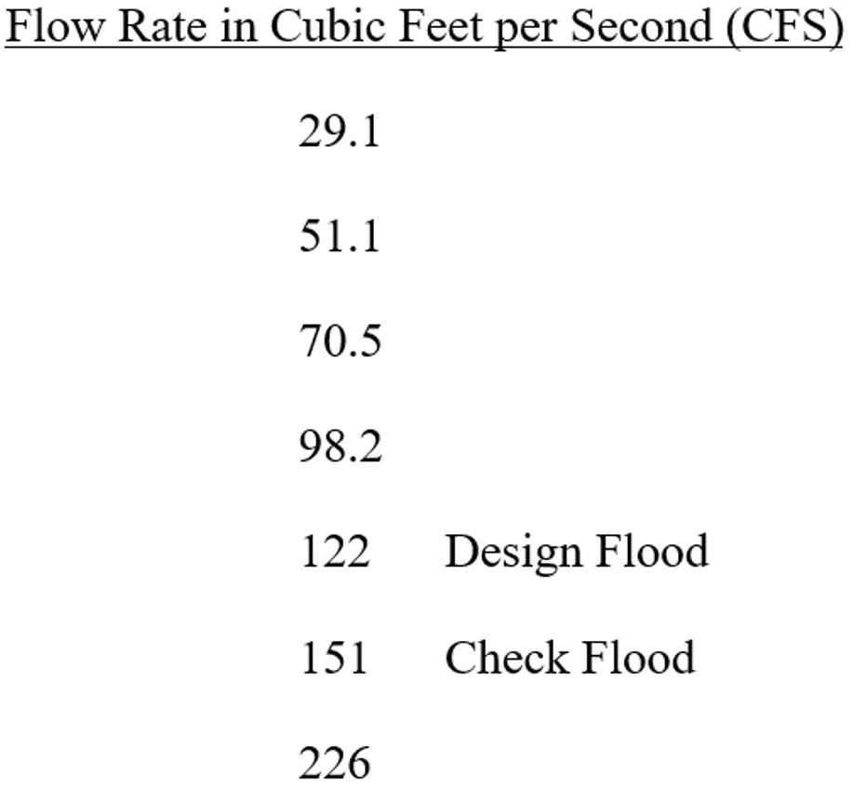
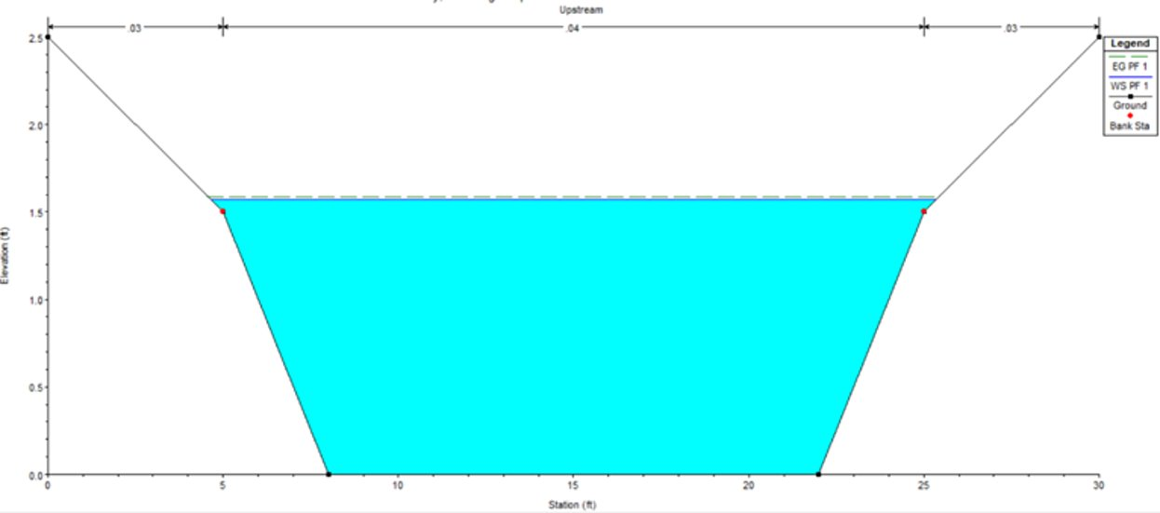
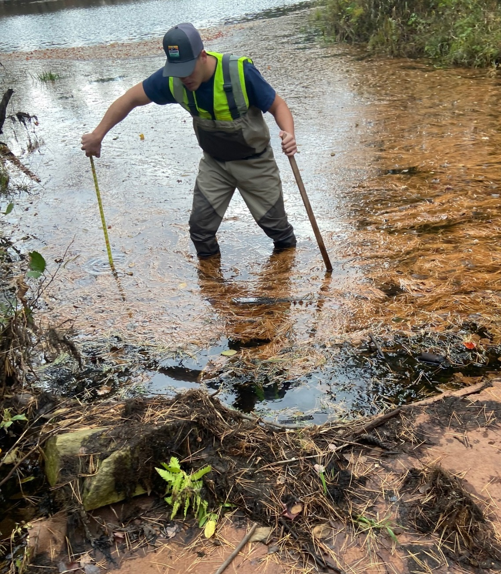
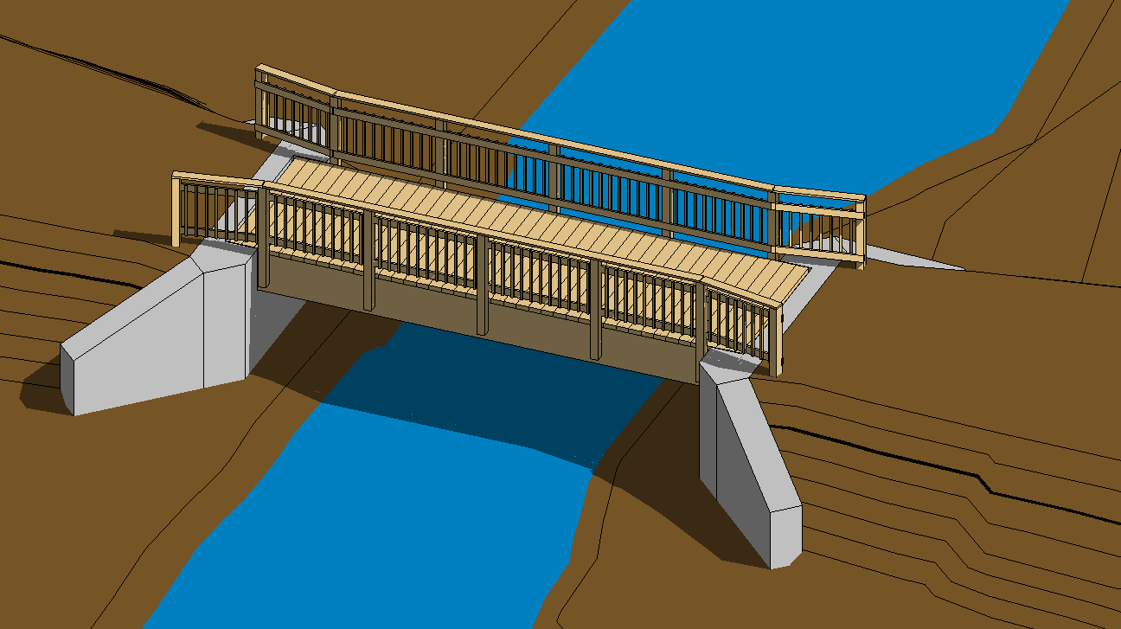
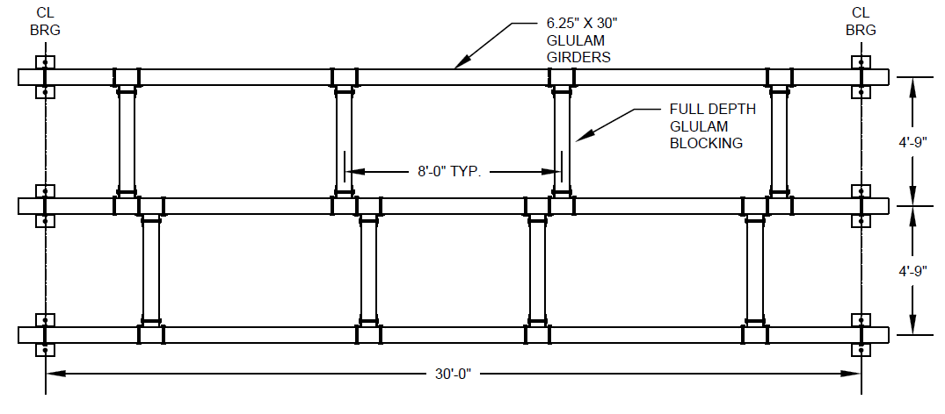
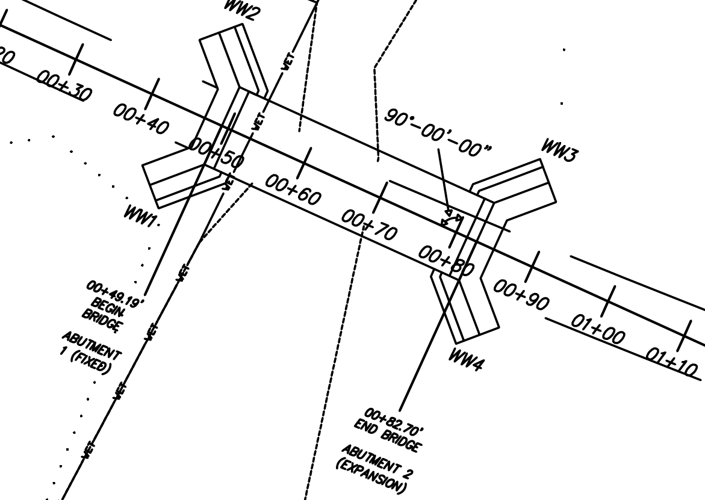
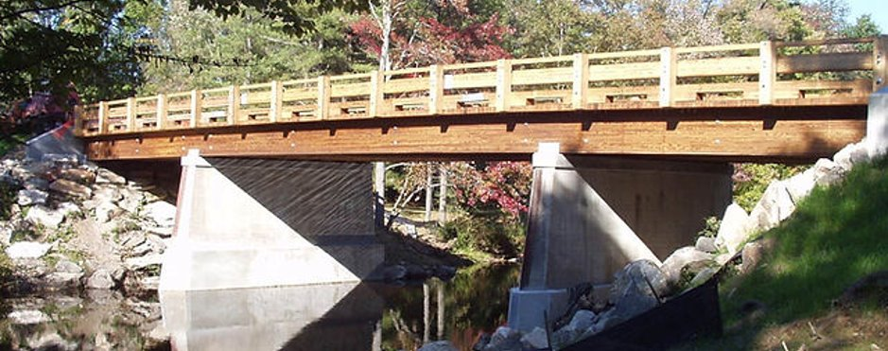
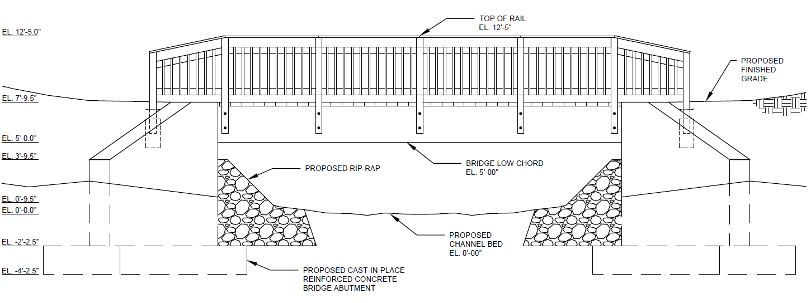
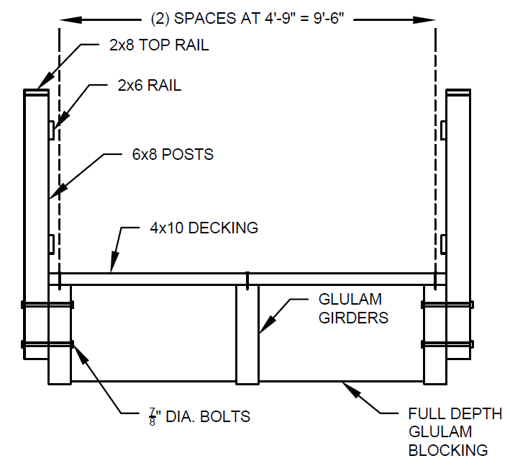
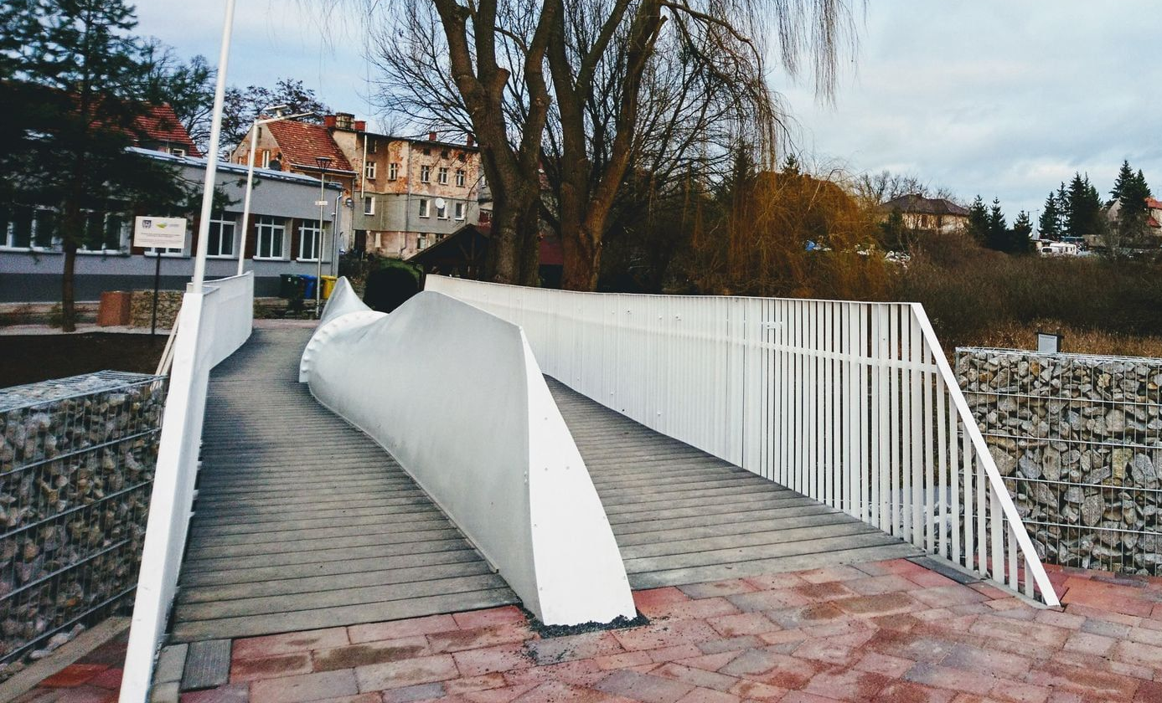
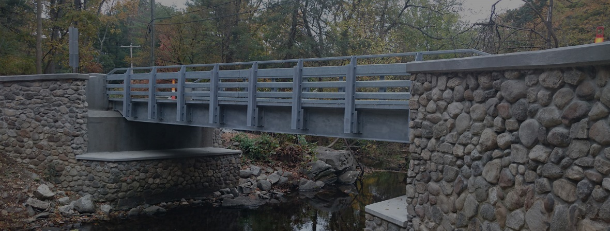
Jaffrey NH, Multipurpose Rail Trail Bridge Replacement
Anthony Accardi, Joseph Clark, Zachary Goin, Jameson Miller, Sean Goodman
Department of Civil and Environmental Engineering, University of New Hampshire, Durham, NH 03824
Introduction
Existing Conditions
Cost Estimate
The Monadnock Branch Rail Trail is a 7.5-mile multipurpose trail
Originates at the NH/MA border and terminates at Webster Street in Jaffrey, NH​
Hiking, biking, snowmobiling, x-country skiing, and horseback riding
Extending this rail trail to connect to Peterborough Street (NH Rt. 202) for an eventual extension to the Town of Peterborough
Professional Engineering services were required for the design and replacement of an existing bridge along the trail
Bridge Conditions
Hydraulic Conditions
20’-0” x 8’-0” existing steel plate bridge​
Severe rusting due to the lack of freeboard present​
Existing substructure is a stacked stone abutment​
Stream bank contains large rocks​
Collected debris and overgrowth around the site​
Small shrubs growing around the banks​
Existing culvert is clogged and restricts flow
Steep slope on eastern approach requires mitigation to promote trail traffic safety
The drainage area is 0.82 square miles
Less than 10% wetlands​
The basin is mostly forested areas and residential neighborhoods​
The brook flows slowly due to the poor drainage provided by the existing culvert​
Design Goals and Criteria
Proposed Bridge and Site Design
Challenges/Solutions
Evaluate existing site conditions
Evaluate geotechnical conditions using available information and soil mapping
Evaluate existing and proposed site hydraulics, accounting for site hydrology based on current and future stormwater impacts
Design the rail system to ensure safety of bridge occupants
Evaluate three bridge alternatives to determine the most efficient and cost-effective design
Design an aesthetically pleasing bridge capable of withstanding large snow loads along with pedestrian, snowmobile, and equestrian traffic
Develop a detailed cost estimate for expected construction and design for the Town of Jaffrey
Understand and determine the needed permits to design and construct the bridge within the wetland
Bridge Design
30-foot span supported by timber girders
9.5-foot clear width minimum for snowmobile trail grooming considerations
Cast-in-place reinforced concrete bridge abutment and foundation with wingwalls
Timber decking and railings
5-foot bridge low chord elevation (proposed channel bed as the reference elevation) to allow for sufficient freeboard
Proposed rip-rap as a scour countermeasure
Site Design
Entire existing bridge to be removed
Existing culvert drain to be unclogged and restored
Reduce slope to eastern bridge approach
Streambed should be dredged to remove miscellaneous rocks, branches, and trash
Cutback the overgrown bushes and small trees on stream edge
Learning and applying code books such as AISC, NHDOT BDM, AASHTO LRFD, ACI 318, AWC NDS
Utilizing HEC–RAS to perform hydraulics analyses
Modeling the existing streambed for the hydraulic analysis
Making existing geotechnical assumptions using soil mapping with the absence of borings
Applying knowledge gained through current and past coursework to solve real-world engineering problems
Preliminary Analysis
Acknowledgements
Soil conditions - Site includes two soils, 526C and 526E, both of which are loamy sands
Design uses a structural fill unit weight of 120 pcf
Develop three bridge alternatives and cost estimates – timber, steel, and windmill blade bridge
Required bridge geometry was determined such as span, out-to-out width, rail height, and orientation
Evaluated and presented the three bridge types to the Town of Jaffrey, NH
The project team would like to acknowledge Steve Reichert and Ryan Trudeau from Fuss & O’Neil for their continuous professional support and guidance. The team would also like to thank, Dr. Yashar Eftekhar Azam for overseeing the completion of this project and Jo Anne Carr from the Town of Jaffrey, NH for her help with the project. This project in its entirety would not have been possible without the resources provided by the University of New Hampshire.
References
“Bridge Design Manual.” NH Department of Transportation, https://www.nh.gov/dot/org/projectdevelopment/bridgedesign/manual.htm. Accessed 10 Apr. 2023.
Construction, American Institute of Steel. Steel Construction Manual. Amer Inst of Steel Construction, 2011.
Council, American Wood. NDS®, National Design Specification® for Wood Construction with Commentary. 2015.
GeoHECRAS Version 1.2.0.10916, 2016 CivilGEO Engineering Software HEC-RAS River Analysis System Hydraulic Reference Manual, US Army Corps of Engineers Hydrologic Engineering Center, Version 4.1, January 2010
“Home.” Fuss & O’Neill, Inc. -, 10 Sept. 2013, https://www.fando.com/. Accessed 10 Apr. 2023.
Institute, American Concrete. ACI 318-14 Building Code Requirements for Structural Concrete and Commentary. 2014.
NH GRANIT. (n.d.). Retrieved November 30, 2022, from https://granit.unh.edu/
Officials, American Association of State Highway and Transportation, and AASHTO Task Force on a Consensus Transportation Program. New Transportation Concepts for a New Century: AASHTO Recommendations on the Direction of the Future Federal Surface Transportation Program and for a National Transportation Policy. 1989.
StreamStats: Streamflow statistics and spatial analysis tools for water-resources applications. (n.d.). U.S. Geological Survey. Retrieved November 30, 2022, from https://www.usgs.gov/mission-areas/water-resources/science/streamstats-streamflow-statistics-and-spatial-analysis-tools

