Slide 1
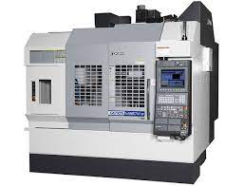
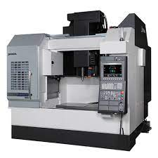
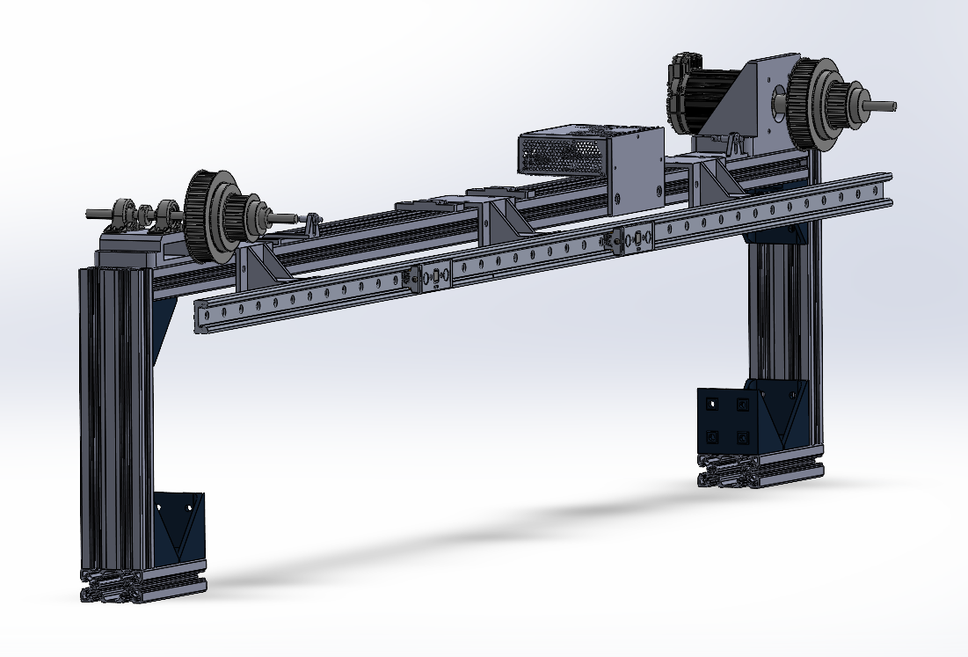
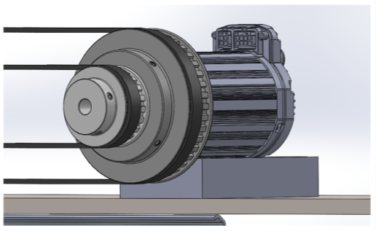
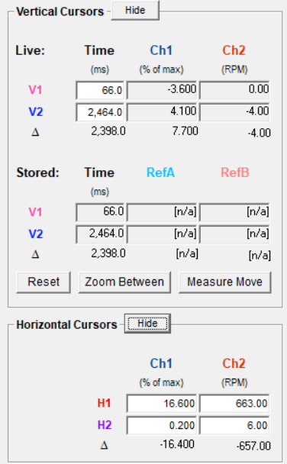
CNC Automatic Door System Nate McCarvill, Collin Edminster, Riley Drew Department of Mechanical Engineering, University of New Hampshire, Durham, NH 03824
Introduction
CNC Machine
Mechanics and Controls
Robotics and automation are a major focus for manufacturers in the US and globally to increase production efficiency. A CNC machine processes material to desired specifications using numerically programmed instructions, as opposed to manually operated controls. Many manufacturers have shifted toward automated manufacturing with CNC machines. The team design, analyzed, and constructed a system allowing for the automatic opening and closing of a CNC machine door that competes with existing solutions.
The following information illustrates the team’s automated manufacturing aid, which increases the efficiency of a CNC machine by autonomously opening and closing the operator door, providing access to the workspace for a robot for automated manufacturing.
Okuma M560-V Closed
Okuma M560-V Open
After thorough research and discussion, the team ultimately decided on the following mechanical system for the opening and closing of the CNC machine door.
The actuation is performed using a single NEMA 34 motor with 9.8 Nm of maximum torque. The motor drives two sets of pulleys mounted to the respective sections of the telescoping door. The open and closed positions of the door are signaled using proximity sensors. The design will use a Programmable Logic Controller (PLC) for communication between the device, CNC machine, and robot.
It was determined that this design best adheres to the specified criteria to ultimately achieve a competitive market solution.
Figure 1: Okuma M560-V CNC Machine in closed door position
Figure 2: Okuma M560-V CNC Machine in open door position
Criteria
Automatic Door System Design
Results
After extensive discussions with the Robert E. Morris company and Okuma, a CNC machine manufacturer, the team identified the most important criteria for the design, analysis, and prototyping of the automatic door system. These criteria are the following:
Affordability
Competing Solutions
Budget goals
Safety
Protect Operator
Protect Machine
Efficiency
Perform open and close cycle efficiently
Robot-Machine Interfacing
Ensure programming allows for position checking and communication.
End-User Ease of Install
SolidWorks Assembly
Motor and Pulleys
With an original budgetary goal of under $3,500 we achieved a bill of materials totaling $1905
For safety we have the door automatically cutting power based on an overall torque limit and are considering a secondary safety using Keyence light curtain or Keyence area scanner.
For efficiency we achieved an open and close cycle time of 2.39 seconds.
The robot controls the system directly currently and has communication both ways between the device and robot controller.
Basic extrusion platform allows for easy manipulation and installation onto CNC machine.
Figure 3: SolidWorks Assembly of final design
Figure 4: SolidWorks rendering of ClearPath Motor with varied pulley diameters for control of sections of telescoping door on CNC machine.
Methodology
Data
Moving Forward
3D Design Software
Over 50 unique designs made for various parts of the project using SolidWorks and Fusion360
Additive Manufacturing
Over 20 custom parts necessary for this project were 3D printed using a large scale (1000mm x 500mm x 500mm) BigRep Studio, as well as a Prusa mk3s+ and Creality Ender 3 S1 Plus.
CNC Waterjet
Replica doors designed and fabricated using waterjet at the UNH John Olson Advanced Manufacturing Center.
Programming
Throughout the project the logistics of the device were controlled using the UR10e collaborative robot and a Click PLC. The robot uses a programming language called URScript. ClearPath motor was programmed using ClearPath MSP software.
Motor Torque and Velocity
Working closely with representatives from Okuma transferring this design to be used with an actual Okuma M560-V CNC machine
Improve safety, ease of install, and various features for design to move towards a package to be available for purchase.
Acknowledgments
We would like to thank Mike Locke, Ben Brown, and everyone at The Robert E. Morris Company for the support throughout this project.
Measured motor torque vs. cycle time (top left), Measured motor velocity vs. cycle time (bottom left), Peak value and start and stop times (right)

