Slide 1
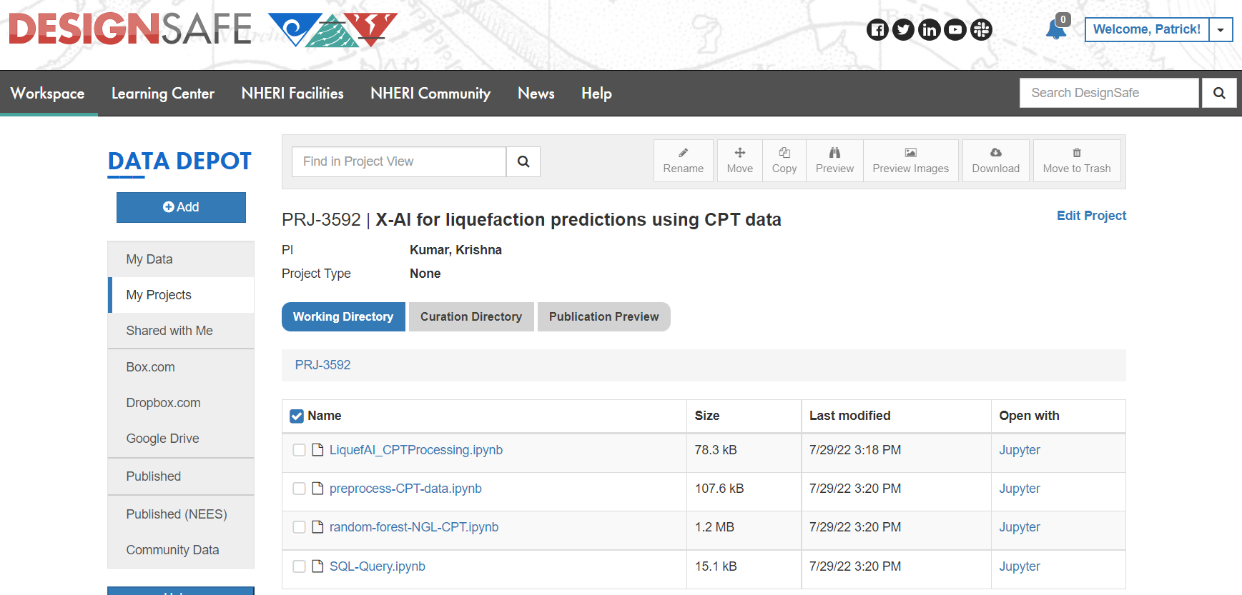
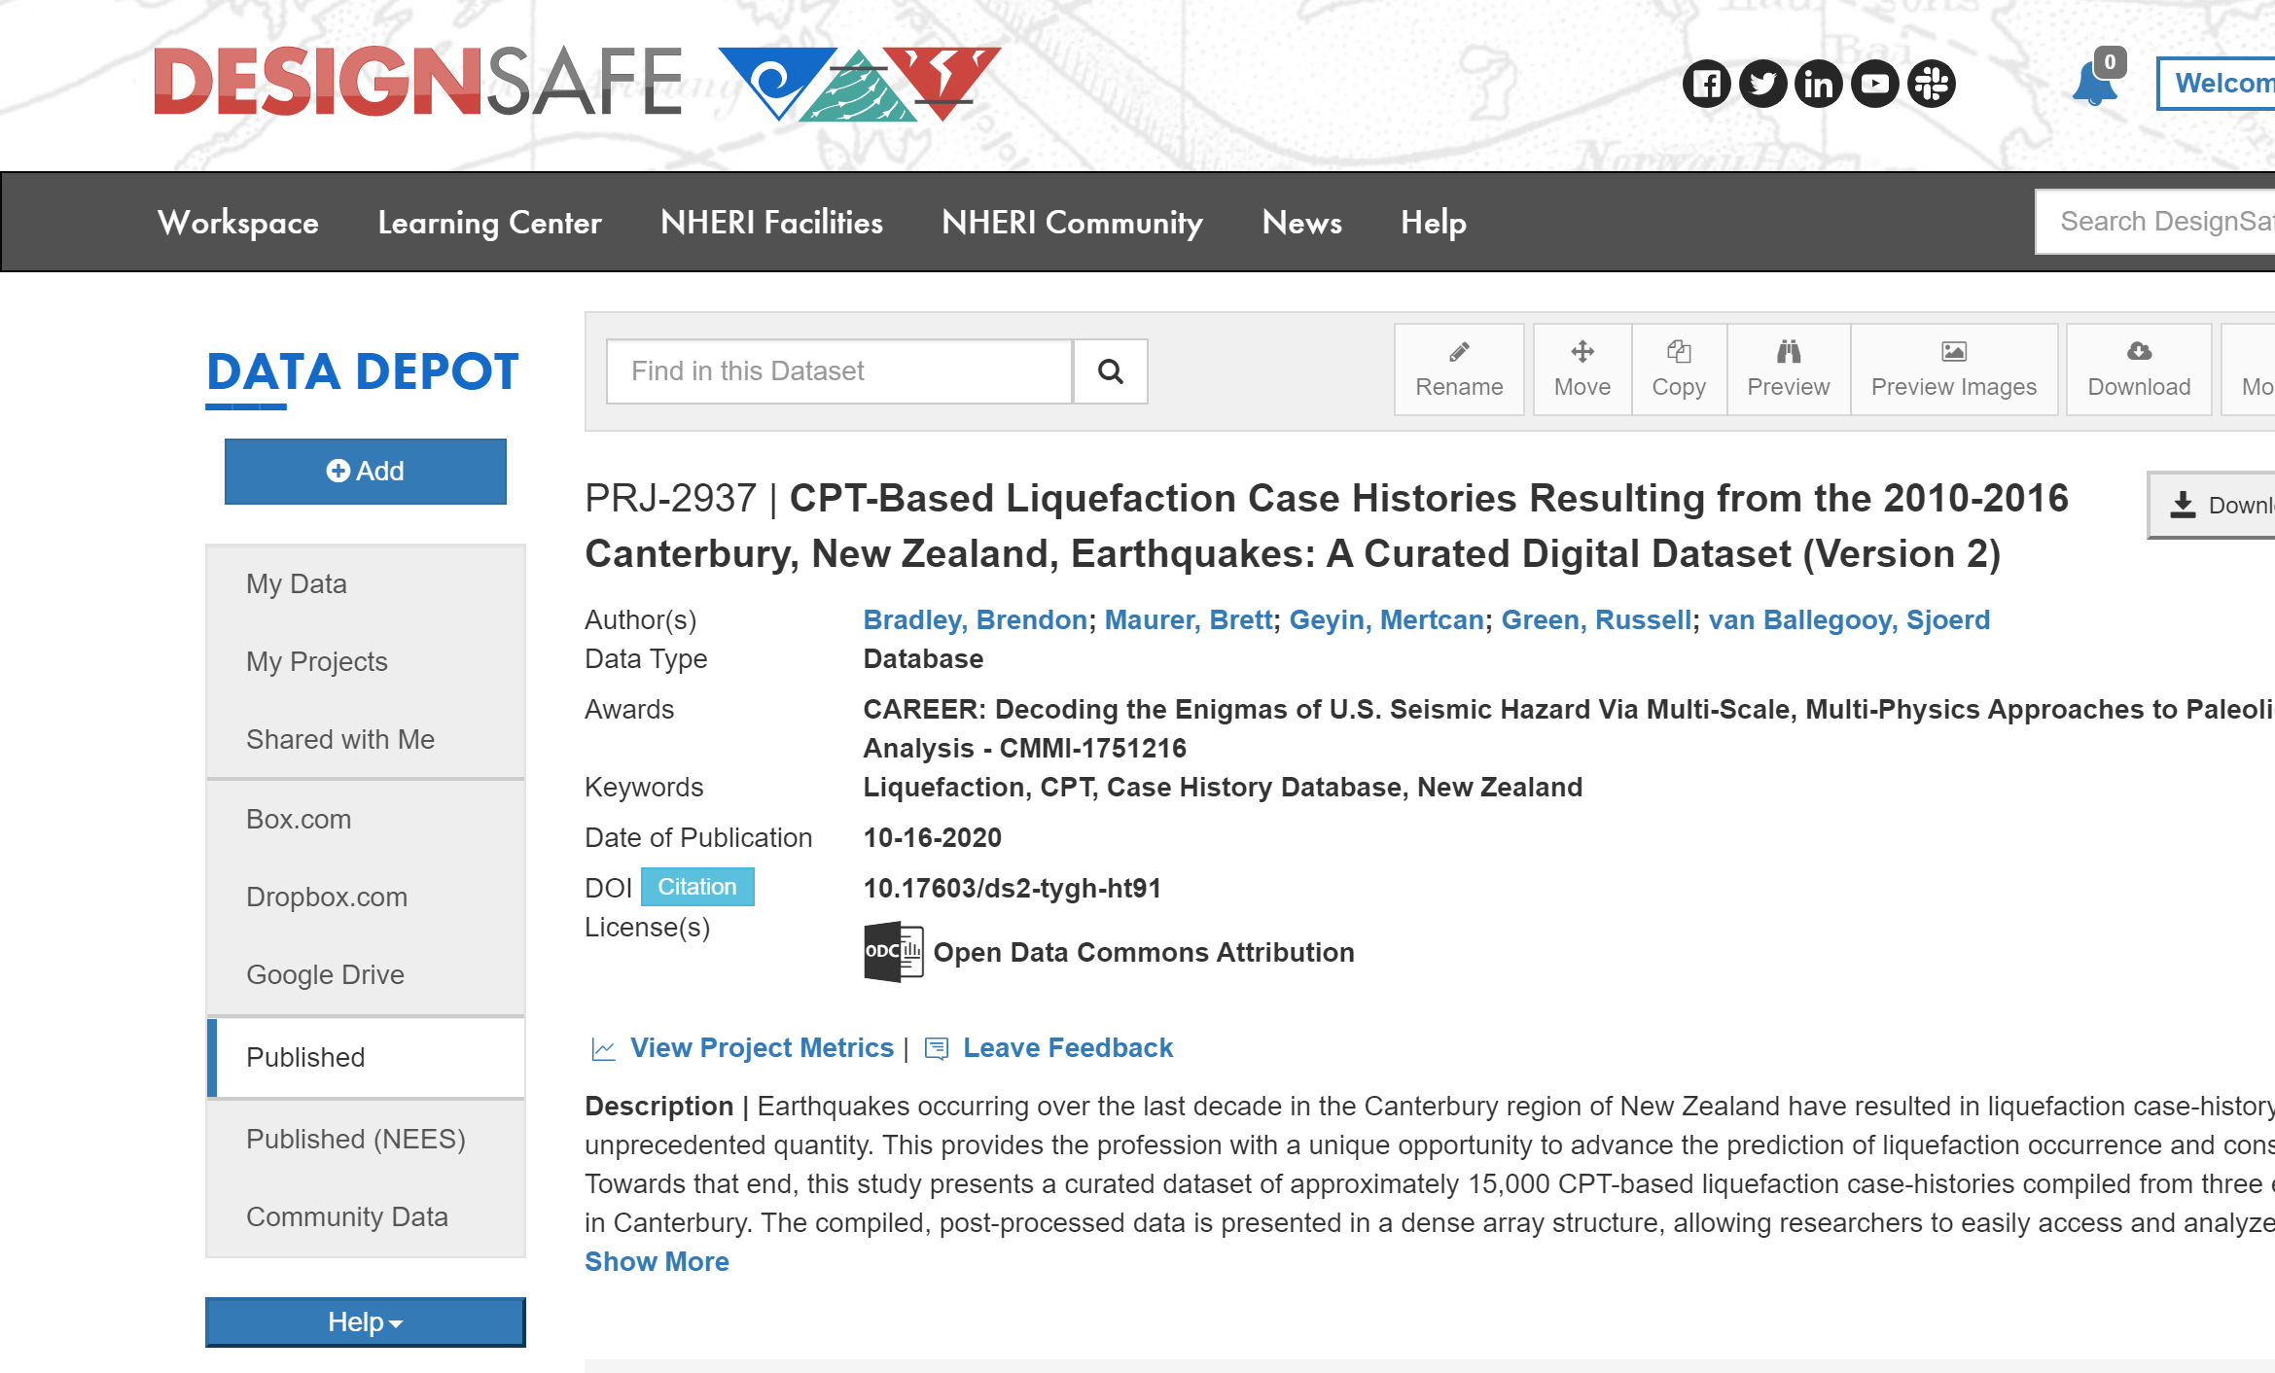
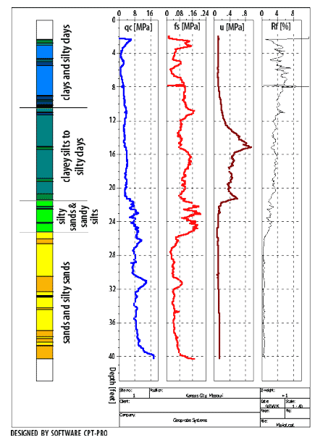
2022 DesignSafe Academy and NHERI Hackathon
Elham Ajorlou, University of New Hampshire Department of Civil and Environmental Engineering
What is the DesignSafe Academy?
How this academy benefits my research?
Our team project in Hackathon:
Explainable AI for predicting liquefaction manifestation
Representative Parameters from CPT Data
DesignSafe is a broad cyberinfrastructure part of the NSF-funded Natural Hazard Engineering Research Infrastructure (NHERI). This facility provides cloud-based tools to organize, investigate, understand, and publish essential data for research to comprehend the consequences of natural hazards such as floods and earthquakes. The NHERI Computational Academy (NCA) includes hands-on lessons and activities on DesignSafe and SimCenter tools and investigates real-world case studies through project-based understanding. The projects are designed to provide new graduate students and postdocs working on natural hazards research opportunities, learn about DesignSafe and SimCenter tools, and use these tools in creative ways.
Filtered dataset for sites with documented observations (yes or no liquefaction)
Soil behavior type index -
Overburden and “clean-sand” corrected tip resistance
First, last summer was the beginning of my Ph.D. program and a great stage for me to be navigated in the proper research direction by interacting with experts and exploring the innovative research activities in my area of study. My thesis is generally focused on the interdisciplinary investigation of lifeline infrastructure resilience and the engineer's behavior in the design, construction, and maintenance of coastal infrastructures considering hazard uncertainties. DesignSafe helped me acquire the creative ideas of using ML to develop high-performance predicting models.
Second, working with big datasets and uncertainties requires data analysis expertise and reliability knowledge. DesignSafe academy provides students some data analysis principles and teaches how to deploy high-performance computing applications through DesignSafe. Moreover, I had the chance to learn more professionally using Python in my research and get hands-on training.
Third, attending this event was an excellent opportunity to communicate with other researchers and discover what other people are working on.
On top of that, NHERI Hackathon was an incredible opportunity for me to interact with wisdom in hurricanes, flooding, and earthquakes by building my own models and practicing the lessons through a team.
Image 1 Our team working on the project for three days
Objective of the project
Develop X-AI models trained on CPT data in DesignSafe and NGL DB for predicting liquefaction manifestations
Image 5 Method 1 Random Forest Results
The main topics of the academy
Image 6 Method 2 Extreme Gradient Boosting (XGBoost)
Jupyter notebooks for research
Data analysis, artificial intelligence, and machine learning for natural hazards
Deploying high-performance computing applications through DesignSafe/SimCenter
Uncertainty quantification
Regional-scale modeling of multi-hazard scenarios
Image 2 Workflow of the project
Image 7 Beeswarm plot of SHAP values for all sites
Our Contribution
Image 3 CPT Datasets with Liquefaction Observations
Image 4 Data extraction

