Slide 1


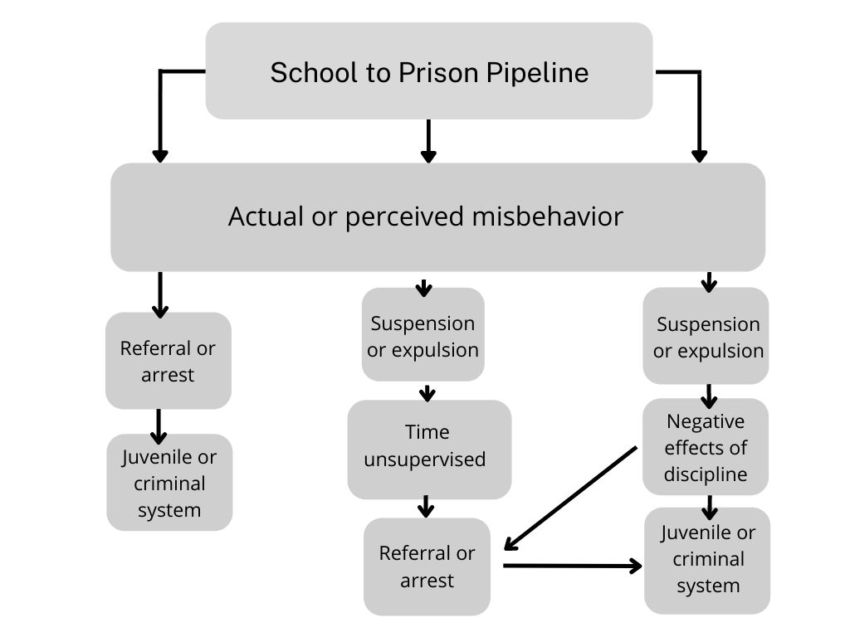


Investigating Exclusionary School Discipline
Suzanne Rubenstein Austin, BS in Psychology | Social Work Masters student
NH-ME LEND, Institute on Disability, University of New Hampshire
Introduction
Stakeholder identification and engagement
The New Hampshire Council on Developmental Disabilities (NHCDD) is a federally funded agency that supports policies and initiatives that promote opportunities in all areas of life for people with developmental disabilities in New Hampshire. The Council carries out its mission through education, advocacy and the funding of innovative projects.
As part of their current five-year plan, the NHCDD will work to decrease disparities that exist for students of color who experience developmental disabilities.
I made connections with families, school systems, journalists, advocacy groups, medical professionals, and educators to learn about impact, policies, and strategies to reduce disparities in discipline.
Impact sheet
Next steps
Activities
The information and contacts made during the internship will support NHCDD in supporting initiatives for capacity building and systemic change.
There is a lack of data on the intersection of disability, race, and discipline available in New Hampshire. Without consistent, standardized, collection and reporting of disciplinary data and accurate and transparent recordkeeping there is no way to monitor the effectiveness of programs in a timely fashion.
Diversity trainings are being developed.
Several School Administration Units (SAU) have hired Diversity, Equity, Inclusion and Justice directors to advance the rights of all students to receive a fair and appropriate education.
Conferences and webinars – I attended virtual programs focusing on different aspects of school discipline
African American Conference on Disabilities – Disproportionality in School Discipline – February, 2022
This conference addresses the intersection between race and disability and the -
uneven application of discipline
role of discipline in the school-to-prison pipeline
impact on children and families
An impact sheet was created to educate stakeholders on exclusionary discipline, why it is a problem for students of color who experience disabilities and the increased risk of negative outcomes including law enforcement contact, poor school performance, and social isolation.
References
Juvenile Reform Project (2019). Keeping Kids in School: The Urgent Need for Reform of School Discipline in NH. https://www.nhla.org/assets/customContent/FINAL_Keeping_Kids_in_School_-_The_Urgent_Need_to_Reform_School_Discipline_in_NH.pdf
Disabling Inequity: The Urgent Need for Race-Conscious Resource Remedies, March 22, 2021 The Center for Civil Rights Remedies at The Civil Rights Project | Proyecto Derechos Civiles, www.civilrightsproject.ucla.edu
Exclusionary discipline is the removal of a student from their learning environment.
Formal discipline includes in and out of school suspension and expulsion.
Informal discipline includes students being sent home early.
Banning our Babies – Addressing the Suspensions of Black Children throughout Early Childhood Education – February, 2022.
Notes:
April 20, 2022 This version includes revision suggestions from Vanessa’s 4/19 email. Still waiting on Isadora’s feedback.

